Slide 1
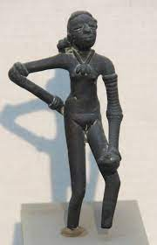
Indus Valley Girls
Deciphering the Indus Valley Script
Keerthana Jayakumar
Sonia Sharma

Slide 2
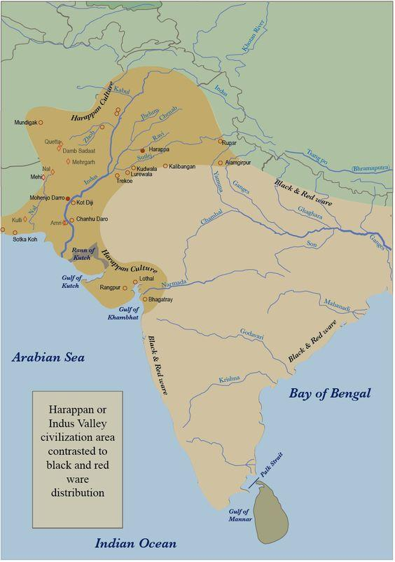
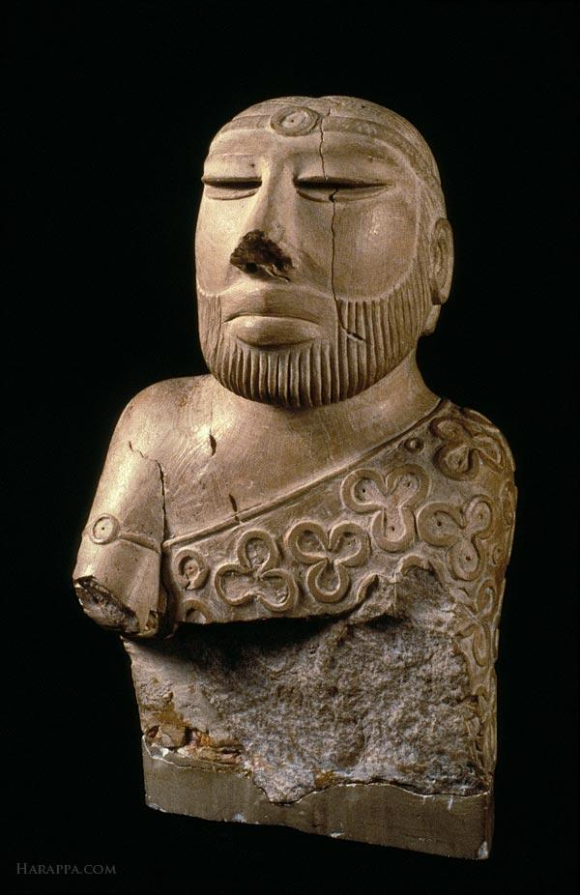
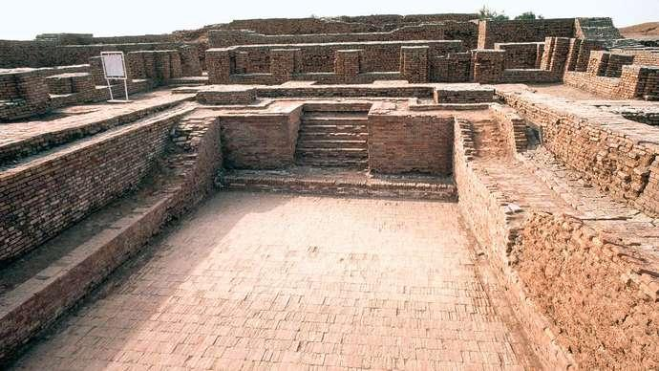
The Indus Valley/Harappan Civilization
Oldest civilization in the Indian subcontinent

Slide 3
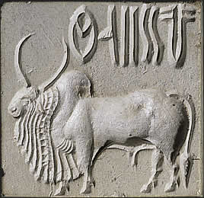
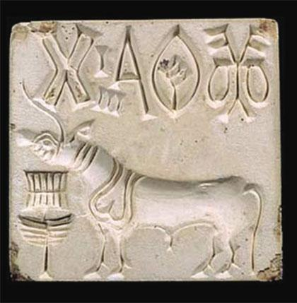
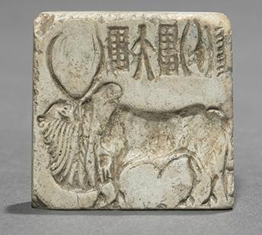
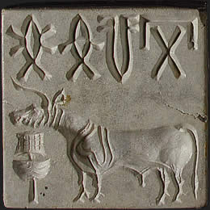
Why has Indus Valley Script not been Deciphered
Indus texts are very short.
Corpus treated as one unit
Lack of context and usage information
Lack of bilingual inscriptions
Debate over root of Indus language
Notes:
https://www.harappa.com/answers/why-has-language-harappa-not-been-deciphered
https://www.discovermagazine.com/planet-earth/why-we-still-cant-read-the-writing-of-the-ancient-indus-civilization

Slide 4
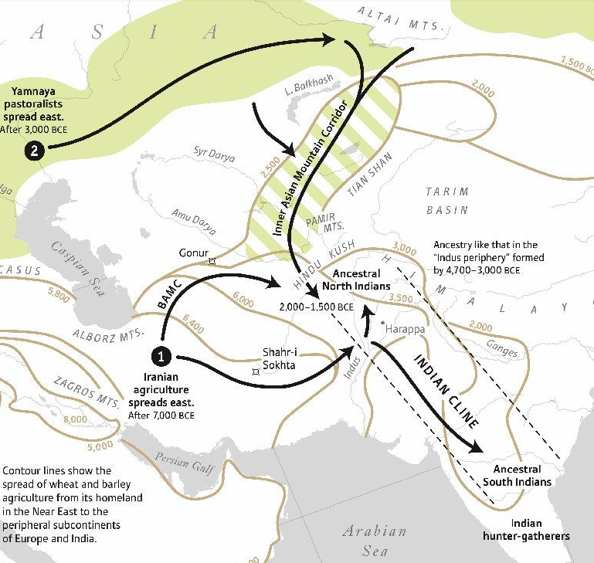
Clues to Root Language
Prior to 2013, we didn’t know who the Harappans were.
First Indians and Iranian Agriculturalists were ancestors of the Harappans.
Spoke Proto Dravidian with influences from Proto Elamite
STRONG EVIDENCE FOR PROTO-DRAVIDIAN AS THE ROOT LANGUAGE OF THE INDUS SCRIPT
Notes:
https://www.harappa.com/answers/why-has-language-harappa-not-been-deciphered

Slide 5
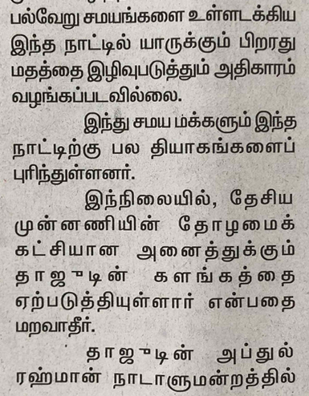
Purpose
To decipher ancient Indus Valley (Harappan) script by comparing it statistically with modern Tamil (Dravidian language)

Slide 6

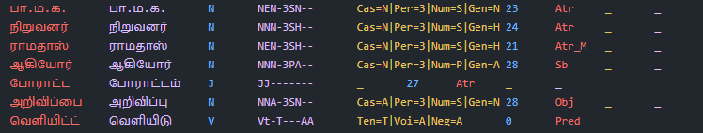
Data Preprocessing
Indus script is Logosyllabic (signs can be syllables or morphemes ex- ‘cat-s’ ‘play-ing’)
Converted Tamil from Syllabic to Logosyllabic by converting grammatical morphemes (smallest unit of a word that changes its meaning) to signs.
Syllabic Script
Logosyllabic Script
001-002 -003-004 -005 -006 - 007 -008 -009 -010
Tagged POS Tamil Database
Pandas for preprocessing + PostgreSQL instance on Amazon AWS for database storage

Slide 7
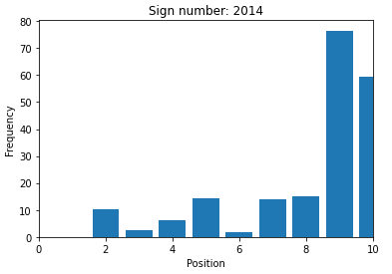
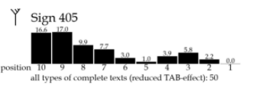
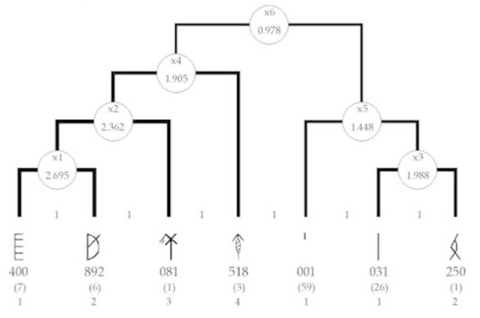
Statistical Analysis
Compared Positional Histograms.
Calculated connectivity between sign groups using multivariate segmentation analysis and compared it to Indus sign groups.
Indus Script
Tamil
Pandas for Statistics Calculations

Slide 8
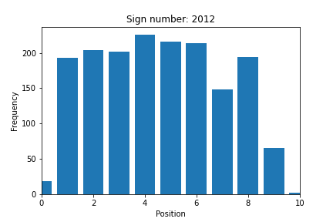
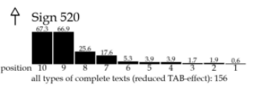
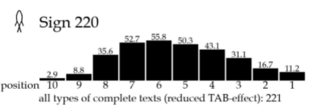
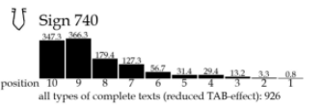
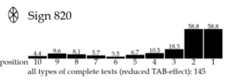
Results - Possible Plural Marker
The most frequent sign in the Tamil script is the plural marker ‘கள்’ (kal) or sign ‘2012’
On analysing the most frequent Indus signs, one sign had a very similar positional distribution
Tamil
Indus Script

Slide 9
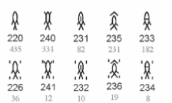
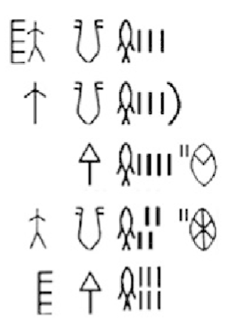
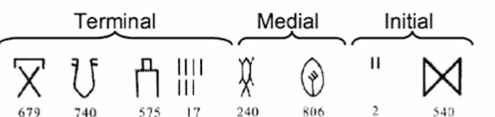
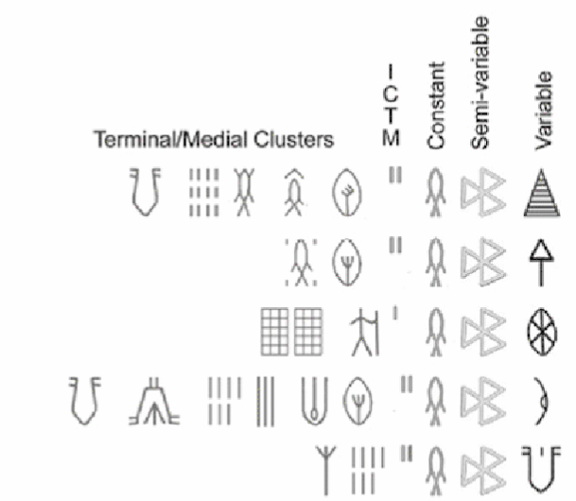
Results - Fish Signs and Sign 220
Fish Signs are often associated with numerals - they were classified as units of measurement (ex- kg) (Bonta 1995)
Fish signs mostly occur in medial context.
Sign 220 is unique. Can be found in initial, medial as well as terminal positions.
Previously attributed to polyvalence
Possibility that range is due to its function as plural marker
Medial
Initial
 | Frequency | Sign Pairs
2012 கள்’ | 551 | 147 different pairings
220 | 475 | 52 different pairings

Slide 10
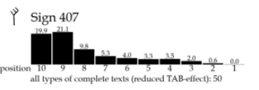
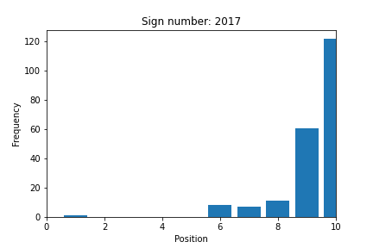
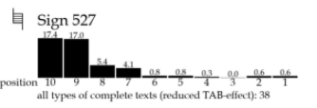
Results - Verb Identification
Identified verb candidates
Tamil has a verb terminal syntax
Can demonstrate that the Indus script is verb terminal (Wells 2007)
Next steps - Predict verb morphemes by comparing calculated connectivities

Slide 11

Machine Learning
Created a SVM algorithm to automatically perform morpheme extraction on modern Tamil
Extracted features: index, current letter, vowel/consonant, noun/verb, current prefix. Output label: morpheme boundary
Segmented Morphemes
Sklearn and imblearn library for machine learning Pandas for feature preprocessing

Slide 12
Next Steps
Continue comparison of two scripts.
Use SVM machine learning algorithm to convert Simpler sentences to LogoSyllabic and run analysis.
Convert Old (Sangam Tamil, Tamil Brahmi Script) to LogoSyllabic and run analysis.
Developing a deep neural network to automatically compare similar positional histograms and connectivities
Create feature in Visualization to:
Run the SVM algorithm on a Tamil csv file/text to segment morphemes
Automatically convert the segmented script to logosyllabic
Automatically run analysis and show results

