Slide 1


Slide 2

Techworkshop 2017:
Go
Khôi Tran

Slide 3

Goals (by the end of the day)
Know what Go is (and isn't)
How to set up a go environment
Able to write and compile a go program
Know where to go from there
Online resources (presentation, links):
https://github.com/KeeTraxx/pitc-go-workshop

Slide 4
Agenda
Block 1 (11:00 - 11:30) : Introduction + Go tooling installation
Lunch
Block 2 (14:00 - 15:30) : Go Hands-On
Coffee break
Block 3 (15:50 - 16:40) : Wrap-Up and Presentation

Slide 5
Go introduction
1

Slide 6
Brief history of Go
2007: Created at Google by Robert Griesemer, Rob Pike, and Ken Thompson
2009: Announcement, Open Source (BSD-style license)
2012: Go 1.0
2015: Go 1.5, written in Go, no more C
2016: Go 1.6, vendoring, built in race detector
Present: Current stable release: Go 1.9

Slide 7
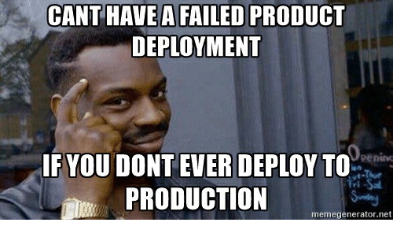
Who uses Go in production?
Google: Kubernetes, Youtube, dl.google.com, ...
GitHub: Releases API upload endpoint
Facebook: several internal libraries
Twitter: REST Endpoint
StackExchange: Monitoring and alerting system (bosun.org)
SoundCloud: several internal libaries, build & deployment system
Netflix: Rend - Memcached-Compatible Server & Proxy
Dropbox: Caching, Error Handling, SqlBuilder, memcache, ...
Docker: Almost all of it
https://github.com/golang/go/wiki/GoUsers

Slide 8
Go in Switzerland?
Google
Centralway
Swisscom
Tamedia
Mobiliar
PostFinance
SmallPdf
Vshn

Slide 9
Go language features
Syntax derived from: C, Pascal/Oberon (Declaration, Packages)
Compiled
(mind CPU architecture and libc vs musl!)
Statically typed language
Garbage collection

Slide 10

Go build-in tools
Testing go test
Benchmarking
Crosscompiling
go test
go test -bench=.
GOOS="linux" GOARCH="arm" \
go build -v .

Slide 11
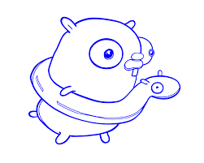
Go official tools
gofmt
godoc
goimports
gorename
lint
cover
race detector
format source code
show, generate and serve documentation
gofmt + imports cleanup
type-safe renaming
go linting
generate test coverage reports
find race conditions

Slide 12

Go 3rd party tools
gometalinter
gocode
godef
deadcode
gocyclo
varcheck
structcheck
errheck
dupl
ineffassign
unconvert
goconst
run several checkers / linters in parallel
autocompletion daemon
track symbol definitions
unused code checker
computes cyclomatic complexity
find unused global variables and constants
find unused struct fields
finds uncecked error return values
finds potentially duplicated code
detect unused assignments
detect redundant type conversions
detect repeated strings that could be replaced with constants

Slide 13
Recommended IDE: vscode (as of 2017)
Completion Lists (using gocode)
Signature Help (using gogetdoc or godef+godoc)
Quick Info (using gogetdoc or godef+godoc)
Goto Definition (using gogetdoc or godef+godoc)
Find References (using guru)
File outline (using go-outline)
Workspace symbol search (using go-symbols)
Rename (using gorename)
Build-on-save (using go build and go test)
Lint-on-save (using golint or gometalinter)
Format (using goreturns or goimports or gofmt)
Generate unit tests skeleton (using gotests)
Add Imports (using gopkgs)
Add/Remove Tags on struct fields (using gomodifytags)
Semantic/Syntactic error reporting as you type (using gotype-live)
Run Tests under the cursor, in current file, in current package, in the whole workspace (using go test)
Generate method stubs for interfaces (using impl)
Debugging (using delve)

Slide 14
Go syntax - odd stuff
no semicolons
raw string literals
with backticks
no ? operator
multiline statements
must have operator before newline
no while or do loops, just for
variable declaration: name before type
quote := `A "quaterpounder" with cheese`
quote := "A \"quaterpounder\" with cheese"
nextmovie := likesScifi ? "Mr. Robot" : "House of Cards"
fmt.Printf("%d %d",
"one",
"two",
)
var countryNames []string

Slide 15
Go syntax - odd stuff (2)
switch statements don't need break
but have fallthrough
case-sensitive function names and field identifiers

Slide 16

Go hello world

Slide 17
Go language properties
Struct and struct methods
Field tags
Error handling
Multiple return values
Slices (aka Arrays) and Maps
Pointers (but no shenanigans like C)
Packages / Imports
Concurrency with goroutines and channels

Slide 18
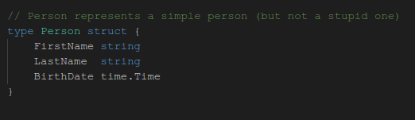
Structs

Slide 19
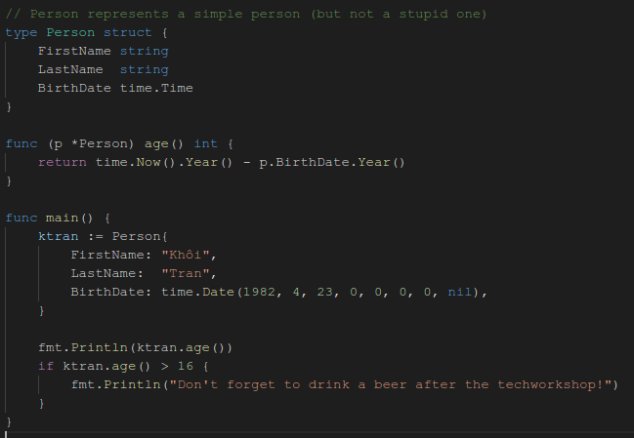
Struct Methods

Slide 20
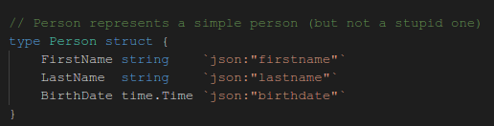
Field tags

Slide 21
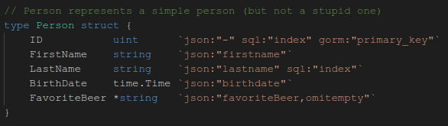
Field tags (adv.)

Slide 22
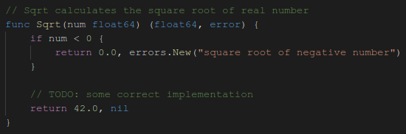
Error handling
Go has a build-in type error
Functions that can fail should return an nil error on success
Tip: always handle errors immediately somehow

Slide 23
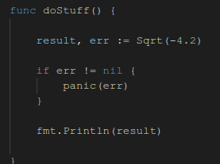
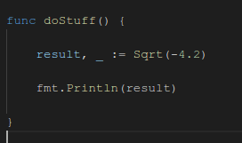
Multiple return values
Most often used for error handling
Can be ignored using the blank identifier

Slide 24
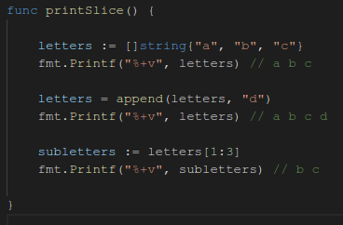
Slices aka the Go arrays
Slices are built on top of arrays
Slices have no fixed length
Slices have length and capacity

Slide 25
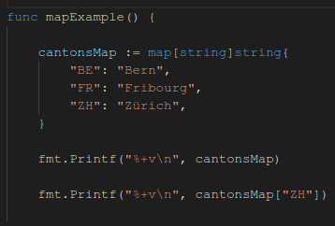
Maps
key type
value type
Example:

Slide 26
Pointers
Similar to C pointers:
*Foo to denote pointer type
* Operator for deferencing
& Operator for referencing
No pointer arithmetics
Hints:
Variable must be modified ==> Pass pointer
Variable is a large struct ==> Pass pointer
(avoids expensive copying)
Variable is a map or slice ==> Pass value
(they are reference types already)

Slide 27
Setup Go Environment: gvm
Written in Go, runs on Linux, OSX, Windows
How to install:
https://github.com/andrewkroh/gvm#installation
Add eval "$(gvm 1.9)" to your ~/.bash_rc
mkdir ~/go
https://github.com/andrewkroh/gvm

Slide 28
Install vscode
https://code.visualstudio.com/docs/setup/linux
Install Go extension
CTRL-SHIFT-P ==> Go: Install/Update Tools

Slide 29
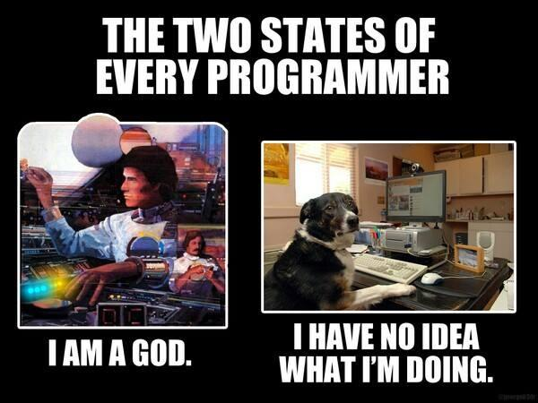
Go Hands-On
2

Slide 30
Exercise 1: Coffee or Beer?
GitHub Skeleton:
https://github.com/KeeTraxx/pitc-go-coffee-or-beer.git
Implement your code in coffeeorbeer.go
Run "go test" to test against the test suite
Focus: Basic go syntax, go testing

Slide 31
Exercise 2: Simple CLI for a REST Service
GitHub Skeleton:
git clone https://github.com/KeeTraxx/pitc-go-exercise-moviequote-rest-cli
GET Requests to:
http://pitc-moviequote.ose3-lab.puzzle.ch/v1/moviequotes/random
Focus: Writing Go Structs with field tags, using net/http for HTTP requests

Slide 32
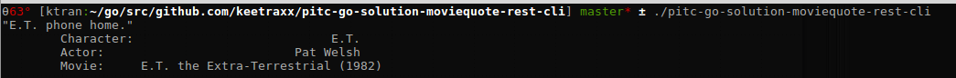
Result

Slide 33
Exercise 3: Simple REST API
GitHub Skeleton:
git clone https://github.com/KeeTraxx/pitc-go-exercise-moviequote-rest-api
Look at TODOs in the code
Look in README.md how to deploy on OpenShift
Focus:
use core library net/http for http requests
json (de-)serialization

Slide 34
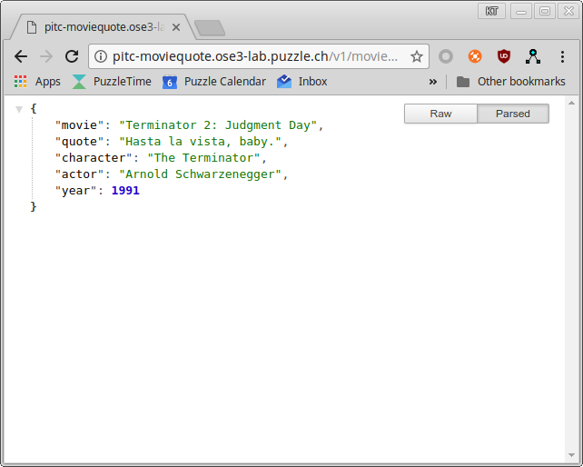
Result

Slide 35
Exercise 4: REST CLI for SBB Connections
GitHub Skeleton:
git clone https://github.com/KeeTraxx/go-cli-skeleton.git
GET Requests to:
http://transport.opendata.ch/v1/connections?from=bern&to=thun
Focus: net/http library to make http requests

Slide 36
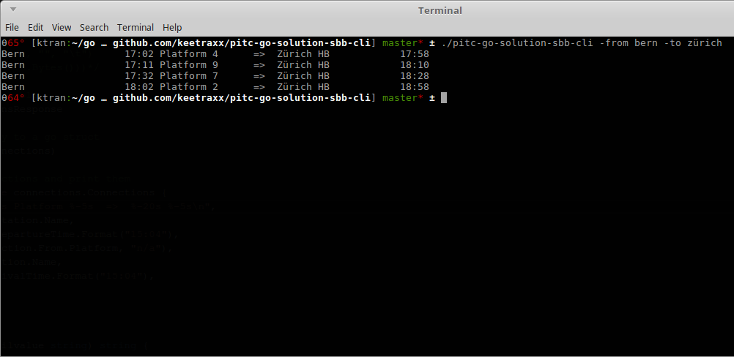
Result

Slide 37

Wrap-Up
3

Slide 38

Thank you!
...for not having slept during the presentation

