Slide 1
iAttendance
Revolutionizing Attendance Questions

Slide 2
Purpose & Objective
IVLE forum
iAttendance
Tedious answering procedure
Tiresome data retrieval system
Easy Attendance answering
Instant student’s answer view
Instant absent students retrieval

Slide 3
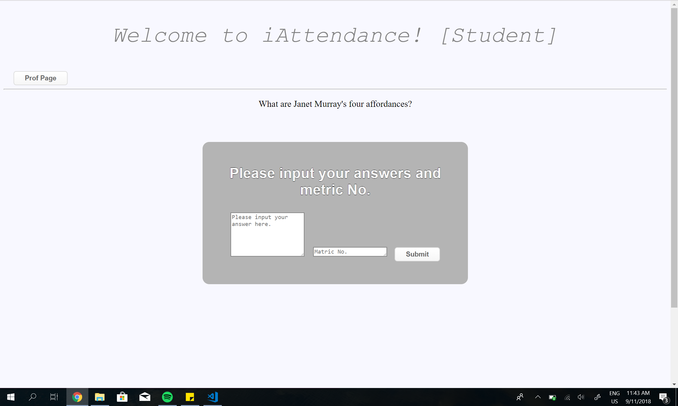
iAttendance [student]
SIMPLY ENTER ANSWERS AND YOU’RE DONE!!

Slide 4
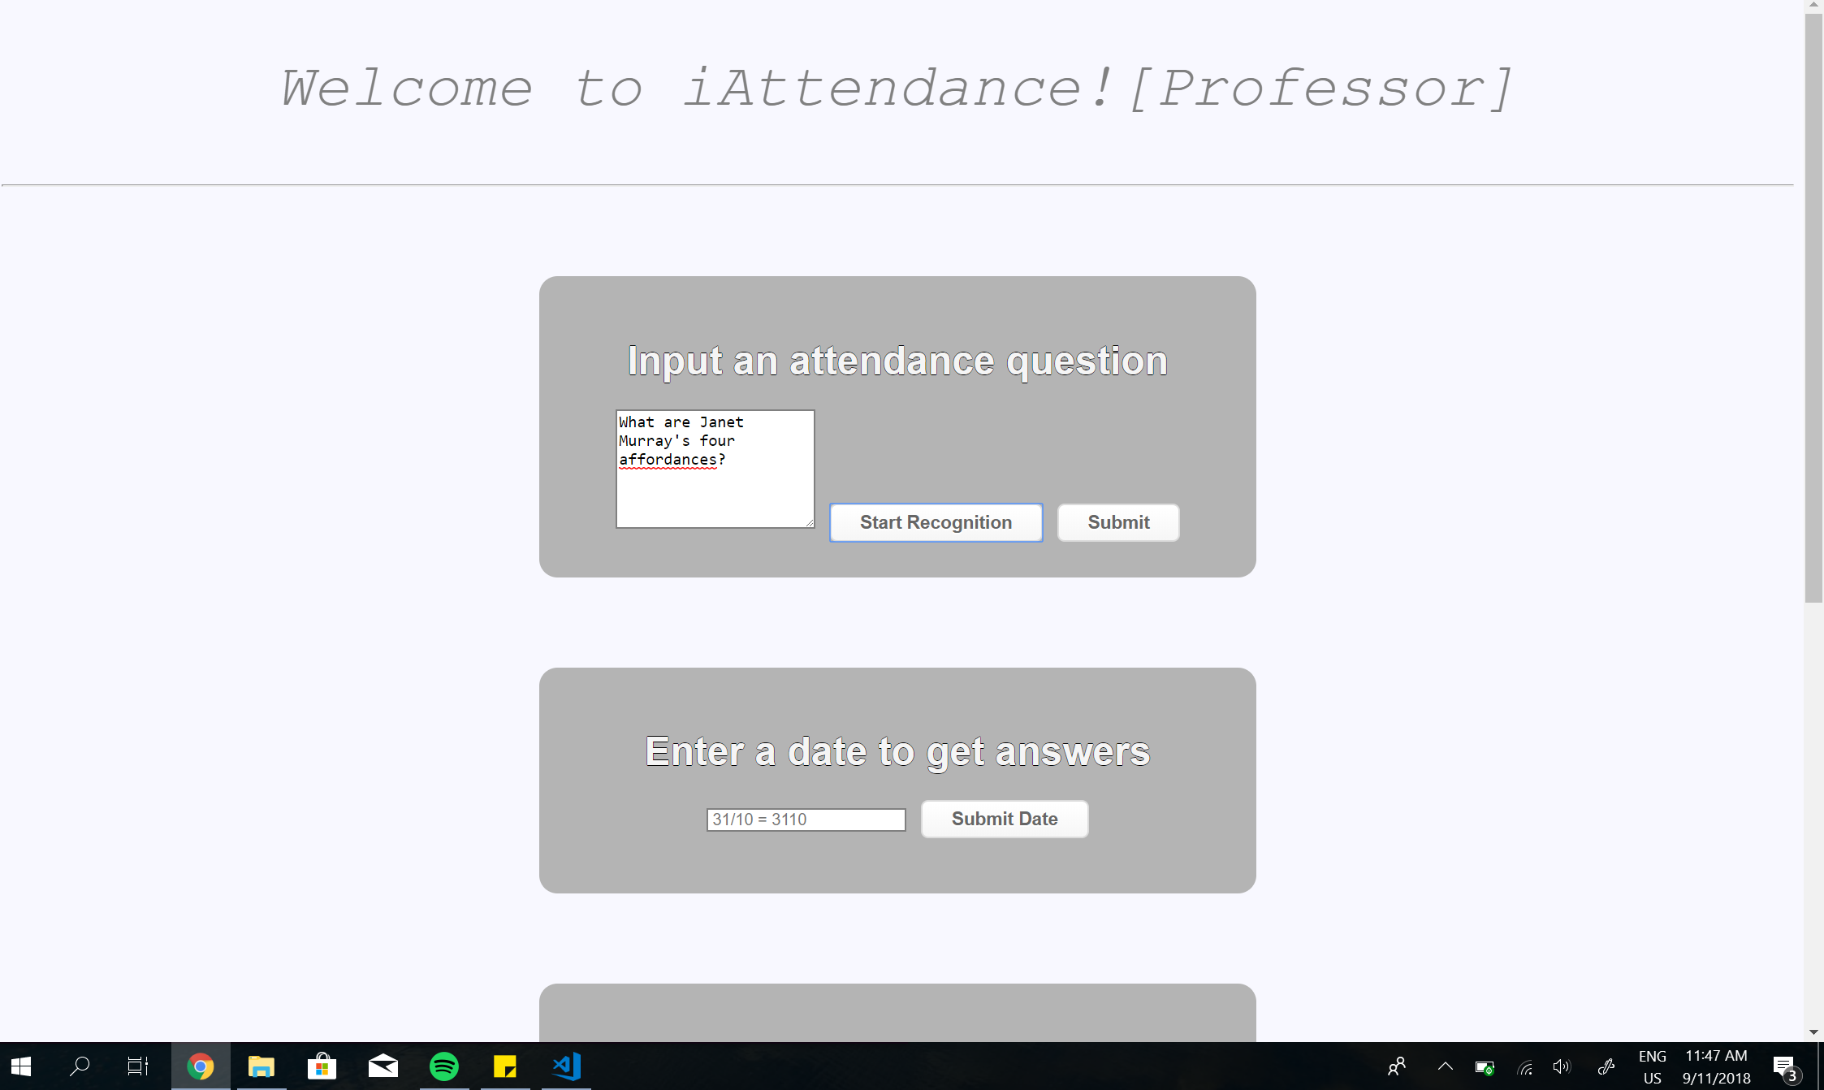
iAttendance [Professor]
Simple and easy to use GUIs!
All in One Page!

Slide 5
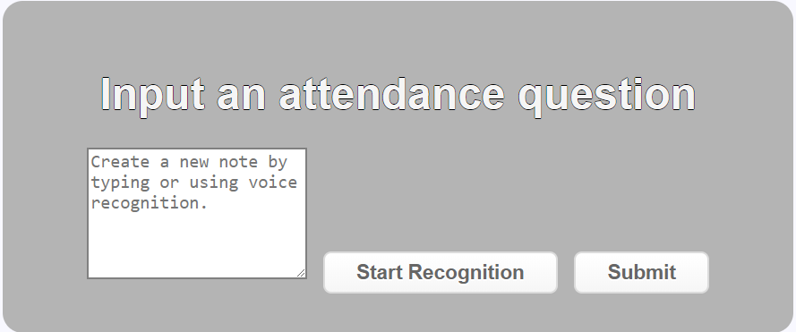
Attendance question creation
Two ways to attendance creation:
Voice Recognition
Text

Slide 6
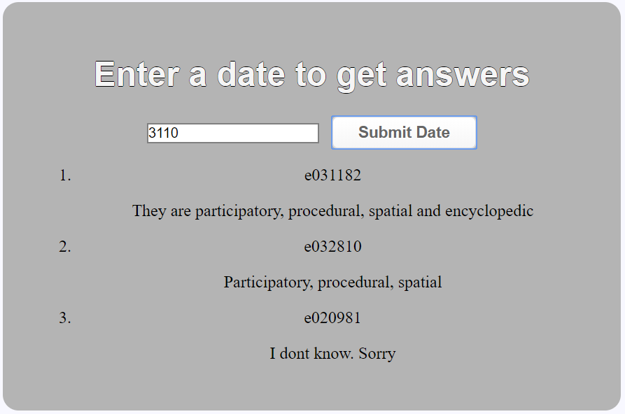
Get Student’s answers function
Just enter date and you’re done!!
Formatted in :
[Metric Number]
[Student’s Answers]

Slide 7
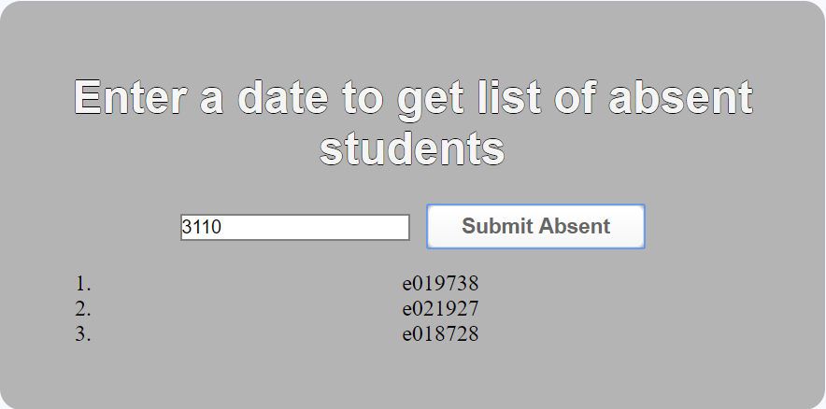
Get absent students function
Just enter date and you’re done!!
Formatted in :
1.[Absent Student’s Metric Number]

Slide 8
What are you waiting for? Check me out now!!
https://keezhongping.github.io/

