Slide 1
BasicTies
Embrace Simplicity: A Social Platform Free from Ads and Privacy Intrusion

Slide 2
Team Members
Daniel Knight
Keegan Preston

Slide 3

BasicTies Overview
BasicTies is a social media application that prioritizes user privacy and delivers an advertisement-free environment. Our platform allows users to create profiles, connect with friends, and post or reply on a public feed.

Slide 4
Our Development Timeline
Week One
Proposal
Week Two
Prototype
Week Three
Database design and implementation
Week Four through Six
Coding/Design changes based on feedback
Week Seven
Technical Design Document
Week Eight through Ten
Finalization

Slide 5
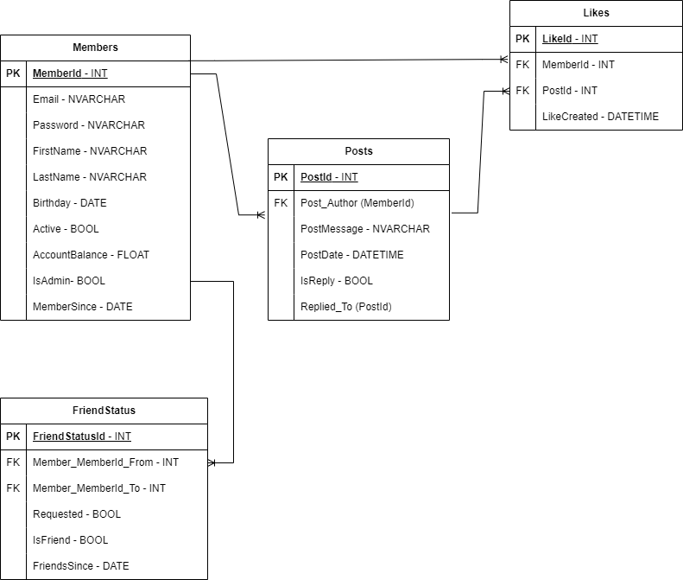
Database Organization

Slide 6

Obstacles We Overcame

Slide 7
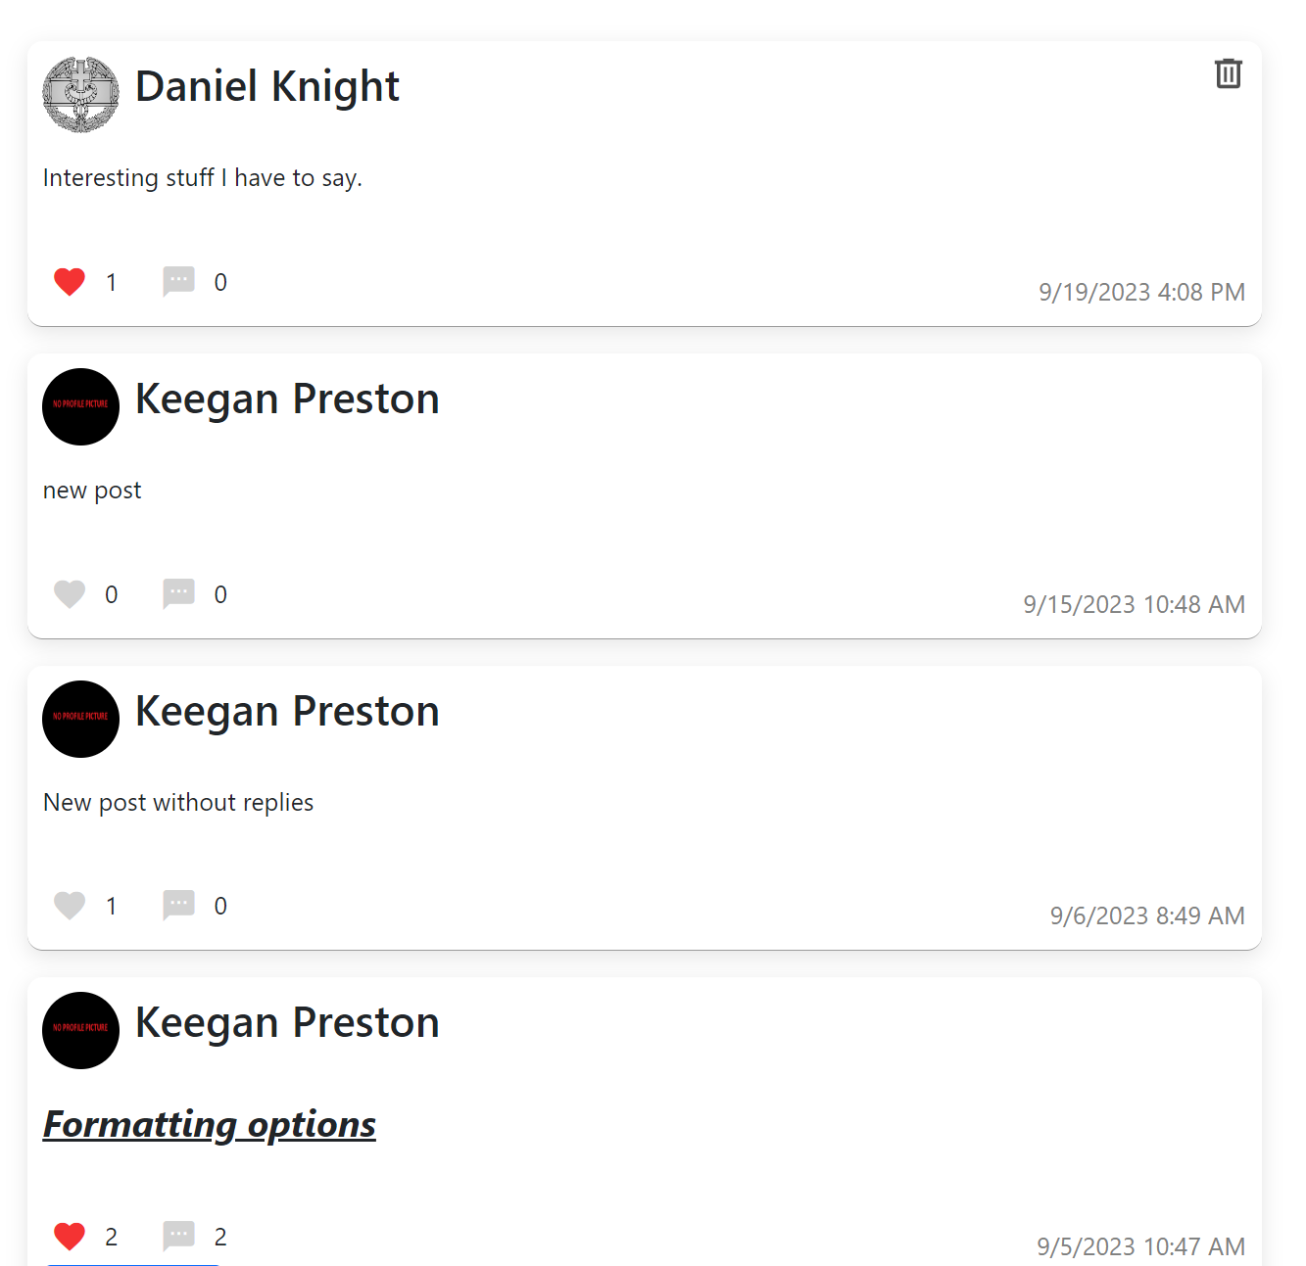
Obstacle 1 of 3
Keeping track of “likes.”
Having to keep track of what posts have likes, how many likes it has, and which users liked them proved challenging.
Making sure likes were cleaned up correctly if a post was deleted was also a concern.

Slide 8
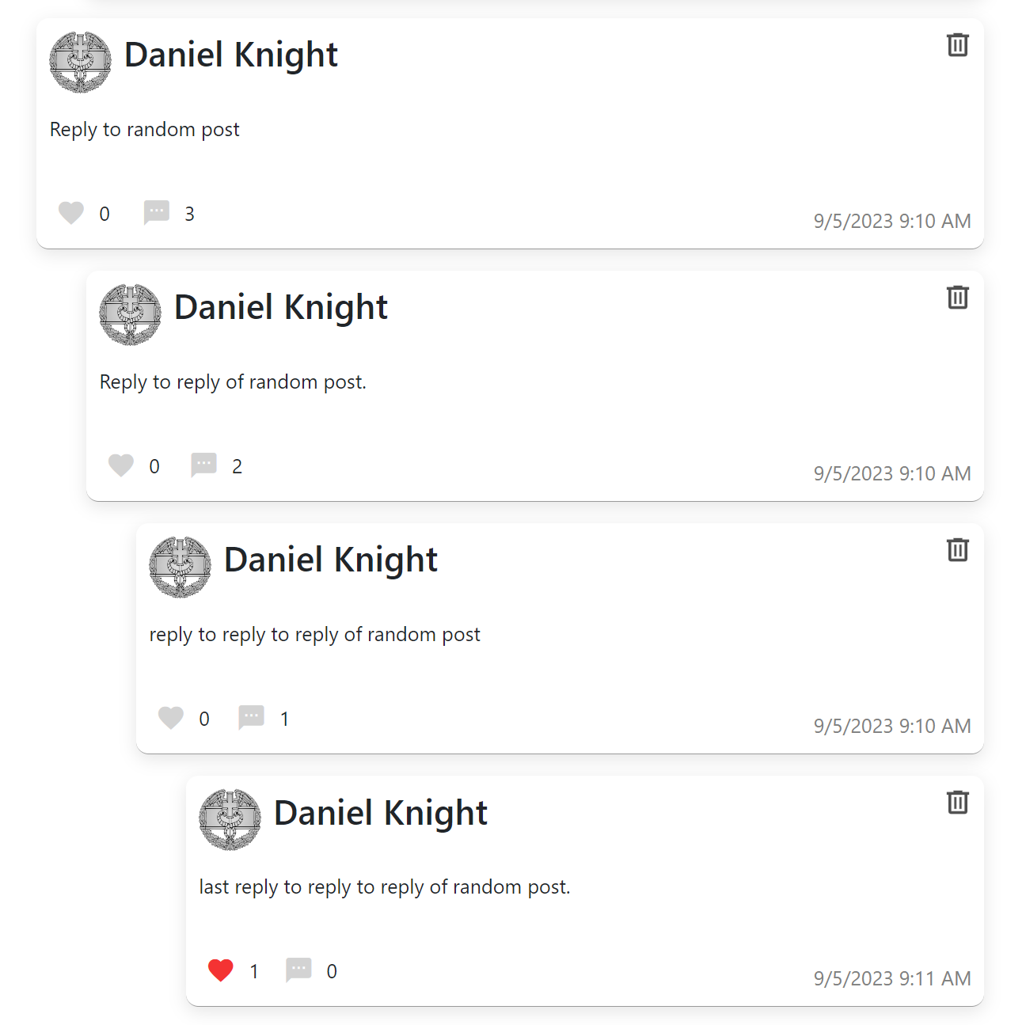
Obstacle 2 of 3
Handling post replies, and replies of replies, and replies of replies of …
Figuring out how to keep track of and display replies to posts took time to figure out.
If a parent post was deleted all the children have to be removed.
Comment counter needs to keep track of both replies to the main post as well as replies to replies.

Slide 9

Obstacle 3 of 3
Maintaining page location
Making sure your position on the page is restored after every page-reloading actions.
Making sure it doesn’t keep scrolling back down after your position has been restored.
Fixing bugs where restoring the scroll position would cause visual errors.

Slide 10
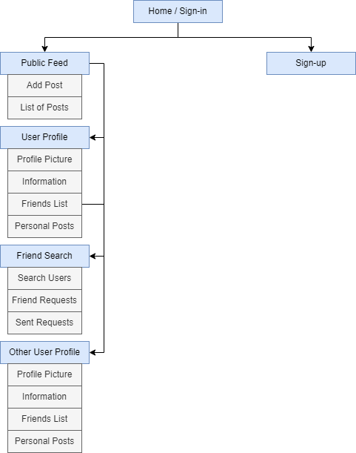
Technical Design
Application Considerations
Create functions anytime code is duplicated.
Limit actions needed by the user to traverse the application.
Keep things familiar and expected.

Slide 11

Summary and Lessons Learned
SQL is powerful.
As the project grew adding additional features became more challenging.
10 Weeks sounds like a lot of time, but it isn’t.

