Slide 1
BasicTies
Developed by Keegan Preston and Daniel Knight

Slide 2
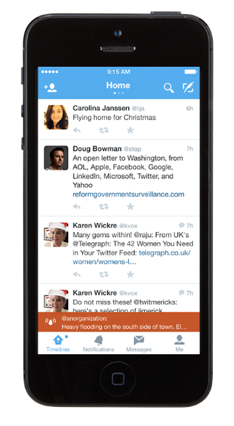
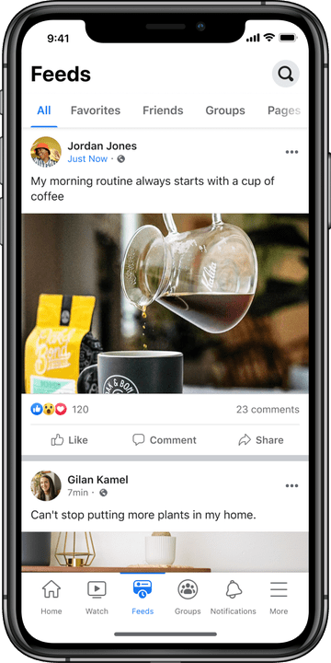
The Original Idea:
Create a basic social media website for mobile that prioritizes user information security and freedom from advertisements.

Slide 3



Our Original Feature List:
User Profiles
Public Feed
Friend Discovery
Likes and Comments
Content Management

Slide 4
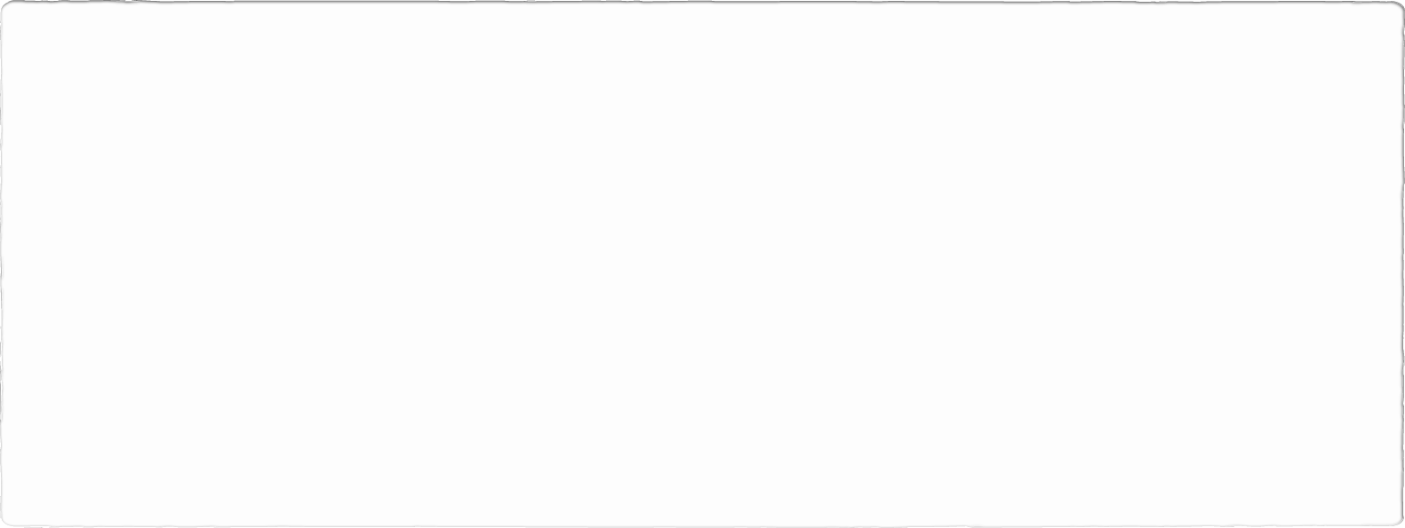
Our Limitations:
Must be both mobile and desktop friendly
Must use the least number of “swipes” and pages as possible
Must keep the users spot on the page

Slide 5

User Profiles - The New User:
Wants to sign up for an account.
Looking for friends and family.
Not skilled with the internet.
Hates advertisements on websites.

Slide 6
User Profiles - The Experienced User:
Uses the website everyday.
Frequently uses the internet.
Makes multiple posts per day.
Likes quick movements between pages.

Slide 7
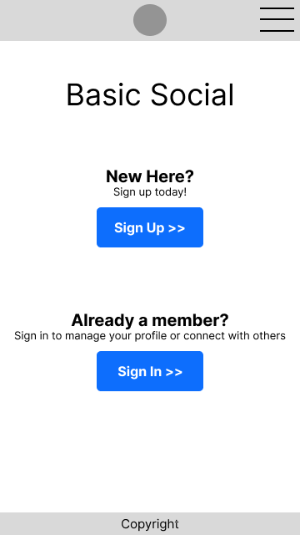
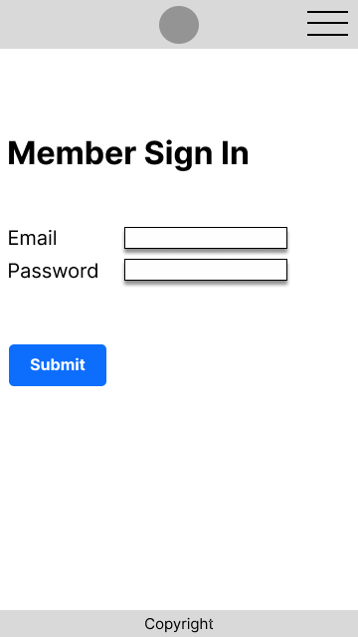
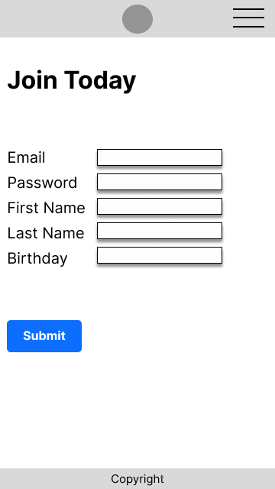
Original Prototype:

Slide 8
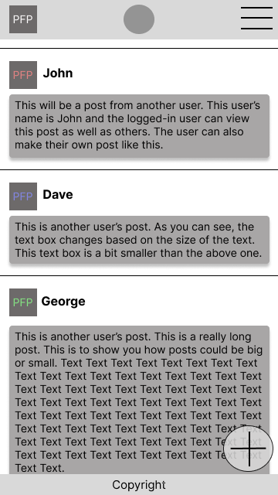
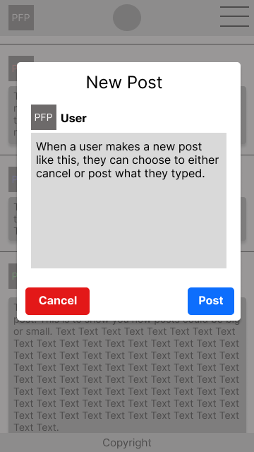
Original Prototype:

Slide 9
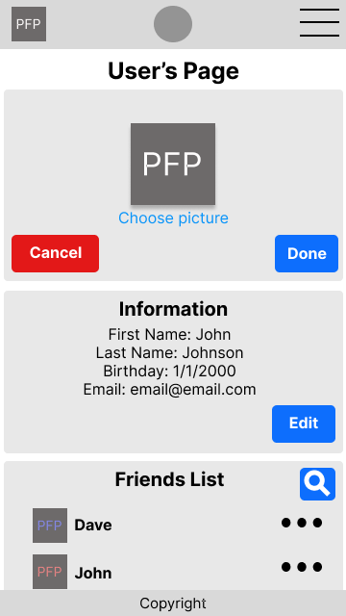
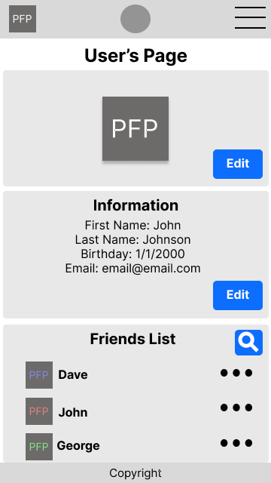
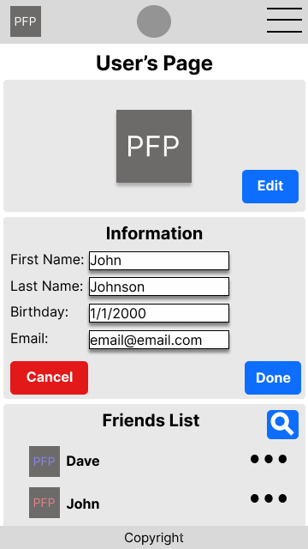
Original Prototype:

Slide 10
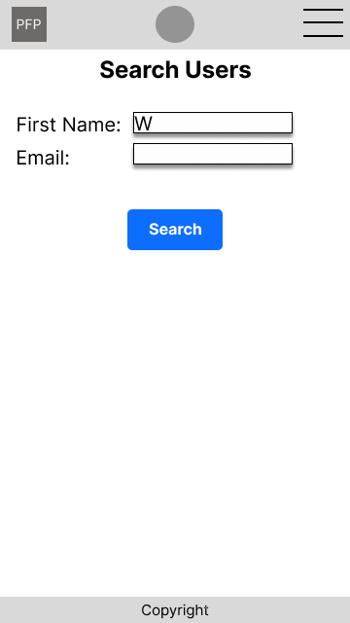
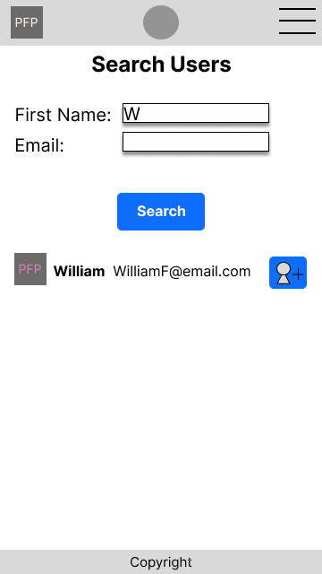
Original Prototype:

Slide 11

First Critique
Feedback Given:
“Should bring you to the main feed after logging in.”
“Add a re-enter password field when signing up.”
“Combine search fields on the search page.”

Slide 12
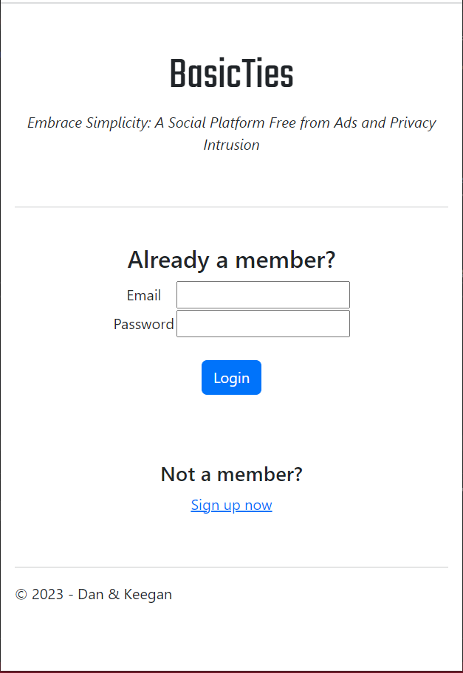
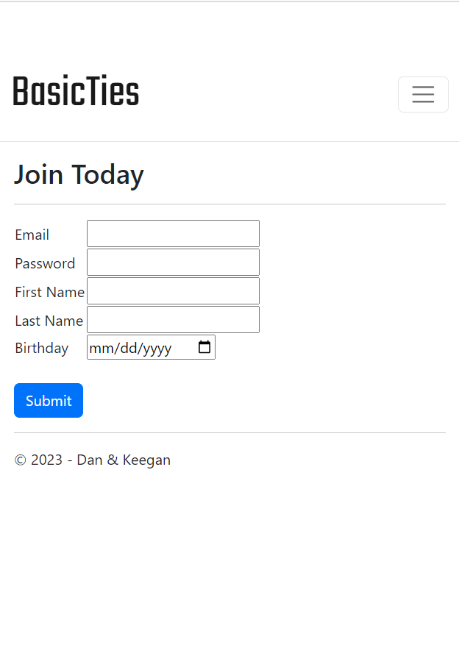
Prototype 2:

Slide 13
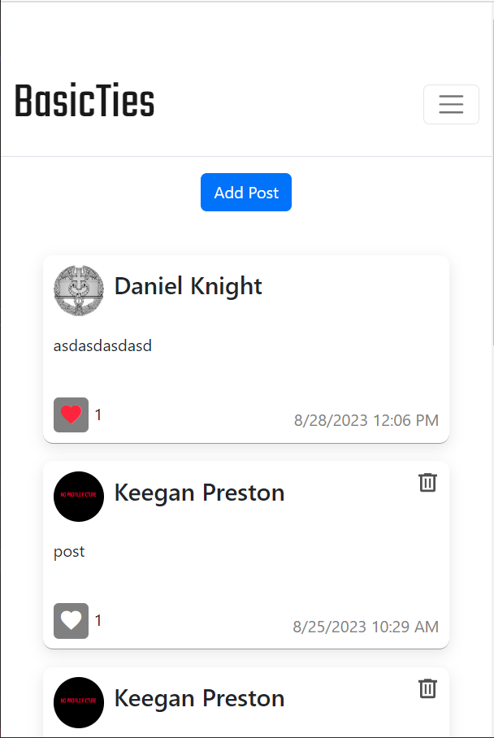
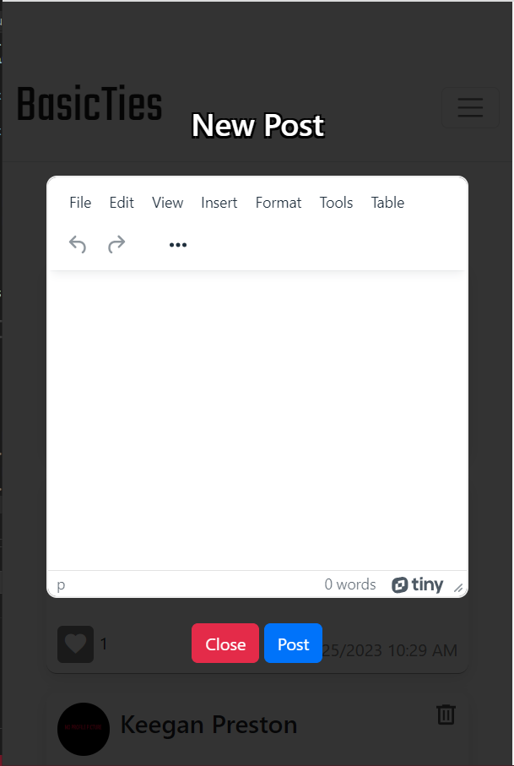
Prototype 2:

Slide 14
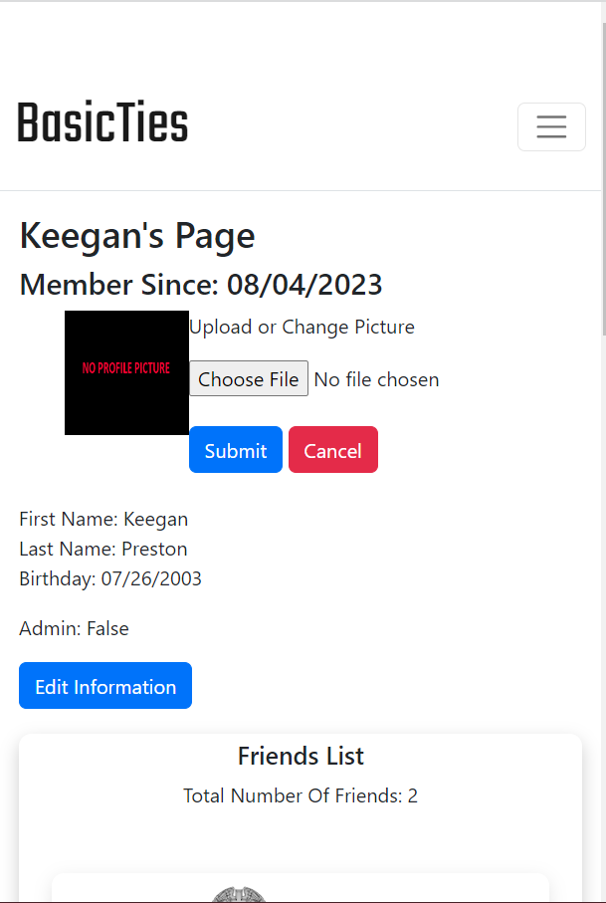
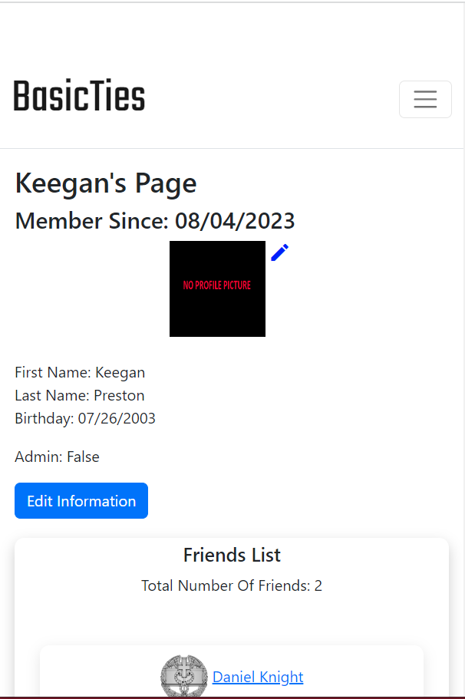
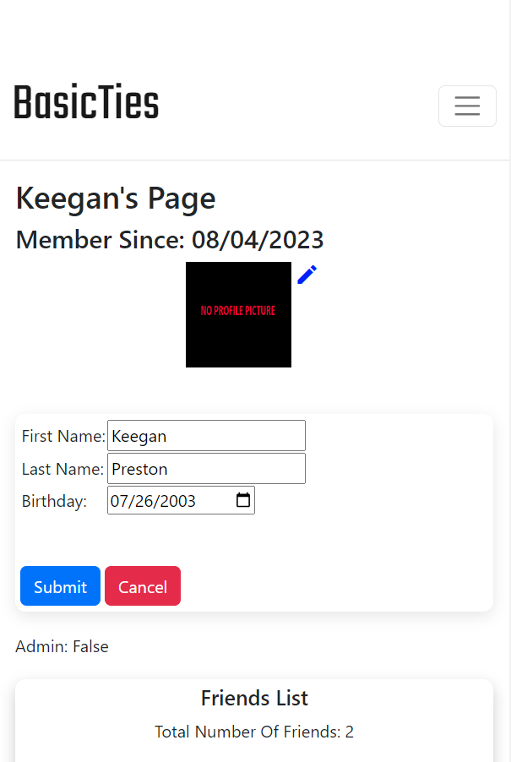
Prototype 2:

Slide 15
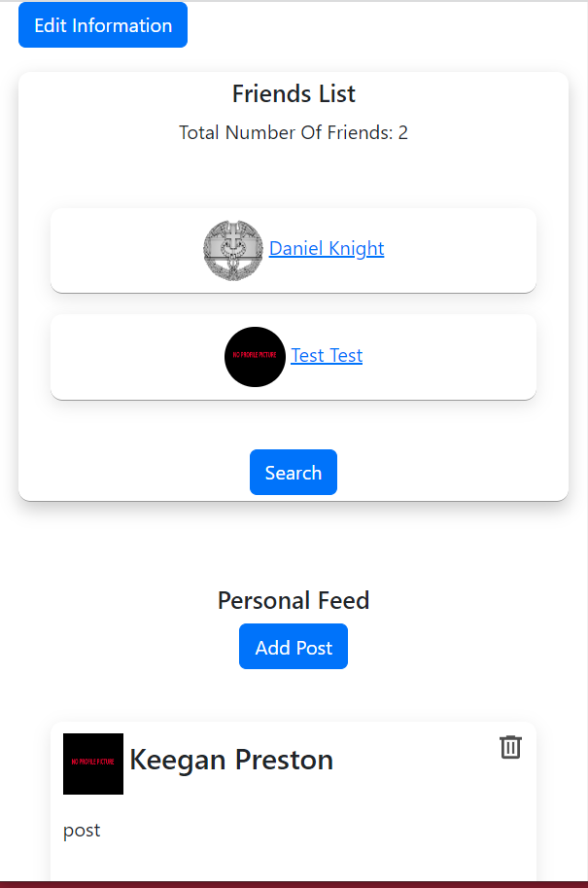
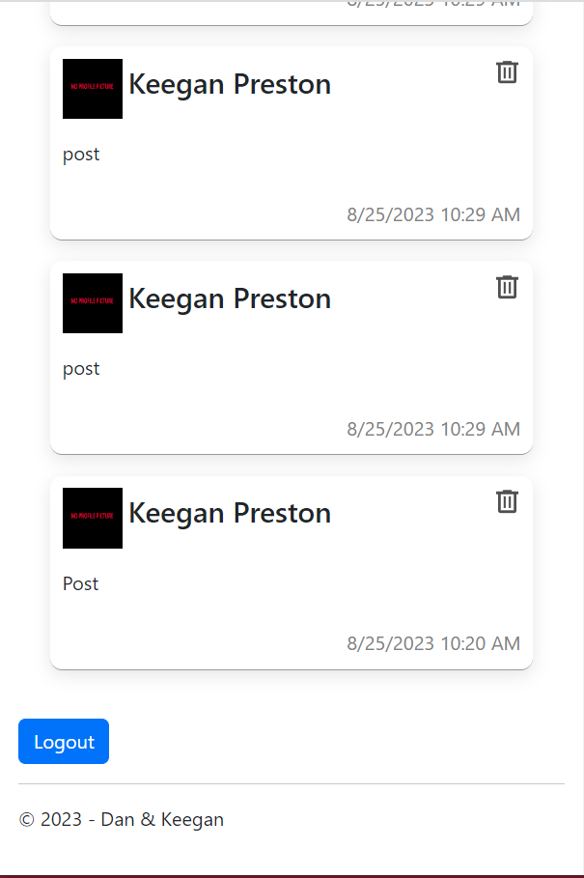
Prototype 2:

Slide 16
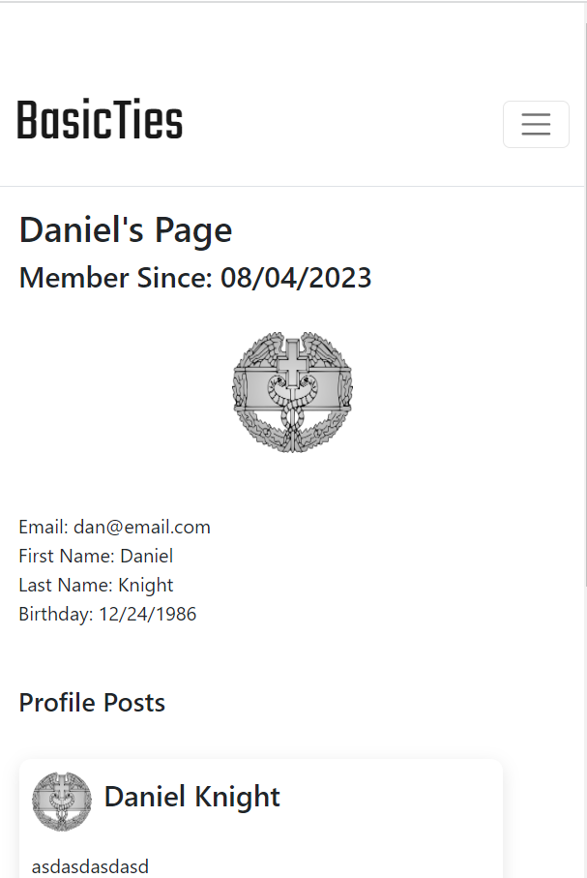
Prototype 2:

Slide 17
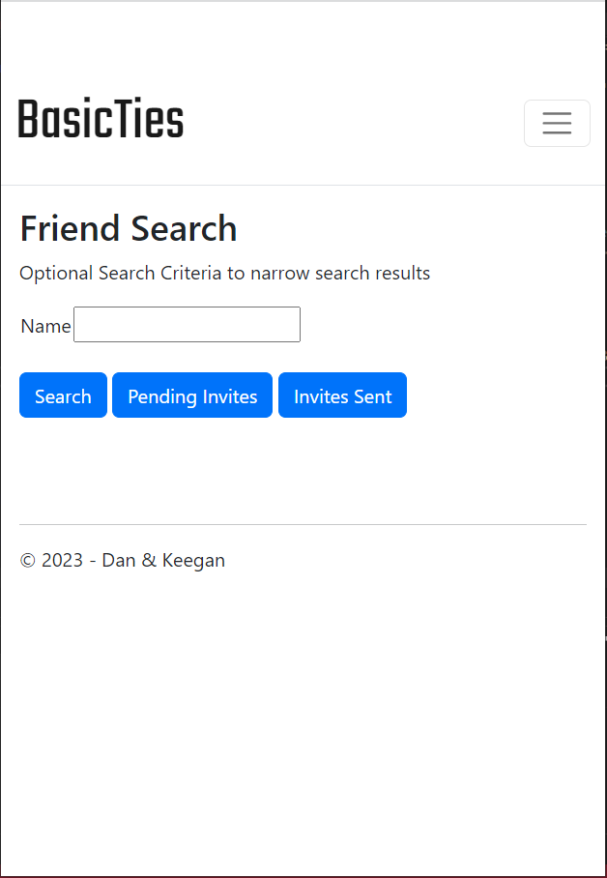
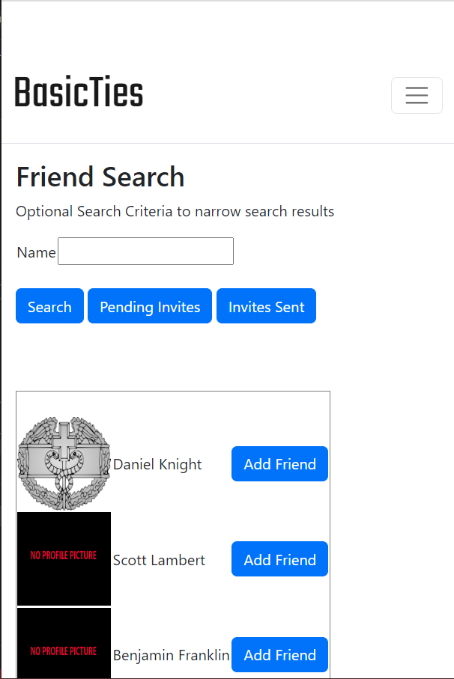
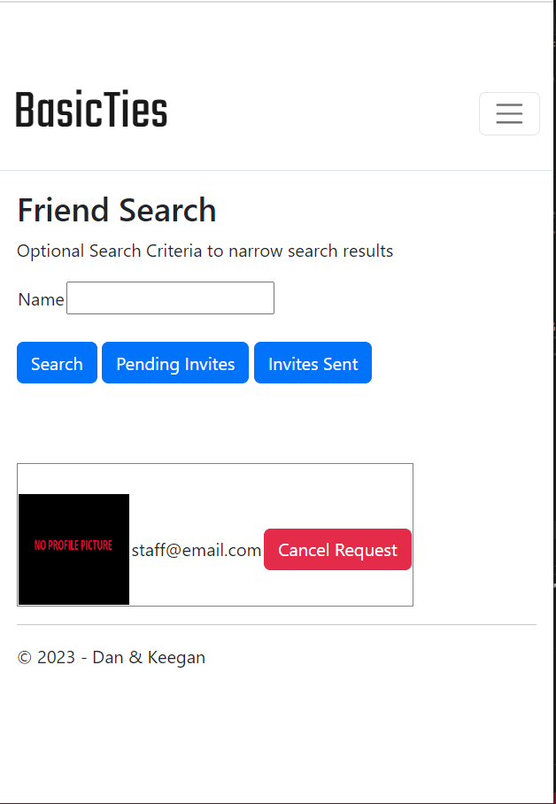
Prototype 2:

Slide 18

What Changed?
Removed a separate log in page and just put the log in on the opening page
Combined search fields into one input
Moved add post button to the top of the page
Added likes
Added other user pages
Changed the header design
Etc.

Slide 19
Second Critique
Feedback Given:
“Search bar up top for all pages.”
“Clean up profile page.”
“Clean design for likes.”
“Add design for comments.”

Slide 20
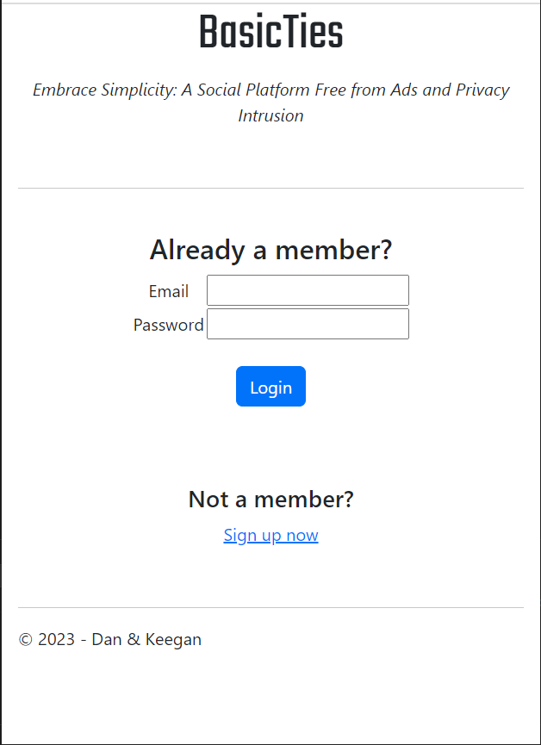
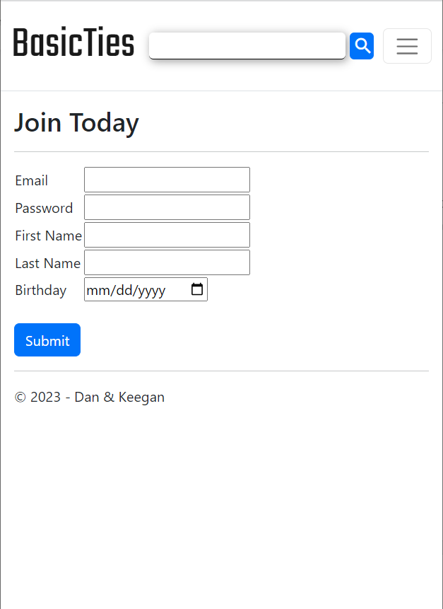
Final Design:

Slide 21
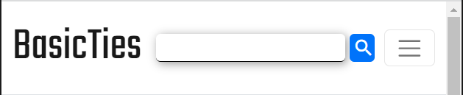
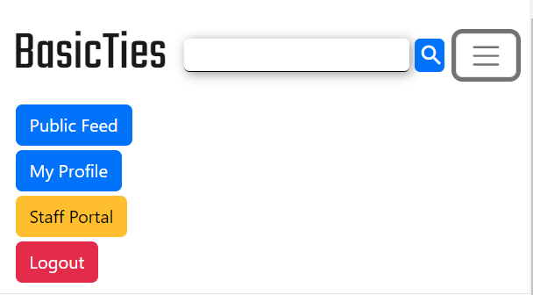
Final Design:

Slide 22
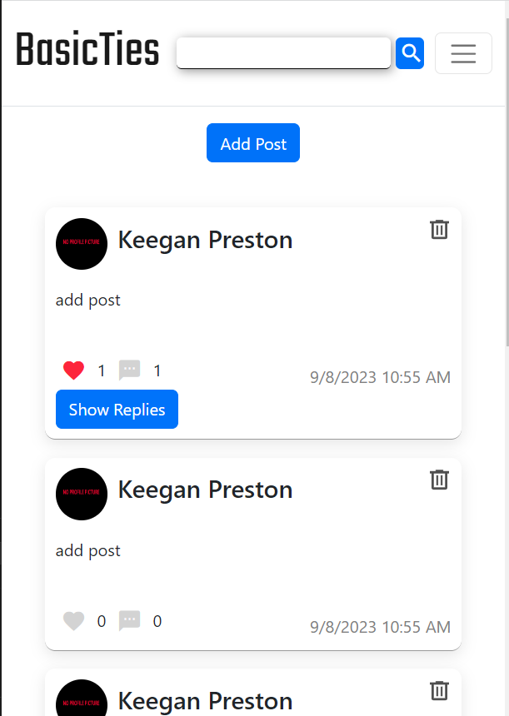
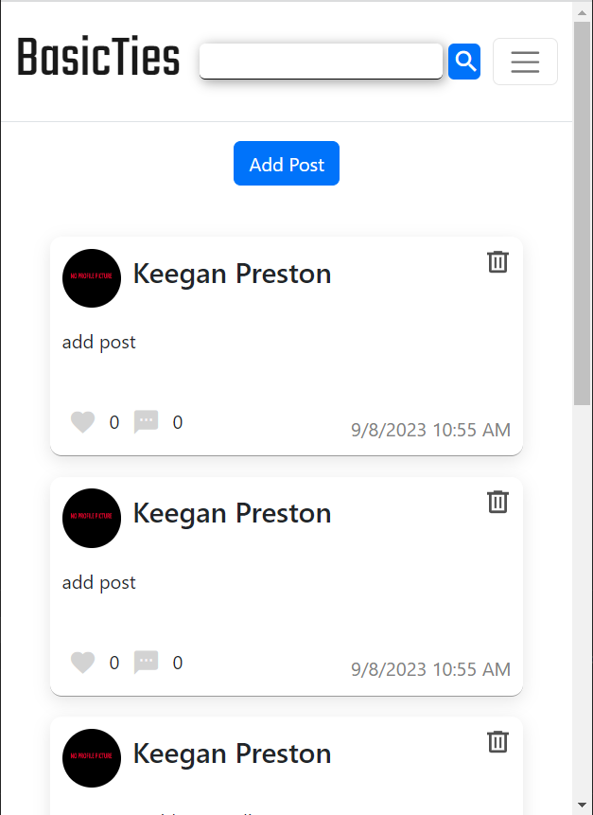
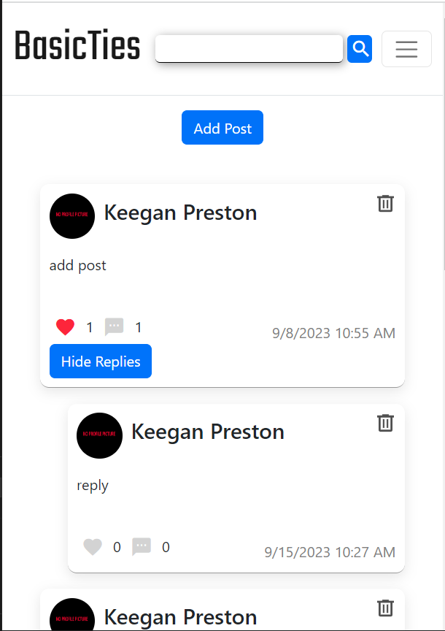
Final Design:

Slide 23
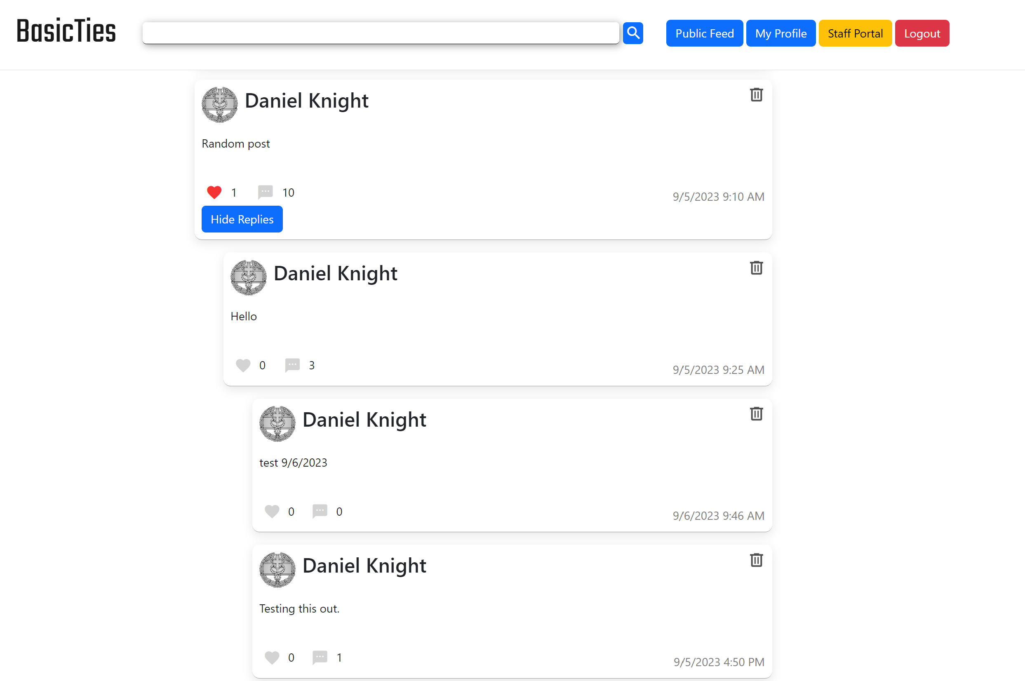
Final Design:

Slide 24
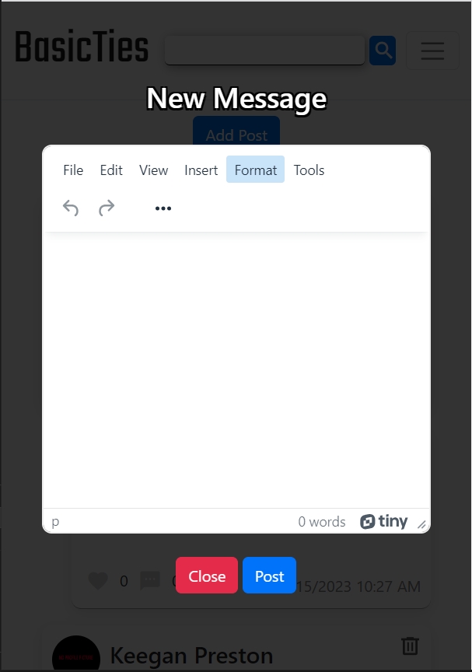
Final Design:

Slide 25
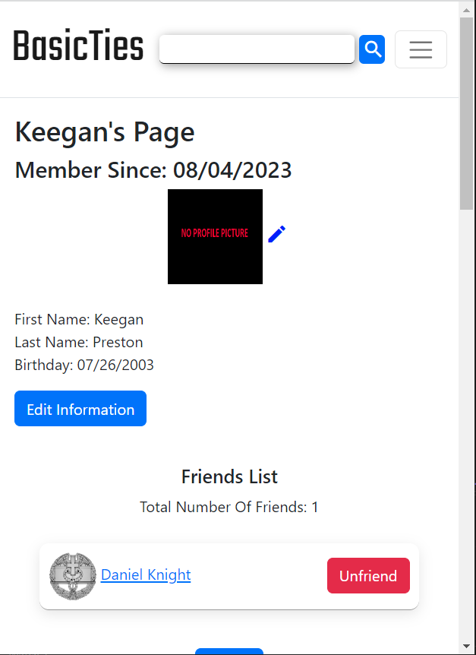
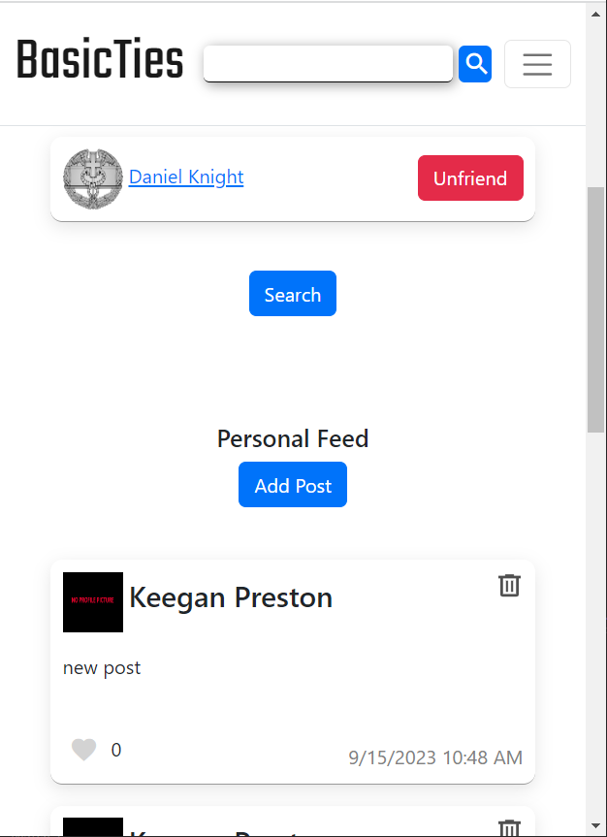
Final Design:

Slide 26
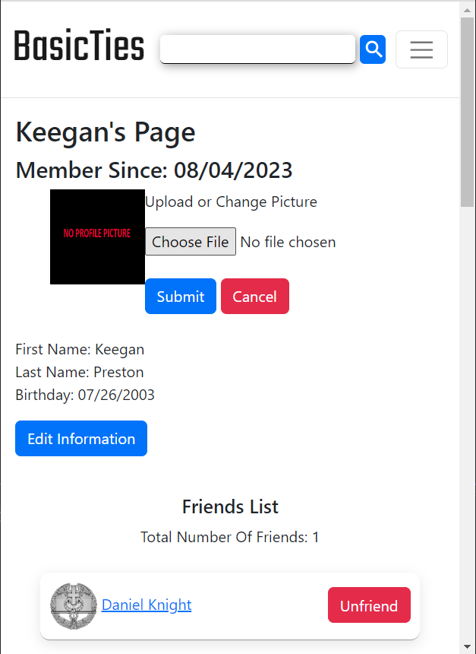
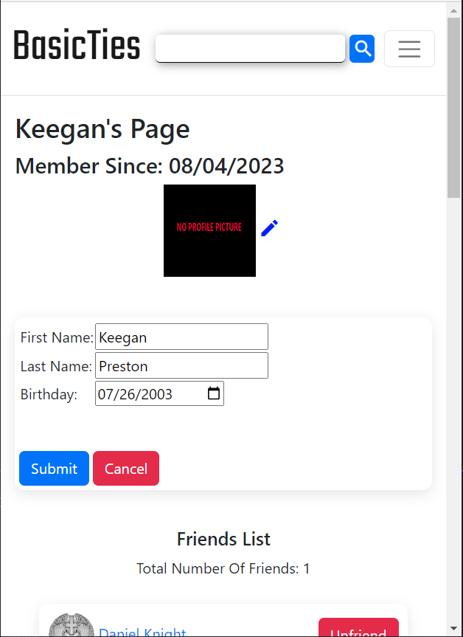
Final Design:

Slide 27
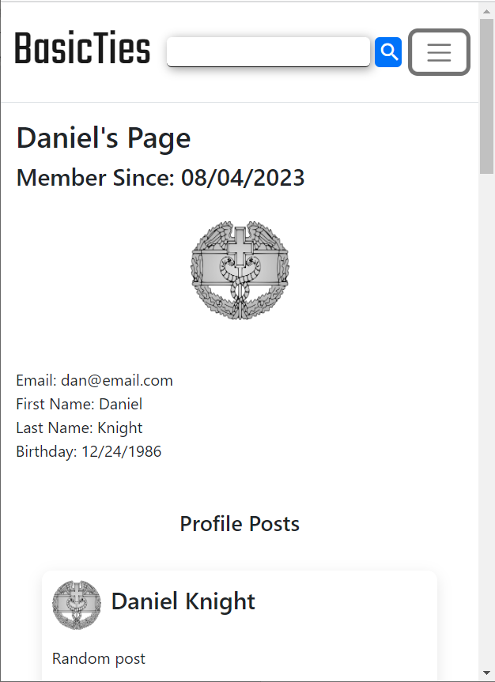
Final Design:

Slide 28
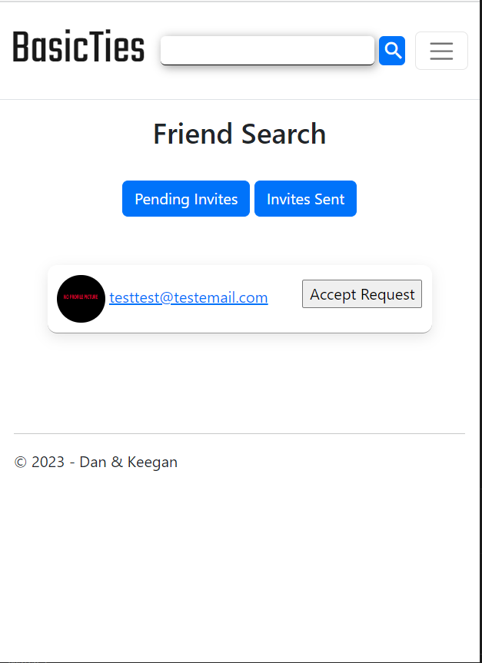
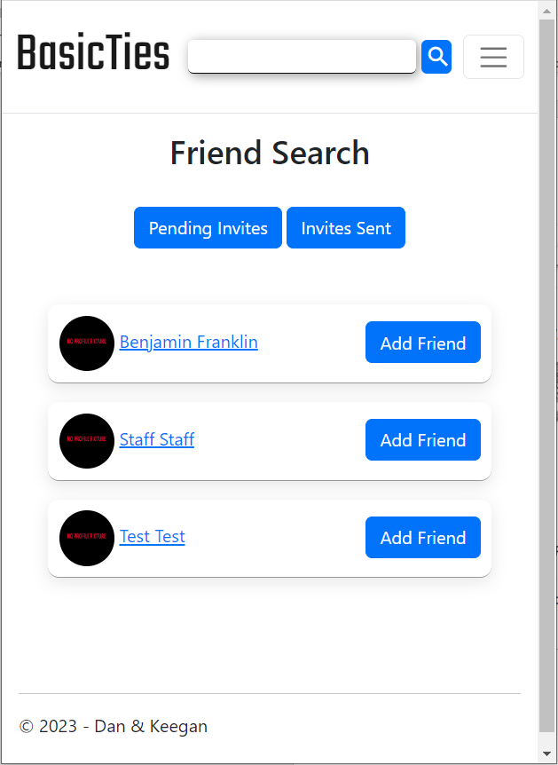
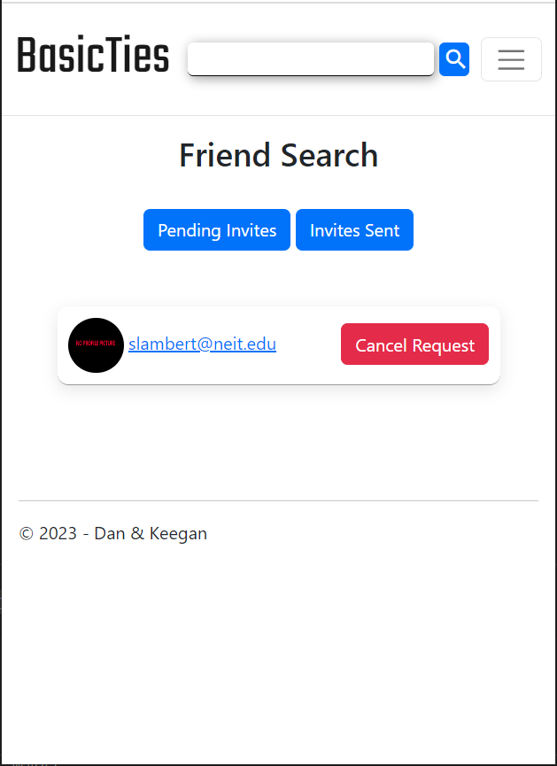
Final Design:

Slide 29
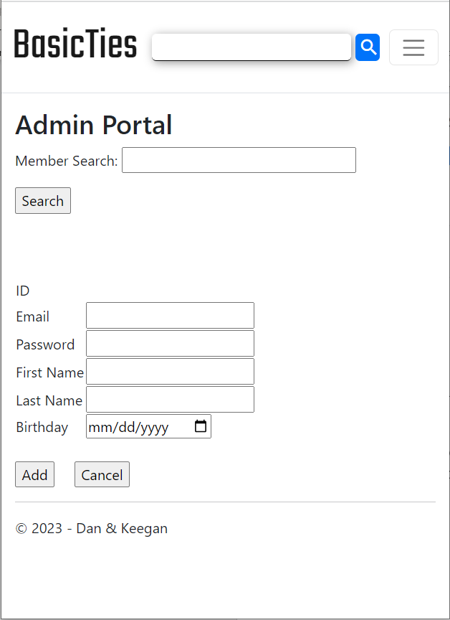
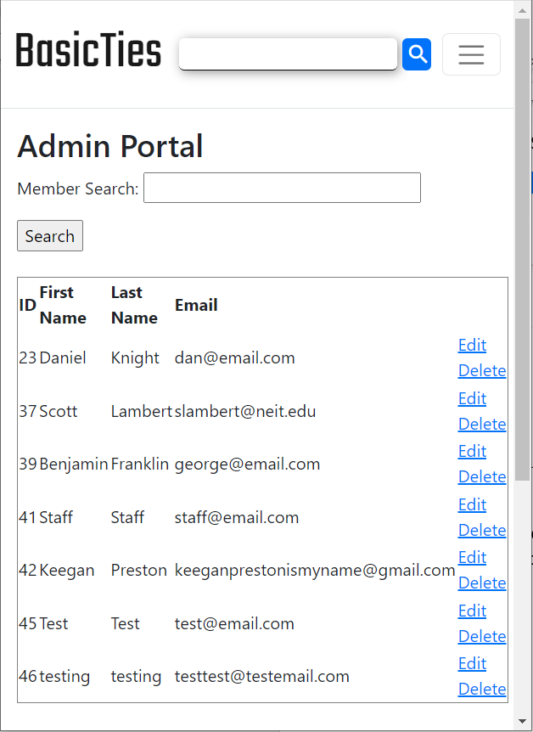
Final Design:

Slide 30
Our Lessons
Documenting everything correctly can be just as time consuming, if not more so, than the coding of a project.
Planning things out ahead of time and sticking to an original design can be difficult.
That good UX is when a product or service performs as expected.
Creating a prototype is very important and makes the programming aspect so much easier.
Making up user stories can help you narrow down what you need and what you don’t.
Critiques can help you realize what can be improved in your project and can help you out of a narrow point of view.

Slide 31
Live Demo

