Slide 1
The Battle of The Neighborhoods Presentation
The Neighborhoods of Manhattan and Toronto
Keegan McCleary-Sharpe
December 3, 2020

Slide 2
Introduction
Business Problem - A potential client has established the following question:
“We have a series of restaurants that perform very well throughout several neighborhoods of New York City. We are looking to expand our operations into Canada, particularly the Toronto area, however, we are unsure which neighborhood we should target in order to access a similar clientele to our New York chain.”
Data – What data will be needed to solve this problem:
Location data for the neighborhoods of Manhattan (Where our client’s locations are)
JSON data file provided by IBM
Location data for the neighborhoods of Manhattan (Where our client wants to expand)
Located via webscraping Wikipedia: https://en.wikipedia.org/wiki/List_of_postal_codes_of_Canada:_M
Data that characterizes these neighborhoods
Foursquare offers an API that can provide the top venues within a neighborhood. This provides a look at the types of venues that are popular in the area, and a way to characterize the clientele of a particular location

Slide 3
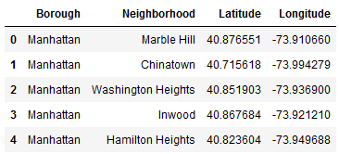
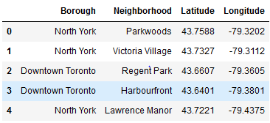
Methodology
Neighborhood Segmentation:
The data for both Manhattan and Toronto was cleaned and organized in a manner that easily tabulated the city, neighborhood, and latitude/longitude of the neighborhood:
Manhattan: Toronto:

Slide 4
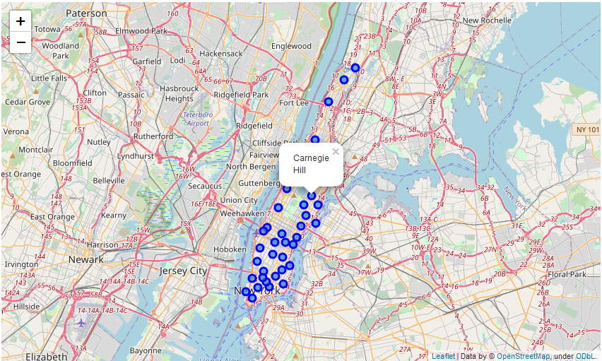
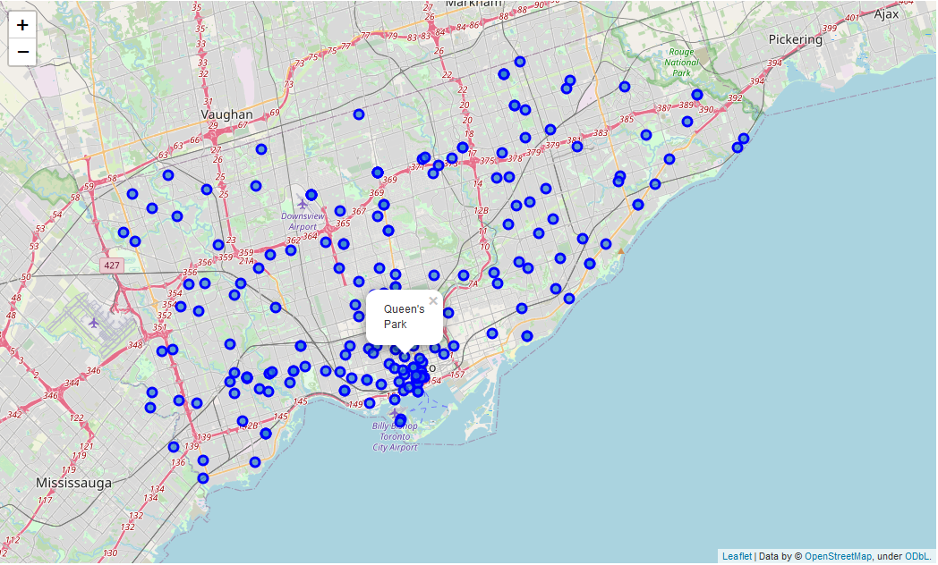
Methodology (cont.)
Neighborhood Visualization:
For exploratory analysis, the segmented neighborhoods were visualized:
Manhattan: Toronto:

Slide 5
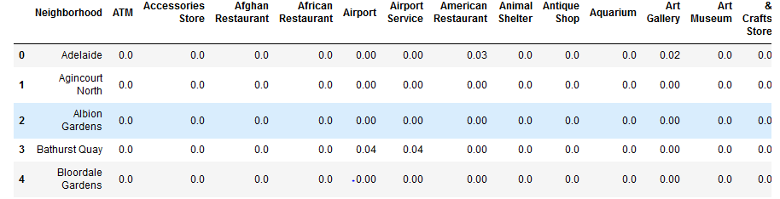
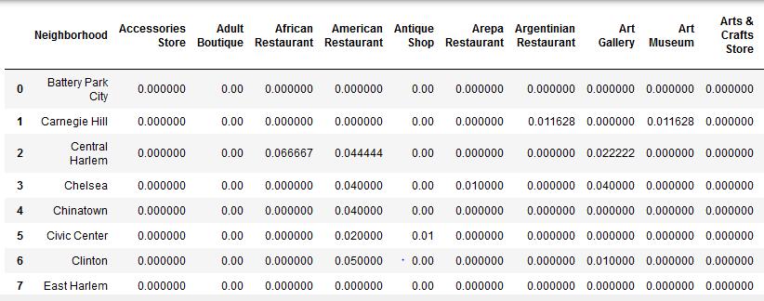
Methodology (cont.)
Neighborhood Characterization:
The neighborhoods were then passed into Foursquare’s API, returning the most common venue types of each neighborhood by relative frequency:
Manhattan: Toronto:

Slide 6
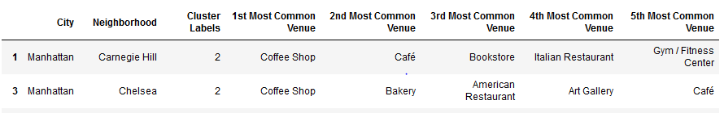
Methodology (cont.)
Clustering:
The frequency data for Manhattan and Toronto neighborhoods were combined and clustered together, after finding an optimal k value of k = 3 via the Elbow Method and Silhouette Score validation, separating the neighborhoods into three clusters.
The cluster containing the neighborhoods with our client’s coffee shops was extracted for further and more detailed analysis.

Slide 7
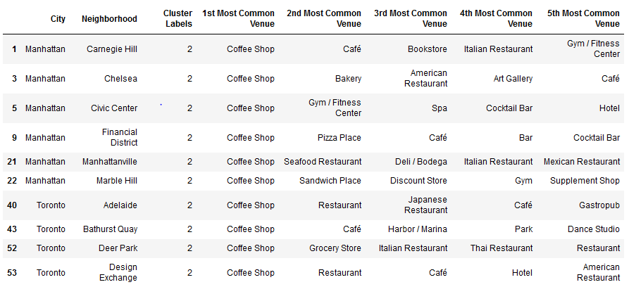
Results
Manhattan Neighborhoods:
Via K Means clustering it was determined that the venues that characterized the two neighborhoods of Manhattan containing the client’s coffee shop locations were primarily Coffee shops, as well as cafés.
For this, Carnegie Hill and Chelsea clustered together with several Toronto neighborhoods characterized similarly:

Slide 8
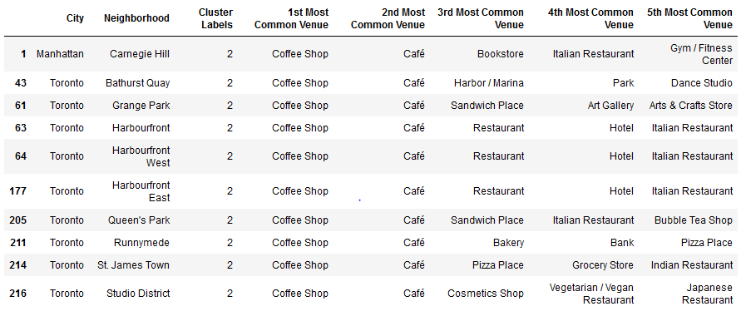
Discussion
Toronto Neighborhoods:
With these results in mind, Toronto neighborhoods were selected from the same cluster as Carnegie Hill and Chelsea. This group was narrowed down to Toronto neighborhoods with Coffee Shops as the most common venue type, and cafés as the second most common.
Special consideration was given to Queen’s Park and Harbourfront as they contained Italian Restaurants in their top five most common venue types, which is another characteristic shared by Carnegie Hall, our client’s most successful neighborhood.

Slide 9
Conclusion
Final recommendation:
Based on the geospatial analysis of both our client’s successful locations and of our client’s target location, using statistical analysis and K Means clustering, our client has received the recommendation to expand into Queen’s Park, Toronto, Ontario Canada. This neighborhood clusters with both Carnegie Hill and Chelsea, the two neighborhoods the client is already operating in, and it also shares the 1st and 2nd most common venue types with Carnegie Hill.
Queen’s Park also contains Italian Restaurants in its top five most common venues, another shared feature with Carnegie Hill.
For this, it is inferred that Queen’s Park contains a similar clientele to Carnegie Hill where our client has already been very successful.

