Slide 1
Introduction to infectious disease dynamics
SRI: Cholera Stream

Slide 2
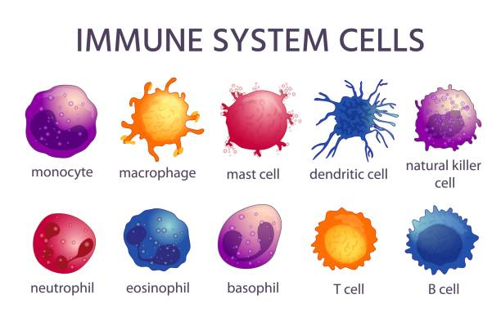


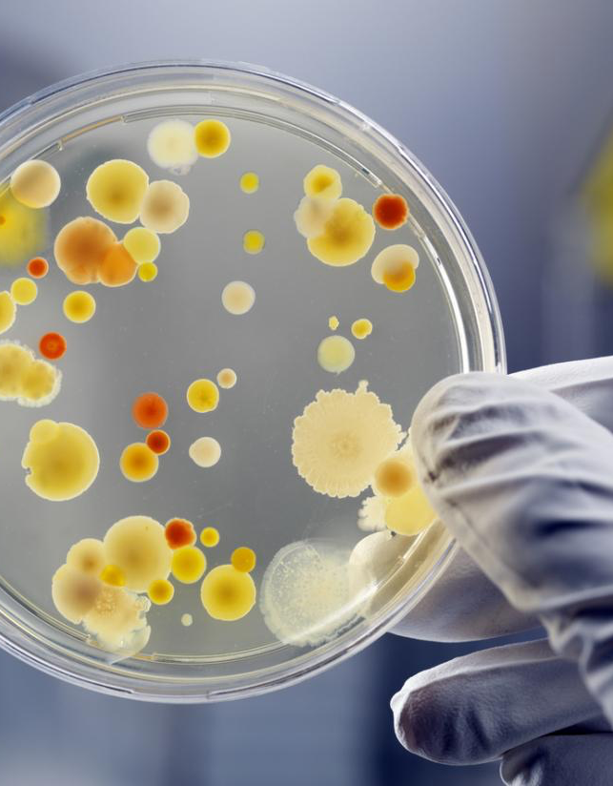

Many ways to study infectious diseases
Immunology
Genomics
Medicine
Microbiology
Public Health

Slide 3
Many ways to study infectious diseases
Within-Host level

Slide 4
Many ways to study infectious diseases
Individual level

Slide 5
Many ways to study infectious diseases
Population level

Slide 6
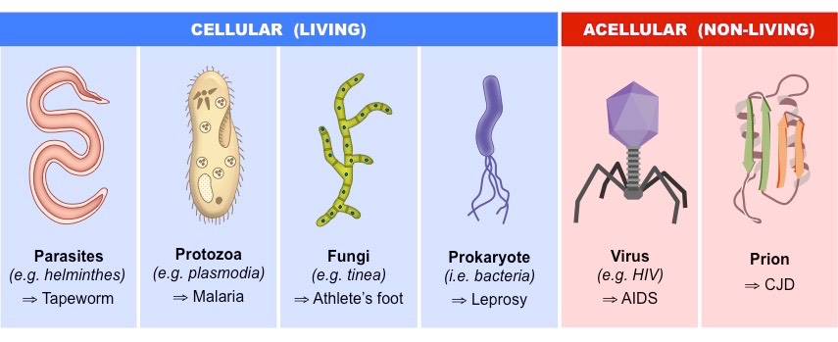
Agents of infectious diseases

Slide 7


Epidemiology & Public Health focus on the population-level
Concept: We can track the movement of pathogens through populations

Slide 8
Epidemiology & Public Health focus on the population-level
Concept: We can track the movement of pathogens through populations

Slide 9
Why do we want to study how infectious diseases spread?
They’re infectious…
They spread from person to person!
They are the leading cause of morbidity and mortality worldwide
They represent a significant economic and social burden
High healthcare costs, significant interruptions to life and productivity
They may be preventable

Slide 10
Why do we want to study how infectious diseases spread?
What can we do about it?
What can we do to reduce the number of infections in the community?
How can we choose the most appropriate interventions?
Can it be eliminated (like smallpox)?
Can we estimate the timing of when it will happen?

Slide 11
Modeling infectious diseases
Mathematical modeling provides a framework for understanding infectious disease transmission
Allows us to gain insights into mechanisms influencing disease spread and link clinical knowledge with population-scale patterns
Can help establish the relative importance of different processes to focus research or management efforts
Allows us to do thought experiments and “what if” since real experiments are often logistically or ethically impossible
Forecast future trends

Slide 12
What is a model?
A model is a representation of a real-world system using mathematical concepts and equations
A mathematical model is a set of equations that describe behavior of a system; such as a biological system, a physical system, a technology or social system.
A statistical model describes relationships between observed quantities and independent variables
Developing a model is different from statistical analyses of data

Slide 13
Mathematical modeling
Real world problem
Mathematical representation
Real world solution
Calibration
Variables + Parameters
Model equations
Results
Inputs
outputs
Analysis/Refinement

Slide 14
Classification of Mathematical models
Mathematical models
Static
Dynamic
Stochastic
Deterministic
Notes:
- A static model is a a mathematical representation of a disease that assumes the conditions and transmission rates remain constant over time.
A dynamic disease model is a mathematical representation of how a disease spreads through a population over time, taking into account factors like changes in the number of susceptible, infected, and recovered individuals, as well as how these populations interact with each other, allowing for simulations to understand disease progression and potential intervention strategies

Slide 15
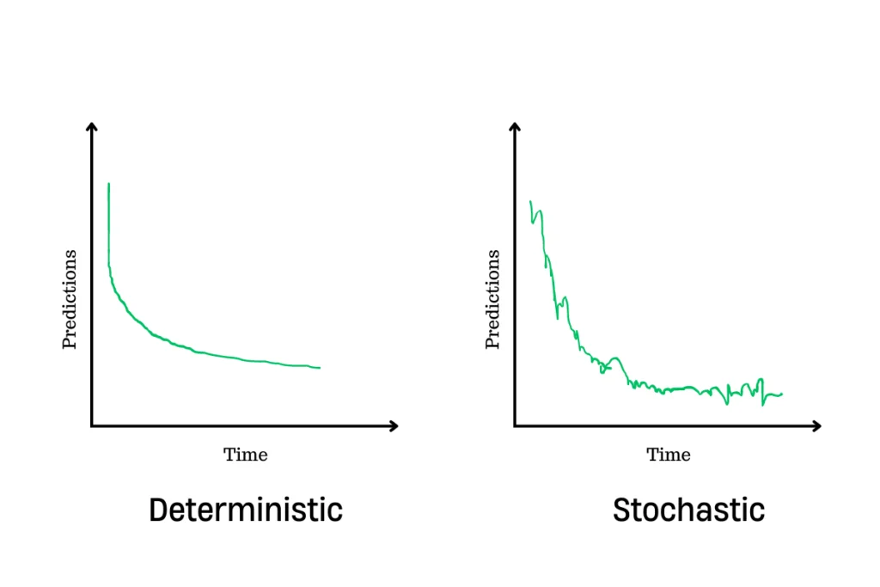
Infectious disease dynamic models
Notes:
Deterministic models are based on precise inputs and produce the same output for a given set of inputs.
- stochastic models incorporate randomness and uncertainty into the modeling process

Slide 16
Skipping over how to choose a model/what is a good model
(We will come back to this in a future meeting)

Slide 17
Mechanistic models
A mechanistic model is a model geared toward explaining some behavior (or phenomenon) in terms of the parts and processes within the system.

Slide 18
Mechanistic models of disease
S
I
R
Break the population apart based on disease states:
Susceptible: Individuals susceptible to disease
Infectious: Individuals able to transmit to others
Removed (Recovered): Individuals who are immune or dead and cant contribute to transmission

Slide 19
Mechanistic models of disease
S
β
I
𝛄
R
Describe the rates at which people move between these states
β : “Force of infection” or how many people get infected per unit of time
𝛄 : “Rate of recovery” or how many people recover per unit time. Easier to think of 1/ 𝛄 which is how long people stay infectious

Slide 20
For next time: R
Please download R here: https://www.r-project.org/
Download R Studio here: https://www.rstudio.com/
Please make a github account here: https://github.com/
Email me your github username so we can add you to our “repo”
If you are feeling excited, here is a short R tutorial: tutorial file
(No need to go past page 6 for now)
Abby will lead an R tutorial next week

