Slide 1

COVID-19 DATA ENGINEERING AND ANALYSIS
Amrit
Keegan
Mandeep
Patrick
Notes:
Our project focuses on leveraging data engineering techniques to analyze the trends and patterns of the COVID-19 pandemic.
In today’s presentation, we’ll walk you through the objectives of our project, the data extraction and transformation and loading processes, key findings, and actionable insights. Each team member will focus on a specific aspect of the project.
Let’s begin by discussing the project objective in more detail.

Slide 2

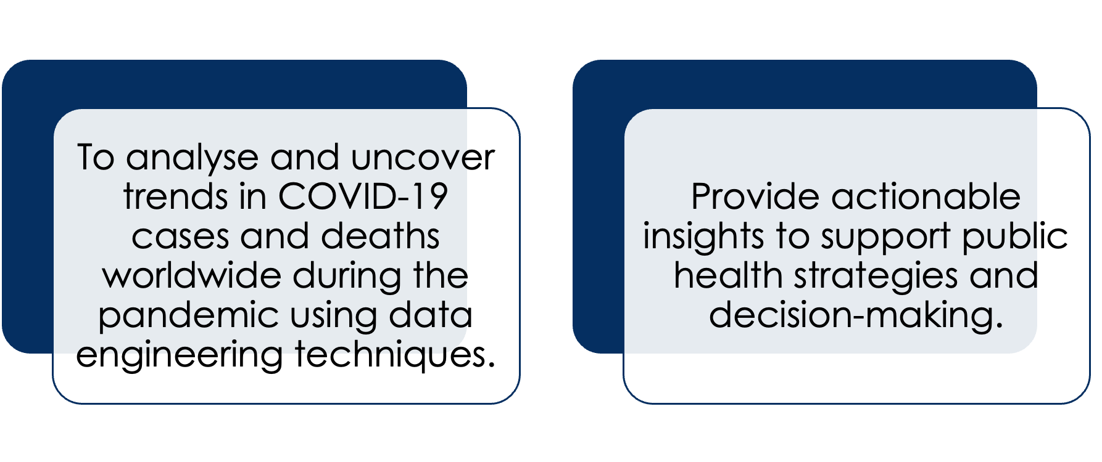
Objective (Mandeep)
Notes:
The objective of this project is to analyze the impact of the COVID-19 pandemic by extracting, transforming, and analyzing globally and regionally, with a particular focus on Australia's pandemic trends,data using Python and Pandas.
By leveraging data engineering techniques, we aim to uncover key trends, correlations, and patterns in cases and deaths worldwide.
This project provides actionable insights to support public health strategies, resource allocation, and future pandemic preparedness.
Ultimately, it demonstrates how clean, well-structured data can drive meaningful decision-making during critical global events.

Slide 3
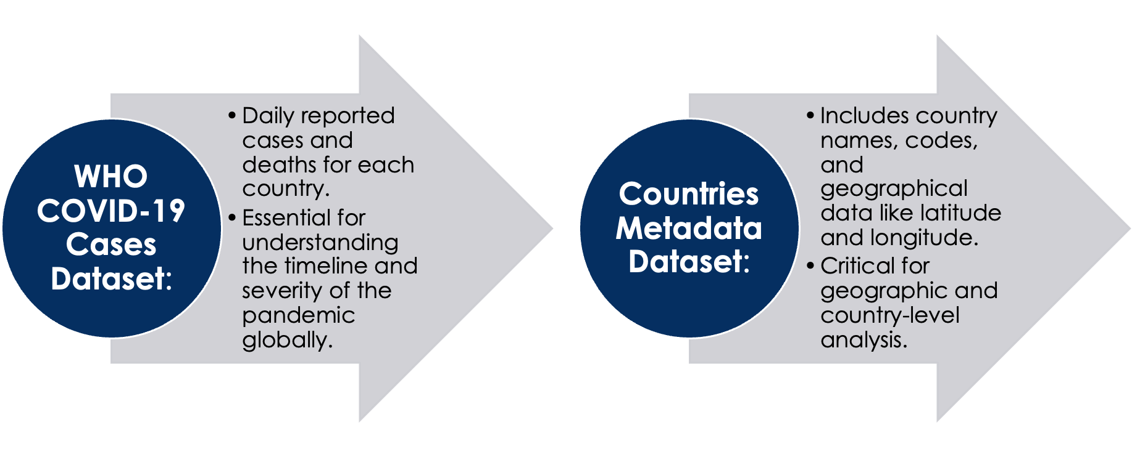
Data Selection (Mandeep)
Notes:
The datasets used in this project were recommended by Patrick and sourced from Kaggle,
We selected the WHO COVID-19 dataset for its detailed daily reporting on cases and deaths, providing valuable insights into global pandemic trends.
The countries metadata added geographic context, enabling us to analyze trends at both global and regional levels.
These datasets were chosen for their reliability, adaptability, and ability to address the project's objective of uncovering pandemic insights through data engineering.

Slide 4

Data extraction (Mandeep)
Notes:
In the data extraction phase, I imported two key datasets: the WHO COVID-19 data and the country metadata. These formed the backbone of the analysis.
Using Pandas, I efficiently loaded and validated the datasets, ensuring they were ready for transformation. I carefully inspected their structure using .head() and .info() to identify potential issues like missing or inconsistent values early.
I aligned columns and data types to ensure compatibility between datasets. This step was critical to prevent errors during merging and allowed me to focus on deeper analysis after cleaning.
By emphasizing validation and consistency, I established a strong foundation for building an accurate and reliable ETL pipeline.
During extraction, I not only imported datasets but also carefully inspected their structure and integrity to ensure readiness for analysis.
I discovered inconsistencies in country naming conventions, which required renaming to align the datasets effectively for merging.

Slide 5
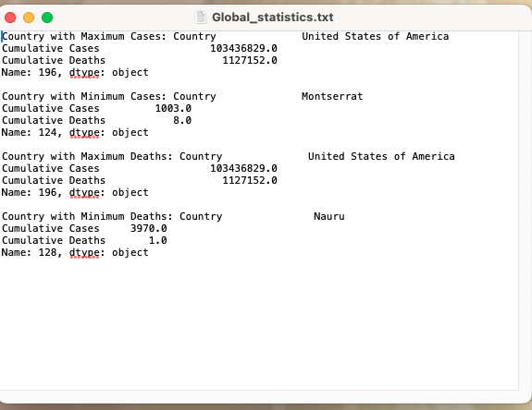
Key Insights and Findings from Data Extraction (Mandeep)
Global Insights: country with maximum and minimal cases and deaths
Local Insights: Daily cases and deaths
Notes:
Globally, countries like the USA were significantly impacted, recording the highest number of cases and deaths, while smaller nations such as Montserrat and Nauru had minimal cases, highlighting global disparities in pandemic severity.
In Australia, we observed relatively lower case and death rates, indicating the effectiveness of early mitigation measures like lockdowns and border closures.
3. Correlation analysis revealed a strong relationship between cumulative cases and cumulative deaths globally, showcasing the long-term effects of the pandemic.

Slide 6
Data Transformation (Amrit)
User Interaction function
Filter data based upon 3 selection criteria:
‘Date’,
‘country‘ and
‘WHO Region’
Notes:
Thank you Mandeep, Now we are onto the next step of the ETL process. After extraction, comes transformation. But before we begin to transform the data, we wanted to create a user interactive function which can be called throughout the whole python program and it empowers the user to filter the data based upon their input dynamically. This function asks the user to choose their filter option, it can be date, country or WHO region, whichever the user chooses, the function then further asks for date input or country input or WHO region name followed by the desired filtered data.

Slide 7
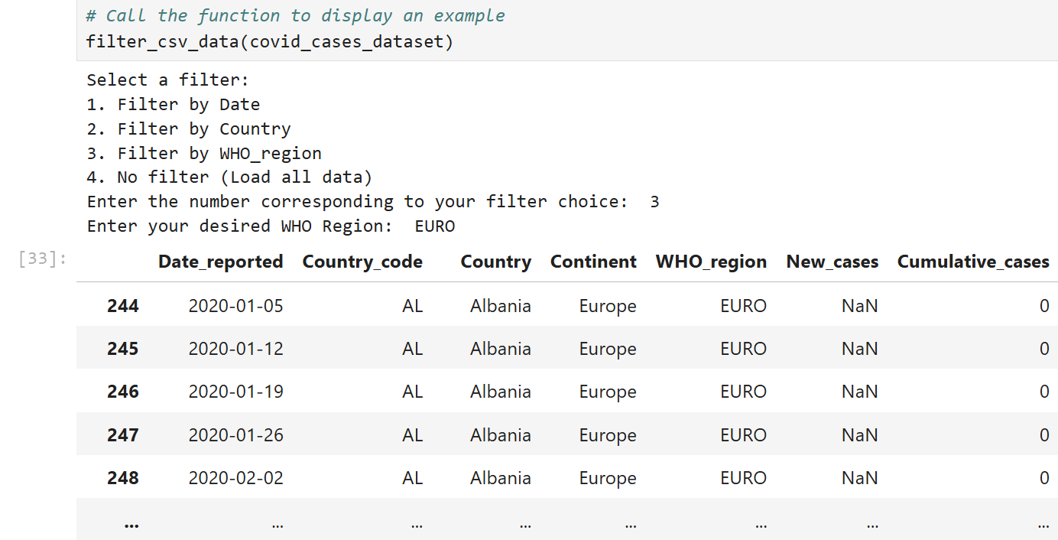
Data Transformation (Amrit)
Notes:
This is the example of the function, as you can see, our user chose option number 3, and promptly chose the who regio ‘Euro’, hence out output shows all the covid cases, in all the countries under euro who region.

Slide 8
Data Transformation (Amrit)
Streamlining Database:
Country
Coordinates,
Patient database,
Covid-19 Dataset)
Notes:
Beginning with the data transformation, our data was further divided into 8 different csv files, and their datatypes were changed to reduce the debugging errors while uploading the data into PostgreSQL Database. To facilitate the foreign keys in SQL, these files were given separate case_Ids column where necessary.

Slide 9
Data exportation(Amrit)
.CSV files output
PyArrow

Slide 10
PyArrow Library(Amrit)
PyArrow is a powerful Python library that provides tools to work efficiently with Apache Arrow, a cross-language development platform for in-memory data. Apache Arrow enables fast data processing, particularly for analytics and big data applications, by defining a columnar memory format that is highly efficient and language-agnostic.
Notes:
As a team, we ventured into exploring some new Python libraries, which felt almost like discovering "extra-terrestrial" tools. One such library we came across was pyarrow. After understanding its capabilities , we utilized it as an output tool. Let me illustrate this with an example:

Slide 11
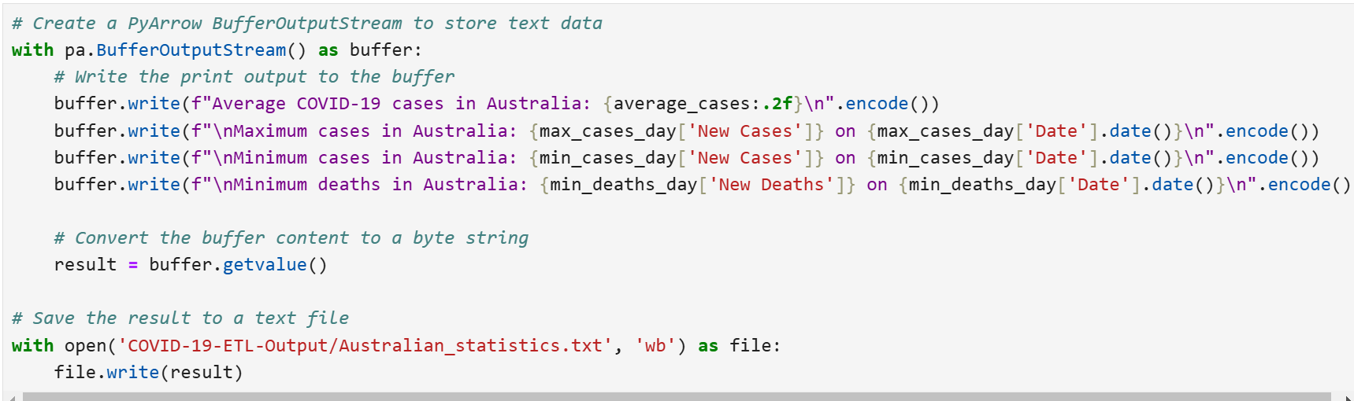
PyArrow Library(Amrit)
Notes:
This is how we utilized PyArrow library, which helped us in tackling the bulk datasets in nano-seconds. Here, I conclude the transformation section and pass over to keegan for the next step in ETL Process called loading.

Slide 12
Data Loading (Keegan)
Source Identification - Identify where the data is coming from.
Data Transfer - Accumulated Data, Batch processing, Stable environment.
Data integration - Combined data.
Notes:
data loading involved taking the transformed data and loading it into a database where it can be accessed and analyzed
The steps that were taken were
1. Source Identification
Identify where the data is coming from. In this case, we are sourcing data from CSV files obtained from Kaggle.
2. Data Transfer
Accumulated Data: Over a specified time period, which resulted in several thousand rows of data.
Batch Processing Advantage: This approach allows us to analyze the complete dataset without the concern of new data being added during the analysis process. This would also mean we would have a
Stable Analysis Environment: By transferring this accumulated data, we ensure a stable environment for thorough analysis, leading to more accurate insights.
3. Data Integration
Combine data from the CSV files where appropriate to create a cohesive dataset for analysis.

Slide 13
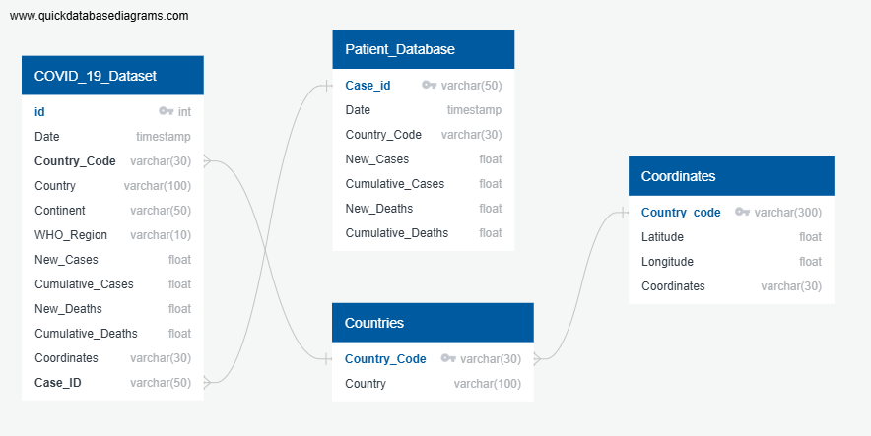
ERD (Keegan)
Notes:
"This is our Entity Relationship Diagram (ERD), which visually represents the relationships between entities in our database."
Entities: "The boxes in the diagram represent entities, which are the main objects or concepts we are storing data about. For example, in our case, we have entities such as Covid_19 dataset, Patient database, countries and Coordinates."
Relationships: "The lines connecting the entities represent relationships. These lines indicate how entities are related to one another. For example, a Country can only have one country in the countries table but in our covid 19, we can have multiple rows of multiple countries , which illustrates a one-to-many relationship."

Slide 14
ERD Purpose (Keegan)
Blueprint for our database design
Help understand data structure
How entities interact with each other
Helping our database be more organized
Improved data management and analysis
Database organised
Notes:
"This ERD serves as a blueprint for our database design, helping us understand how data is structured and how different entities interact with each other. It is essential for both documenting any existing databases or new ones."
"By using this ERD, we can ensure that our database is organized efficiently, which will facilitate better data management and analysis."

Slide 15
Postgres SQL (Keegan)
Benefits
Reliable and stable
Flexible - Supporting various data types
Extensibility - Define own data types
Strong community support
Notes:
We used Postgres SQL for our database
The Benefits of Using PostgreSQL:
Robustness: Reliable and stable, suitable for large-scale applications.
Flexibility: Supports various data types and custom functions.
Extensibility: Allows users to define their own data types, operators, and index types.
Strong Community Support: Active development and a wealth of resources available.
Because of this we believed it would be the ideal choice for us.
Once our data was transformed we then imported our CSV file into postgres database based on our ERD diagram.

Slide 16
Data sourced through legitimate means
Respect privacy and confidentiality
Anonymize personally Identifiable information
Represent a diverse population
Ethical Considerations (Keegan)
Notes:
In our project analyzing COVID-19 cases globally, we prioritize ethical considerations by ensuring that all data sourced is obtained through legitimate and transparent means, respecting the privacy and confidentiality of individuals. We reviewed our dataset for any personally identifiable information (PII) and took necessary steps to anonymize it, as it is crucial to protect the identities of those affected by the pandemic.
Additionally, We aimed to ensure that our analysis represented a diverse population, considering factors such as geographical disparities, to avoid biases or excluding vulnerable groups. By adhering to these ethical principles, we aimed to safeguard the rights of individuals represented in our data.

Slide 17
Flask(Patrick)
Create dynamic routes that
query the PostgreSQL database in real-time
Enables users to interact with the data
Notes:
We built a Flask web application that enables users to interact with the data intuitively.

Slide 18
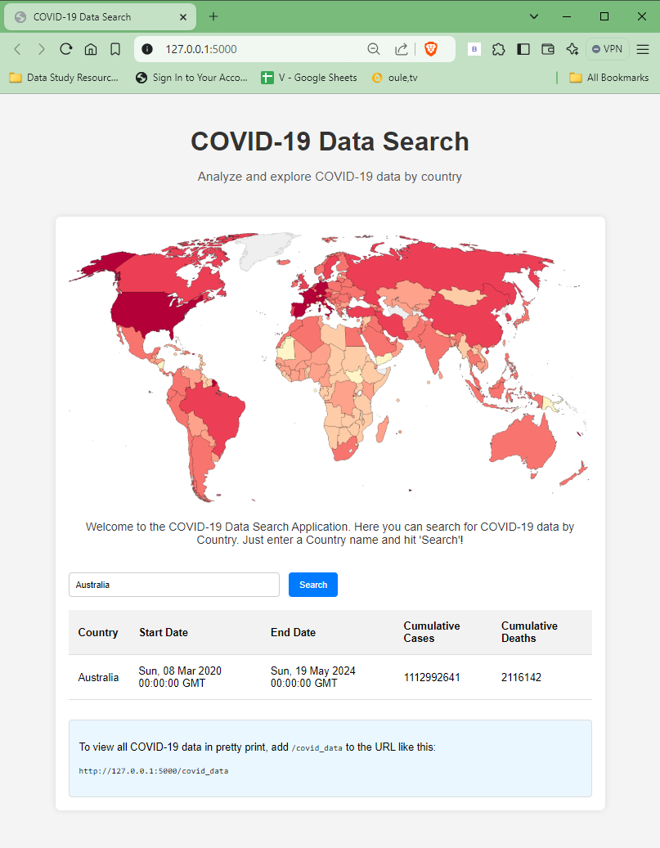
Flask (Patrick)
Notes:
Users can search for data by country, or view the results in a pandas DataFrame.
Flask served as the backbone of our web application and enabled us to create dynamic routes that query the PostgreSQL database in real-time, providing users with relevant data.

Slide 19
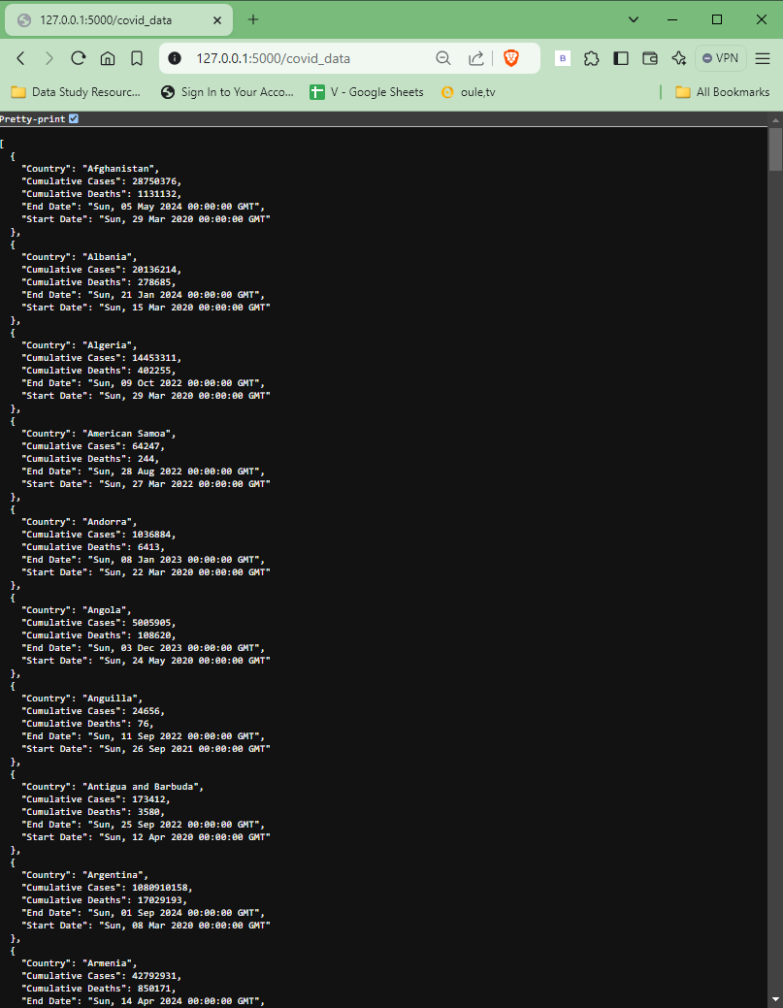
Flask (Patrick)
Notes:
The Flask application also includes a Restful API that outputs data in JSON format, making it easily consumable by other applications.
By integrating pandas, we were able to display the data in a user-friendly format, with visualizations and with the help of the Pyarrow library, we ensured that our data processing was both efficient and scalable.

Slide 20
Conclusion (Patrick)
In conclusion, our COVID-19 Data Search Application embodies effective data engineering practices, user-centric design, and ethical responsibility. It provides a reliable platform for exploring COVID-19 data, supporting informed decision-making and contributing to our understanding of data engineering.
In conclusion, our COVID-19 Data Search Application embodies effective data engineering practices,
user-centric design, and ethical responsibility. It provides a reliable platform for exploring COVID-19 data,
supporting informed decision-making and contributing to our understanding of data engineering.
Notes:
Conclusion:
In conclusion, our COVID-19 Data Search Application embodies effective data engineering practices,
user-centric design, and ethical responsibility. It provides a reliable platform for exploring COVID-19 data,
supporting informed decision-making and contributing to our understanding of data engineering.

Slide 21
Questions?
Q/A

Slide 22
Thank you

Slide 23
Thank You!
Amrit
Keegan
Mandeep
Patrick
Notes:
Our project focuses on leveraging data engineering techniques to analyze the trends and patterns of the COVID-19 pandemic.
In today’s presentation, we’ll walk you through the objectives of our project, the data extraction and transformation and loading processes, key findings, and actionable insights. Each team member will focus on a specific aspect of the project.
Let’s begin by discussing the project objective in more detail.

