Slide 1
Use of T_Tide Package

Slide 2
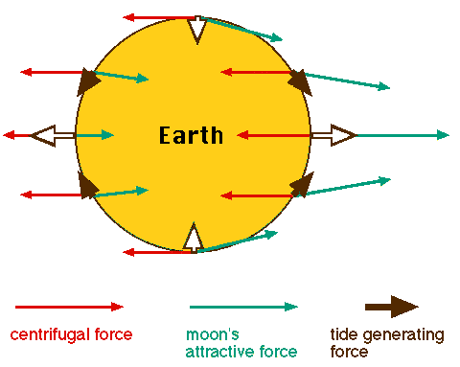
Tides and tidal current phenomena
Under the action of tidal force (the combined force of gravitational force and inertial centrifugal force of celestial bodies), sea water produces a periodic motion.
Tide - periodic rise and fall of sea level;
Tidal current - periodic horizontal flow of sea water.

Slide 3
Tides and tidal current phenomena
Tidal types:
F = ( K₁ + O₁ ) / ( M₂ + S₂ )
value of F | category
0 - 0.25 | semidiurnal
0.25 - 1.5 | mixed, mainly semidiurnal
1.5 - 3 | mixed, mainly diurnal
> 3 | diurnal

Slide 4
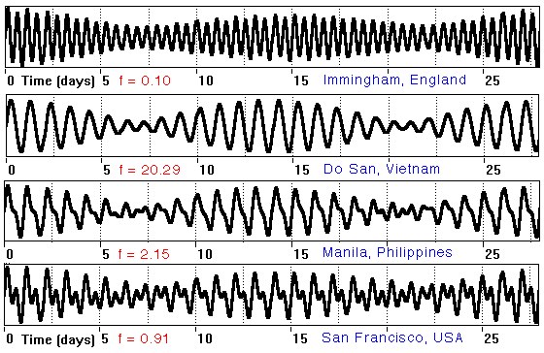
Tides and tidal current phenomena
semidiurnal
diurnal
mixed, mainly diurnal
mixed, mainly semidiurnal

Slide 5
Tidal harmonic constant
Tidal level can be expressed as the superposition of multiple tidal components:
S₀ : the average water level
t : time zone
f : the intersection factor of the tidal component
H : the average amplitude of the tidal component
σ : the frequency of the tidal component angle
: the initial phase angle of the equilibrium tidal component at Greenwich zero
g : the special delay angle for the area.
H and g are the tidal harmonic constants to be determined.

Slide 6
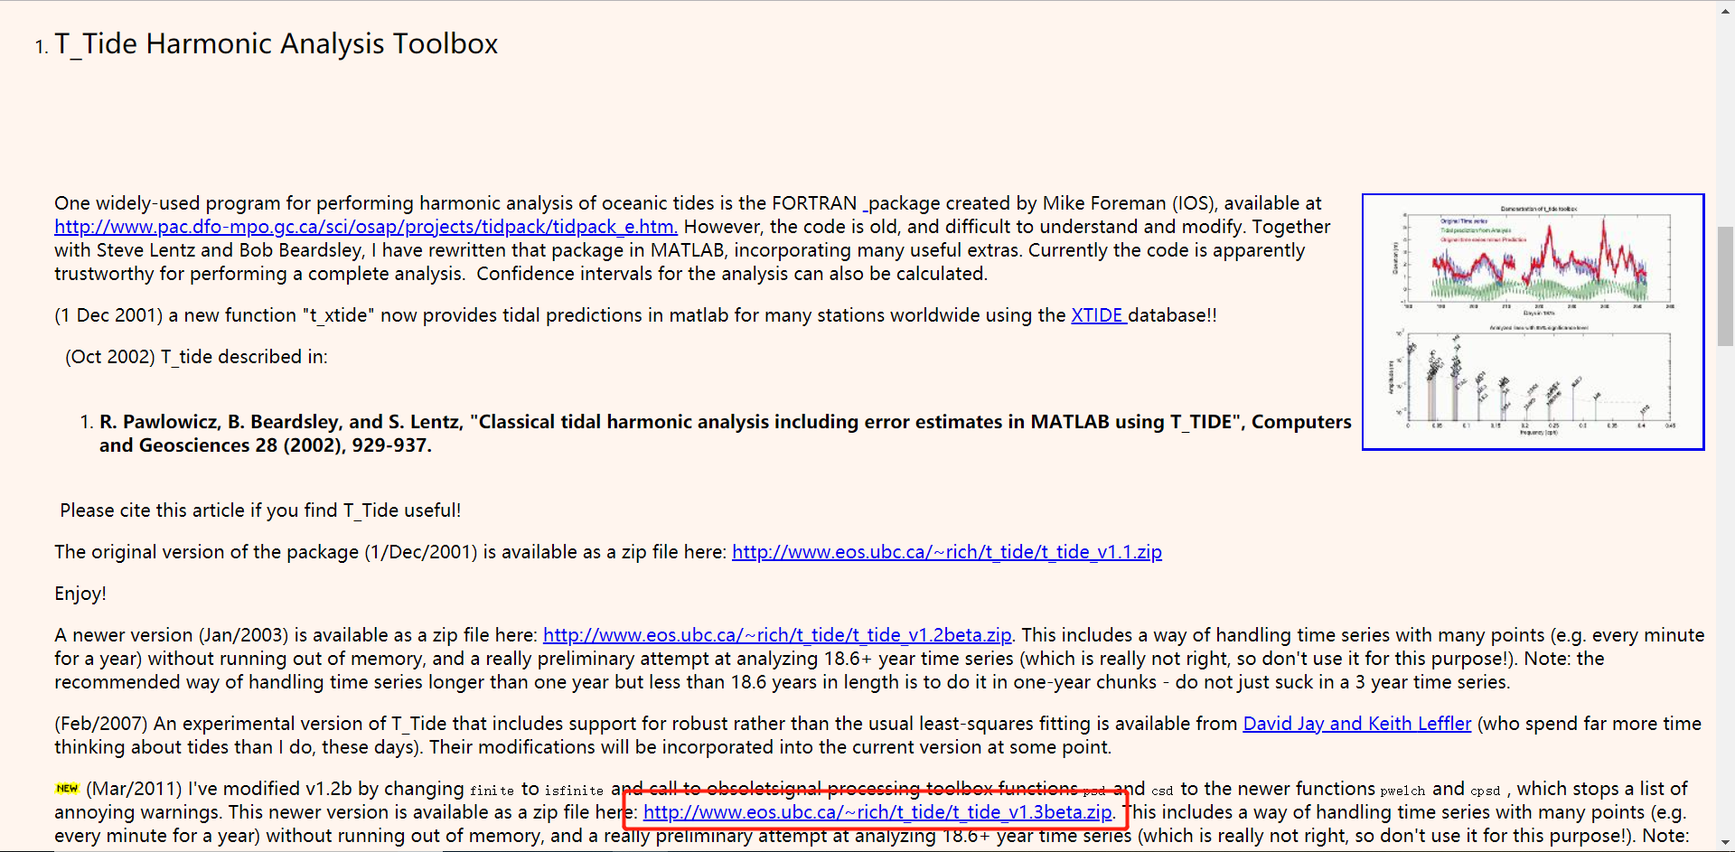
Download T_Tide
Search SEA-MAT or Google for T_Tide
Website: https://www.eoas.ubc.ca/~rich/#T_Tide
We can add t_tide folder to the search path of MATLAB
For Windows：C:\Program Files\MATLAB\R2017a\toolbox

Slide 7

Basic usage of T_Tide
T_Tide is mainly used for two functions:
Tidal harmonic analysis function t_tide and prediction function t_predic
Usage of t_tide ：
[NAME,FREQ,TIDECON,XOUT]=t_tide(XIN,INTERVAL,START_TIME,LATITUDE,RAYLEIGH)
Input Parameter：
XIN： Input tidal level variables
INTERVAL： Time interval, unit 1 hour
START_TIME： Start time (Greenwich time), e.g. [1975, 01, 01, 00]
LATITUDE：Latitude
RAYLEIGH：Output of specified tidal components, such as ['M2','S2','O1','K1']
Output Parameter ：
NAME：Tidal Name
FREQ：Angular velocity of tidal component （°/h）
TIDECON：The first is the amplitude of tidal component and the third is the delayed angle of tidal component.
XOUT：Harmonizing the tidal level of return (without average sea level)

Slide 8
Basic usage of T_Tide
t_prediction is the process of using the results of t_tide analysis as input parameters to predict.
Usage of t_tide ：
YOUT=t_predic(TIME,NAMES,FREQ,TIDECON,LATITUDE)
Input Parameter：
TIME：Time series
NAMES,FREQ,TIDECON：Output parameters corresponding to t_tide, respectively
LATITUDE：Latitude
Output Parameter ：
YOUT：Output tidal level (without average tidal level)

Slide 9
Examples of usage
Based on the harmonic analysis of the observed data from the North China Sea tide gauge station in 1975, the harmonic constants and other information obtained are used to forecast the 1976 tide level, and the accuracy is verified by comparing the drawings.
Tidal Level Information Website ：http://uhslc.soest.hawaii.edu/data/?rq#uh288a
Main Procedures ：
Harmonic analysis ：
[NAME,FREQ,TIDECON,XOUT]=t_tide(data,‘interval’,1,‘latitude’,latitude,‘start time’,[1975,01,01,00], 'rayleigh',['M2';'S2';'O1';'K1']);
prediction ：
ypre=t_predic(time,NAME,FREQ,TIDECON,latitude);
Drawing ：
plot(data);
hold on
plot(ypre+data_aver)；
hold off

Slide 10
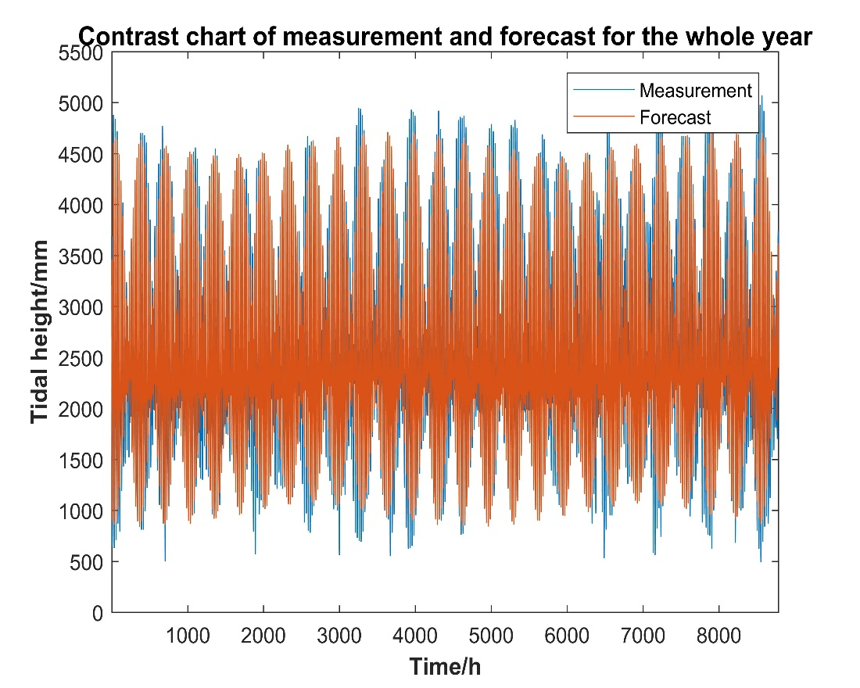
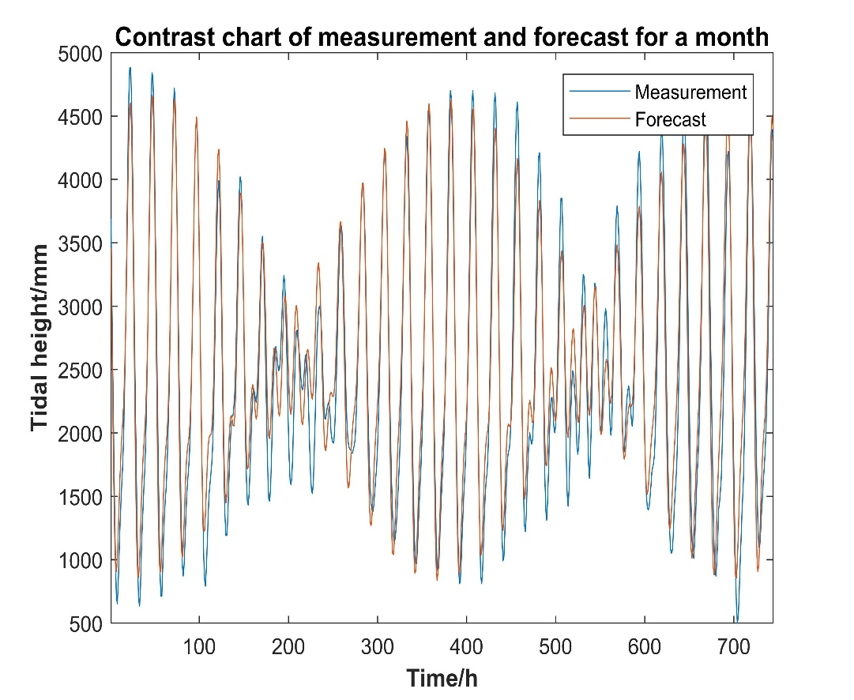
Drawing results
Annual comparison results
Interception of January comparison results
Getting Programs and T_Tide Tools：https://github.com/KeegenTang/tiaohefenxi

