Slide 1
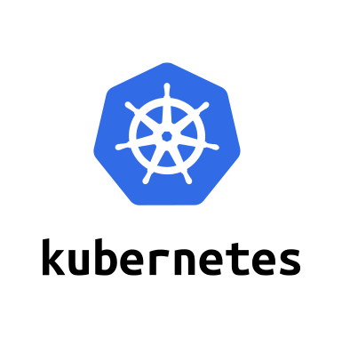

Introduction to Helm

Slide 2
Agenda
What is Helm?
Using Helm
Developing charts
Developing templates
Conclusion
Resources

Slide 3
What is Helm?

Slide 4
Helm – A package manager for Kubernetes
What is a package manager?
Automates the process of installing, configuring, upgrading, and removing computer programs
Examples: Red Hat Package Manager (RPM), Homebrew, Windows Pkgmgr/PackageManagement
Helm enables multiple Kubernetes resources to be created with a single command
Deploying an application often involves creating and configuring multiple resources
A Helm chart defines multiple resources as a set
An application in Kubernetes typically consists of (at least) two resource types
Deployment – Describes a set of pods to be deployed together
Services – Endpoints for accessing the APIs in those pods
Could also include ConfigMaps, Secrets, Ingress, etc.
A default chart for an application consists of a deployment template and a service template
The chart creates all of these resources in a Kubernetes cluster as a set
Rather than manually having to create each one separately via kubectl

Slide 5
Helm Terminology
Helm – The CLI
Helm installs charts into Kubernetes, creating a new release for each installation
To find new charts, search Helm chart repositories
Chart – The application package
Templates for a set of resources necessary to run an application
The chart includes a values file that configures the resources
Repository – The library
Storage for Helm charts
stable – The namespace of the hub for official charts
Release – The application runtime
An instance of a chart running in a Kubernetes cluster
The same chart installed multiple times creates many releases
Tiller – The server-side engine
Helm templating engine, runs in a pod in a Kubernetes cluster
Tiller processes the chart to generate the resource manifests, then installs the release into the cluster
Tiller stores each release as a Kubernetes config map
Chart (templates)
Values (config)
install
Kubernetes cluster
Release
(resources)
Tiller

Slide 6
Advantages of Using Helm
Deploy all of the resources for an application with a single command
Makes deployment easy and repeatable
$ helm install <chart>
Separates configuration settings from manifest formats
Edit the values without changing the rest of the manifest
values.yaml – Update to deploy the application differently
Upgrade a running release to a new chart version
$ helm upgrade <release> <chart>
Rollback a running release to a previous revision
$ helm rollback <release> <revision>
Delete a running release
$ helm delete <release>
Kubernetes cluster
Chart
myapp v1
install
Release
myapp r1
upgrade
rollback
Chart
myapp v2
(upgrade)
Release
myapp r2
delete

Slide 7
Installing Helm
Helm runs as a CLI client
Typically installed on your laptop
See Installing Helm
https://docs.helm.sh/using_helm/#installing-helm
Options for installing Helm
Download the release, including the binary
https://github.com/kubernetes/helm/releases
Homebrew on MacOS
brew install kubernetes-helm
Installer script
curl https://raw.githubusercontent.com/kubernetes/helm/master/scripts/get > get_helm.sh

Slide 8
Using Helm

Slide 9
Helm Commands
Install Tiller
$ helm init
Create a chart
$ helm create <chart>
List the repositories
$ helm repo list
Search for a chart
$ helm search <keyword>
Info about a chart
$ helm inspect <chart>
Deploy a chart (creates a release)
$ helm install <chart>
List all releases
$ helm list --all
Get the status of a release
$ helm status <release>
Get the details about a release
$ helm get <release>
Upgrade a release
$ helm upgrade <release> <chart>
Rollback a release
$ helm rollback <release> <revision>
Delete a release
$ helm delete <release>

Slide 10
Working with Repositories
$ helm repo list
NAME URL stable https://kubernetes-charts.storage.googleapis.com/
$ helm search jenkins
NAME VERSION DESCRIPTION stable/jenkins 0.1.14 A Jenkins Helm chart for Kubernetes.
$ helm repo add my-charts https://my-charts.storage.googleapis.com $ helm repo list
NAME URL stable https://kubernetes-charts.storage.googleapis.com/ my-charts https://my-charts.storage.googleapis.com

Slide 11
Installing an Application
To deploy an application into Kubernetes, install that application’s Helm chart
$ helm search mysql
NAME VERSION DESCRIPTION stable/mysql 0.1.1 Chart for MySQL
$ helm install stable/mysql
Fetched stable/mysql to mysql-0.1.1.tgz NAME: loping-toad LAST DEPLOYED: Thu Oct 20 14:54:24 2016 NAMESPACE: default STATUS: DEPLOYED
RESOURCES: ==> v1/Secret NAME TYPE DATA AGE loping-toad-mysql Opaque 2 3s
==> v1/Service NAME CLUSTER-IP EXTERNAL-IP PORT(S) AGE loping-toad-mysql 192.168.1.5 <none> 3306/TCP 3s
==> extensions/Deployment NAME DESIRED CURRENT UP-TO-DATE AVAILABLE AGE loping-toad-mysql 1 0 0 0 3s
==> v1/PersistentVolumeClaim NAME STATUS VOLUME CAPACITY ACCESSMODES AGE loping-toad-mysql Pending
Install output
Details about the release
Details about its resources
Chart
stable/mysql
Release name
loping-toad (auto generated)
Resources
Four total, one of each type
All named loping-toad-mysql
Secret
Service
Deployment
PersistentVolumeClaim

Slide 12
Overriding Values
Default values are stored in the chart
<chart-path>/values.yaml
Helm CLI uses Kubernetes CLI’s configuration to connect to your current cluster
~/.kube/config
$ kubectl config view
To specify a release’s name, use the name flag
$ helm install --name CustomerDB stable/mysql
To deploy the release into a particular Kubernetes namespace, use the namespace flag
$ helm install --namespace ordering-system stable/mysql
To override an individual value, use the set flag
$ helm install --set user.name='student',user.password='passw0rd' stable/mysql
To override values with a values file, use the values or f flag
$ helm install --values myvalues.yaml stable/mysql

Slide 13
Developing Charts

Slide 14
Creating a Chart
Creating a new chart generates a directory with sample files
$ helm create my-chart $ tree my-chart
my-chart/ # The content of this directory is the chart |- Chart.yaml # Information about the chart |- values.yaml # The default configuration values for this chart |- charts/ # Charts that this chart depends on |- templates/ # This chart's template files |- NOTES.txt # OPTIONAL: A plain text file containing short usage notes |- _helpers.tpl # OPTIONAL: The default location for template partials |- deployment.yaml # Sample template for a deployment resource |- service.yaml # Sample template for a service resource
By default, a chart starts with sample templates for a Kubernetes deployment and service
In the simplest case, just edit the values.yaml file

Slide 15
How Install Uses Charts
The main step of installing a chart is rendering its templates
How Helm installs a chart
User runs an install in the Helm CLI
$ helm install myapp
Helm CLI loads the chart into Tiller
Tiller renders the chart templates
Tiller loads the resulting resources into Kubernetes
Tiller returns the release data to the client
The client exits
Rendering the templates
Each template generates a Kubernetes resource manifest file (yaml)
Tiller runs each of the template files, generating the resource files
Tiller then loads the resources—as described by the manifests—into the Kubernetes cluster

Slide 16
Chart Lifecycle Hooks
Hooks
Hooks in the Helm Install Lifecycle
pre-install
Executes after templates are rendered
Before any resources are created in Kubernetes
post-install
Executes after all resources are loaded into Kubernetes
pre-delete
Executes before any resources are deleted from Kubernetes
post-delete
Executes after all of the release’s resources have been deleted
pre-upgrade
Executes after templates are rendered
Before any resources are loaded into Kubernetes
post-upgrade
Executes after all resources have been upgraded
pre-rollback
Executes after templates are rendered
Before any resources have been rolled back
post-rollback
Executes after all resources have been modified
User runs an install in the Helm CLI
Helm CLI loads the chart into Tiller
Tiller renders the chart templates
Tiller executes the pre-install hooks
Tiller loads the resulting resources into Kubernetes
Tiller executes the post-install hook
Tiller returns the release data to the client
The client exits
A hook can be any Kubernetes resource
A hook is often a Kubernetes job
Goes in the templates directory

Slide 17
Sharing Charts
A chart is a directory
Easy for a Helm client to use the chart directories on the same computer
Difficult to share with other users on other computers
Packaging a chart
Bundle Chart.yaml and related files into a tar file
$ helm package <chart-path> # Bundles chart directory into a tar file
$ helm install <chart-name>.tgz # Installs the chart in the chart file
Chart repository
HTTP server that houses an index.yaml file and optionally some packaged charts
Server can be any HTTP server that can serve YAML and tar files and can answer GET requests
Ex: Google Cloud Storage (GCS) bucket, Amazon S3 bucket, Github Pages, or even create your own web server
To add a chart to the repository, copy it to the directory and regenerate the index
$ helm repo index <charts-path> # Generates an index of the charts in the repo

Slide 18
Developing Templates

Slide 19
Creating Templates
The main aspect of implementing a chart is implementing its templates
A related task: Create and populate the files that contain the settings used by the templates
These settings files, particularly values.yaml, define the chart’s API
The settings files list the variables the templates can use, therefore the only values worth changing
Examples of chart templates can be found in https://github.com/kubernetes/charts/
Each file is a Golang template
Includes functions from the Sprig template library
A template can create the manifest for any type of Kubernetes resource
Each file in a chart’s templates directory is expected to be a template
Expected to generate a Kubernetes resource manifest
Filename can be anything, should describe the resource it defines
Exception: The notes file (i.e. NOTES.txt) provides instructions to the chart’s users
Exception: Files whose names begin with an underscore (e.g. _helpers.tpl) are expected to contain partials

Slide 20
Chart Template for Deployment Manifest
Kubernetes Deployment Manifest
Helm Deployment Template
apiVersion: apps/v1beta1
kind: Deployment
metadata:
name: nginx-deployment
spec:
replicas: 3
template:
metadata:
labels:
app: nginx
spec:
containers:
- name: nginx
image: nginx:1.7.9
ports:
- containerPort: 80
apiVersion: apps/v1beta1
kind: Deployment
metadata:
name: {{ template "fullname" . }}
labels:
app: {{ template "name" . }}
chart: {{ .Chart.Name }}-{{ .Chart.Version }}
heritage: {{ .Release.Service }}
release: {{ .Release.Name }}
spec:
replicas: {{ .Values.replicaCount }}
template:
metadata:
{{- if .Values.podAnnotations }}
annotations:
{{ toYaml .Values.podAnnotations | indent 8 }}
{{- end }}
labels:
app: {{ template "name" . }}
release: {{ .Release.Name }}
spec:
containers:
- name: {{ template "name" . }}
image: "{{ .Values.image.repository }}:{{ .Values.image.tag }}"
imagePullPolicy: {{ .Values.image.pullPolicy }}
ports:
- name: http
containerPort: 80
protocol: TCP
. . .

Slide 21
Chart Template for Service Manifest
Kubernetes Service Manifest
Helm Service Template
apiVersion: v1
kind: Service
metadata:
name: my-service
spec:
selector:
app: MyApp
ports:
- protocol: TCP
port: 80
targetPort: 9376
apiVersion: v1
kind: Service
metadata:
{{- if .Values.service.annotations }}
annotations: {{ toYaml .Values.service.annotations | indent 4 }}
{{- end }}
name: {{ template "fullname" . }}
labels:
app: {{ template "name" . }}
chart: {{ .Chart.Name }}-{{ .Chart.Version }}
heritage: {{ .Release.Service }}
release: {{ .Release.Name }}
spec:
selector:
app: {{ template "name" . }}
release: {{ .Release.Name }}
ports:
- name: http
protocol: TCP
port: {{ .Values.service.port }}
targetPort: http
{{- if (and (eq .Values.service.type "NodePort") ...) }}
nodePort: {{ .Values.service.nodePort }}
{{- end }}
. . .

Slide 22
Values YAML – A Chart’s API
Values (values.yaml)
Helm Deployment Template
replicaCount: 1
restartPolicy: Never
# Evaluated by the post-install hook
sleepyTime: "10"
index: >-
<h1>Hello</h1>
<p>This is a test</p>
image:
repository: nginx
tag: 1.11.0
pullPolicy: IfNotPresent
service:
annotations: {}
clusterIP: ""
externalIPs: []
loadBalancerIP: ""
loadBalancerSourceRanges: []
type: ClusterIP
port: 8888
nodePort: ""
podAnnotations: {}
resources: {}
nodeSelector: {}
. . .
spec:
replicas: {{ .Values.replicaCount }}
template:
metadata:
{{- if .Values.podAnnotations }}
annotations:
{{ toYaml .Values.podAnnotations | indent 8 }}
{{- end }}
. . .
Helm Service Template
. . .
spec:
ports:
- name: http
protocol: TCP
port: {{ .Values.service.port }}
targetPort: http
{{- if (and (eq .Values.service.type "NodePort") ...) }}
nodePort: {{ .Values.service.nodePort }}
{{- end }}
. . .

Slide 23
Chart YAML – A Chart’s Meta Information
Chart (Chart.yaml)
Helm Template
name: nginx
description: A basic NGINX HTTP server
version: 0.1.0
keywords:
- http
- nginx
- www
- web
home: https://github.com/kubernetes/helm
sources:
- https://hub.docker.com/_/nginx/
maintainers:
- name: technosophos
email: mbutcher@deis.com
. . .
metadata:
{{- if .Values.service.annotations }}
annotations: {{ toYaml .Values.service.annotations | indent 4 }}
{{- end }}
name: {{ template "fullname" . }}
labels:
app: {{ template "name" . }}
chart: {{ .Chart.Name }}-{{ .Chart.Version }}
heritage: {{ .Release.Service }}
release: {{ .Release.Name }}
. . .

Slide 24
Chart Template Helpers – More Default Settings
Helpers (templates/_helpers.tpl)
{{/* vim: set filetype=mustache: */}}
{{/* Expand the name of the chart. */}}
{{- define "name" -}}
{{- default .Chart.Name .Values.nameOverride | trunc 63 | trimSuffix "-" -}}
{{- end -}}
{{/* Create a default fully qualified app name. We truncate at 63 chars because . . . */}}
{{- define "fullname" -}}
{{- $name := default .Chart.Name .Values.nameOverride -}}
{{- printf "%s-%s" .Release.Name $name | trunc 63 | trimSuffix "-" -}}
{{- end -}}
Helm Template
. . .
metadata:
name: {{ template "fullname" . }}
labels:
app: {{ template "name" . }}
chart: {{ .Chart.Name }}-{{ .Chart.Version }}
heritage: {{ .Release.Service }}
release: {{ .Release.Name }}
. . .

Slide 25
Chart Predefined Values – More Default Settings
Predefined Values
Helm Template
Release – Information about the release being created
Release.Name – The name of the release (not the chart)
Release.Service – The service that conducted the release
Usually this is Tiller
Release.Revision – The revision number
It begins at 1, and increments with each helm upgrade
Lots of other Release values
Chart – The contents of the Chart.yaml
Chart.Name – The chart name
Chart.Version – The chart version
Chart.Maintainers – The maintainers
Etc.
Files – Map of all non-special files in the chart
Capabilities – Map of info about Kubernetes and Helm
Capabilities.KubeVersion – Version of Kubernetes
Capabilities.TillerVersion – Version of Tiller
Capabilities.APIVersions – Kubernetes API versions
Template – Information about the current template
. . .
metadata:
{{- if .Values.service.annotations }}
annotations: {{ toYaml .Values.service.annotations | indent 4 }}
{{- end }}
name: {{ template "fullname" . }}
labels:
app: {{ template "name" . }}
chart: {{ .Chart.Name }}-{{ .Chart.Version }}
heritage: {{ .Release.Service }}
release: {{ .Release.Name }}
. . .

Slide 26
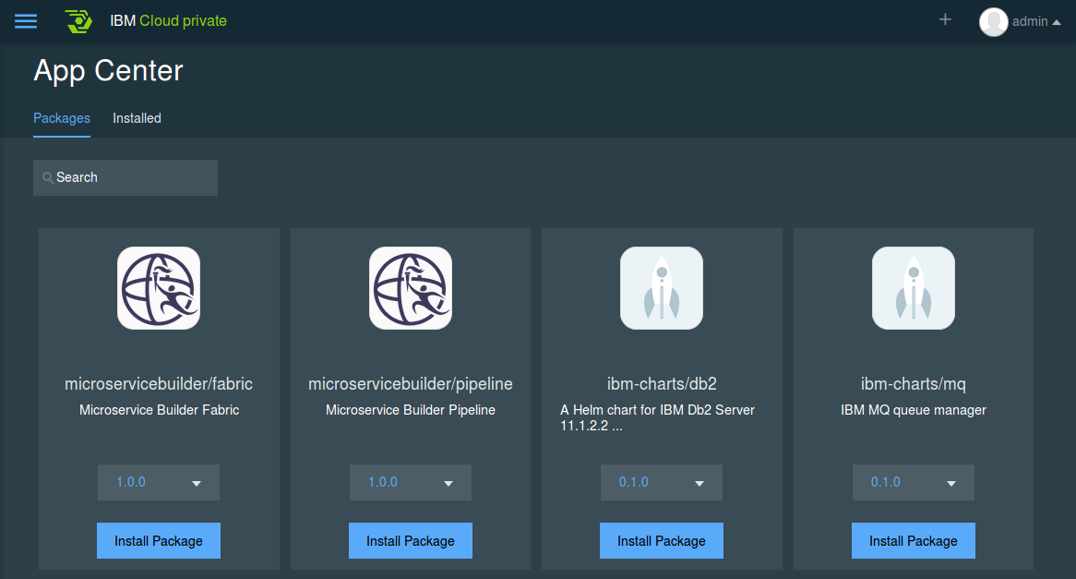
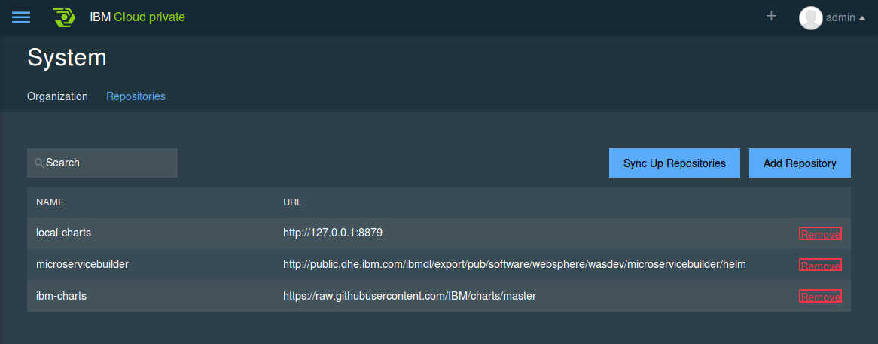
Helm and IBM Cloud Private
AppCenter entries are helm charts that can be deployed from the chart repositories.

Slide 27
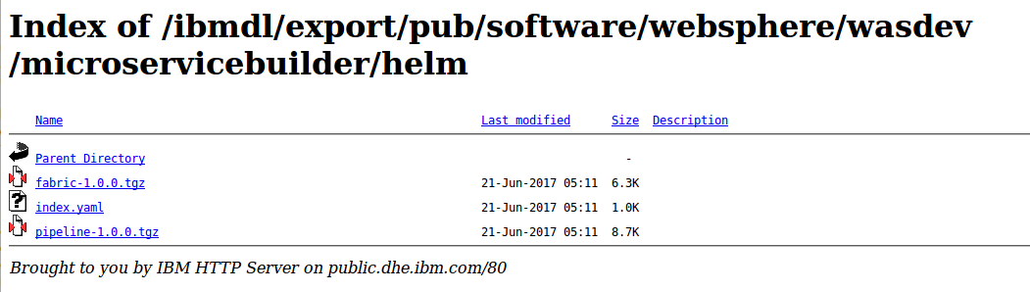
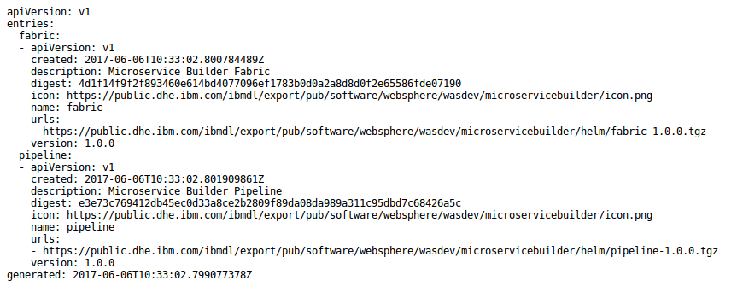
Chart repository
Chart repository:
HTTP server that houses an index.yaml file and optionally some packaged charts
Server can be any HTTP server that can serve YAML and tar files and can answer GET requests
To serve a local repo
$ helm serve
To add a chart to the repository, copy it to the directory and regenerate the index
$ helm repo index <charts-path>

Slide 28
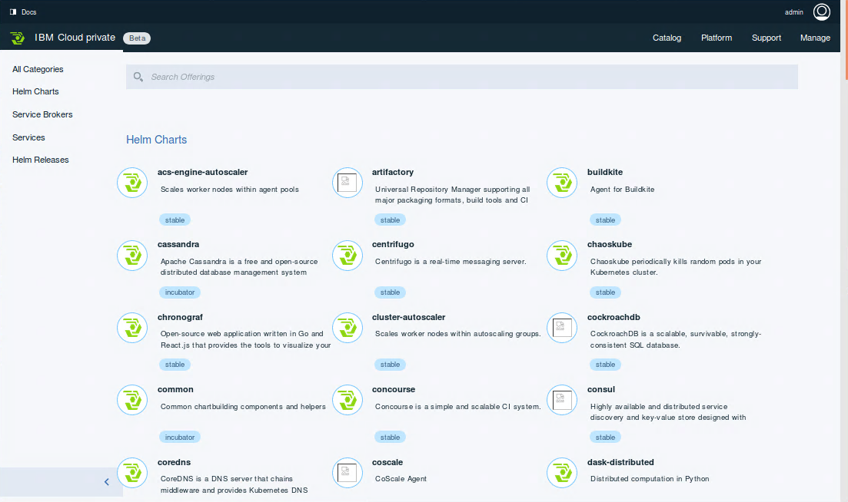
IBM Cloud Private catalog
https://<master>:8443/catalog

Slide 29
Conclusion

Slide 30
Conclusion
What is Helm?
Using Helm
Developing charts
Developing templates

Slide 31
Resources – Introduction
Helm - The Kubernetes Package Manager
https://helm.sh
https://docs.helm.sh
https://github.com/kubernetes/helm
https://github.com/kubernetes/helm/blob/master/docs/index.md
Taking the Helm: Delivering Kubernetes-Native Applications by Michelle Noorali (KubeCon 2016)
https://www.youtube.com/watch?v=zBc1goRfk3k
Installing Helm
https://docs.helm.sh/using_helm/#installing-helm

Slide 32
Resources – Developing Charts
Helm examples
https://github.com/kubernetes/helm/tree/master/docs/examples
Stable Helm charts
https://github.com/kubernetes/charts/tree/master/stable
Golang templates
https://golang.org/pkg/text/template
Sprig template library
https://godoc.org/github.com/Masterminds/sprig
Getting Started Authoring Helm Charts
https://deis.com/blog/2016/getting-started-authoring-helm-charts
How to Create Your First Helm Chart
https://docs.bitnami.com/kubernetes/how-to/create-your-first-helm-chart
Packaged Kubernetes Deployments – Writing a Helm Chart
https://www.influxdata.com/packaged-kubernetes-deployments-writing-helm-chart

