Slide 1
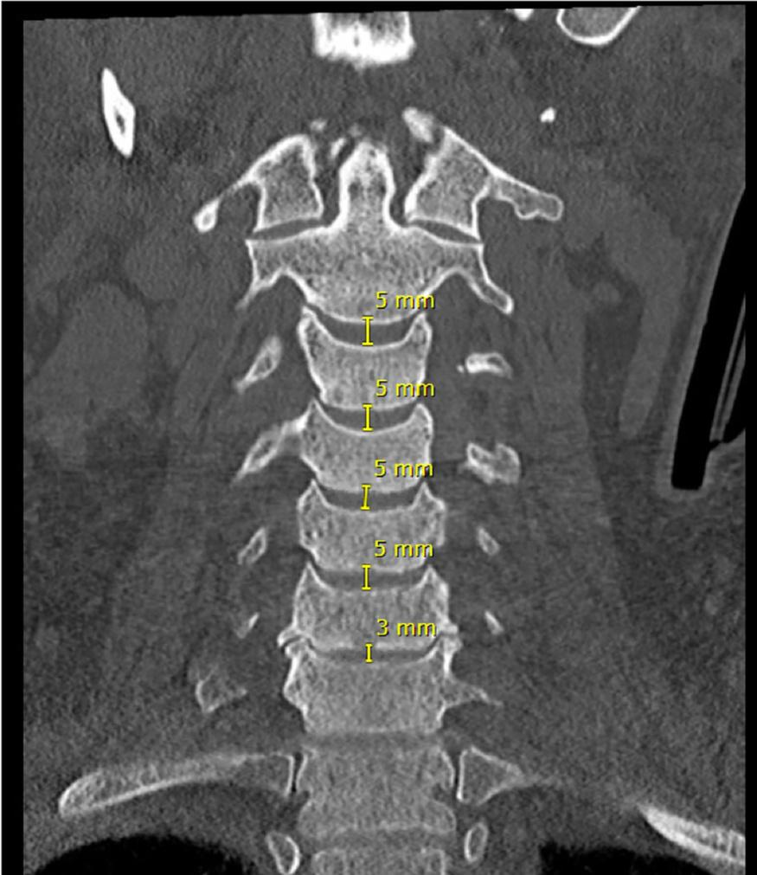
Cervical Spine Fracture Detection
Team FineSpine : Himanshu, Aayush, Saurabh

Slide 2
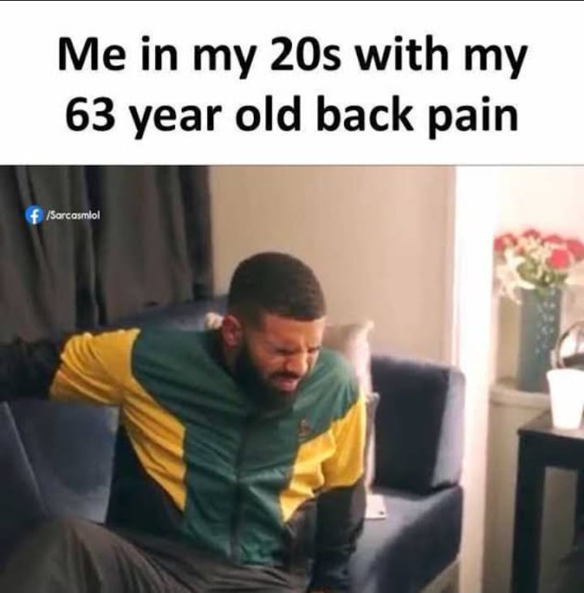
Problem Definition
There has been a rise in the incidence of spinal fractures in the elderly and in this population, fractures can be more difficult to detect on imaging due to superimposed degenerative disease and osteoporosis.
Quickly detecting and determining the location of any vertebral fractures is essential to prevent neurologic deterioration and paralysis after trauma.

Slide 3

Proposed Solution
Creating an application that assists radiologists with Cervical Spine Fracture detection.
Improve fracture detection accuracy.
Reduce reporting time.
Reduce workload.

Slide 4
Project Scope
Proof Of Concept (POC)
Prototype
Minimum Viable Product (MVP)
Work on the RSNA kaggle competition
Perform EDA
Experiment on some baseline models.
Compare models on different metrics. (ROC/AUC/Inference)
Segmentation and Explainable AI
Create a mockup of screens to see how the app could look like
Deploy one model to Fast API to service model predictions as an API
Create an app to detect cervical spine fracture
API Server for uploading CT scan and predicting and segmenting the fracture.

Slide 5
Data
We are using the data provided by RSNA kaggle challenge
It has 2019 CT scans(dicom and nii files ~300 GB)
Label Counts:
fractured vertebrae: 1058
normal vertebrae: 961

Slide 6
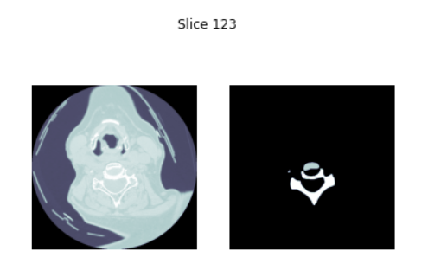

DICOM and NIFTI files
.dcm - DICOM file: A DCM file is an image file saved in the Digital Imaging and Communications in Medicine (DICOM) image format. It stores a medical image, such as a CT scan or ultrasound, and may also include patient information to pair the image with the patient.
.nii - NIFTI file format - A nibabel image object is the association of three things:an N-D array containing the image data;a (4, 4) affine matrix mapping array coordinates to coordinates in some RAS+ world coordinate space (Coordinate systems and affines);image metadata in the form of a header.
DICOM NIFTI

Slide 7
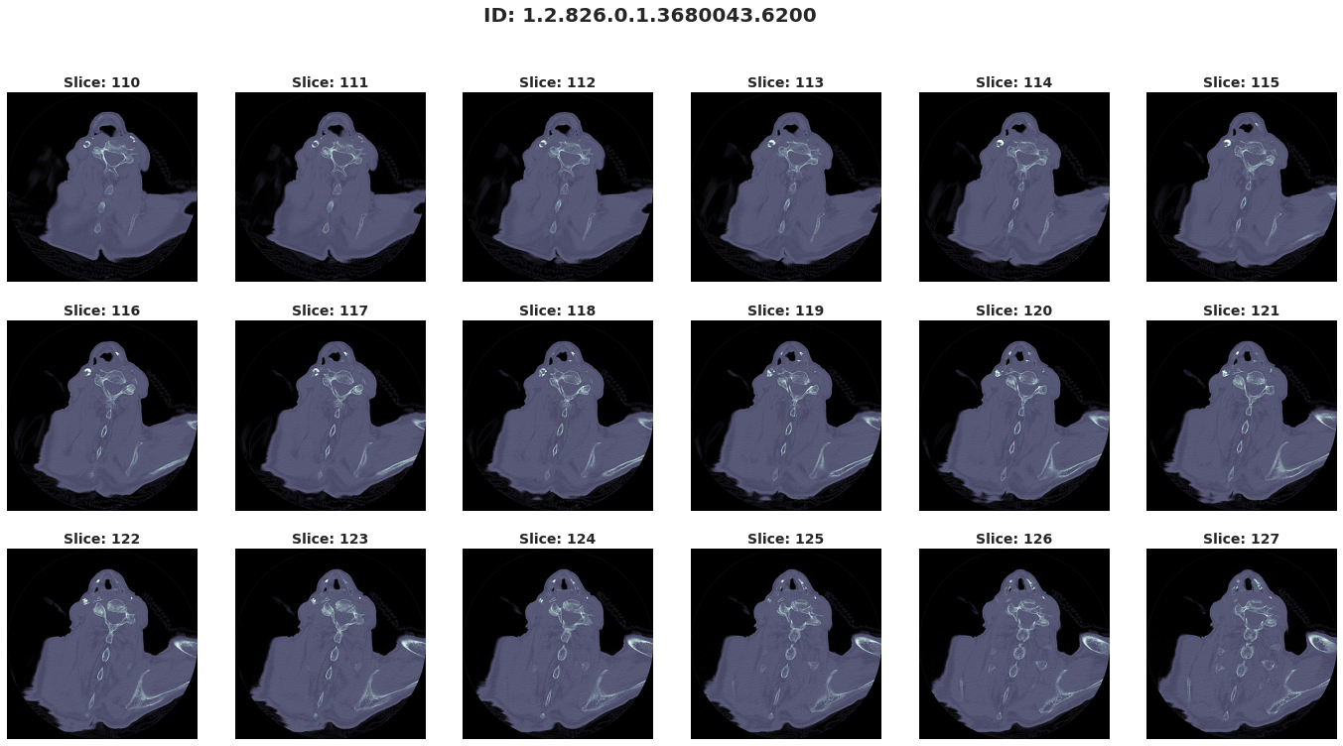
Data
Input data (.dcm and .nii files) are slices of the vertebrae in axial plane.

Slide 8
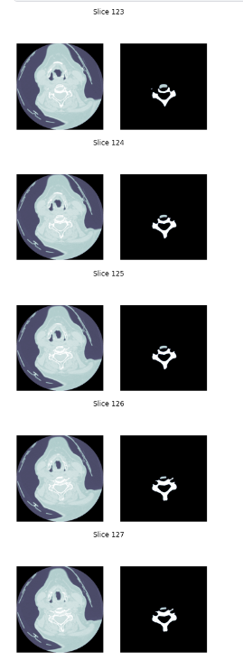
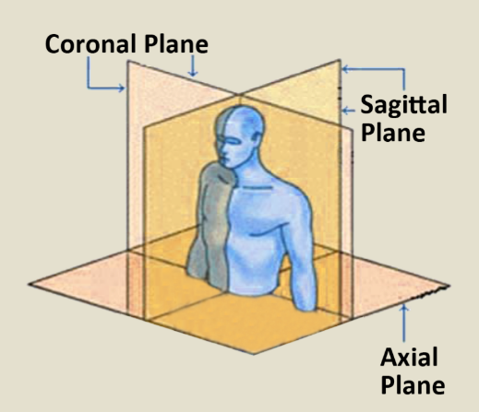
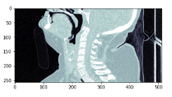
Data Preprocessing
Convert Spinal Cord images from axial plane to Sagittal plane

Slide 9
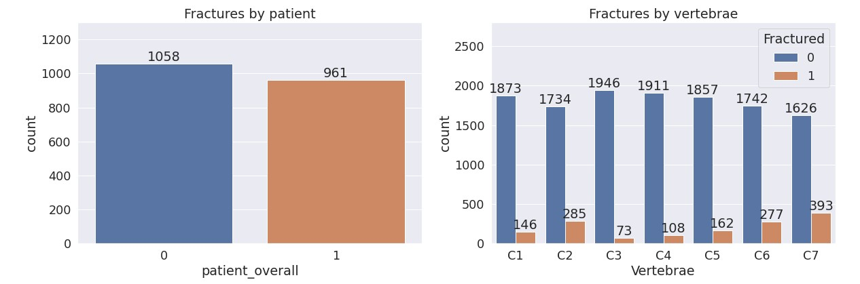
EDA
The overall target is roughly balanced (52/48 split).
C7 has the highest proportion of fractures (19%) whereas C3 has the lowest (4%).

Slide 10
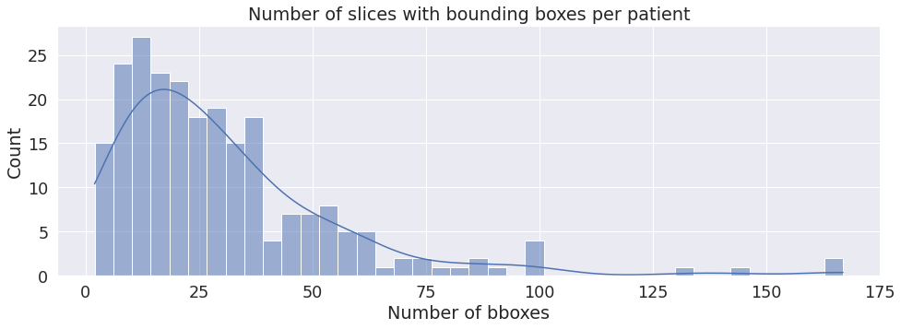
EDA
We are only given bounding boxes for a subset of the data. In particular, only 12% of patients in the train set have any bounding box measurements.
This information is useful in telling us exactly where the fractures have occured.

Slide 11
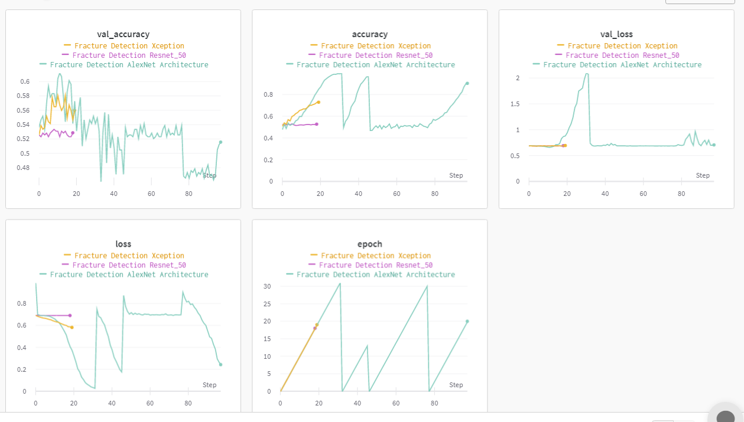
Fracture Detection
Sr. No | Model | Validation Accuracy
1. | Exception | 60%
2. | Resnet | 55%
3. | EfficientNet | 52.8%
4. | ConvNet model v1 | 61%
5. | ConvNet model v2 | 47.6%
6. | AlexNet | 47.6%

Slide 12
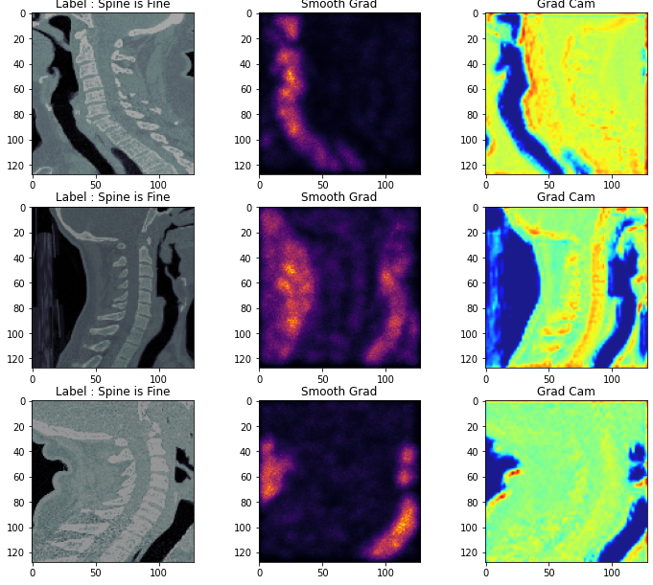
GradCam & Smooth Grad

Slide 13
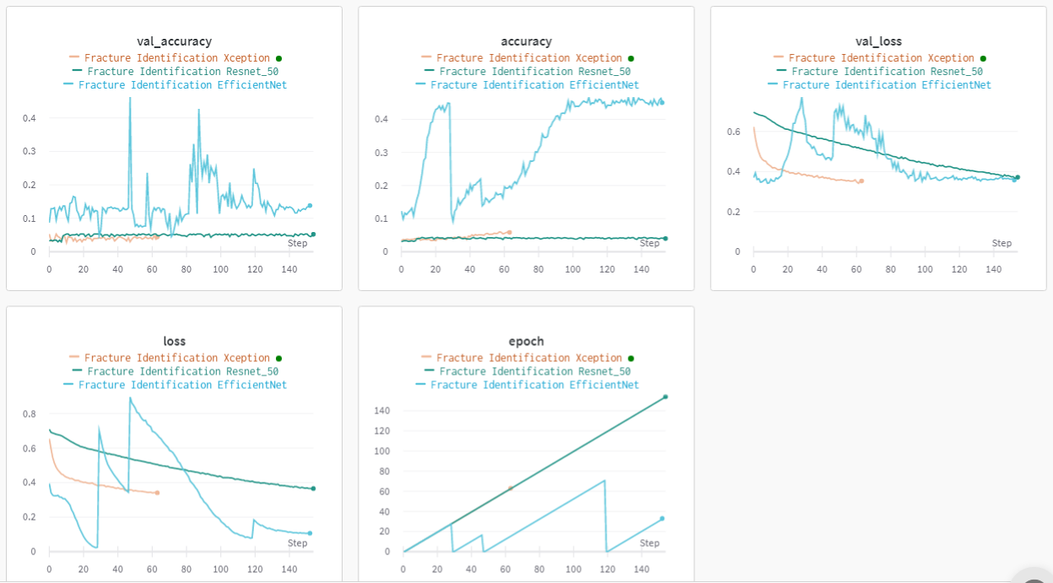
Fracture Identification
Sr. No | Model | Validation Accuracy
1. | Exception | 6%
2. | Resnet | 5.2%
3. | EfficientNet | 7.6%
4. | ConvNet model v1 | 13.3%
5. | ConvNet model v2 | 12.9%
6. | AlexNet | 20.5%

Slide 14



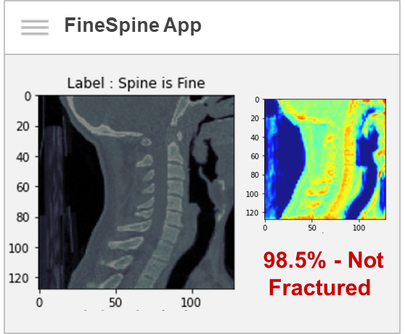
Screenflow & Wireframes
FineSpine App
FineSpine App
Upload photos or zip file
ADMIN LOGIN
USER LOGIN
UPLOAD
USER LOGIN
FineSpine App
Patient ID
Predict
CHECK
Retrieve

Slide 15
Solution Architecture
Collect data from Kaggle
Data Processing and EDA
Model training/tuning
Upload dicom files
View prediction and explainability results
Build App
Process (People)
Request customer id and extract customer dicom files from GCP
Apply same preprocessing steps
Use the best model to make prediction
Return results to user
Spine Fracture or not
Show model explainability
Execution (Code)
Save images to GCP bucket
Save model weights
Information on preprocessing
State (Source, Data, Models)

Slide 16



Solution Architecture - Group 18 - FineSpine
Process
Develop App
EDA + Model training
Upload picture
Post Patient ID, view predictions and Explainability
Execution
(HTTP / SSH)
(Human Interactions)
(Human Interactions)
Colab
Frontend
Notebooks
FineSpine App
(HTTP)
Backend
(HTTP)
Data Collector
Model Tracking
API Service
State
(Protocol specific)
Source Control
Image Store
Model Store

Slide 17
Technical Architecture
Developers
Data Scientists
Users
IDE/ CLI
Browser
Browser
HTTPS 443
HTTP 80
Colab
Source Control
Single Compute Instance/ Kubernetes Cluster
GitHub
Notebooks
HTTP 80
HTTP 9000
NGINX Container
HTTP 3000
GCP
HTTPS 443
Google Container Registry
API Service Container
FineSpine App
Container
GCS Bucket
FineSpine App
Models
HTTPS 443
API Service Image
HTTPS 443

Slide 18



GCS Bucket
Data & Models
Terminal
Browser
REST / JSON
HTML
Download Images Container
API Service Container
Frontend App Container
Mount
Mount
Mount
Source Code
Source Code
Source Code
Mount
Mount
Persistent Folder
Secrets

Slide 19
Wireframe Demo (Figma)
We have created a simple wireframe for our FineSpine app using Figma.
Go to the link
Click on the clickable tabs (user/admin login) to navigate through the pages
Press R to go back to the main page
Click here

Slide 20
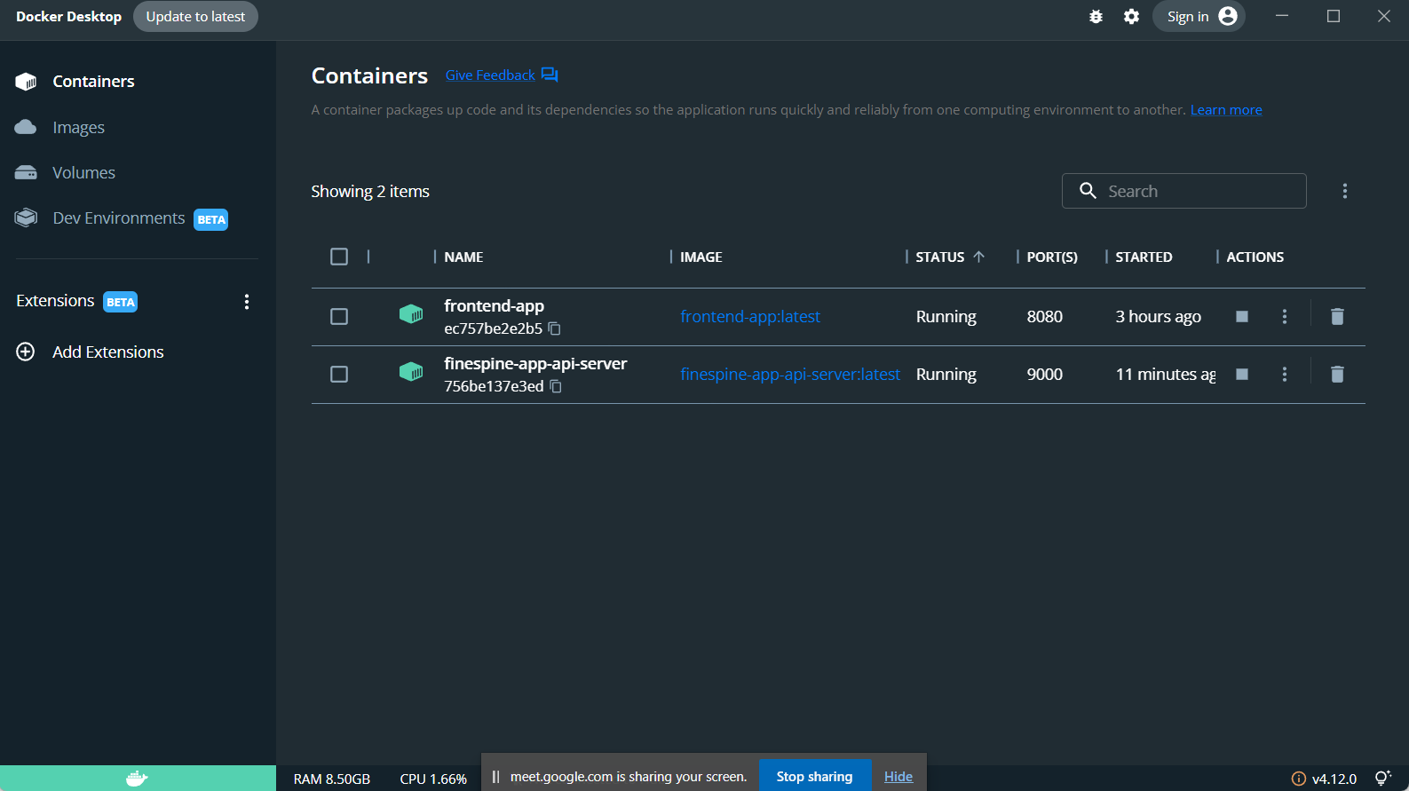
Running Containers

Slide 21
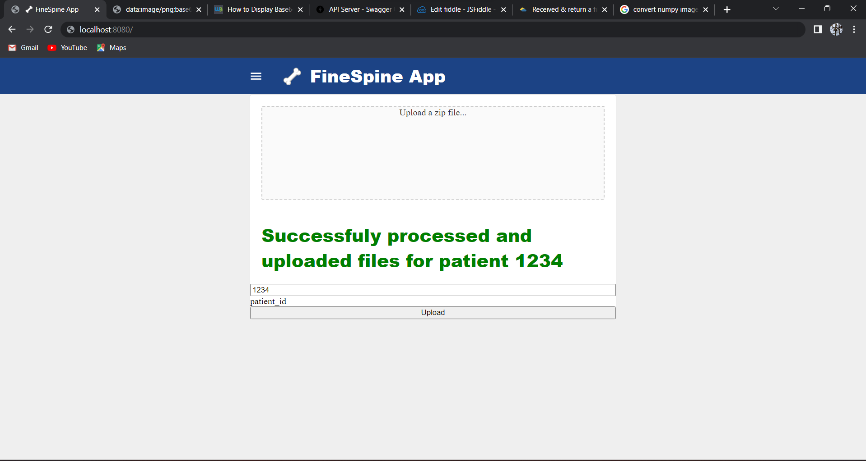
Upload Page

Slide 22
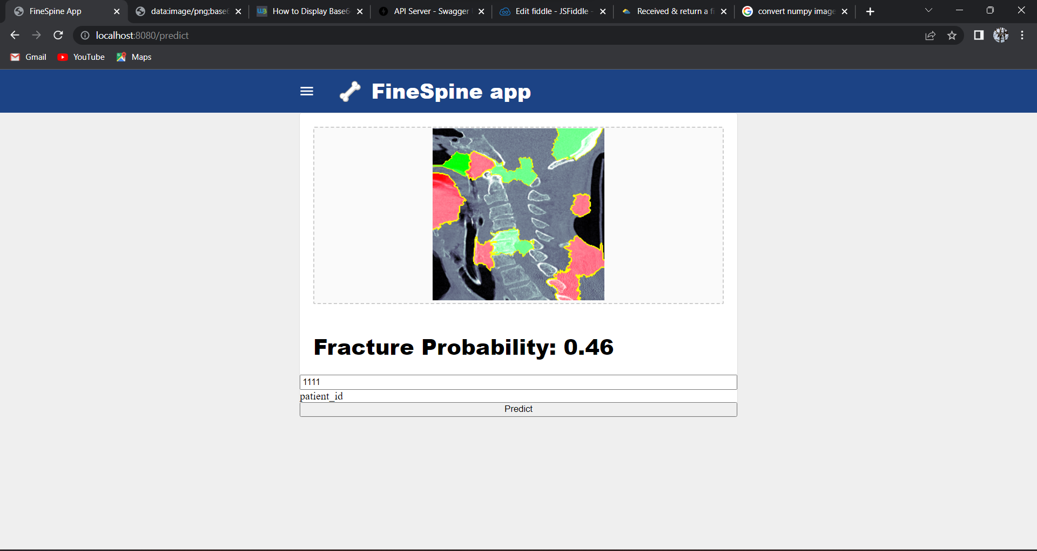
Predict Page

Slide 23
THANK YOU

