Slide 1
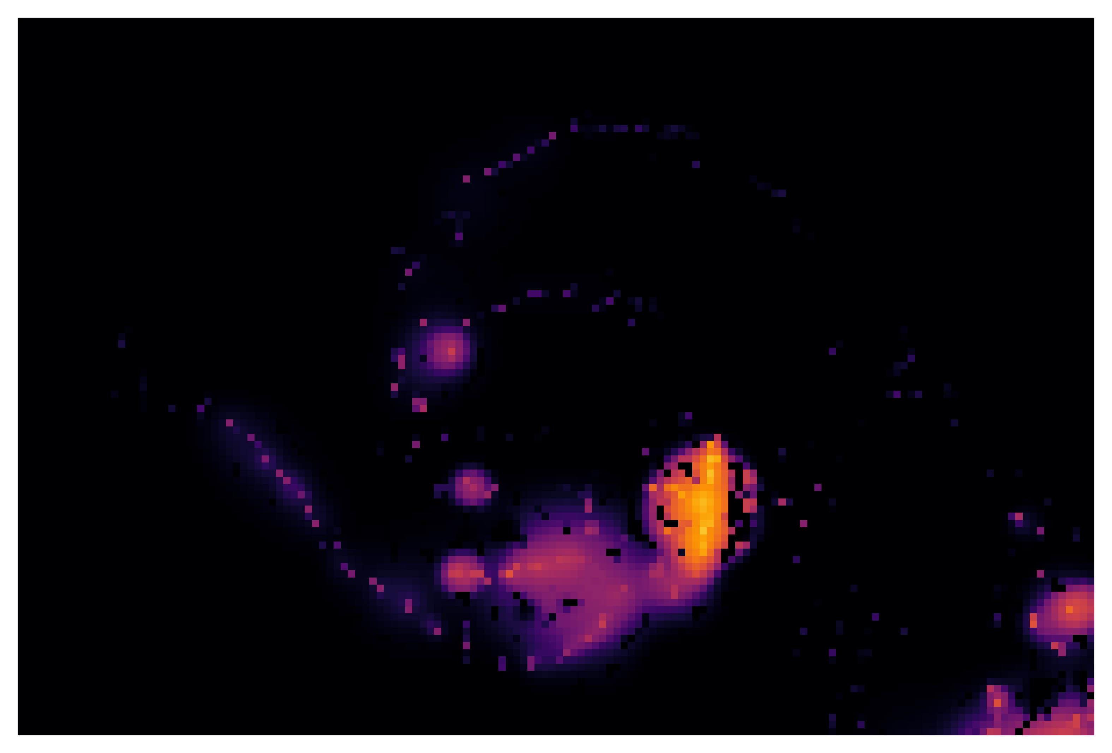

Machine Learns to CLEAN
Keenan Fiedler - 06 August 2025

Slide 2
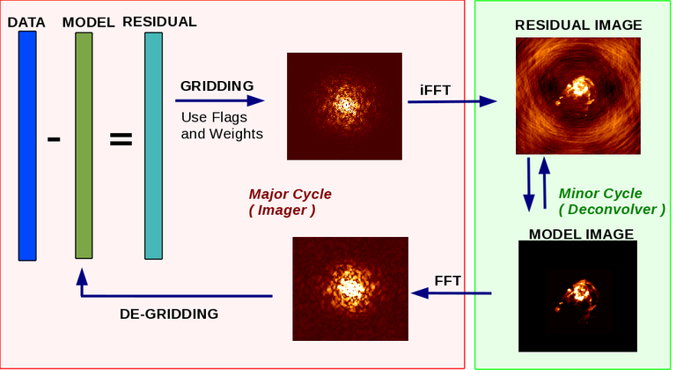
Deconvolution with CLEAN
Image Credit: The CASA Team et al.
Machine Learns to CLEAN • 06 August 2025
Notes:
General process of making synthesized images – Jonathan talked about gridding last week
I am focusing on deconvolver, trying to make a faster way to get more accurate deconvolutions
Major difference between deconvolvers is …->

Slide 3
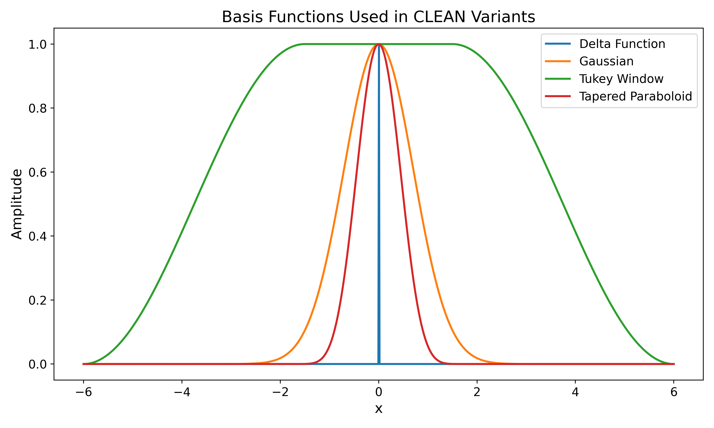
Basis Functions of Deconvolvers
Different bases for different deconvolvers
More flexible basis compounds computation cost
Also increased accuracy
Machine Learns to CLEAN • 06 August 2025
Notes:
Major difference is the basis function use, and how much flexibility in that basis function you have
Higher flexibility and complexity of basis function -> higher compute
Hogbom uses delta functions -> extremely low complexity
MS uses gaussian of specific scales, Asp can adjust the sigma of gaussian to fit best
Others allow changing of shape of gaussian, other basiss functions, shapeelts, wavelets etc.
For me, want to bridge the first gap – hogbom to multiscale

Slide 4
Goals
Create a neural network that can
Mimic accuracy effects of MS CLEAN from Högbom CLEAN
Reduce computational cost of MS CLEAN accuracy
Generalize to more than the data it is trained on
Insert model into CLEAN algorithm
Run Högbom until threshold
Run neural network and generate new multiscale-like model image
Run Högbom again to deal with effects of neural network
Machine Learns to CLEAN • 06 August 2025
Notes:
Generalizes since it converts directly hogbom to multiscale, doesn’t learn shape of say radio galaxies, learns relations between hogbom/multiscale components
Even full running of hogbom basically twice should be faster than multiscale

Slide 5
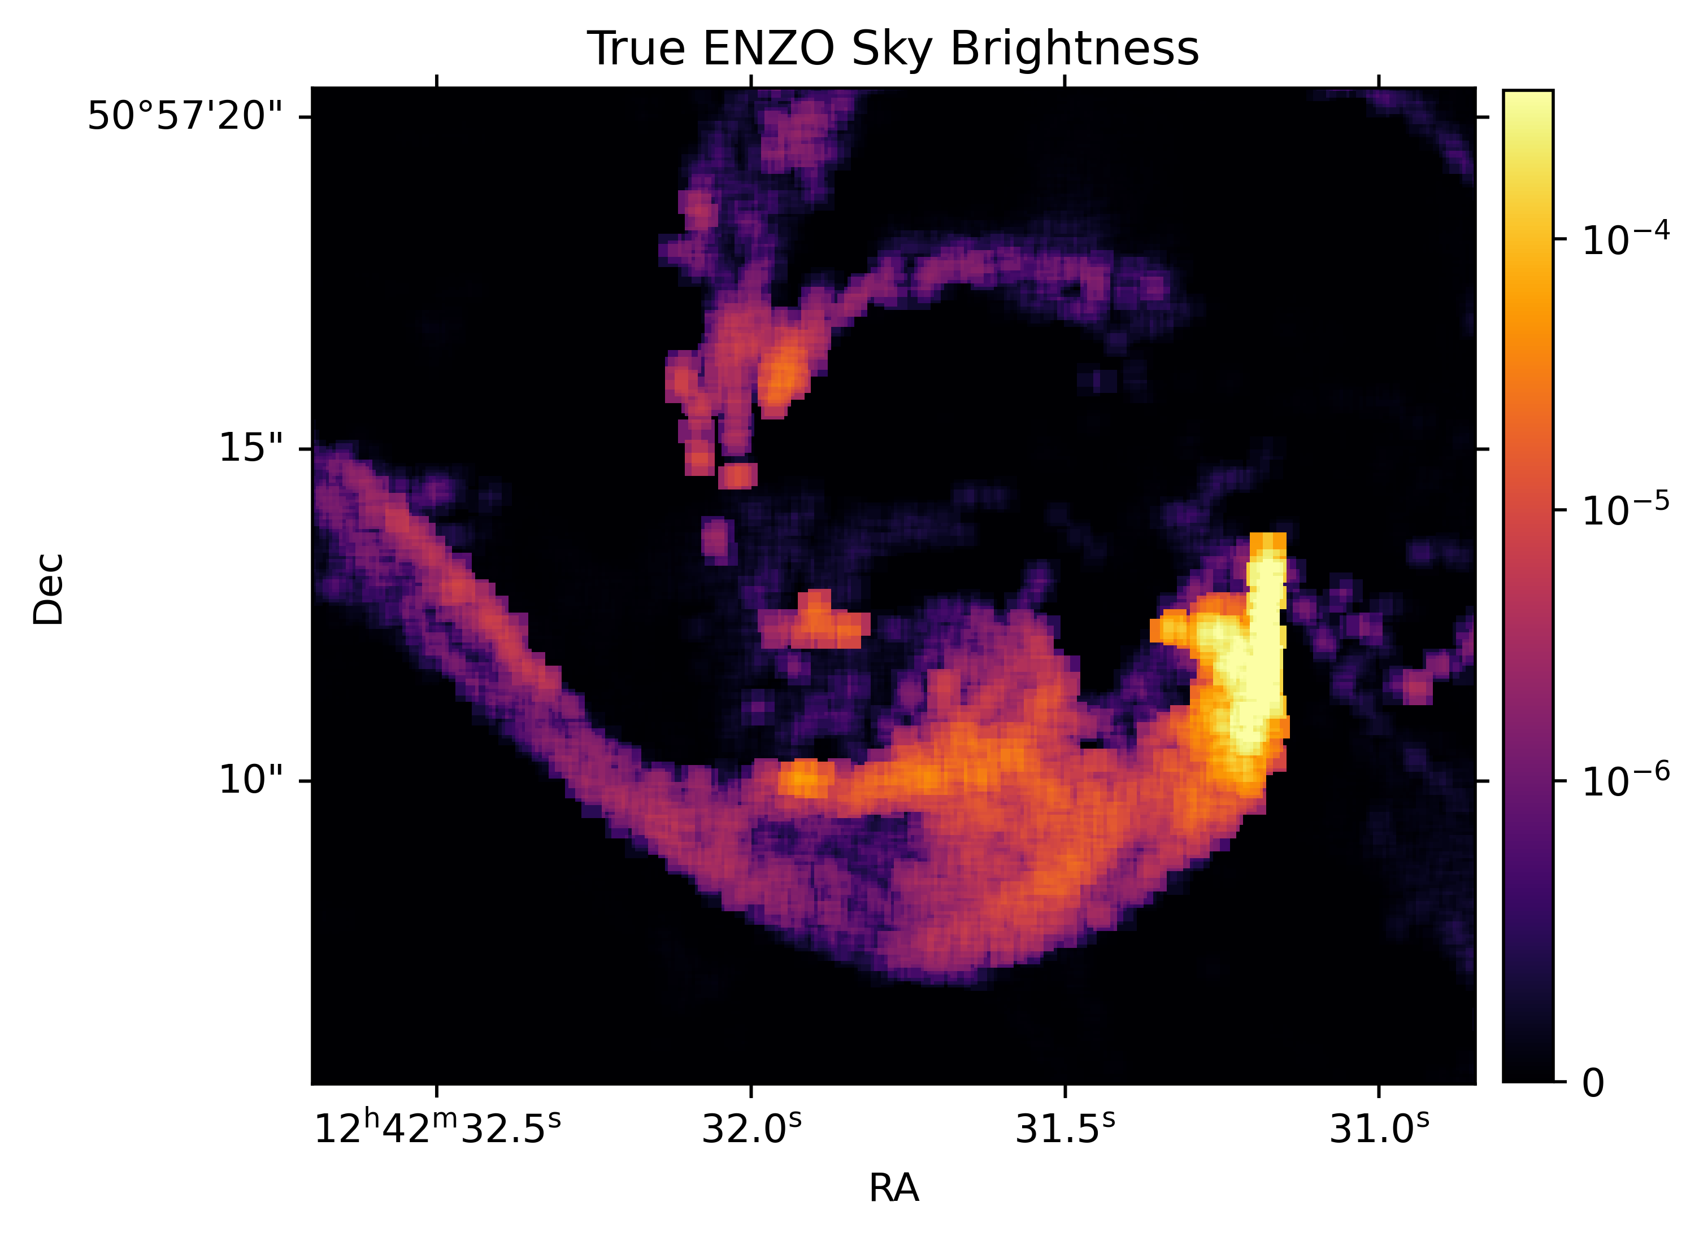
Data from ENZO Simulations
Gheller and Vazza (2022) generated a series of true sky radio sources using the ENZO simulation suite
Generated measurement sets using simobserve
CLEANed the measurement sets with both Högbom and Multiscale CLEAN
Machine Learns to CLEAN • 06 August 2025
Notes:
Same 500 images they used for noise reduction

Slide 6
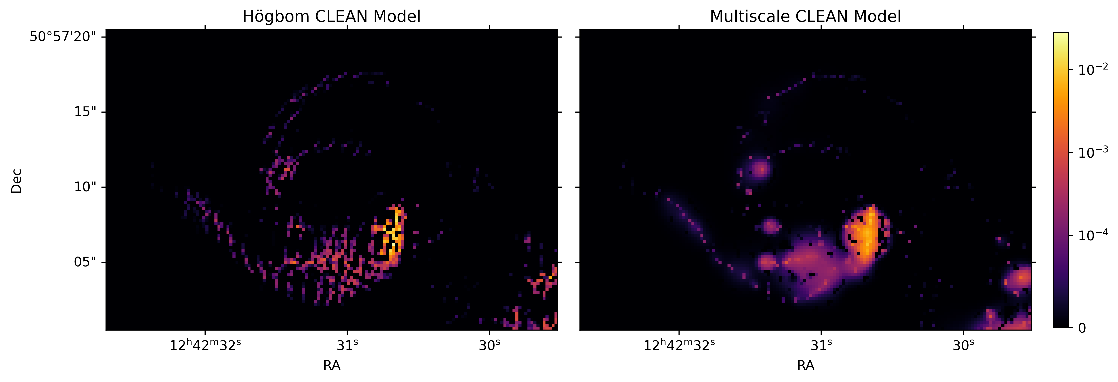
Final Training Data
Machine Learns to CLEAN • 06 August 2025
Notes:
Got 500 images like this, with both the hogbom and multiscale models, and the multiscale components, which appear as a 3D group of values.
Click -> red circles, grouping of delta hogbom components = guassian in multiscale Click -> narrow thin structure/filament, not much change in multiscale
Hope model learns gaussian, and keeps filament

Slide 7
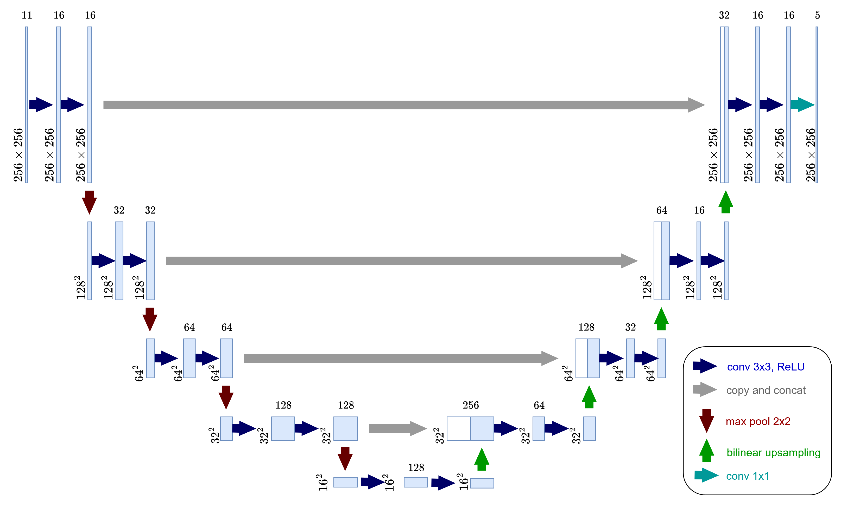
Network Architecture Basis - UNet
Typical image processing tasks use convolutional networks
Allows network to learn spatial context
Skip connections (gray) allow fine scale structure to remain
Machine Learns to CLEAN • 06 August 2025

Slide 8
Investigations into Improvements
Attempts to improve over the basics
Additive vs. Concatenative Skip Layers
Fully connected bridge
Number of Convolutional Layers
Differing normalizations of data and network layers
Hyperparameter Tuning
Learning Rate, Optimizer, Bridge Construction
Machine Learns to CLEAN • 06 August 2025
Notes:
Also, model learns to predict both model image and the multiscale components

Slide 9
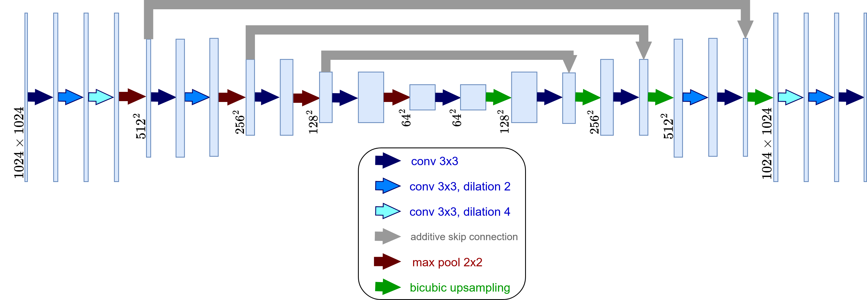
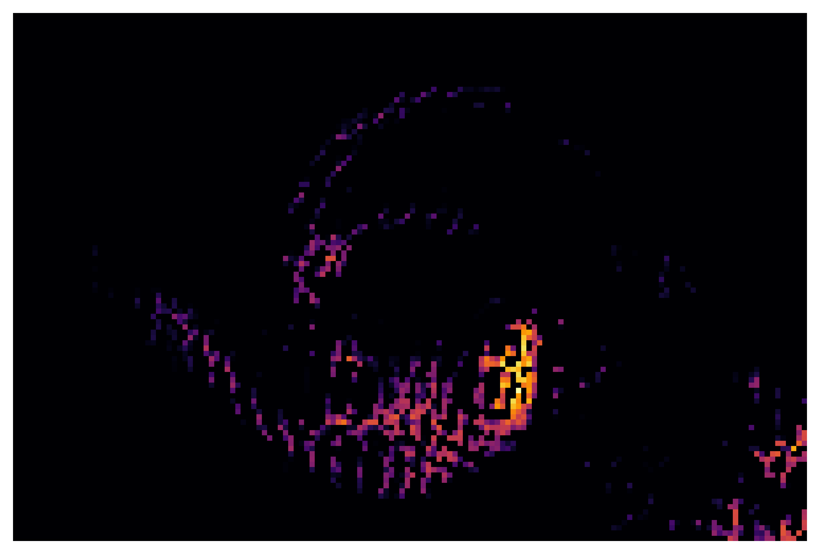
Final Network Layout
Machine Learns to CLEAN • 06 August 2025
Notes:
Model predicts the multiscale components in the 5 gaussian scales (0,3,5,10,20) pixel, tries to reproduce the model image like that

Slide 10
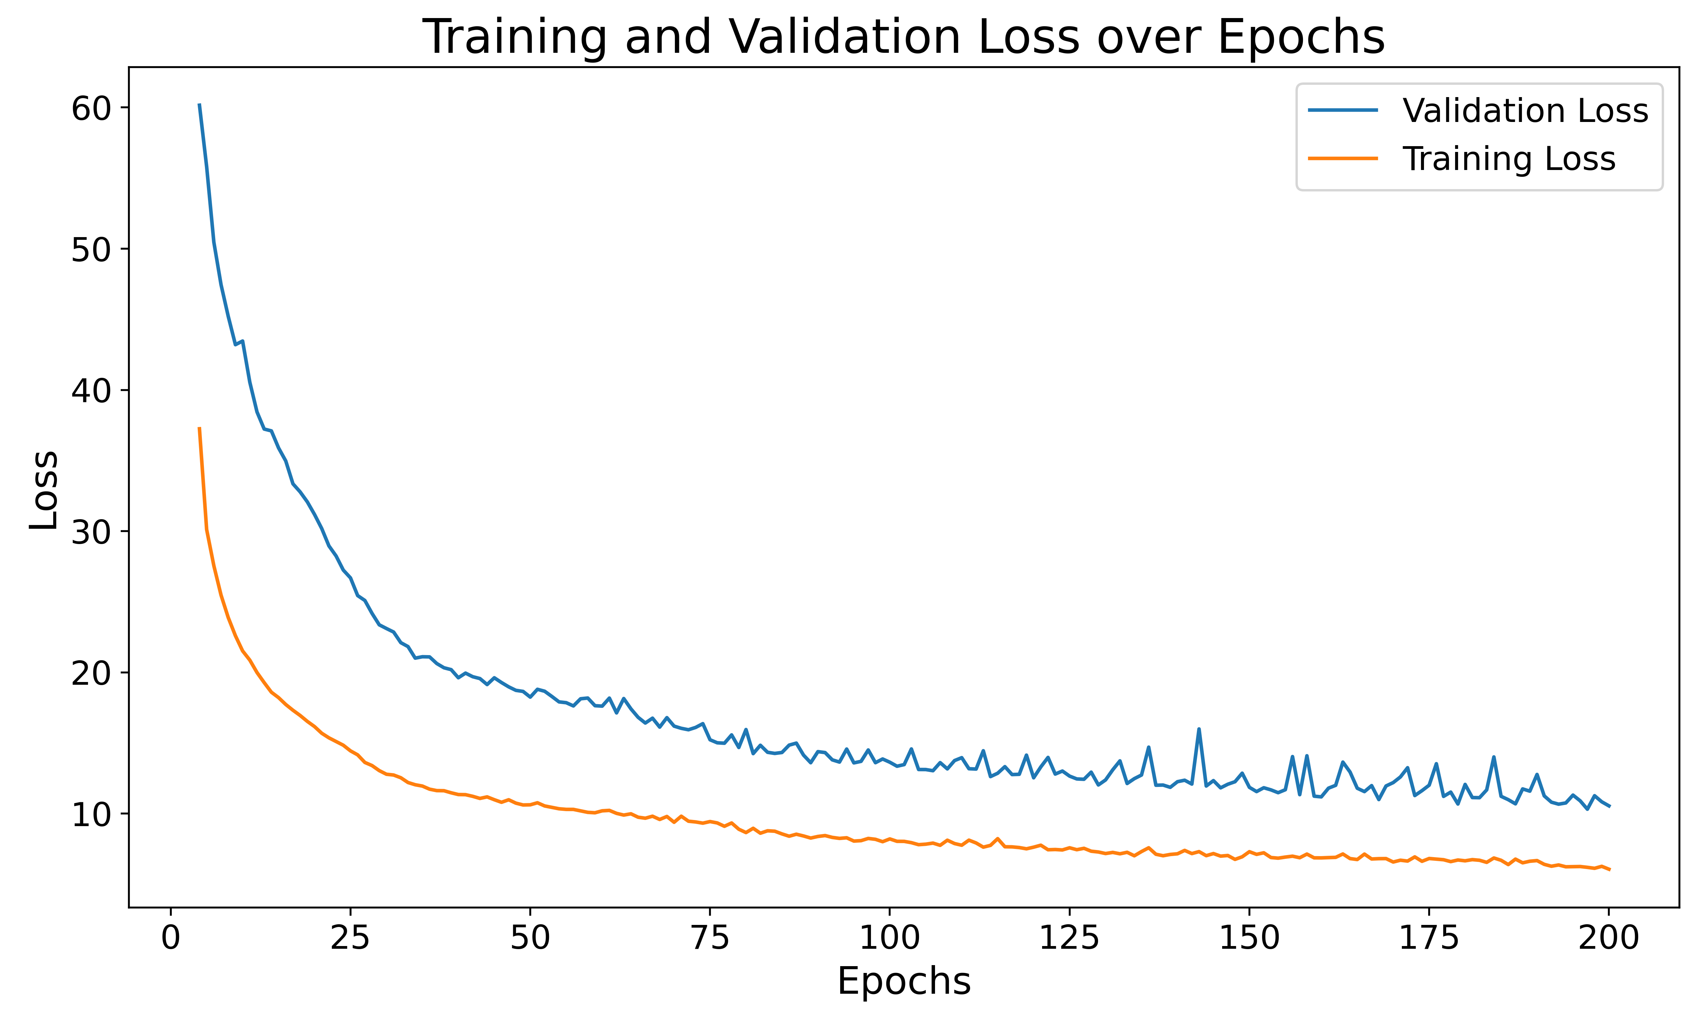
Training and Validation Loss
Machine Learns to CLEAN • 06 August 2025
Notes:
Loss shows that the model has some overfitting(training is less than validation), likely due to small dataset (500 images)
but the validation loss continues decreasing, so model is still very generalizable
Typical extreme over fitting has validation loss increasing as training decreases

Slide 11
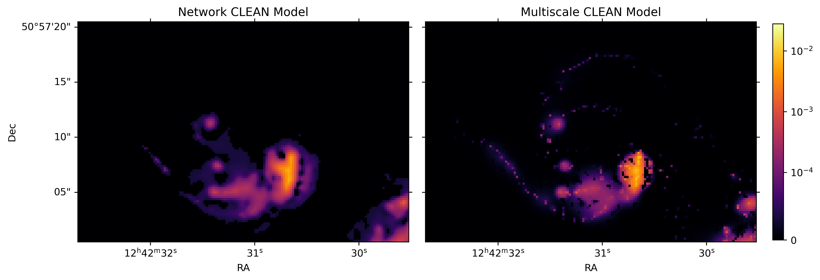
The Original Network Output is lacking
Machine Learns to CLEAN • 06 August 2025
Notes:
Model matches most of multiscale structure very well, clear gaussian shapes and such, better representation than hogbom
But can see that the model misses the small hogbom components and such from the edges, and doesn’t predict sharpness heavily enough
Likely cause – design of network, kernel size on convolution layers somewhat dictates how much fine structure can be kept, kernel is 3x3, hogbom is 1x1 (delta)

Slide 12
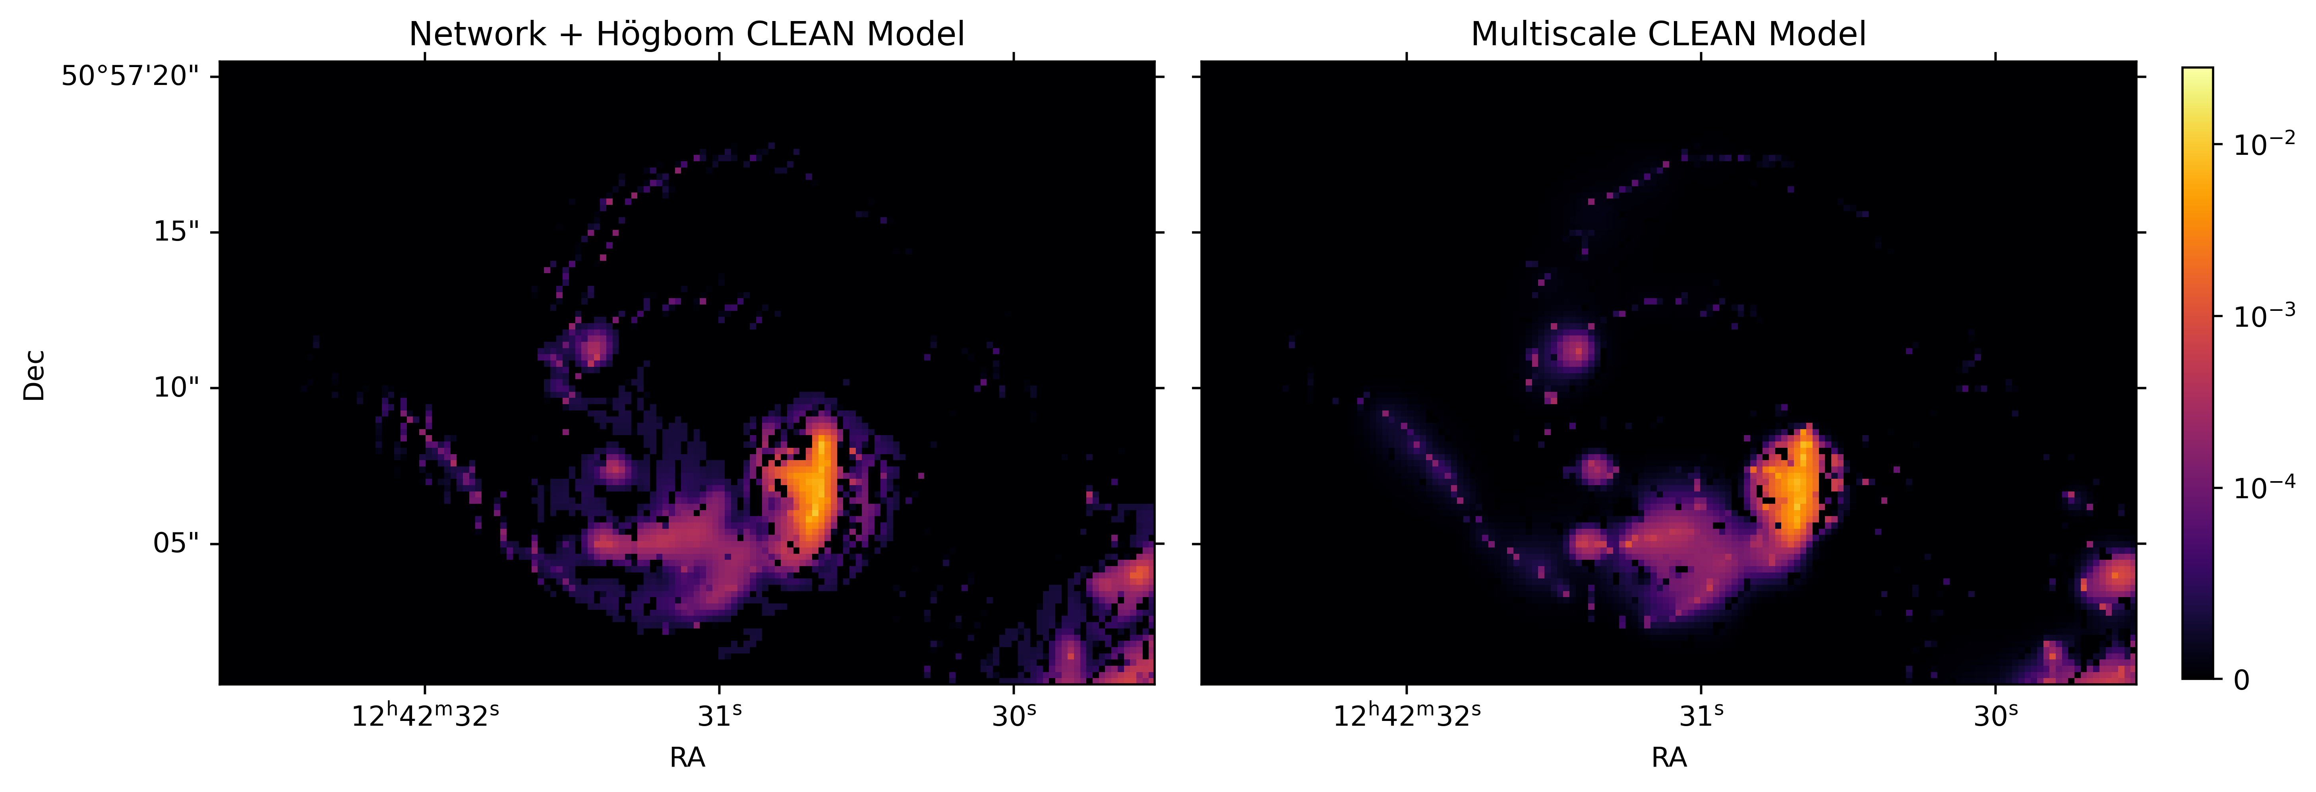
With Högbom Added, Model Improves
Machine Learns to CLEAN • 06 August 2025
Notes:
Adding hgobom corrects this deficiency a lot, gets almost all structure back
also solves the problem of the network not training to minimize residual, instead to recreate model

Slide 13
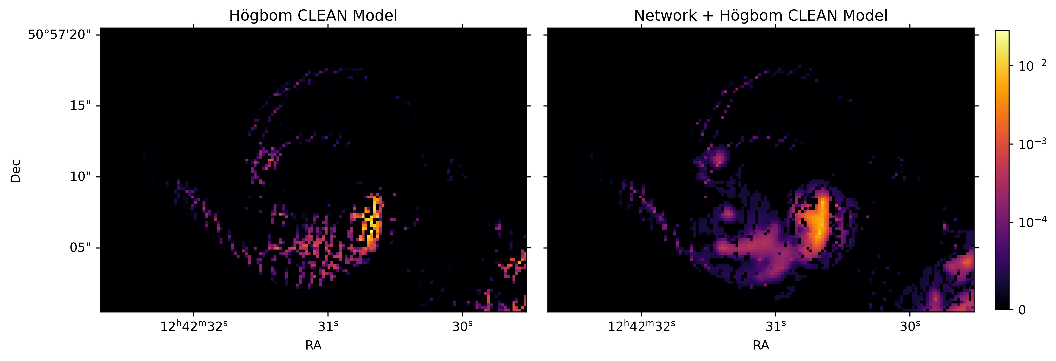
Comparison to Högbom
Machine Learns to CLEAN • 06 August 2025
Notes:
Adding hogbom corrects this deficiency a lot, gets almost all structure back
also solves the problem of the network not training to minimize residual, instead to recreate model

Slide 14
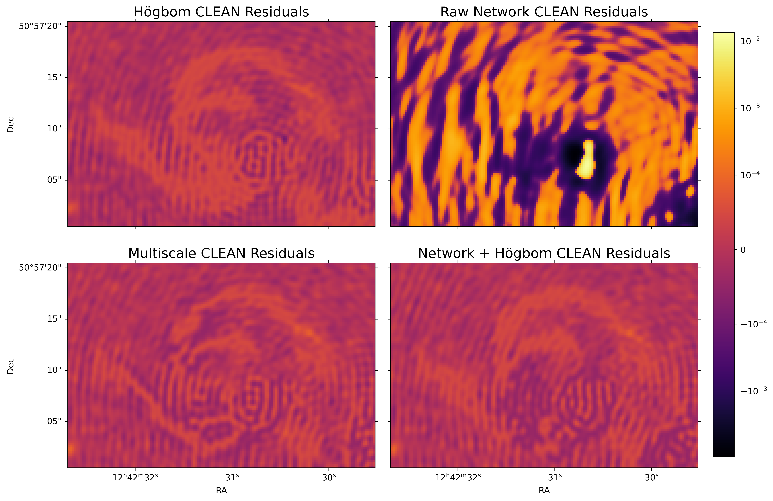
Machine Learns to CLEAN • 06 August 2025
Notes:
Can see the raw network is bad, since it doesn’t train to minimize residual, instead to match model image
Adding hogbom improves this a lot since it goes back to solving for min resid

Slide 15
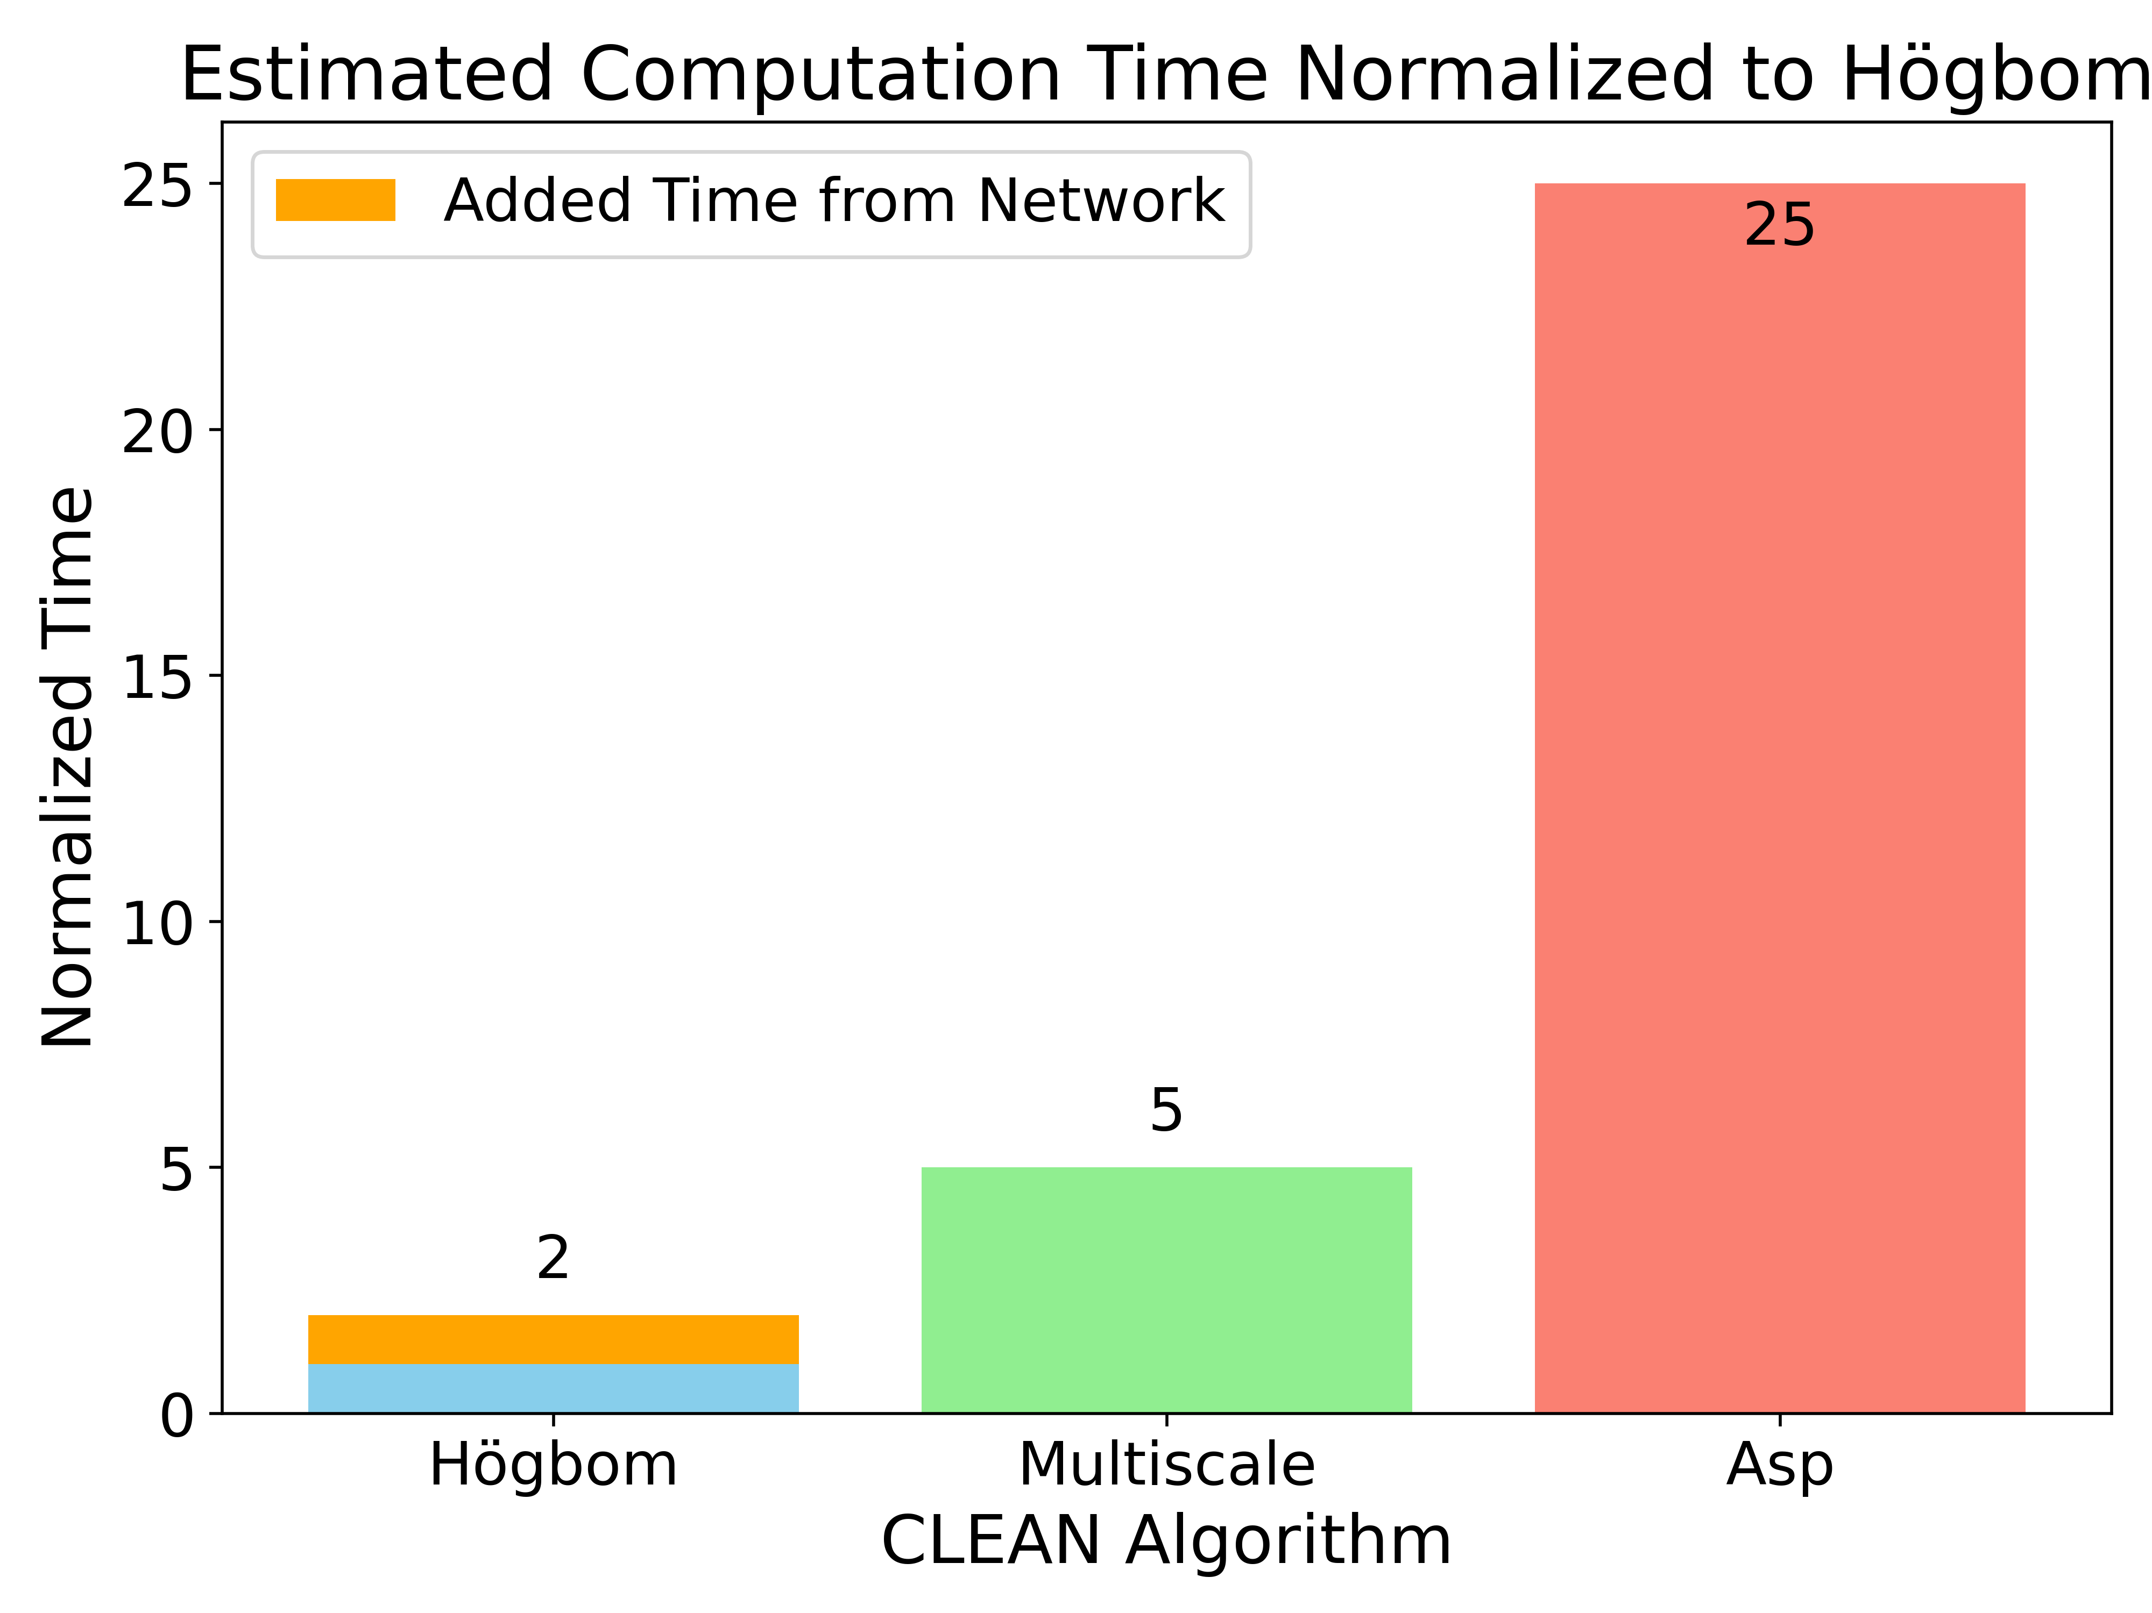
Outlook and Next Steps
Current best model is not very generalized
Multiterm, widefield
Currently only replicates Multiscale CLEAN
Expand to Asp-CLEAN, more expensive methods
Ellipticity of Gaussian
Angle of Gaussian
Machine Learns to CLEAN • 06 August 2025
Notes:
Brings Computation time down some for MS clean
But big improvement if we can expand to even just Asp CLEAN
Other methods even more expensive, if we can bring down to hogbom with only losing some accuracy, very good

Slide 16
Thank You
kfiedler@arizona.edu
Machine Learns to CLEAN • 06 August 2025

Slide 17
References
[1]Gheller, C. and Vazza, F., “Convolutional deep denoising autoencoders for radio astronomical images”, Monthly Notices of the Royal Astronomical Society, vol. 509, no. 1, OUP, pp. 990–1009, 2022. doi:10.1093/mnras/stab3044.
[2]Bryan, G. L., “ENZO: An Adaptive Mesh Refinement Code for Astrophysics”, The Astrophysical Journal Supplement Series, vol. 211, no. 2, Art. no. 19, IOP, 2014. doi:10.1088/0067-0049/211/2/19.
[3] The CASA Team, et al. 2022, "CASA, the Common Astronomy Software Applications for Radio Astronomy", PASP, 134, 114501. DOI: 10.1088/1538-3873/ac9642
Machine Learns to CLEAN • 06 August 2025

Slide 18
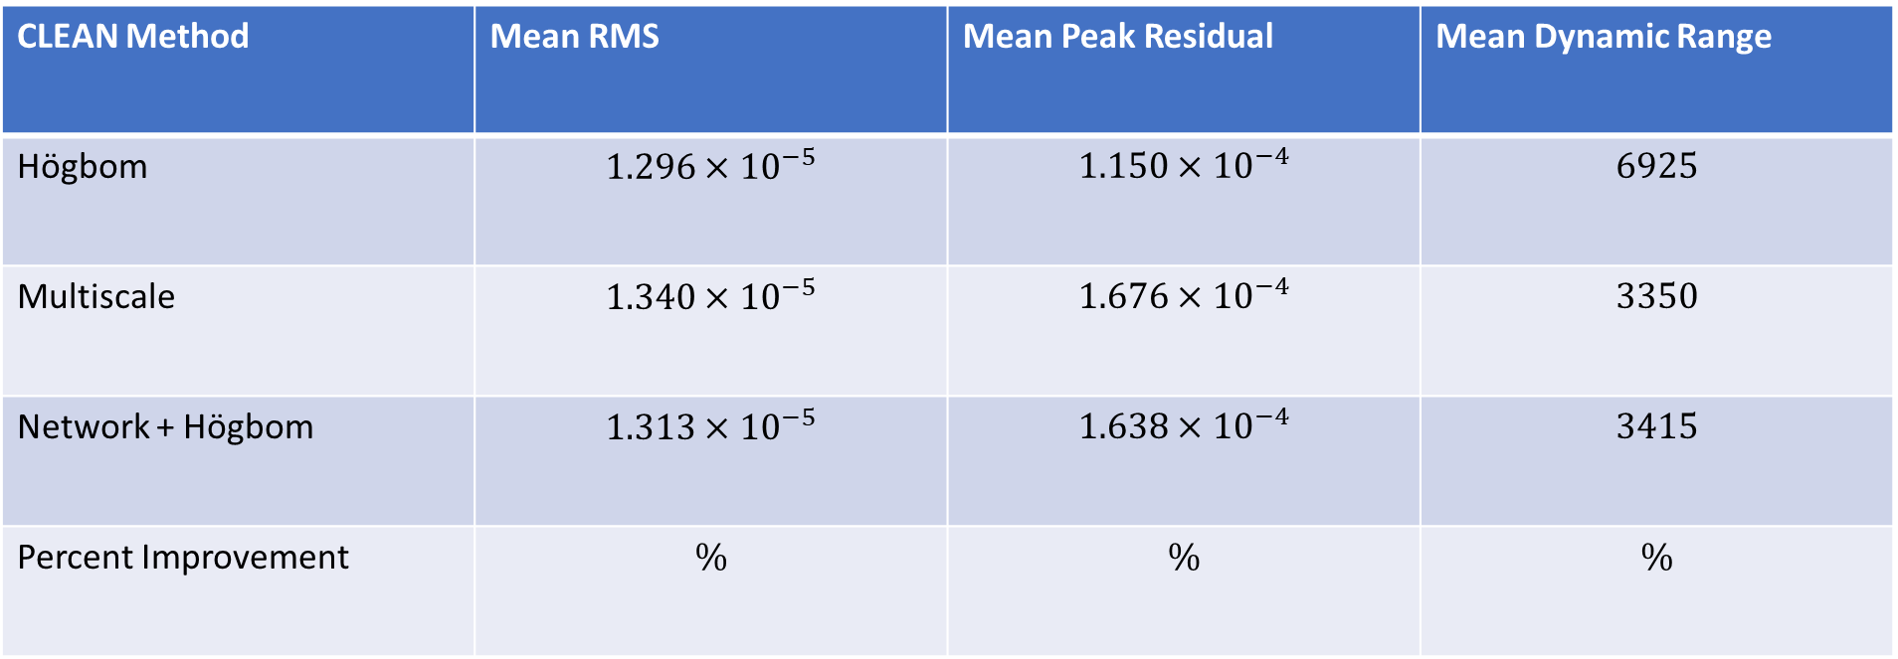
Evaluation Metrics
CLEAN Method | Mean RMS | Mean Peak Residual | Mean Dynamic Range
Högbom | $$1.296×{10}^{−5}$$ | $$1.150×{10}^{−4}$$ | $$6925$$
Multiscale | $$1.340×{10}^{−5}$$ | $$1.676×{10}^{−4}$$ | $$3350$$
Network + Högbom | $$1.313×{10}^{−5}$$ | $$1.638×{10}^{−4}$$ | $$3415$$
Percent Improvement | $$\%$$ | $$\%$$ | $$\%$$
Machine Learns to CLEAN • 06 August 2025

