Slide 1
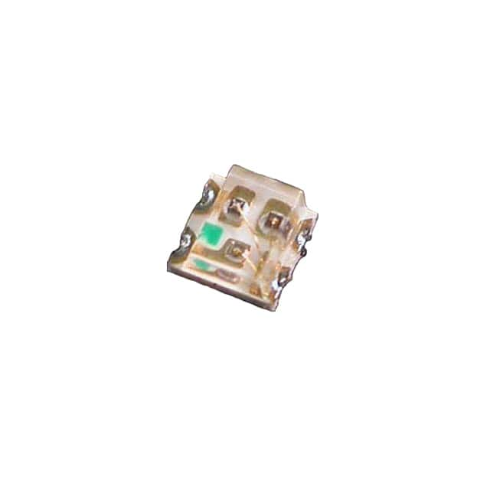
RED
GREEN
BLUE

Slide 2
