Slide 1
FINAL PROJECT TEMPLATE

Slide 2
THREAT SUMMARY
Summary of Situation: In hospitals A, B and C a message has popped up. The message indicates that all the personal files are encrypted by the attacker and will only be decrypted and released only when they pay some ransom. In this case the ransom is bitcoins. It is indicated that the incident has started with a user in the technology department opening an email attachment resource. This incident has not yet been seen in Hospital X.
Asset: Personal Documents.
Impact: Confidentiality, Integrity and Availability.
Threat Actor: External threat actors here include an attacker (cyber-criminals) that carried out an attack for financial reasons. Potential Internal Threat Actor could be the employee that opened the email attachment with an intention to cause harm and is financial motivated.
Threat Actor Motivation: Employees who are unhappy with the organization and seek to retaliate often through digital resources and exploitation. There could also be individuals who are terminated but steal data as they are leaving or have access after their separation from the company.
Common Threat Actor Techniques:
Intentional Threats – Techniques like Phishing, Spear Phishing used by attackers to acquire sensitive data through an email attachment
Unintentional threats – Could be caused by victims like the employees who are security unaware and are victims to social engineering.

Slide 3
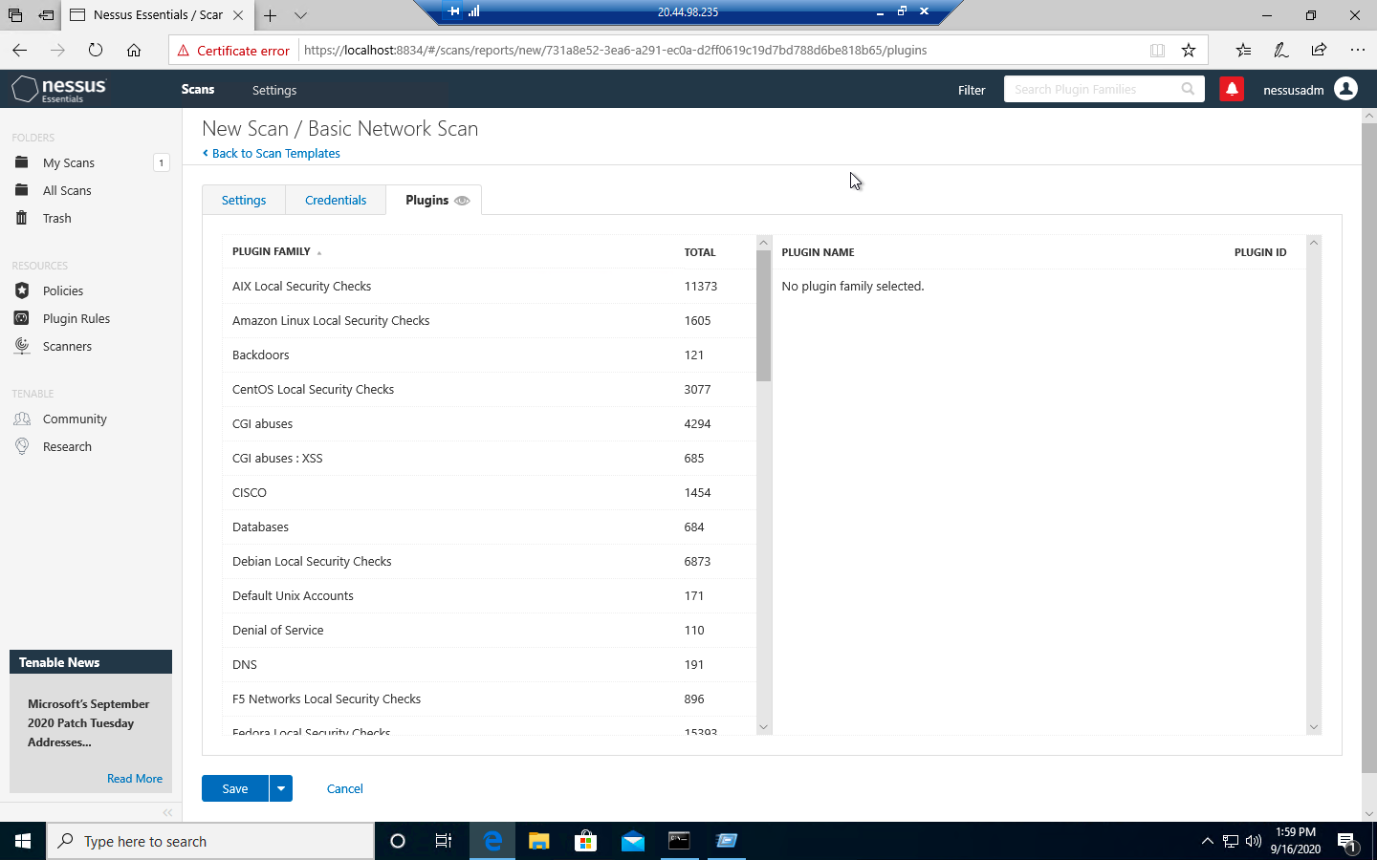
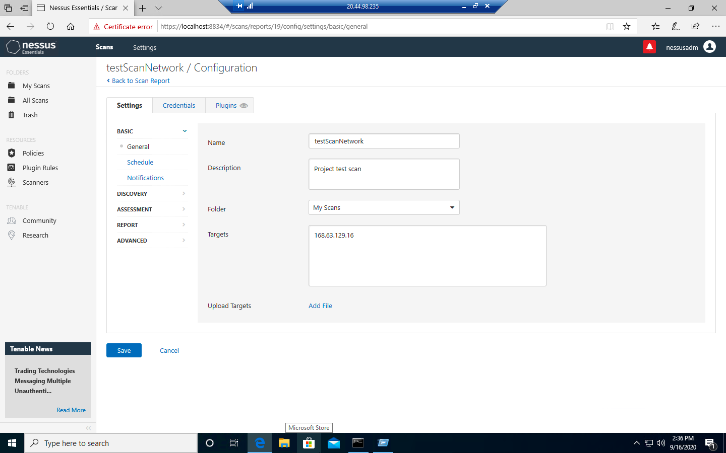
VULNERABILITY SCANNING TARGETS
Summary of scan targets:
Number of devices scanned: 1
Device type: Virtual Machine (General Purpose)
Primary purpose of device: General purpose computer
(insert 2 screenshots from scan configuration window – one of the settings tab and one of the plugins tab)

Slide 4
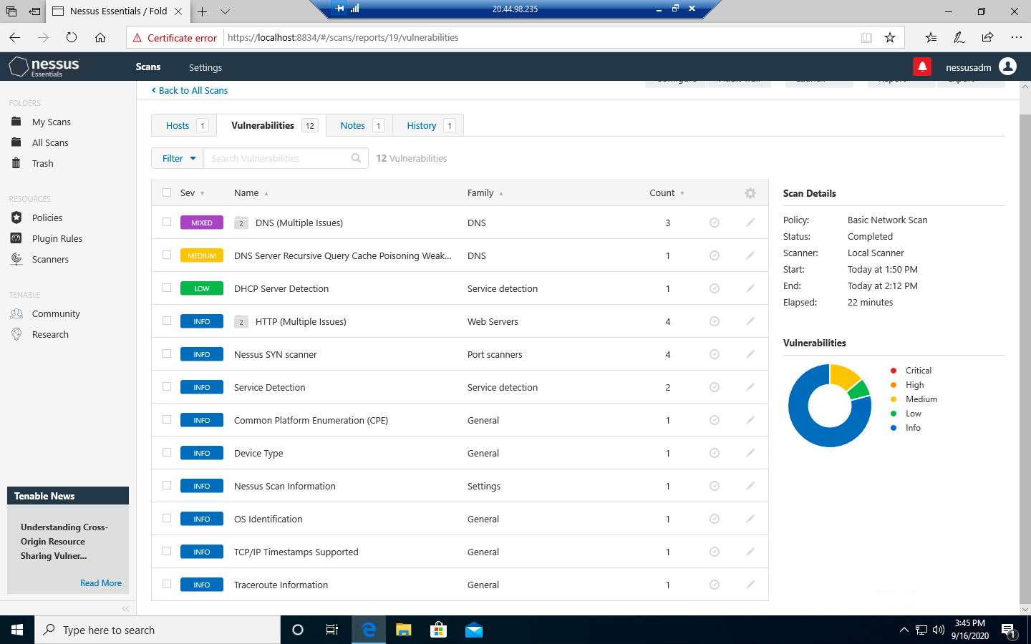
VULNERABILITY SCAN RESULTS
Summary of findings:
Total number of actionable findings: 12
Critical: 0
High: 0
Medium: 1
Low: 1
(insert screenshot from scan results dashboard)

Slide 5
REMEDIATION RECOMMENDATION
Finding | Severity Rating | Recommended Fix
No Critical or High Vulnerabilities found
Fix within 7 days
Fix within 30 days
Finding | Severity Rating | Recommended Fix
DNS Server Spoofed Request amplification DDoS | Medium | Restrict access to your DNS server from public network or reconfigure it to reject such queries
DNS Server Recursive Query Poisoning Weakness | Medium | Restrict recursive queries to the hosts that should use this nameserver
Fix within 60 days
Finding | Severity Rating | Recommended Fix
DHCP Server Detection | Low | Apply filtering to keep this information off the network and remove any options that are not in use

Slide 6
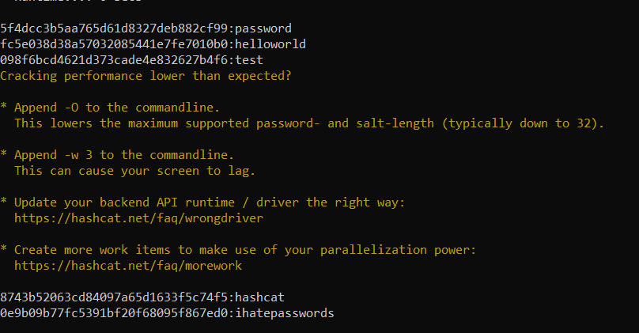
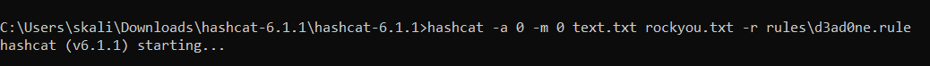
PASSWORD PENETRATION TEST OUTCOME
Methodology: Place all the hashed passwords in a text file. Download a password list (in this case I named it rockyou). Open command prompt and type the command hashcat –m (is the hash type) –a (attack mode) and the hashfile and masked file with the rule at the end.
Number of passwords tested: 44
Number of passwords cracked: 5
Evidence of weak passwords: 5 (Passwords that could be cracked easily)
Recommended steps to improve passwords security: Use passwords which are at least 8 characters long. Passwords need be changed every 90 days. Passwords need to be a combination of digits, special and alpha numeric characters

Slide 7
INCIDENT RESPONSE PRELIMINARY ASSESSMENT
Summarize ongoing incident:
What do you know so far?
An attack has occurred in which all the personal documents are encrypted by the attacker. The attacker has demanded to pay 1 million dollars in bitcoins in return to the documents. The staff (Doctors, nurses and administrative staff have no access to the control systems that are used to monitor patient stats. Doctors are not able to render treatments as the detailed information and the patient status is not available. The log analysis tool is not accessible and there is a critical security incident declared.
Document actions or notes from the following steps of the initial incident response checklist
Step 1: Gather a team of professionals who can deal with cybersecurity problems.
Step 2: Don’t agree to pay the ransom as there is no guarantee that you will be given back what is taken.
Step 3: Try to restore servers and files from the backups
Step 4: Search for the source of the incident
Step 5: Contain and isolate the source of the incident
Step 6: Plan a strategy to avoid paying ransom
Step 7: Once the incident is over conduct proper cybersecurity training to all the staff members.
Step 8: Conduct regular backups.

Slide 8
INCIDENT RESPONSE RECOMMENDED ACTION
Summarize recommendation to contain, eradicate, and recover:
Describe the overall recommended containment, eradication, and recovery plan
The source of the incident must be found. The email attachment must either be deleted or isolated. Once this is done, the files and servers need to be restored using the backups. As the attacker has mentioned, we can delete the software. Once it is deleted all the remaining traces of the software must also be erased.
The severity of this incident is high. The medical staff is unable to treat patients as the information is not available. This might cause loss of patient life. In order to avoid such incidents in the future, there must be regular information sessions for the staff. The session must contain what the staff should do and what they shouldn’t. Regular data and server backups must be conducted so that the data is available even if there is any problem.
Documented actions and notes from the IR checklist
Step 7: Perform procedures such as Malware response, Insider threat or Denial of service response.
Step 8: Check the system activity and determine if the cause of the incident was intentional or unintentional.
Step 9: Make sure all the systems are patched and backups are in place.
Step 10: Document the incident, cause, impact, risk score, steps taken to overcome it, what steps needs to be followed etc.
Step 11: Have a proper planning mechanism until the incident is solved and also for future.

