Slide 1
transportation
SAI KEERTHI DOMA

Slide 2


SCENARIO
Consider a wholesale company that supplies some general merchandise products to the nearby store.
2
3
6
Notes:
Consider a Wholesale company in Boston, that supply Some General Merchandise things like chips, chocolates to the near by Store.
Let Consider he has 7 Customers.
Depends on the Customer requirement, the owner of the wholesale company will tell his deliver boy, today deliver these stuff to Store 2,3,6.

Slide 3
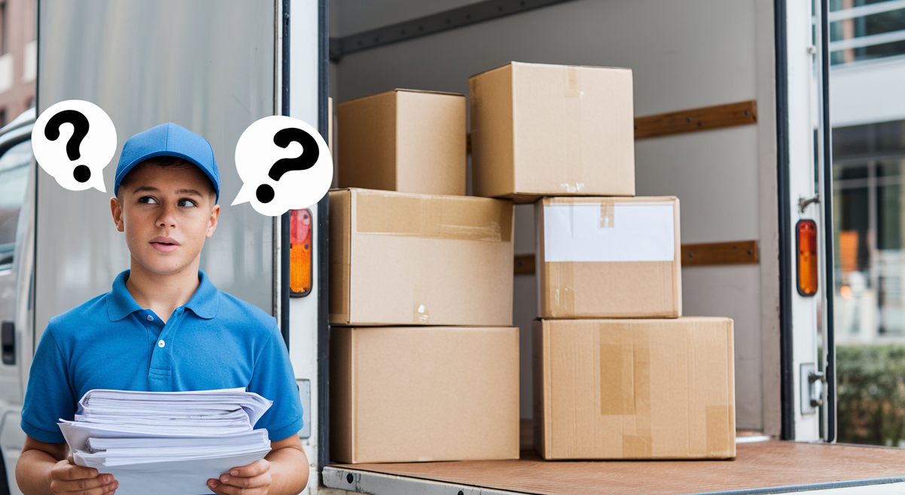
SCENARIO
How can I finish my task fast?
(2,3,6)
(2,6,3)
(6,3,2)
(6,3,2)
(3,2,6)
(3,6,2)
Notes:
Now he will ask his deliver boy tell me what time you will reach these stores. So that I will inform the store person that we are delivering your products at this time. So please arrange the money by this time/ please available at the store for this time? To manually solve this problem it takes more time like he should think for all permutations and calculate the distance.

Slide 4
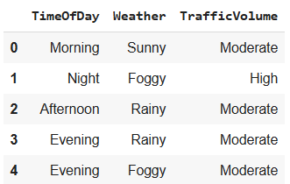
Dependent features
Time Of the Day(Morning, Afternoon, Evening, Night)
Weather( Rainy, Sunny, Foggy)
Etc.,
Notes:
But now one more problem rises is the time to reach one particular location is not static. Because it depends on the Traffic Volume. And it depends on the many features like Time Of the Day, Weather and some more features. But Right now I am considering only these two features. So he will use some external software to update the delivery time so he should mention the dependent feature that at what time he is starting and how was the weather now.

Slide 5
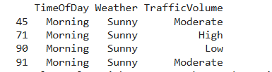
sets& Probability
Set(A)-Weather -Sunny
Set(B)-Time Of Day- Morning
Set(A^B)- Sunny & Morning
P(H/A^B)= P(H)/P(A^B) = 1/4
P(M/A^B)= P(M)/P(A^B) = 2/4
P(L/A^B)= P(L)/P(A^B) = 1/4
A
B
34
4
18
Notes:
Now that software will update the delivery time based on the given dependent features. Now For suppose he entered Time Of the Day - Morning, Weather- Sunny

Slide 6
Linear Equation
Time Variance(Δt)=1.5P(H)+1.2P(M)+P(L)
Notes:
I want to change my time based on the traffic volume, if it is high increase the time

Slide 7
Graph
2
1
2
3
4
5
10
1
7
3
3
4
2
5
6
6
2
1

Slide 8
Updated Graph
2.52
1
2
3
5.04
6.3
12.59
1.26
7
3.78
3.58
4
2.52
5
7.55
6
2.52
1.26
Notes:
This is the Updated graph with the updated time based on the dependent features

Slide 9
Fastest path
Fastest Path 1->2->3->4->6
Delivery Time = 16.38(5.04+6.3+3.78+1.26)
2.52
1
2
3
5.04
6.3
12.59
1.26
7
3.78
3.58
4
2.52
5
7.55
6
2.52
1.26
Notes:
This is the Updated graph with the updated time based on the dependent features

Slide 10
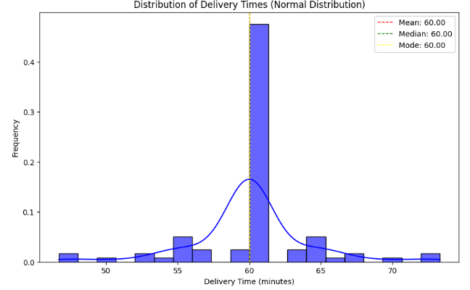
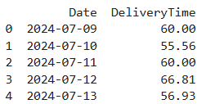
Descriptive Statistics & Distributions
Notes:
I have 3 months data of delivery time to reach to particular store from my distribution center. And I have plotted my data spread then I can visually see that my data is in Normal Distribution because the spread was symmetry about the mean

Slide 11
Descriptive Statistics & Distributions
Mean : 60 Minutes
Median : 60 Minutes
Mode : 60 Minutes
Variance : 15.91 ≈ 16
Standard deviation : 4
Delivery time ≈ 52 min to 68 minutes (95%)
Notes:
Since it is Normal Distribution, we can say that 68% of data sample is within one standard deviation, 95% is within 2nd standard deviation,99.7% is is with in 3rd standard deviation. So we can say that 95% of chance that he will deliver with in 52 minutes to 68 minutes.

Slide 12
Eigen vectors
?
Notes:
Now his customers are increased and he was planning to add one more distribution center such that he can efficiently deliver to the stores. To solve this we can use eigenvector centrality, which helps to determine the most influential or central store in your network.

Slide 13
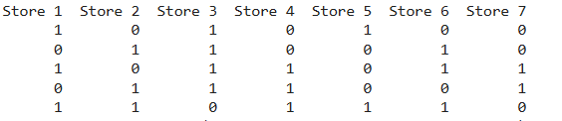
Eigen vectors
Eigenvector Centrality for each store:
Store 1: 0.1057,Store 2: 0.0682,Store 3: 0.2223
Store 4: 0.2082,Store 5: 0.1869,Store 6: 0.1575,
Store 7: 0.0513

Slide 14
Questions?

Slide 15
Thank you

