Slide 1

Refresher on Algorithms
Keerat Kaur Guliani
ML Operations, TUSK

Slide 2
Topics to cover today…
Divide and Conquer
Dynamic Programming
Greedy Approach

Slide 3
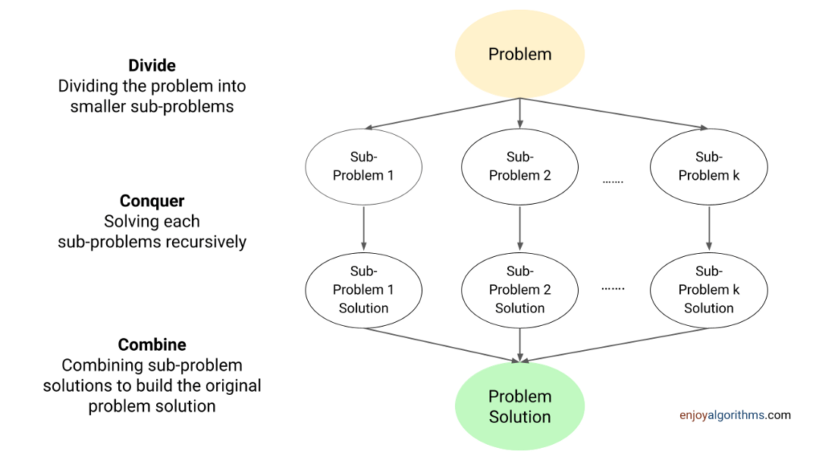
Divide and Conquer

Slide 4
Divide and Conquer - Types
DAC using one subproblem – Decrease and Conquer Eg: Binary Search
DAC using two subproblems Eg: Merge Sort
Notes:
Binary Search and Merge Sort: elaborate from here https://www.enjoyalgorithms.com/blog/divide-and-conquer

Slide 5
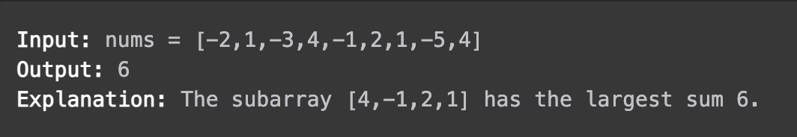
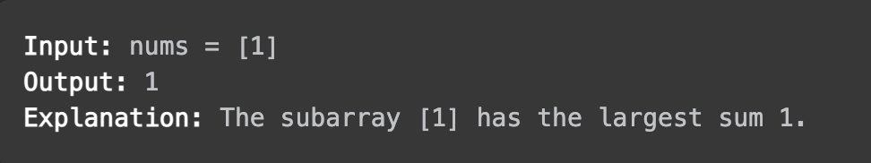
Illustration: Maximum Subarray Sum
Given an integer array, find the subarray with the largest sum/return its sum.
Not the same as maximum subsequence sum!

Slide 6
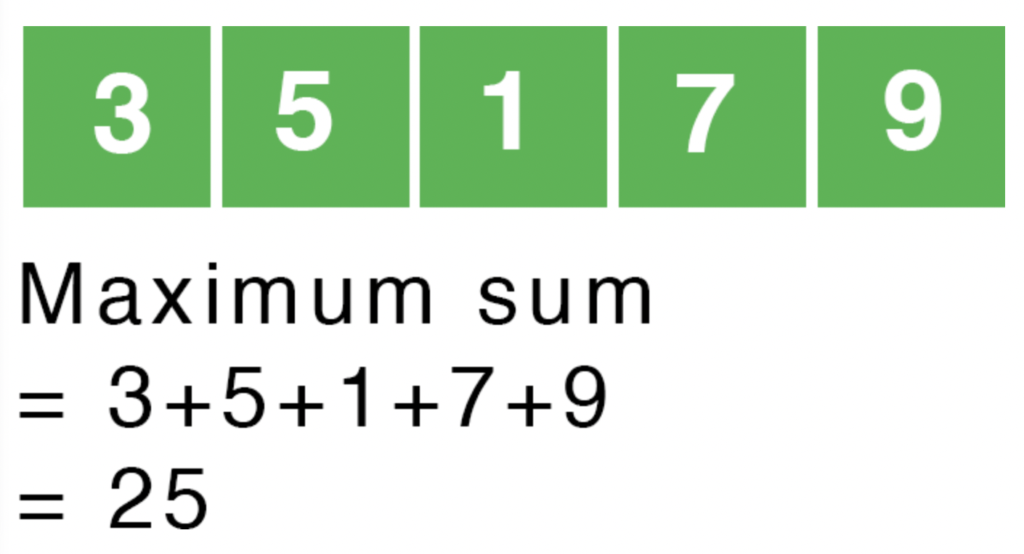
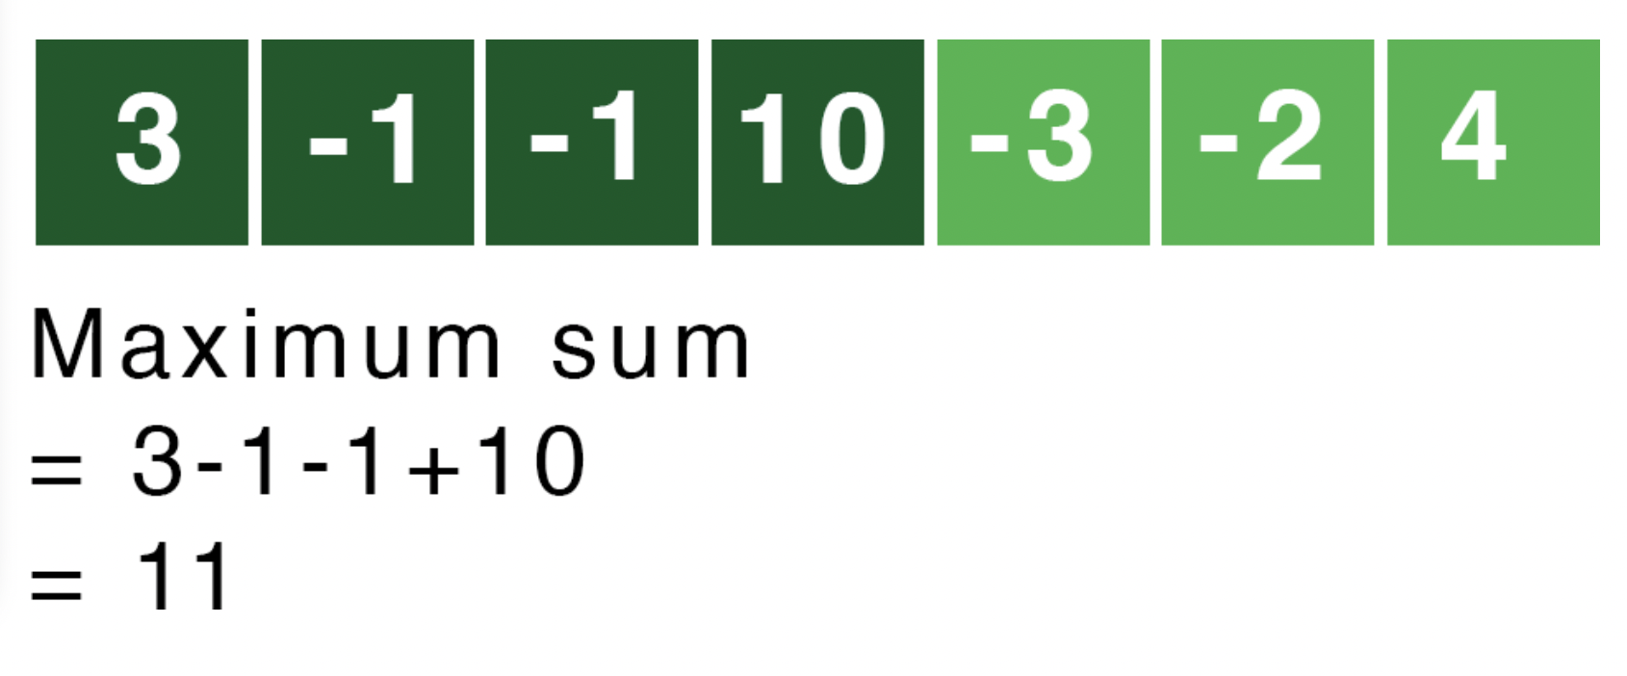
Maximum Subarray
Naïve Method: Consider every possible subarray using 2 loops and return the overall maximum. Time complexity: O(n^2)

Slide 7
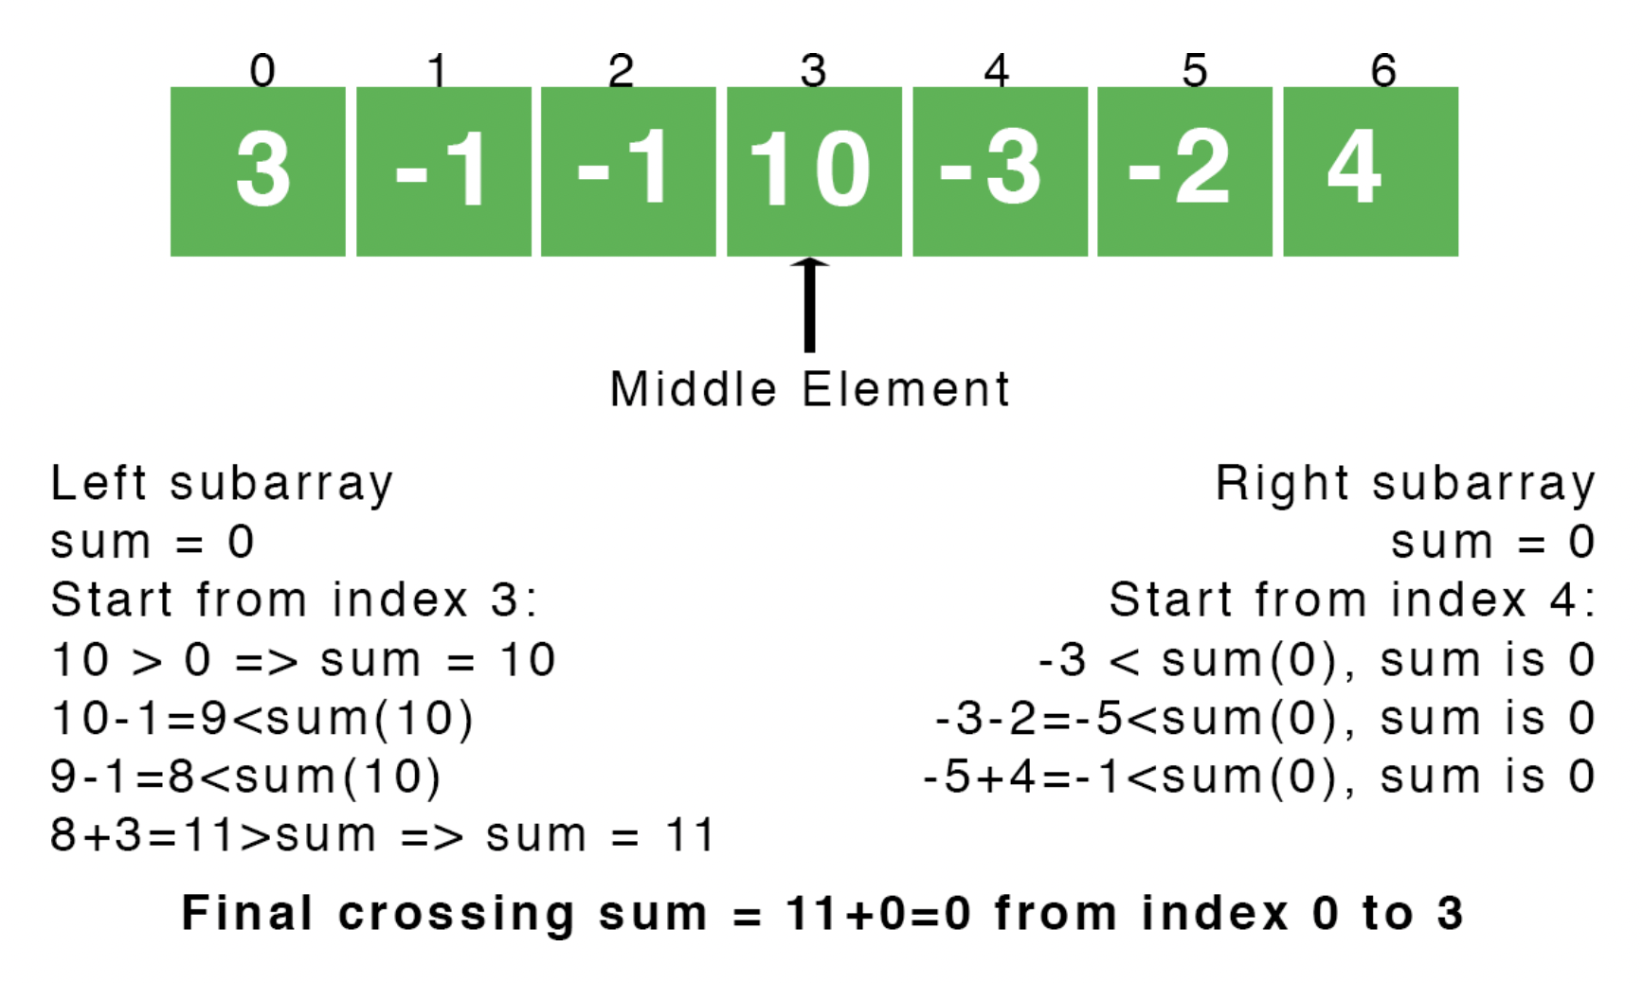
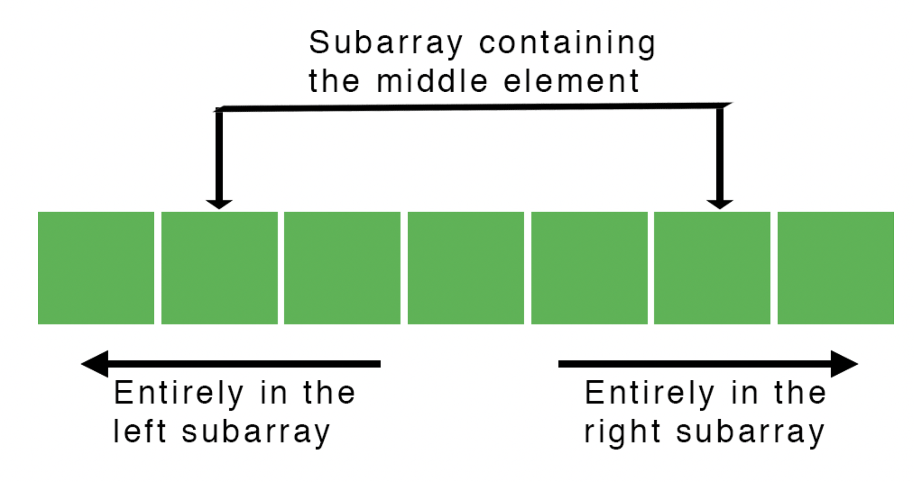
Maximum Subarray with DAC

Slide 8
Code
T(n) = 2T(n/2) + Θ(n)
Time: O(nlogn)
Space: O(1)

Slide 9
Dynamic Programming
What is DP?
Useful technique for optimization problems
Looks through all possible sub-problems and never recomputes the solution to any sub-problem
Guarantees correctness and efficiency
When can DP be applied?
Breaking down an optimization problem into simpler sub-problems (optimal substructure)
Storing the solution to each sub-problem so that each sub-problem is solved only once (memoization)
What exactly is a sub-problem?
Smaller version of the original problem
Sub-problems build on each other to obtain the solution to the original problem

Slide 10
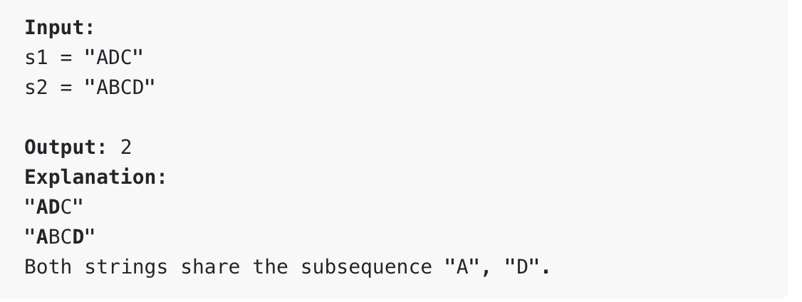
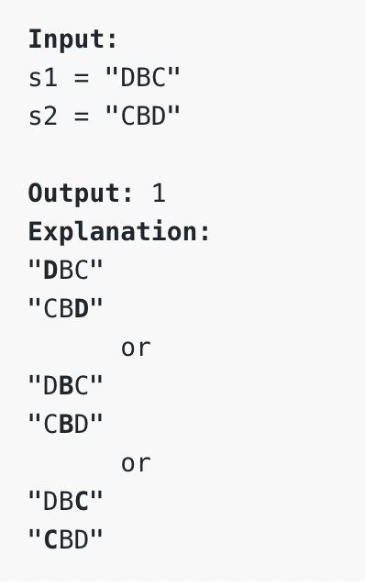
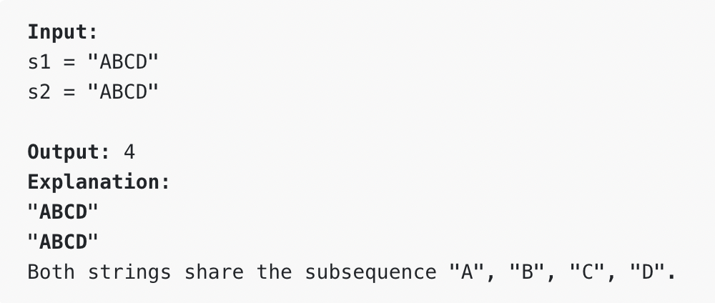
Illustration 1: Longest Common Subsequence (LCS)
Given two strings s1 and s2 return the length of the longest common subsequence of characters between the two strings (need not be contiguous).
For example,
lcs(‘azb’, ‘aab’) = 1 + lcs(‘az’, ‘aa’) = 1 + max(lcs(‘az’, ‘a’), lcs(‘a’, ‘aa’))
= 1 + max(max(lcs(‘az’, ‘’), lcs(‘a’, ‘a’)) , 1 + lcs(‘ ’, ‘a’))
= 1 + max(1,1) = 2

Slide 11
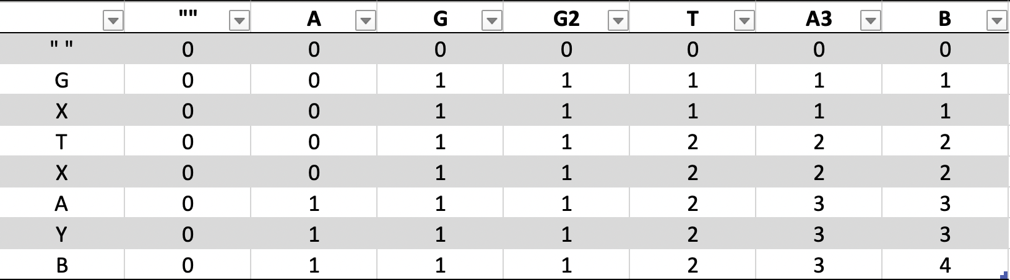
Subproblem decomposition using the DP Table
Find the LCS between AGGTAB and GXTXAYB.

Slide 12
Code
Time: O(mn)
Space: O(mn)
Where m = len(s1), n = len(s2)

Slide 13
Greedy Algorithm
An optimization algorithm that prioritizes the optimal choice at each step as it attempts to find the overall optimum to solve the entire problem.
An example where it works: Shortest path through a graph
An example where it does not work: To reach the largest sum in the graph

Slide 14
Greedy Algorithm
When can a greedy algorithm be used?
Greedy choice property: A global (overall) optimal solution can be reached by choosing the optimal choice at each step.
Optimal substructure: A problem has an optimal substructure if an optimal solution to the entire problem contains the optimal solutions to the sub-problems.
Limitations of Greedy Algorithms:
May not be able to find the global optimum because only limited data is considered.
Decision at each time step is made based on choices made so far, which may not include all possible future choices.

Slide 15
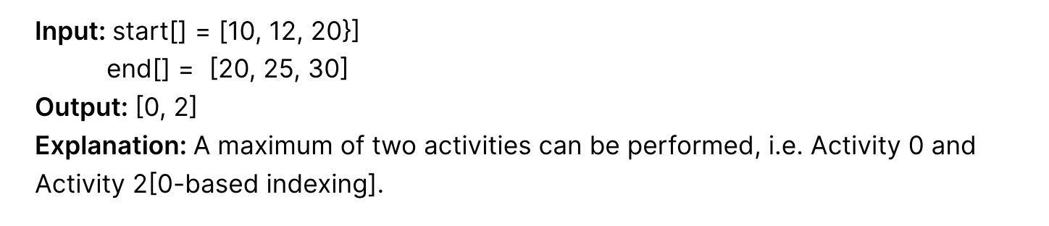
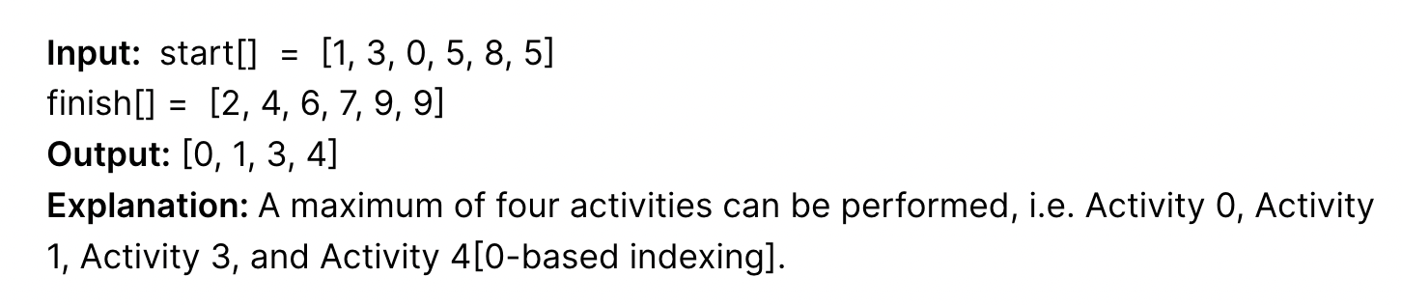
Illustration: Activity Selection Problem
Given N activities with their start time and end time. The task is to find the solution set having a maximum number of non-conflicting activities that can be executed within the given time, assuming only a single activity can be performed at a given time.

Slide 16
The Greedy Choice
Choose activities with the earliest finish time. The earlier you finish, the more time you have for other activities!
Steps:
Sort the activities according to their finishing time
Select the first activity from the sorted array and print it
Do the following for the remaining activities in the sorted array
If the start time of this activity is greater than or equal to the finish time of the previously selected activity then select this activity and print it

Slide 17
Code
Time: O(nlogn)
Space: O(1)

