Slide 1

Project Title - Seasonal Agriculture Performance Analysis
[Student Name-College Name- ] Keertana Gopal Holi
Government Engineering College Ramanagara
AICTE STU ID : STU699a8aa60c5e91771735718

Slide 2

PROBLEM STATEMENT
Agricultural activities are influenced by seasonal variations in environmental conditions, farming practices, resource availability and market conditions. As a result, agricultural performance may differ from one season to another. However, raw agricultural data does not clearly explain how agricultural performance changes across seasons or what patterns can be observed in different seasonal conditions. The problem is to analyze the given agricultural dataset and investigate seasonal differences in agricultural performance by identifying meaningful patterns, trends, relationships and variations within the available data.

Slide 3
Project Description
This project focuses on analyzing agricultural performance across different seasons using data analytics techniques. The dataset contains information related to crops, environmental conditions, resource utilization, production, revenue, and profit. The objective is to identify seasonal patterns, trends, and variations in agricultural activities and evaluate how factors such as rainfall, temperature, humidity, irrigation methods, and resource usage influence agricultural outcomes.
The project involves data cleaning, exploratory data analysis, statistical analysis, and visualization to compare agricultural performance across seasons. Key performance indicators such as crop yield, production, revenue, profit, water usage, and fertilizer usage are analyzed to understand seasonal differences. Correlation analysis and hypothesis testing are used to investigate relationships between environmental conditions and agricultural performance.
The findings provide data-driven insights into seasonal agricultural trends and support evidence-based agricultural planning, resource management, and decision-making.

Slide 4

WHO ARE THE END USERS?
Farmers
Agricultural Researchers
Agricultural Extension Officers
Government Agricultural Departments
Agricultural Policymakers
Agribusiness Organizations

Slide 5

Technology Used
Python
Jupyter Notebook
Pandas
NumPy
Matplotlib
Seaborn
SciPy
CSV Dataset
Analytics Techniques
Data Cleaning
Exploratory Data Analysis (EDA)
Seasonal Performance Analysis
Correlation Analysis
ANOVA Hypothesis Testing
Data Visualization

Slide 6
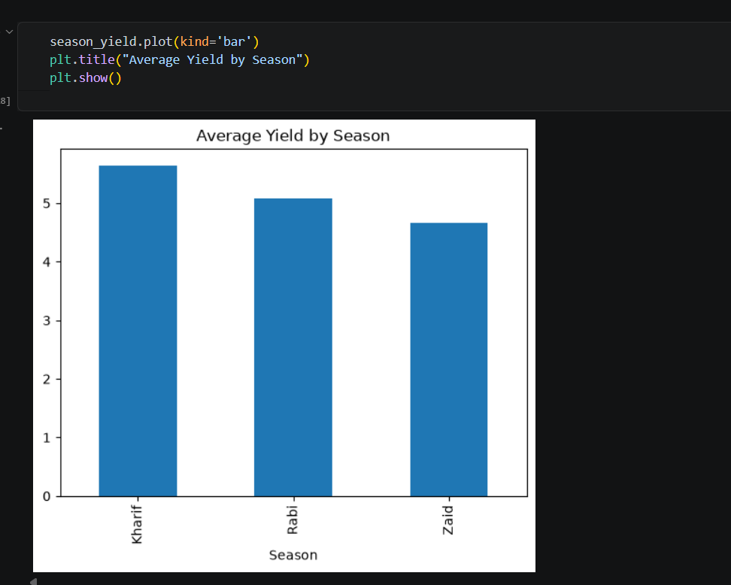
RESULTS
1.Average Yield by Season
Observation: The bar chart shows the average crop yield (tonnes per hectare) across different agricultural seasons. Among the three seasons, Kharif recorded the highest average yield, followed by Rabi, while Zaid showed the lowest average yield.
Interpretation: This indicates that agricultural productivity is influenced by seasonal conditions. The higher yield during the Kharif season may be associated with favorable environmental factors such as rainfall, temperature, and soil moisture, whereas the Zaid season appears to provide comparatively less favorable conditions for crop production.
Key Insight: Agricultural performance varies across seasons, and the Kharif season demonstrates the best overall yield performance in the dataset. This highlights the importance of considering seasonal factors in agricultural planning and resource management.

Slide 7
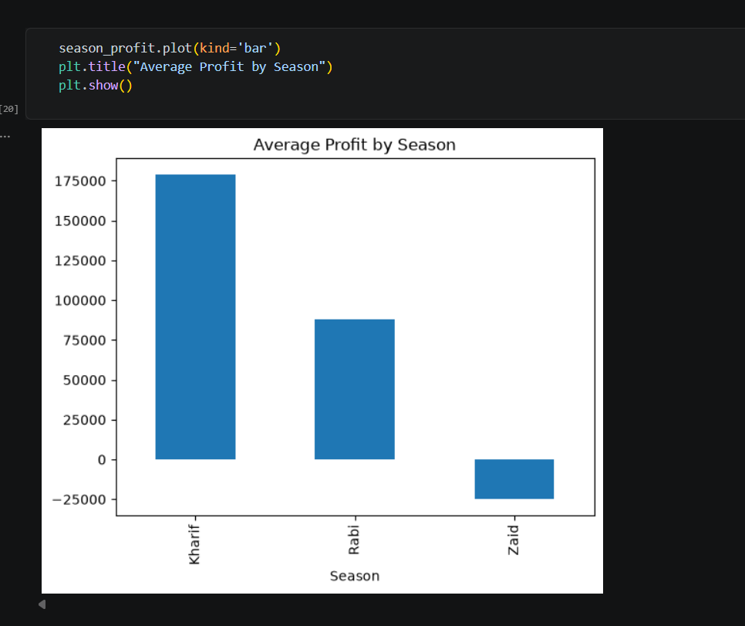
RESULTS
2: Average Profit by Season
Observation: The bar chart shows the average profit earned during different agricultural seasons. Kharif season generated the highest average profit, followed by Rabi season. In contrast, the Zaid season recorded a negative average profit, indicating a loss during that period.
Interpretation: The results suggest that economic performance varies significantly across seasons. The high profitability during the Kharif season may be due to better crop yields and favorable environmental conditions. The negative profit observed in the Zaid season indicates that production costs may have exceeded revenue, making it the least economically favorable season.
Key Insight: Among all seasons, Kharif is the most profitable season, while Zaid presents the highest financial risk. These findings highlight the importance of seasonal planning and efficient resource management to improve agricultural profitability.

Slide 8
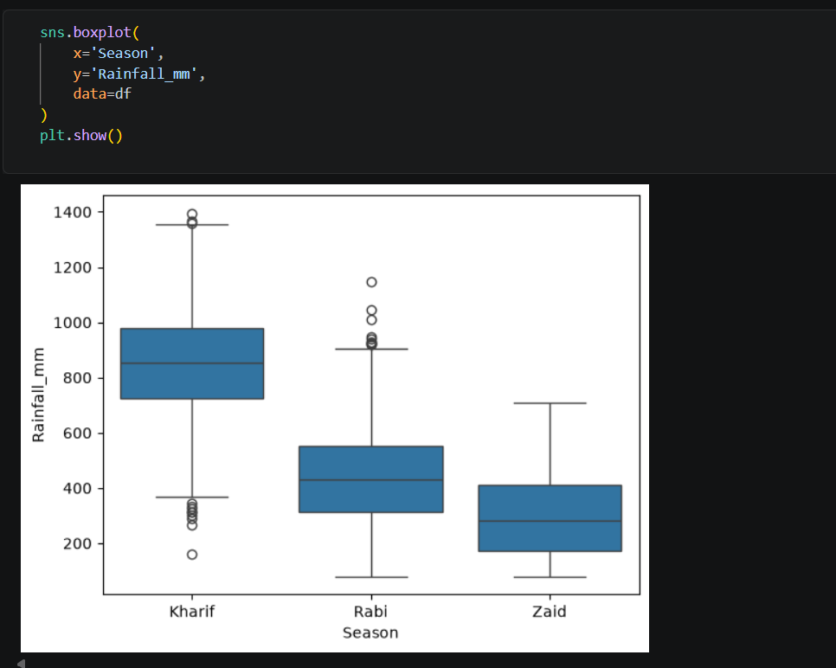
RESULTS
3: Rainfall Distribution Across Seasons
Observation: The box plot illustrates the distribution of rainfall across the Kharif, Rabi, and Zaid seasons. Kharif season receives the highest rainfall, with a median rainfall significantly greater than the other seasons. Rabi receives moderate rainfall, while Zaid experiences the lowest rainfall levels.
Interpretation: The variation in rainfall across seasons reflects the differences in climatic conditions. Kharif, being the monsoon season, benefits from abundant rainfall, whereas Zaid is comparatively drier. The presence of outliers indicates that some regions or farming areas experienced unusually high or low rainfall compared to the seasonal average.
Key Insight: Rainfall patterns vary considerably across seasons, with Kharif showing the highest rainfall availability. This seasonal difference in rainfall can influence crop growth, water requirements, and overall agricultural performance.

Slide 9
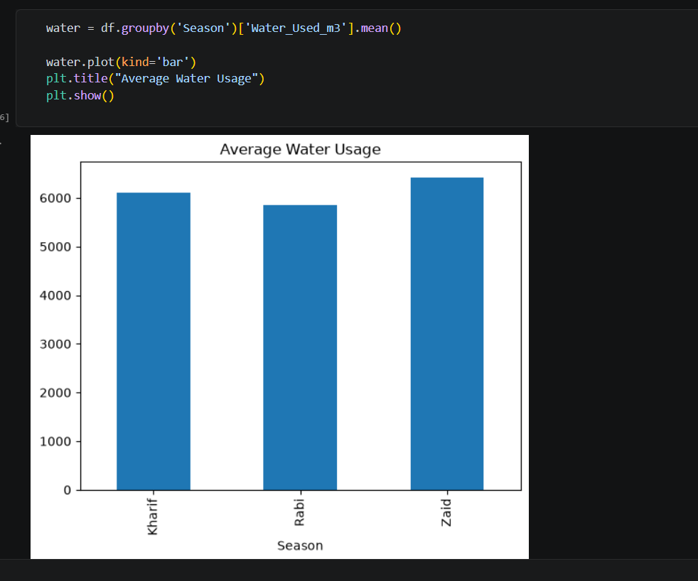
RESULTS
4: Average Water Usage by Season
Observation: The bar chart presents the average water consumption across different agricultural seasons. Zaid season shows the highest average water usage, followed by Kharif, while Rabi season records the lowest water usage among the three seasons.
Interpretation: The higher water consumption during the Zaid season may be due to lower natural rainfall and greater dependence on irrigation for crop cultivation. In contrast, the Rabi season requires comparatively less water, indicating more efficient water utilization or favorable environmental conditions.
Key Insight: Water usage varies across seasons, with Zaid being the most water-intensive season. Understanding seasonal water requirements can help in planning irrigation strategies and improving resource management for sustainable agriculture.

Slide 10
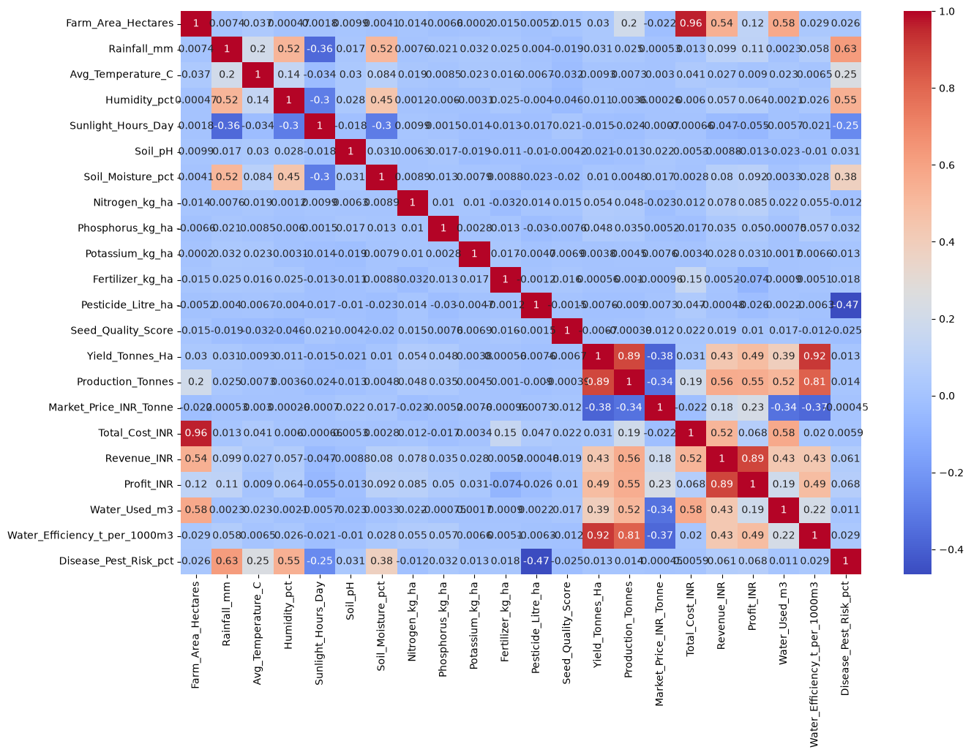
RESULTS
5: Correlation Analysis Heatmap
Observation: The correlation heatmap shows the relationships between various agricultural, environmental, and economic factors in the dataset. Strong positive correlations can be observed between Yield and Production, Revenue and Profit, and Yield and Water Efficiency. Some variables show weak or negative correlations, indicating limited or inverse relationships.
Interpretation: The analysis suggests that higher crop yield contributes significantly to increased production and profitability. Revenue and profit are strongly related, indicating that improvements in production performance positively impact economic outcomes. Environmental factors such as rainfall, humidity, and soil moisture also show relationships with agricultural performance indicators.
Key Insight: The heatmap helps identify the most influential factors affecting agricultural performance. Understanding these relationships can support better decision-making, efficient resource utilization, and improved seasonal agricultural planning.

Slide 11
Future scope
Real-Time Data Integration Future versions of the project can incorporate real-time weather and agricultural data to provide more accurate seasonal analysis.
Predictive Analytics Machine learning models can be used to predict crop yield, production, and profitability based on environmental and resource-related factors.
Region-Wise Analysis The study can be extended to compare seasonal agricultural performance across different geographical regions and states.
Advanced Resource Optimization Further analysis can help optimize water, fertilizer, and irrigation usage to improve productivity and reduce costs.
Decision Support System The insights generated from the analysis can be integrated into a decision support system to assist farmers and agricultural planners in making data-driven decisions.
Crop Recommendation System Future work can include recommending suitable crops for specific seasons based on environmental conditions and historical performance data.
Sustainable Agriculture Planning The analysis can be expanded to evaluate sustainable farming practices and their impact on agricultural productivity and profitability.

Slide 12
GitHub Link
https://github.com/KeertanaHoli/Seasonal-Agricultural-Performance-Analysis.git

Slide 13

VOIS Course completion certificate - Course name- Data Visualization

Slide 14
Thank you
.
.

