Slide 1
The Rojobot World

Slide 2
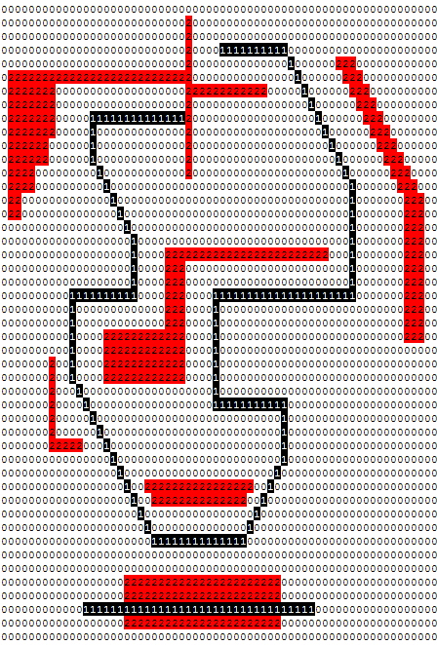
Rojobot Lab – Automated Line Tracking Robot
Demo Track
Maps are:
0-0x7F (0-127) by
0-0x7F (0-127)
Your Rojobot Lab should display a BOT icon moving around the track

Slide 3
Videos
Two videos on D2L in the labs areas. Shows the automated rojobot tracking 2 different maps.
Right turns only video
Right and Left turns video

Slide 4
Rojobot31 IP Block Diagram Hookup
LMDist and
RMDist have
been deprecated
do not use
Rojobot31 top level is bot31_top.v

Slide 5
Instantiate the rojobot31 and map(s)
Make a new Rojobot module inside swervolf_core.v
This will contain Wishbone register access and connecting up to the IP
This will contain the rojobot31 instantiation
The map or multiple map Memories can be instantiated there too
rojobot31_0 robot (
.MotCtl_in(MotCtl_in_75), // input wire [7 : 0] MotCtl_in
.LocX_reg(LocX_reg), // output wire [7 : 0] LocX_reg
.LocY_reg(LocY_reg), // output wire [7 : 0] LocY_reg
.Sensors_reg(Sensors_reg), // output wire [7 : 0] Sensors_reg
.BotInfo_reg(BotInfo_reg), // output wire [7 : 0] BotInfo_reg
.worldmap_addr(worldmap_addr), // output wire [13 : 0] worldmap_addr
.worldmap_data(worldmap_data), // input wire [1 : 0] worldmap_data
.clk_in(clk_75), // input wire clk_in
.reset(~rstn_75), // input wire reset
.upd_sysregs(upd_sysregs), // output wire upd_sysregs
.Bot_Config_reg(debounced_SW_75) // input wire [7 : 0] Bot_Config_reg
);
world_map world_map(
.clka(clk_75),
.addra(worldmap_addr),
.douta(worldmap_data_part_1),
.clkb(clk_75),
.addrb(vid_addr),
.doutb(world_pixel_part_1)
);

Slide 6
Add Rojobot, Clock Generator IP, Map
As described in Project 2 documentation
Add the Rojobot to the IP Integrator
Add the ece540_ip_repo folder to the list of IP repositories for the IP Integrator to search. You can do this by clicking on FlowNavigator/ProjectManager/Settings/Project Settings/IP/Repository and adding the folder location of ece540_ip_repo.
Add the Rojobot IP
Search for rojobot in IP Catalog, double click it.
Manual instantiation needed
Add the Clock Generator IP for 100->75Mhz clock generator
Apply desired options
Manual instantiation needed
Need to connect up the signals through the hierarchy still
Add the World Map source directory(s)
Instantiate the world map(s)

Slide 7
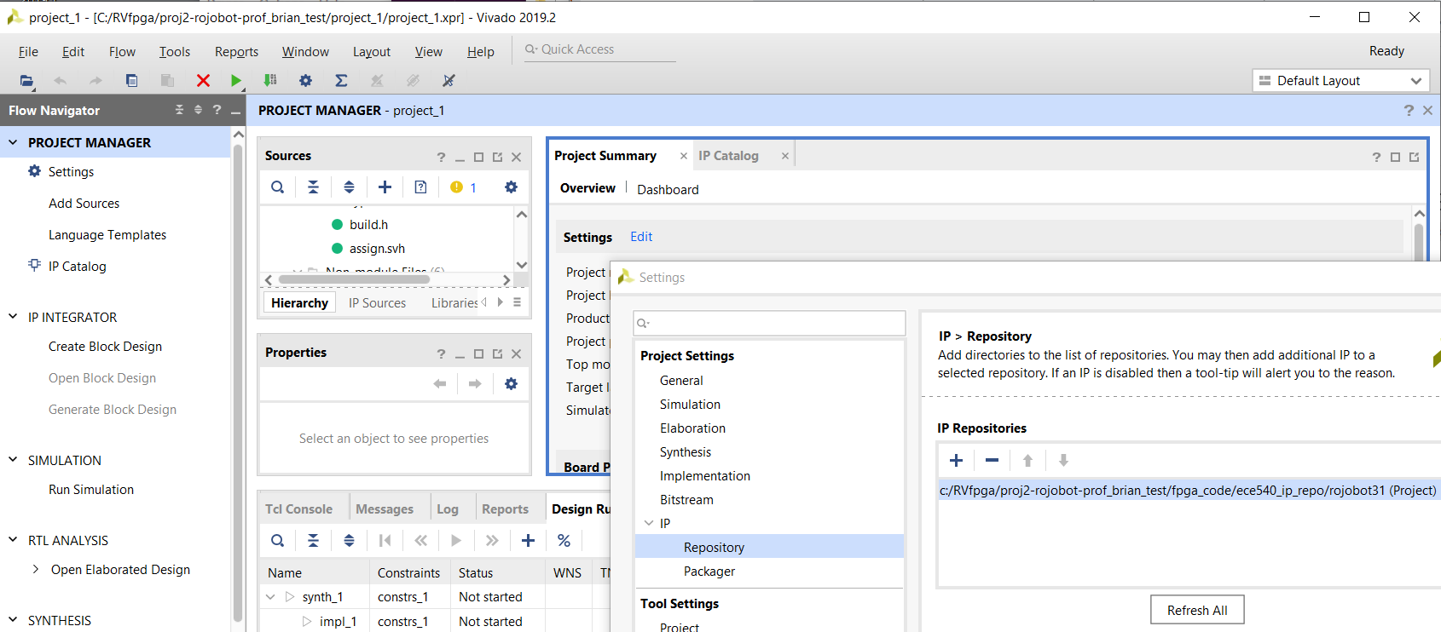
Vivado 2019.2 Rojobot IP directory add
Project Manager, Settings, IP, repository, + the directory

Slide 8
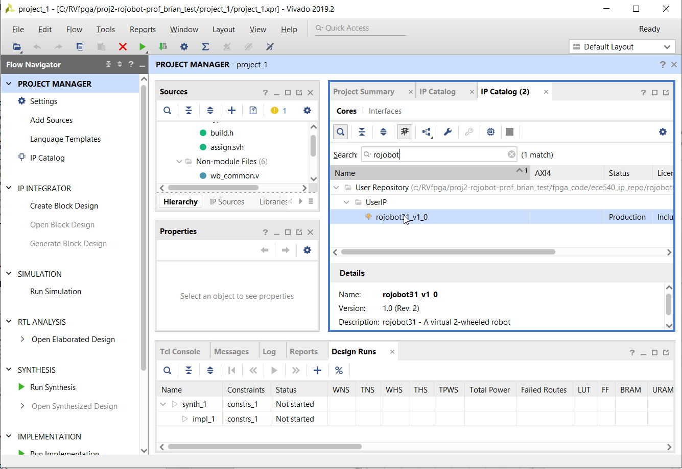
Add Rojobot IP
Click IP catalog, search for rojobot, then double click rojobot.
Generate out of context IP

Slide 9
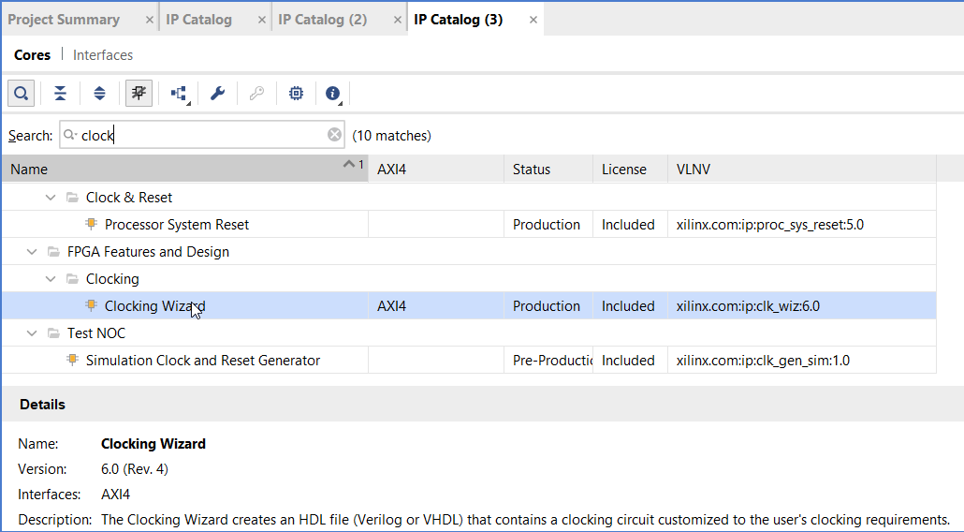
Clock Wizard and options
Double click as shown below inside IP catalog
Clk_in1: custom
Clk_in2: custom
Ext_reset_in: custom
Primitive: mcmm
Clk_in1: 100Mhz
Clk_out1: 75Mhz
Port name: clk_75
Unchecked: Locked

Slide 10
Clk wizard instantiation
Template found at: Project Sources -> clk_wiz_0 -> Installation Template
clk_wiz_0 clock_divider (
// Clock out ports
.clk_75(clk_75), // output clk_75
// Status and control signals
.reset(rst_core), // input reset
// Clock in ports
.clk_in1(clk));

Slide 11
World Maps
Add the Verilog file that instantiates the RAM
hdl_part1/world_maps_part1/world_map.v
hdl_part1/world_maps_part1/world_map.ngc
For other maps change the ngc file to one of the other directories
world_maps/world_map_lr/world_map.ngc
world_maps/world_map_loop/world_map.ngc
The world_map ROM takes the module name from the ngc name.
So if you want to load more than one, change the names of the .ngc files and load more than one
Then instantiate all of them with separate world_map.v that match the changed .ngc name and mux the different map outputs depending on a switch or something.

Slide 12
Reseting/pausing the RojoBot World
Reset does not reset the rojobot back to the starting place. You will need to turn the Eval board off/on and reinstall the bitstream.
There is a way to fix this, but I need to figure it out.
When you pause/debug your code, the rojobot PicoBlaze still is running, so if your last command was with motors on, it will keep doing that operation even though you paused the RiscV since PicoBlaze is not paused.
These two items have always been a challenge left to the student. Do not spend time on fixing either these until your code is finished or almost finished.

Slide 13
Rojobot Registers Interface
Motor Control register (left/right motors)
Location registers (location on a 128x128 map)
Bot Info Register (Motor status and Compass Direction)
Sensor Register (Black line, obstruction detection)

Slide 14
Input: Motor Control
7 5 4 3 1 0
LMSpd[2:0] | LMDir | RMSpd[2:0] | RMDir
LMSpd[2:0] Left motor speed. This 3-bit binary value sets the speed of the left motor, and thus how fast the left wheel is moving
LMDir Left motor direction This bit sets the rotation direction of the left wheel. Setting the bit to ‘1’ causes the wheel to move clockwise (forward). Setting the bit to ‘0’ causes the wheel to move counterclockwise (reverse)
RMSpd[2:0] Right motor speed. This 3-bit binary value sets the speed of the right motor, and thus how fast the right wheel is moving
RMDir Right motor direction This bit sets the rotation direction of the right wheel. Setting the bit to ‘1’ causes the wheel to move clockwise (forward). Setting the bit to ‘0’ causes the wheel to move counterclockwise (reverse)

Slide 15
Output: Location Registers
7 0
Location X Reg
0 | X[6] | X[5] | X[4] | X[3] | X[2] | X[1] | X[0]
7 0
Location Y Reg
0 | Y[6] | Y[5] | Y4] | Y[3] | Y[2] | Y[1] | Y[0]
X[6:0] - X coordinate (column address) of the RojoBot. This is an unsigned binary number running from 0 (left) to 127 (right)
- The Rojobot is placed in the middle of its world whenever the simulator is initialized
- In a 128 x 128 world the initial X-coordinate is 64 (0x40)
Y[6:0] - Y coordinate (row address) of the RojoBot. This is an unsigned binary number running from 0 (top) to 127 (bottom)
- The Rojobot is placed in the middle of its world whenever the simulator is initialized
- In a 128 x 128 world the initial Y-coordinate is 64 (0x40)

Slide 16
Output: Bot Info Register
7 3 2 0
Mvmt[3:0] | 0 | Orient[2:0]
Mvmt[3:0] Current movement (or action) of the RojoBot. Mvmt is based on the direction the RojoBot’s wheels are turning. The Rojobot is stopped when the simulator is initialized
Orient[2:0] Orientation (or heading) of the RojoBot. The orientation of the RojoBot is the direction the RojoBot is moving in the world. The RojoBot faces East in its world when the simulator is initialized
Setting the Bot’s heading is done by asserting the motor control inputs
to turn the Rojobot right or left until it reaches the desired heading and then stopping or making the Rojobot move forward or reverse.

Slide 17
Bot Info Register Decoder Ring
Mvmt [3:0] | Action | Motor Settings
00 | Stopped | Left and right motor off
04 | Forward | Left and right motor forward (clockwise)
08 | Reverse | Left and right motor reverse (counterclockwise)
0C | Slow left turn (1X) | Left motor off, Right motor forward -or- Left motor reverse, Right motor off
0D | Fast left turn (2X) | Left motor reverse, Right motor forward
0E | Slow right turn (1X) | Left motor forward, Right motor off, –or- Left motor off, Right motor reverse
0F | Fast right turn (2X) | Left motor forward, Right motor reverse
Orient [2:0] | Heading (degrees) | Direction
00 | 0 | North
01 | 45 | Northeast
02 | 90 | East
03 | 135 | Southeast
04 | 180 | South
05 | 225 | Southwest
06 | 270 | West
07 | 315 | Northwest

Slide 18
Output: Sensors Register
Map - These bits contain the value of the map bits for the current location
x - This bit is reserved for future enhancements (perhaps provided by you). It is driven to 0 in the current implementation
ProxL - Proximity Sensor, Left. ProxL returns ‘1’ if the Bot detects an obstacle to the left or in front of it. The sensor returns ‘0’ if there is no obstacle. The proximity sensors are detecting obstacles one location ahead of the Bot’s current position.
ProxR - Proximity Sensor, Right. ProxR returns ‘1’ if the Bot detects an obstacle to the right or in front of it. The sensor returns ‘0’ if there is no obstacle.
BlkLL - Black Line Sensor, Left. BlkLL returns ‘0’ if the left front of the Bot is over a black line. The sensor returns a ‘1’ if no black line is present under the sensor.
BlkLC - Black Line Sensor, Center. BlkLC returns ‘0’ if the center front of the Bot is over a black line. The sensor returns a ‘1’ if no black line is present under the sensor.
BlkLR - Black Line Sensor, Right. BlkLR returns ‘0’ if the right front of the Bot is over a black line. The sensor returns a ‘1’ if no black line is present under the sensor.

Slide 19
The Rojobot31 Sensors Point of View
Black Line Sensor
Located under the front of Rojobot and is exactly the width of the black line. Two values: 111 = no black line, 000 = black line
Proximity Sensor
Looks ahead one location to adjacent locations
Detects barriers two locations ahead when orientation is 45°, 135°, 225°, or 315°

Slide 20
The Rojobot Video Controller
Acknowledgement: Some of this material comes from the Digilent Nexys 4 Board Reference Manual

Slide 21
Translating Pixel/Icon map to VGA port
Rojobot Map is 128x128 low res
Icon will be 16x16 high res (Overlaps 4x4 Rojobot pixels)
VGA is 1024x768
Scale the Rojobot Map to 512x512 initially
Scale the Rojobot Map to 1024x768 eventually
VGA cable continuously scans each pixel horizontally line by line and then starts at the top of the screen again
VGA is controlled by 5 main signals
Hsync to indicate end of a line
Vsync to indicate end of the screen
Red/Green/Blue analog lines
(controlled digitally by our FPGA through resistor network)

Slide 22
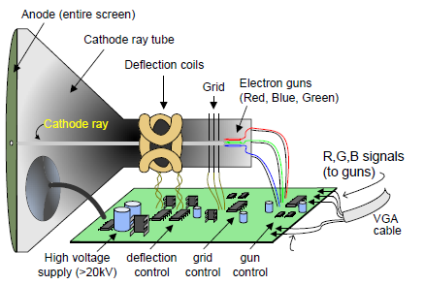
The VGA CRT
LCD panel displays and flat panel TVs
often support a VGA input but are not necessarily raster devices
Image source: Digilent Nexys 4 Board Reference Manual

Slide 23
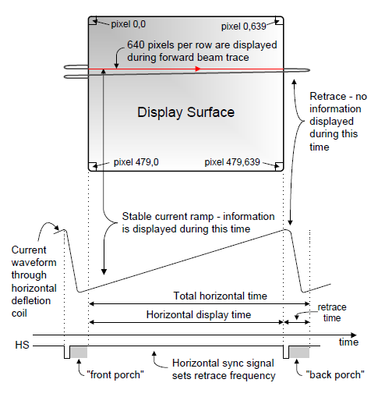
Sequencing pixel data to the display
VGA compatible displays use the Raster format developed years ago for CRTs, even though flat panel displays are not raster scanned
Transfers one pixel at a time
Starts at upper left corner of display – scans right to end of row
Rows sequenced from top to bottom
Horizontal Sync pulse indicates new row
Vertical Sync pulse indicates new frame
(row,col)
This example:
640 columns x 480 rows
or
480 rows by 640 columns
Image source: Digilent Nexys 4 Board Reference Manual

Slide 24
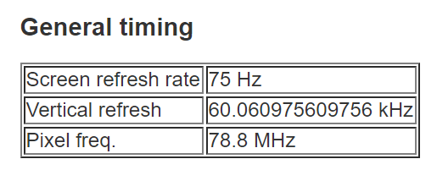
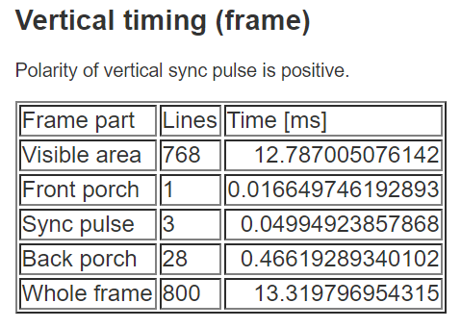
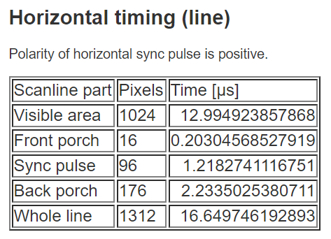
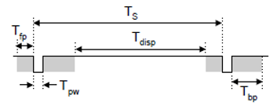
XVGA 1024 x 768 @ 60 Hz timing
1024 x 768 display
75MHz pixel clock
60Hz refresh rate (60 frames/second)
“Blanking” time, during which no pixel data is delivered, allows electron beam to “retrace”
Source http://tinyvga.com/vga-timing/1024x768@60Hz

Slide 25
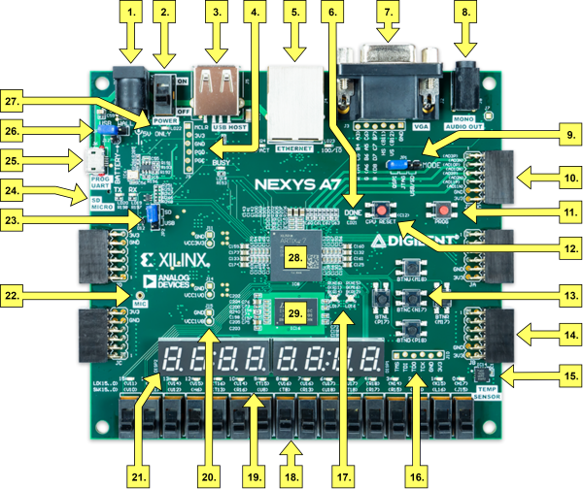
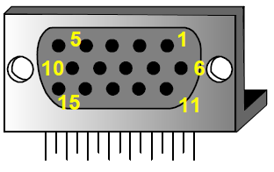
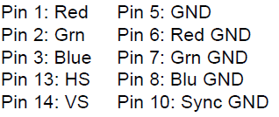
Digilent Nexys A7 VGA
Image source: Digilent Nexys A7 Board Reference Manual

Slide 26
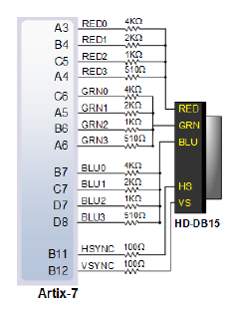
Digilent Nexys A7 VGA (cont’d)
4-bits of intensity per color for
12-bit color - 4096 possible colors
Image source: Digilent Nexys A7 Reference Manual

Slide 27
Display Timing Generator
Generates timing signals for 1024 x 768 (XVGA) display
Implements 12-bit row and column counters
Inputs
75MHz Clock
Outputs
vert_sync (Vertical Sync)
horiz_sync (Horizontal Sync)
pixel_row, pixel_column (horizontal and vertical position of the pixel being written to the display)
video_on (enable video display)

Slide 28
Rojobot Video Controller (inside swervolf_core.v)
Display Timing Gen
vSync
75 MHz pixel clock
hSync
RojoBotCtlr
WB
R/W
Ctl
Hand shake
RTL
Scalar
Map colorizer
Memory mapped I/O interface to RVfpga system
world_pixel[1:0]
video_on
Rojobot
Final Colorizer
vgaRed[3:0]
pixel_column
pixel_row
LocY_reg
LocX_reg
BotInfo_reg
vgaGreen[3:0]
vgaBlue[3:0]
Icon colorizer
Icon_pixel[1:0]
Wishbone interconnect needs to be modified again
VGA signals need to propagate to the top to new ports
Add the signals in the xdc file.

Slide 29
Rojobot Example Module definition
module rojobot_controller(
// System
input wire clk, // 100MHz clock
input wire rstn, // reset active low
input wire clk_75, // 75MHz clock
input wire [15:0] debounced_SW, // the switches
// WISHBONE Interface
input wire [31:0] wb_adr_i,
input wire [31:0] wb_dat_i,
input wire [3:0] wb_sel_i,
input wire wb_we_i,
input wire wb_cyc_i,
input wire wb_stb_i,
input wire [2:0] wb_cti_i,
input wire [1:0] wb_bte_i,
output reg [31:0] wb_dat_o,
output reg wb_ack_o,
output wire wb_err_o,
output wire wb_rtry_o,
// VGA
input wire [11:0] pixel_column, // VGA screen column
input wire [11:0] pixel_row, // VGA screen row
input wire video_on, // VGA signal for visible region
output wire [ 3:0] VGA_R, // VGA red channel
output wire [ 3:0] VGA_G, // VGA green channel
output wire [ 3:0] VGA_B // VGA blue channel
);
Rojobot_controller Contains:
Handshake FF
World Maps
Rojobot IP
WB registers for Rojobot
Synching of 100Mhz to 75 Mhz signals
Vga Scalar
Map Colorizer
Rojobot Icon
Colorizer

Slide 30
Robot Icon Example Module Definition
module robot_icon (
input wire signed [31:0] pixel_row,
input wire signed [31:0] pixel_column,
input wire signed [31:0] LocX_reg,
input wire signed [31:0] LocY_reg,
input wire [7:0] BotInfo_reg,
input wire clk,
input wire reset,
output reg [11:0] icon
);

Slide 31
VGA Scalar Example Module Definition
module vga_scaler_v2(
input [11:0] pixel_row, pixel_column, // input pixel coordinates
output [13:0] vid_addr, // concatenation of {world row, world column}
output out_of_map // indicate if the given pixel coordinates out-of-map (1) or not (0)
);
This converts the current VGA Pixel/row to an address to send to the World Map Memory(s)
The World Map output is then combined with the Icon

Slide 32
Map Colorizer Example Module definition
module map_colorizer (
input wire [1:0] map_value, // map value returned from the map memory
input wire [11:0] pixel_row, // pixel row from the dtg
input wire [11:0] pixel_column, // pixel column from the dtg
output reg [11:0] map_color
);
The map color could be a single color or this could give you an opportunity to add texture to a given World Map block.

Slide 33
Final Colorizer example Module Definition
module colorizer_v2(
input [11:0] icon,
input [11:0] map_color,
input [11:0] title_color,
input video_on,
output reg [3:0] VGA_R,
output reg [3:0] VGA_G,
output reg [3:0] VGA_B
);

Slide 34
Display Timing Generator Module
module vga_dtg(
input wire clock, rstn,
output reg horiz_sync, vert_sync, video_on, output reg [11:0] pixel_row, pixel_column
);

Slide 35
DTG output
You will map the 128x128 Rojobot world and 512x512 icon space to a 768x1024 display
HS
VS
0
pixel_column
1023
1053
1189
1327
0
Viewable Image on Display
video_on = 1
pixel_row
767
773
779
Blanking
video_on = 0
805
Verilog: dtg.v
Notes:
Clock 75Mhz – 13.3ns period (vs. spec of 65MHz) is within 14% of spec
Tpw for Horiz Sync 13.3ns * 136 = 1.8 usec (vs spec of 2.09)
Ts for Horiz Sync = 13.3ns *1327 =17.65 usec (vs. spec of 20 usec)
Tpw for Vert Sync = 6 *13.3ns = 119.7ns (vs. spec of 124ns)
Whole frame = 806 * 1344 * 13.3ns = 14.4ms (vs. spec of 16.5ms)

Slide 36
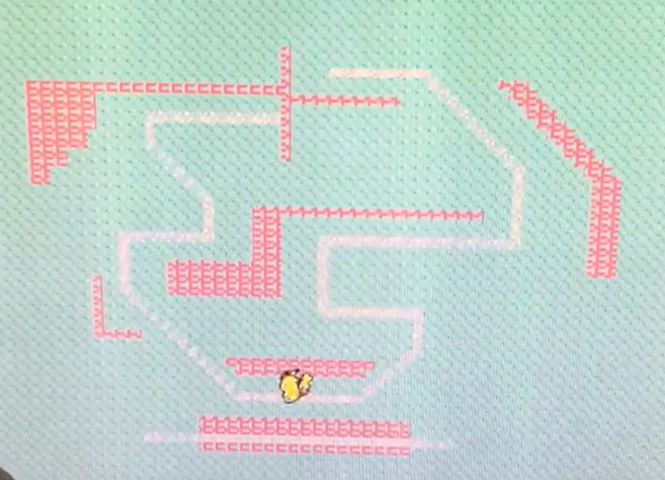
Icon vs Rojobot map
Deepen and Thong's project last year
See higher detail 16x16 on Icon overlapping 4x4 map squares
See the overlay of transparent icon

Slide 37
Icon Generator
Store a 16 x 16 pixel image of RojoBot icon
Two stored bits represent one pixel:
00 = transparent; 01, 10, 11 = three icon color choices;
The icon does not need not be rectangular
Design your own icon – be creative!
Moves around the screen on top of world background
LocX, LocY inputs from Rojobot emulation determines vertical and horizontal position of Rojobot and therefore the icon
Scale & compare LocX, LocY values against current row and column values from DTG to decide whether to display the icon
You can show orientations using vertical/horizontal flip
One bitmap for 0, 90, 180, 270 degrees
2nd bitmap for 45, 135, 225, 315 degrees
… or you can implement individual icons for each direction
Inputs: Clock, reset, row, column, LocX, LocY, BotInfo (orientation)
Output: icon_pixel[1:0]
Icon is positioned every 4 pixels because 512x512 maps nicely to 128x128 world map coordinate system
But the icon resolution is 512x512 for a more detailed picture. The Icon is higher resolution than map.
You will need to fit 512x512 to 768x1024, so each 512x512 pixel covers 1.5 x 2 display pixels, in the past students have used a number of approximations
512 goes into 1024 (2x) evenly, but not 768 (1.5x)
VGA display pixels
Icon space pixel

Slide 38
Implementing a ROM
Implementing a ROM or Initialized RAM is fairly easy
Infer a block or distributed memory
Read the memory contents in a hex format with
initial
begin
$readmemh(initialization_filename, memory_array_reg)
end
https://projectf.io/posts/initialize-memory-in-verilog/
https://timetoexplore.net/blog/tag/memory
Use the Ram Wizard and use the COE initialization format
http://web.mit.edu/6.111/volume2/www/f2019/handouts/labs/lab3_19/rom_vivado.html
Infer a ROM with a case statement:
https://www.xilinx.com/support/answers/7140.html
look at the methods used to create the RojoBot World Map

Slide 39
Colorizer Module
Uses a color look-up table to convert the two pixel inputs from the world map and the icon to a 12-bit screen color so that icon appears in front of the background
Colors are 12-bit values of your choice {red(4 bits), green (4 bits), blue(4 bits)}
World[1:0] | Icon[1:0] | Color
00 | 00 | Background
01 | 00 | Black Line
10 | 00 | Obstruction
11 | 00 | Reserved
x | 01 | Icon color 1
x | 10 | Icon color 2
x | 11 | Icon color 3

Slide 40
Assign Rojobot Lab

Slide 41
Rojobot Lab Overview
Learning objectives:
Gain experience designing an SoC with an embedded CPU, 3rd party IP, and custom hardware
Gain experience implementing an icon-based VGA video controller
Gain experience writing assembly language for the RVfpga softcore CPU
Learn SoC simulation (optional) and debug techniques
Administrivia:
Team will use GitHub and GitHub classroom to manage this assignment
Teams of 2

Slide 42
Rojobot Lab Tasks
Given:
RVfpga Release 2 and your Project #1 implementation
“Off-the-shelf” IP in the form of the Rojobot31 custom IP block
Pages and pages of documentation
Tasks:
Understand how to make the Rojobot do what you want it to do
Understand the changes you need to make to your SimpleBot Lab hardware for Rojobot Lab
Get the Proj2Demo system built and running
Understand the Proj2Demo application code
Add memory mapped I/O for access to the Rojobot31 registers by the application software
Create/debug a top-level rvfpga.sv
Add a world map to your Vivado project
Modify main.s in the Rojobot lab Proj2Demo firmware to match your Rojobot I/O interface design
Synthesize, implement, download, assemble Proj2Demo code and confirm that the Proj2Demo system runs correctly

Slide 43
Project #2 Tasks (cont’d)
Write firmware (RVfpga assembly code) to traverse a right-turn-only track:
Create/debug a RiscV Assembly language program to perform black-line following
Make a copy of, rename, and modify, main.s from Proj2Demo
Synthesize, implement and generate the FPGA programming file
Confirm that your SoC and your application is working correctly
You may want to use world_map_part1 (in world_map_part1 folder) as your test case. You only have the 7-segment display and LEDs to look at so the simpler the track, the easier it is to confirm that your algorithm is working correctly.
The file Proj2 Bot Tracker.pdf will help

Slide 44
Project #2 Tasks (cont’d)
Add a video controller:
Design and implement the colorizer module.
Design and implement the icon module.
Add a clock generator using the Xilinx IP Integrator
Add VGA signal output ports to nexys4_ddr.v and modify the nexys4_ddr.xdc constraints file accordingly
Check/fix your Project 2 application program to make sure it successfully traverses world_map_loop - this world map is more difficult to traverse than world_map but consists of only right turns
(if necessary) Modify your application to handle both right and left turns
Replace (or add) a world map to your project
Debug and demonstrate your final application with video using the world_map_lr track which contains right and left turns
Document your work and do a final push of your deliverables and documentation to you GitHub team repository

Slide 45
Add Wishbone Control Registers
Make a module for all rojobot control registers
Modify the wb interconnect for the new address space
0x8000180c Bot Info Read Port
0x80001810 Bot Control
0x80001814 Bot update Read Port
0x80001818 Bot Int Ack
Make control inside rojobot control module for wb read/write/ack control. 2 cycle access preferred right now.

Slide 46
Pushbuttons
Current demo code
Pushbutton GPIO is set to addresses
0x80001600
Currently it does not set enable bits for pushbuttons and should default to inputs. Maybe add an enable control?
Pushbutton order in code:
LEDMSK_BTN_CENTER = 0x10 # Pushbutton Center is bit 4
MSK_BTN_LEFT = 0x08 # Pushbutton Left is bit 3
MSK_BTN_UP = 0x04 # Pushbutton Up is bit 2
MSK_BTN_RIGHT = 0x02 # Pushbutton Right is bit 1
MSK_BTN_DOWN = 0x01 # Pushbutton Down is bit 0

Slide 47
7-Segment additions
Make sure top 4 segments work
Address: 0x8000101c
Make control of decimal points
Add control up to the top package pin
Add a register to control it: 0x80001018
Lower priority
Assembly code counts on 8 bits per segment like I think most people have done.
Single segments are 0x10-0x16
Extra characters in assembly code
CC_UCH = 0x17 # Upper Case H
CC_UCL = 0x18 # Upper Case L
CC_UCR = 0x19 # Upper Case R
CC_LCL = 0x1A # Lower Case L
CC_LCR = 0x1B # Lower Case R
CC_SPACE = 0x1C # Space (blank)

Slide 48
Add WB Registers to Rojobot Ctl Module
Ack Control WB Example
always @(posedge clk, negedge rstn)
begin
if (~rstn) begin
wb_ack_o <= 0;
end
else begin
wb_ack_o <= wb_cyc_i & wb_stb_i & !wb_ack_o;
end
end
Read Control WB Example
always @ (posedge clk, negedge rstn) begin
if (~rstn) begin
wb_dat_o <= 32'h00_00_00_00;
end
else begin
case (WB_HADDR)
8'h0C: wb_dat_o <= WB_H_BOT_INFO; // bot info
8'h14: wb_dat_o <= {31'h00_00_00_00, WB_H_BOT_UPDATE_SYNC}; // update sync
endcase
end
end
Write Control WB Example
always @(posedge clk, negedge rstn) begin
if (~rstn) begin
WB_H_INT_ACK <= 1'b0;
WB_H_BOT_CTRL <= 8'h00;
end
else if ( wb_cyc_i & wb_stb_i & wb_we_i & !wb_ack_o & wb_sel_i[0]) begin // Possibly wb_ck_o instead.
case (WB_HADDR)
8'h10: WB_H_BOT_CTRL <= wb_dat_i[7:0]; //bot control
8'h18: WB_H_INT_ACK <= wb_dat_i[0]; // int ack
endcase
end
end

Slide 49
Synch signals between rvfpga and rojobot
Any signals that are going between the rvfpga at 100Mhz and the rojobot at 75Mhz should be synchronized with a FF
Simple do an always @ block with the clock it is going to with new registers to store the values at the desired new clock
We normally would be worried that this could cause metastability if the old data and the new clock are changing at the same time.
But we have an update control to guarantee the data is stable while being sampled.
Watch for update signal, read the new bot_info, then send the acknowledge

Slide 50
Project #2 Demo Block Diagram
mfp_sys
IO_BotCtrl = MotCtl_in
Bot31.v
IO_BotInfo = {LocX_reg,LocY_reg,Sensors_reg,BotInfo_reg}
IO_INT_ACK
Handshake flip-flop
IO_BotUpdt
IO_BotUpdt_Syncc
db_sw = Bot_Config_reg
50MHz
50MHz
75MHz
worldmap_addr
worldmap_data
world_map.v
75MHz
mfp_nexys4_ddr.v

Slide 51
Debug ideas
Remember you can view your memory space in PlatformIO
Stored variables
Read IO space
You can output things to your single LEDs or 7-segment for debugging.
You could make your write IO registers also read accessible and view them in PlatformIO
It is possible to embed a Digital Analyzer inside the FPGA to sample signals. To be discussed in later class.
https://www.xilinx.com/video/hardware/logic-debug-in-vivado.html
Before your VGA is working, you can watch your location and direction on the 7-segment LEDs. This can tell if you bot is doing the right thing in Manual or Auto mode.
There is a list of locations and turns to do for the right turn map that can be used to help the debug without vga.
Proj2 Bot Tracker.pdf

Slide 52
Following a Black Line (Right turns only)
Reset
INIT
STOP
This is just one algorithm
There are others
On Blk Line
ONLINE
FWD
Wall
Off Blk Line
~Reset
BLOCKED
STOP
Off Blk Line
REV2LINE
REV
ENDTURN
STOP
On Blk Line
Turned 45°
TURNING
SRT
Not turned 45°

Slide 53
Coding the automation
Store your last state in SP_NSA_STATE
State can be stored in one of two methods
A number indicating state (0,1,2,3,4)
An address of code you want to execute for a state

Slide 54
Coding the automation: State is an address
Initialize SP_NSA_STATE before main_L0: with "la"
la t0, state_online_moving # This is a later label with code
la t2, (SP_NSA_STATE)
sw t0, 0(t2)
Jump to current state at beginning of next_step_auto:
lw t0, (SP_NSA_STATE)
jr t0
You then need to code your different states.
Each section of code should start with the appropriate label for example:
state_online_moving:
Setting a new state when needed
la t0, state_rev2line
la t2, SP_NSA_STATE
sw t0, 0(t2)

Slide 55
Coding the automation: State is an address
Define your state numbers
STATE_ONLINE_MOVING = 0x00
STATE_REV2LINE = 0x01
Initialize SP_NSA_STATE before main_L0: with "li"
li t0, STATE_ONLINE_MOVING
la t2, (SP_NSA_STATE)
sw t0, 0(t2)
Check for value of SP_NSA_STATE and branch if equal at beginning of next_step_auto:
lw t0, (SP_NSA_STATE)
li t1, STATE_ONLINE_MOVING
beq t1, t0, state_online_moving
li t1, STATE_REV2LINE
beq t1,t0, state_rev2line
You then need to code your different states.
Each section of code should start with the appropriate label for example:
state_online_moving:
Setting a new state when needed
li t0, STATE_REV2LINE
la t2, SP_NSA_STATE
sw t0, 0(t2)

Slide 56
Right/Left Turn tracking
Similar to right
Main challenge is you don't want to try going straight backwards.
Need to keep track of where you last went forward along line for one square or a period of time
Different methods possible
Compared to original track: Rotate 45,90,135,225,270,315 degrees. Skip 180 degrees.
Compared to original track: Rotate 45, -45, 90, -90, 135, -135 degrees. Do not do 180 degrees relative to original track.
Very important. You need to save what was the last good straight track. You need to then set it again when you have gone straight again for a while.
When you start going forward after a turn, record your X/Y location
When your X/Y location has changed and you are on a black line still, you are going forward in a valid direction again.
Record this direction for when you go off line next time

Slide 57
Demo Code walk through
Defines at the top for addresses and masking. This makes the lower code easier to read.
Make sure it matches your address space.
Make sure 7-segment method match or change. We can give new 7-segment code possibly if needed.
_start:
Initialize variables for rojobot state, and IO registers
Initialize a button to MotoCtl lookup table
Initialize a movement to character code table
Set decimal points
Initialize some states that are not used yet: SP_*
_main_L0:
Read the Switch 15 to determine Manual/Auto tracking mode
Wait for new data from Rojobot module
Read, separate, and store data into variables
Next_loc jump: determine the digits for 7-segment display variables
Next_mvmt jump: determine movement character code
Next_hdg jump: determine compass according to BotInfo
Wr_alldigits jump
LED_wrLeds jump:
Clear ack to Rojobot
Next_step jump: Determine next step (Manual or Automatic)
Record state changes and next step, but do not wait in the automatic area
Loop back to _main_L0

Slide 58
Project #2 – Left/Right Track
Demo Track
IMPORTANT: The Project 2 demo should be done with world_map_lr.ngc
Maps are:
0-0x7F (0-127) by
0-0x7F (0-127)
Your Project #2 should display a BOT icon moving around the track

Slide 59
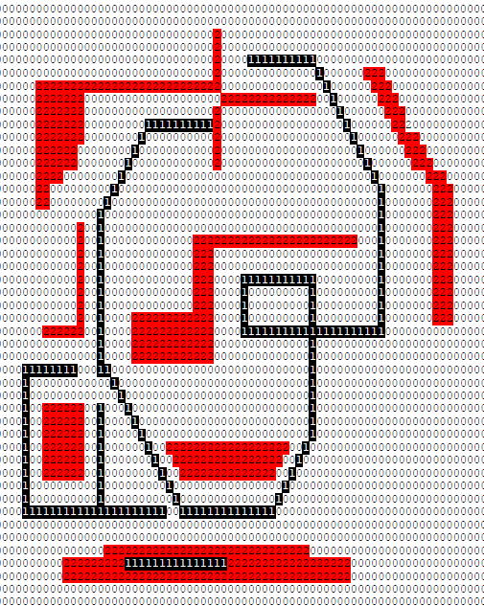
Project #2 – Complex Right-turn only Track
If you can’t get your Left/Right algorithm working you can demo with this track (right turn only) … but you will lose some points
Alternate Track

Slide 60
Multiple maps selectable
If you want, you can load all 3 maps into your design.
Then select which map is active with the slider switches
Make your own map with BotWorldDevKit

Slide 61
Project #2 Deliverables
Deliverables:
Demonstration of your project to the instructor or the T/A
In the demo we will expect your Rojobot icon to successfully traverse the assigned path
We will also expect the icon to rotate to show its orientation (0°, 45°, 90°, 135°, 270° and 315°)
Display will be on an LCD monitor in the lab being used as a VGA display
A Theory of Operation document (less than 10 pages)
Your report should include a flowchart, state diagram or pseudo-code and text explaining your black line following algorithm.
Source code for the Verilog module(s) you write
You do not need to include any simulation testbenches (simulation is optional)
Source code for the RiscV assembly language program(s) you write
Be sure to comment your Verilog and RiscV assembly code – you will lose lots of points for poor documentation!

Slide 62
Use GitHub as Teams
Please let us know your github username since it likely is different than your PSU username.
When sharing files with your team member through GitHub, do a pull before you do a push
You can fix a merge need by command line options and maybe other ways
rebase options are usually best for merges. If two people have modified the same file, you may want to double check the rebased file
You can and should push multiple times throughout the project. It can be useful for saving past versions in case you break something.
Each team member should check in their own code so we can see who is modifying which files and when. We can see when you got started and were active in the project.
Link to accept assignment. Coordinate so you only set up one repository per team. One person makes the team, the other joins it.
--- To be given soon ---
Please look inside your sweRVfpga.xpr file with a text editor and make sure it points only to sources inside your repository area. Fix or redo your sources if it is not correct.

Slide 63
Get Started as soon as you can
This is a complicated project
Each piece will take longer than you expect
If somehow you have extra time, you can do fancy things like Icon animation or new more complex maps

