Slide 1


Slide 2
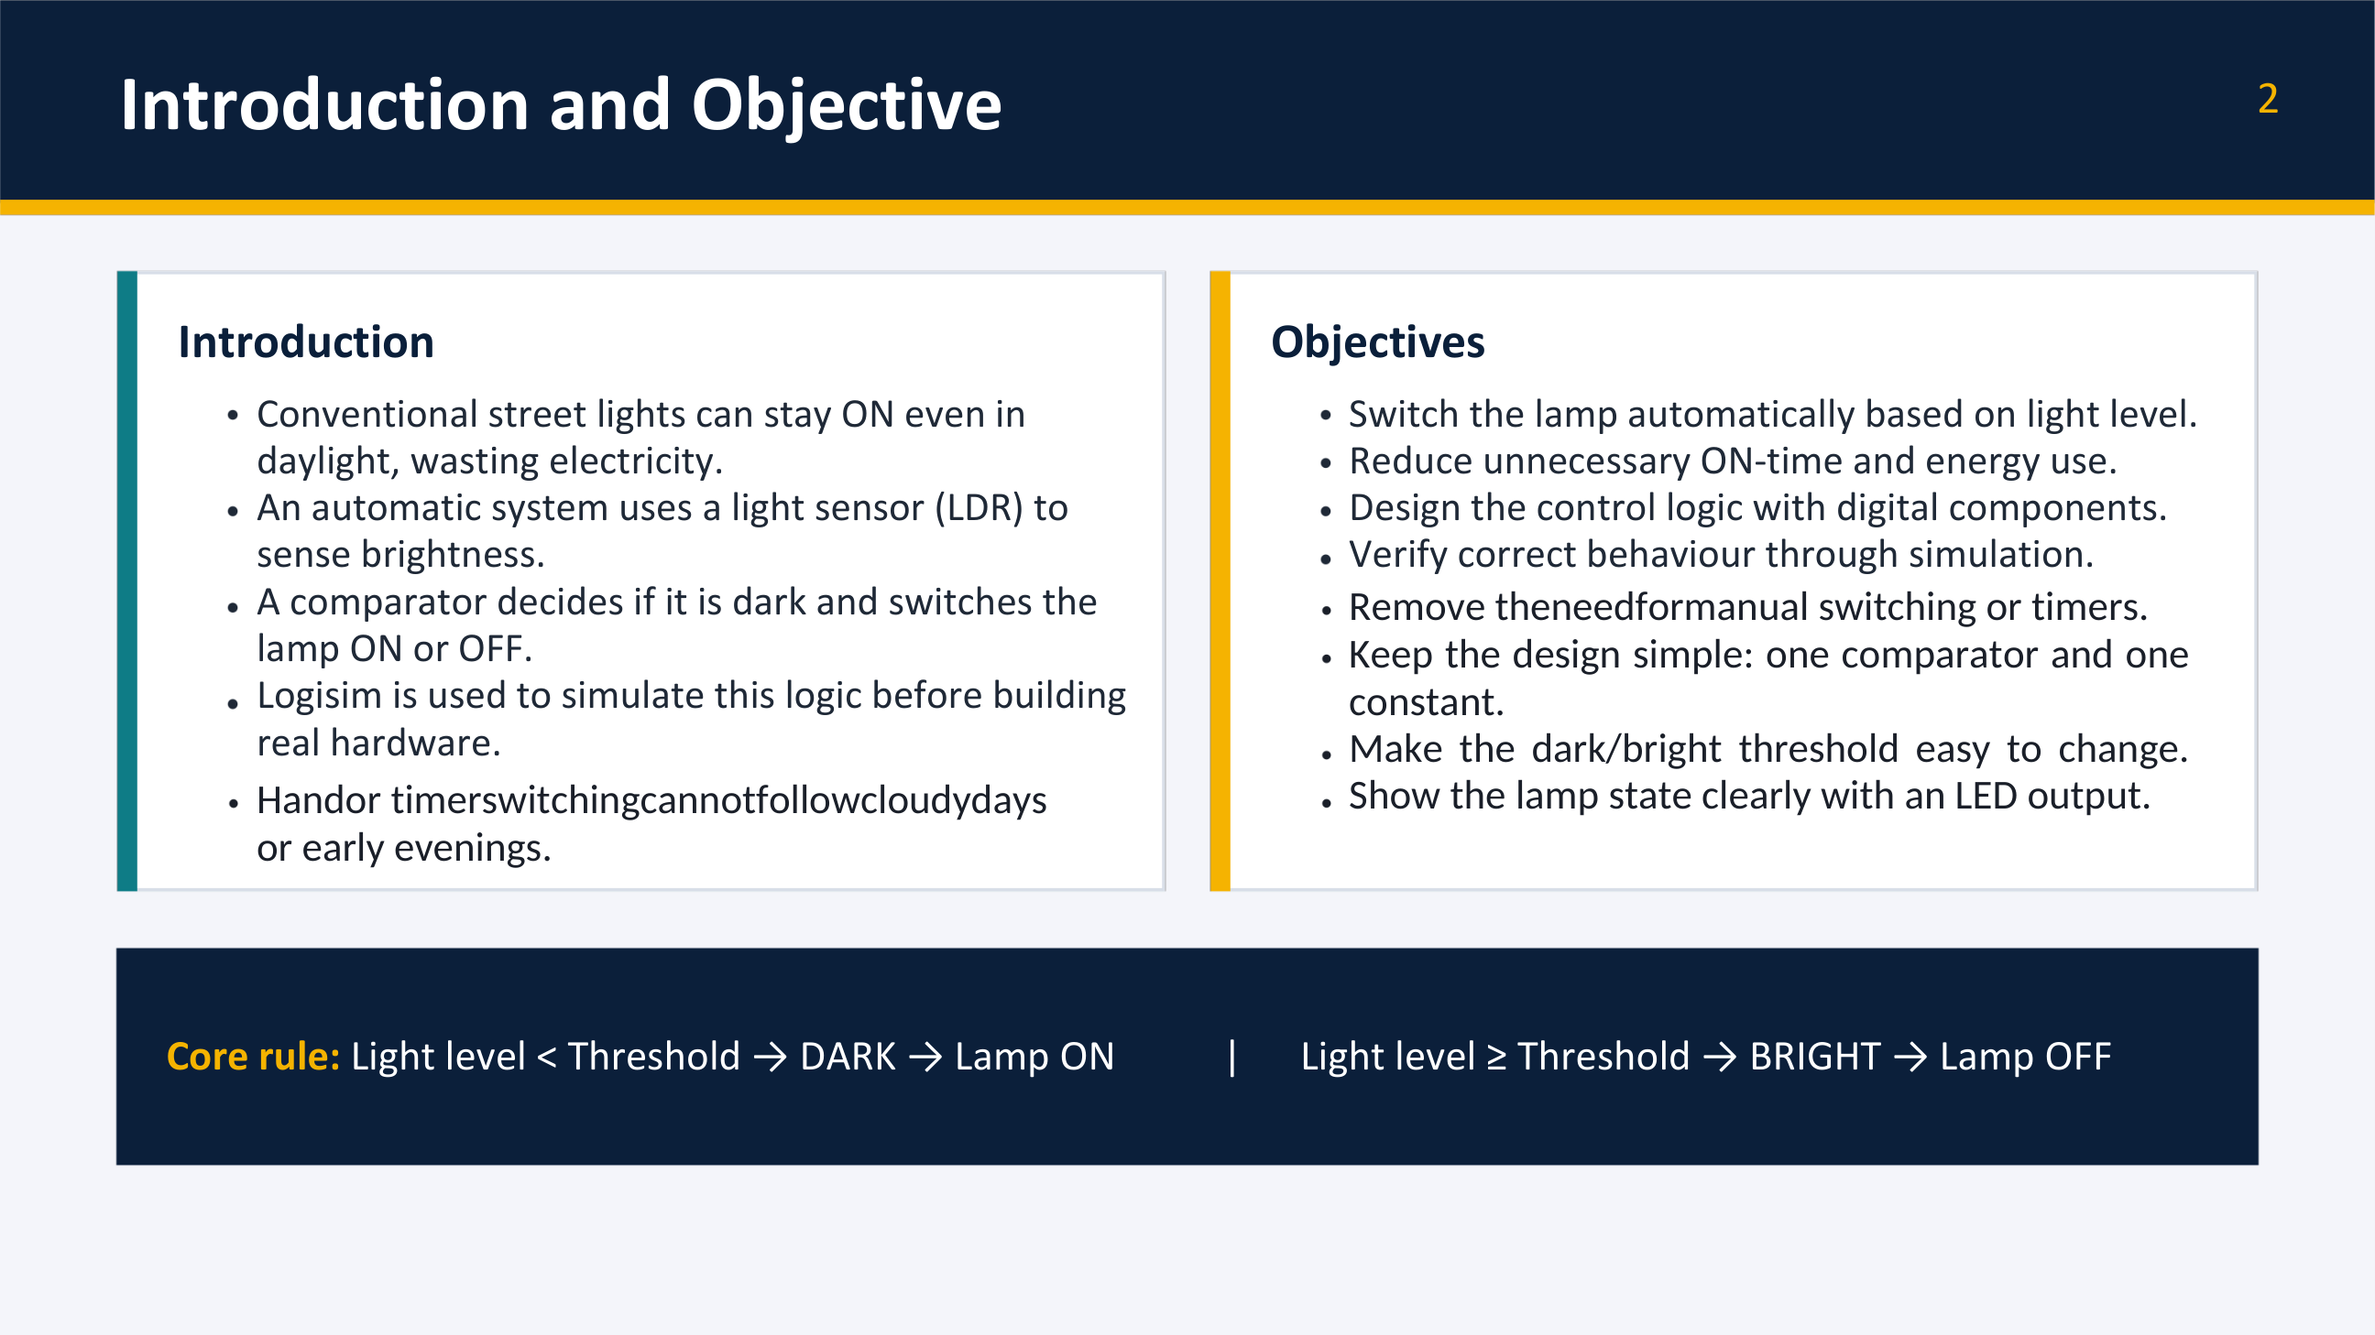

Slide 3
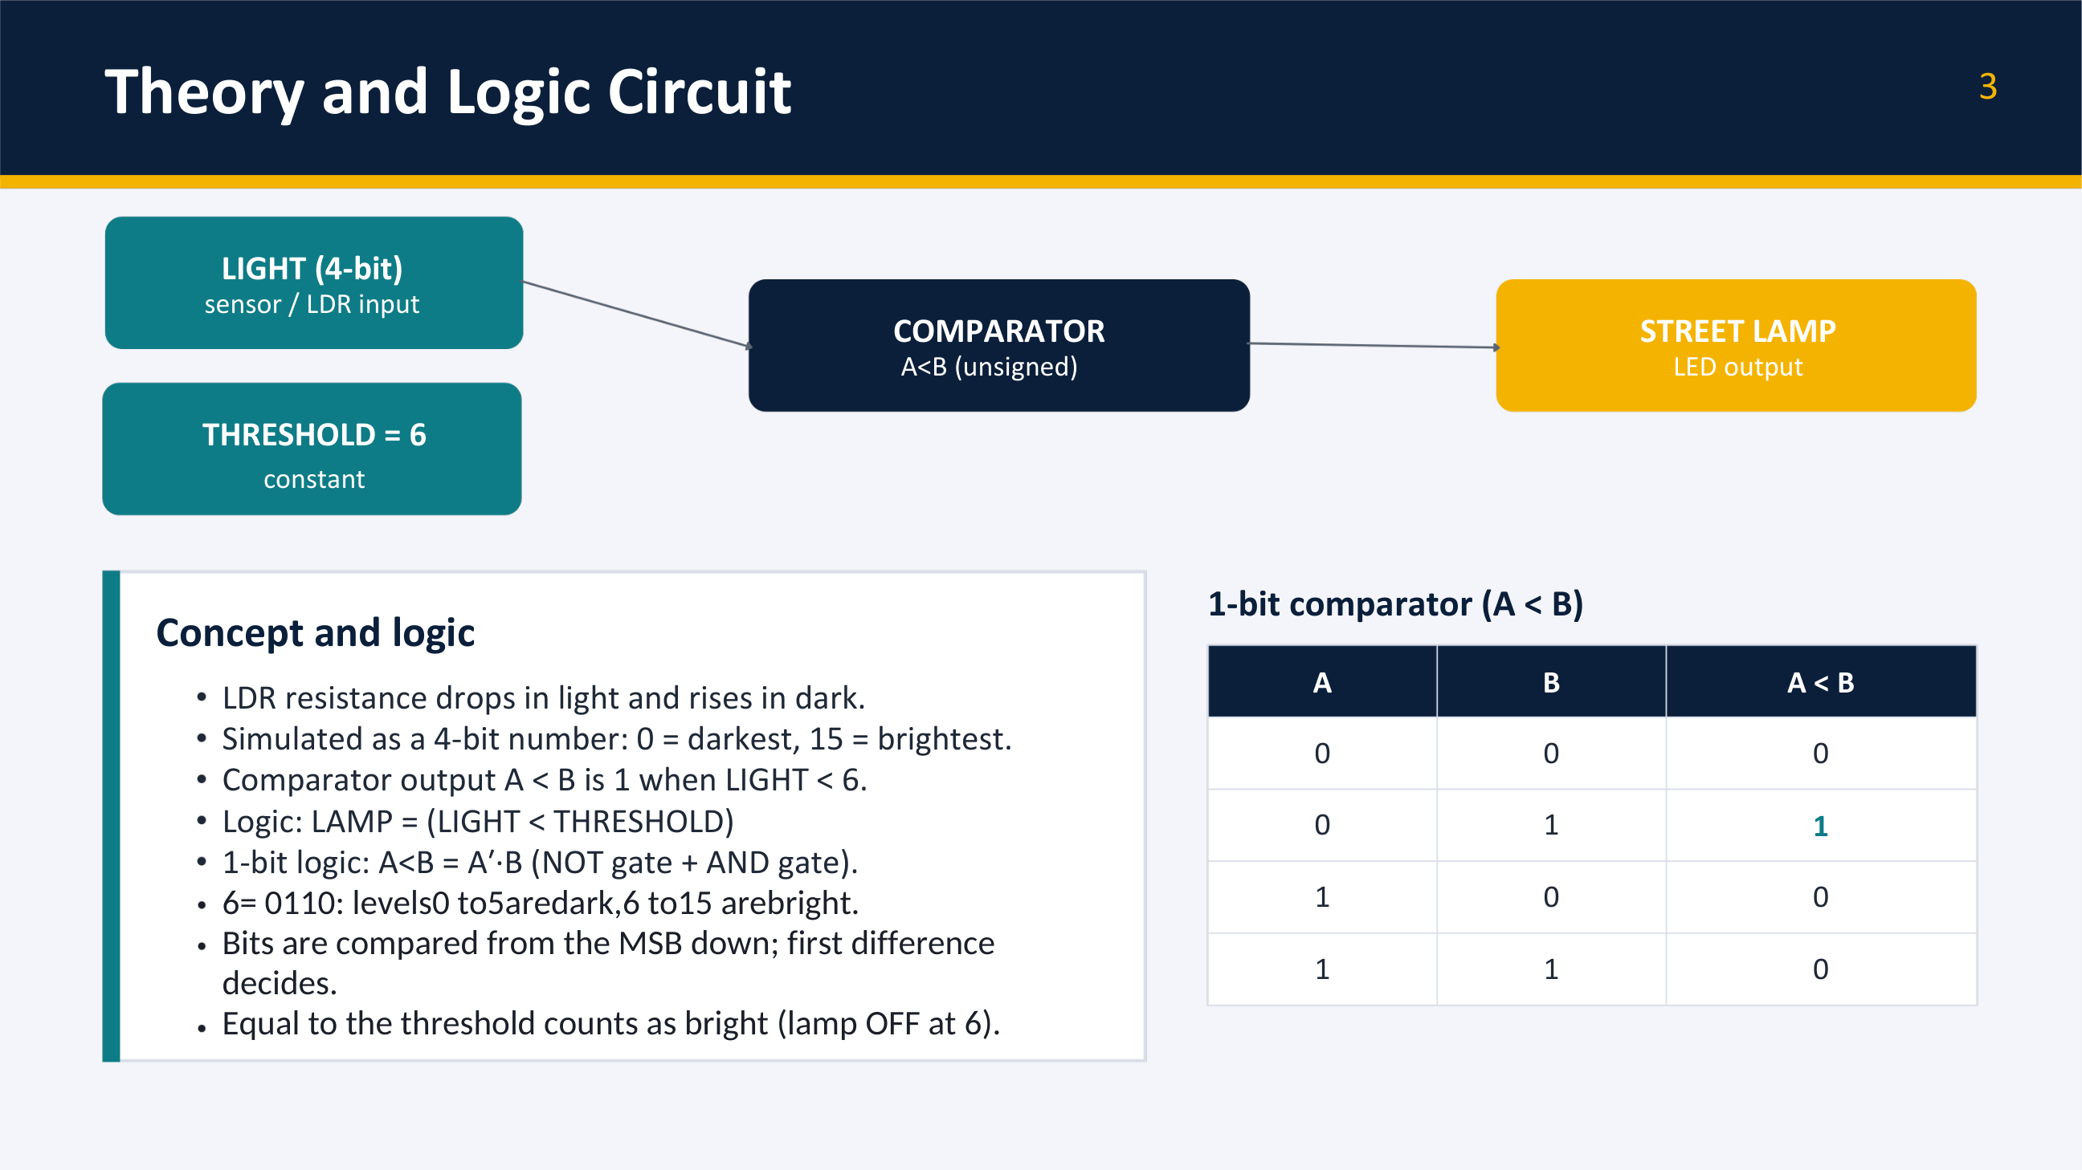

Slide 4
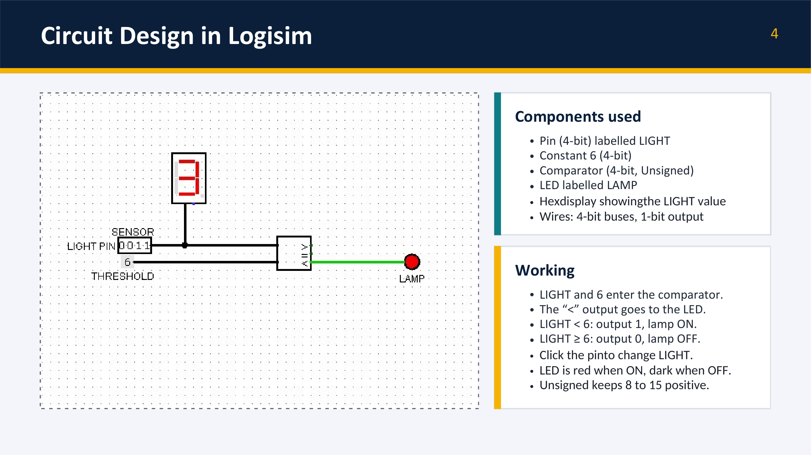

Slide 5
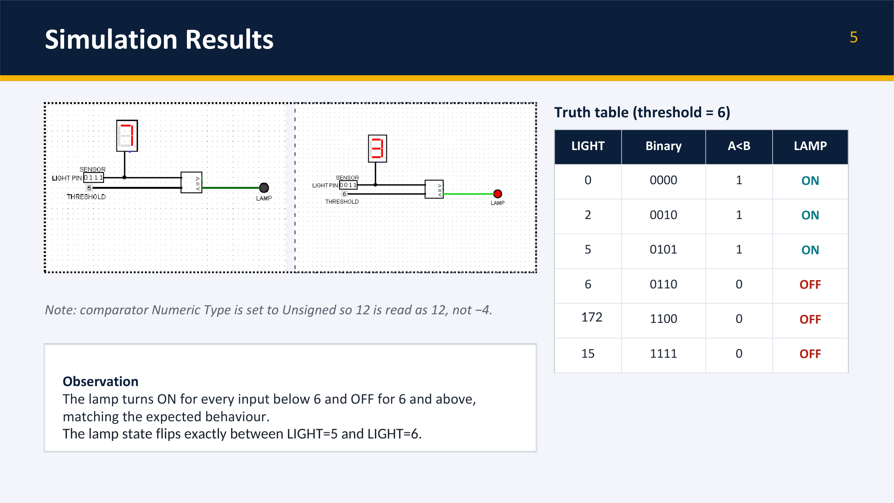

Slide 6
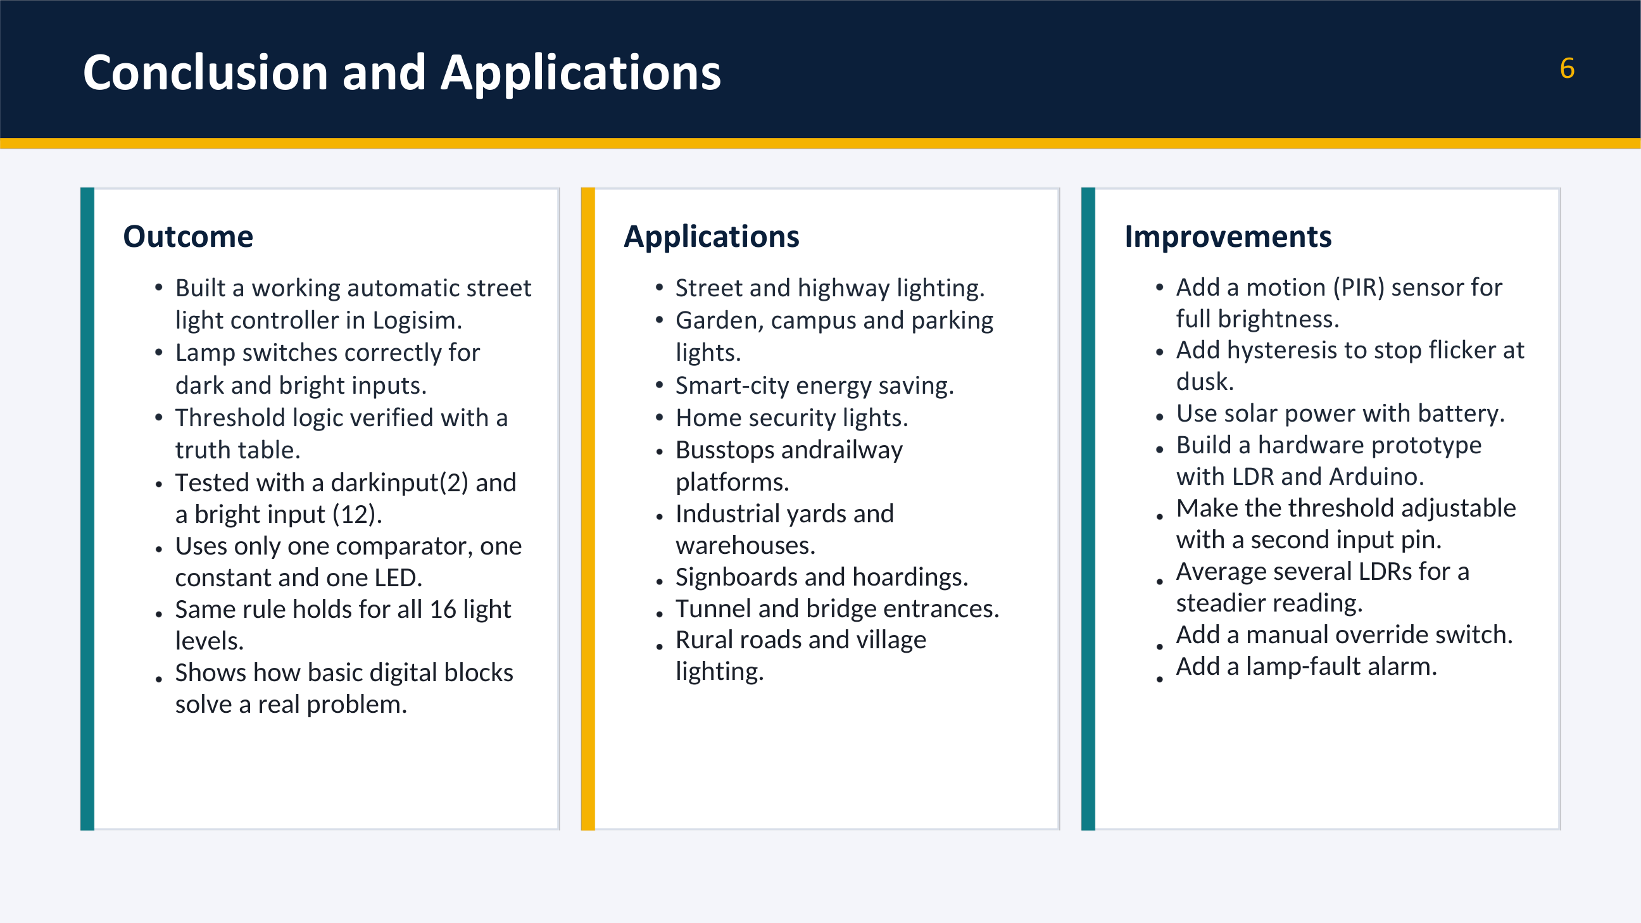

Slide 7
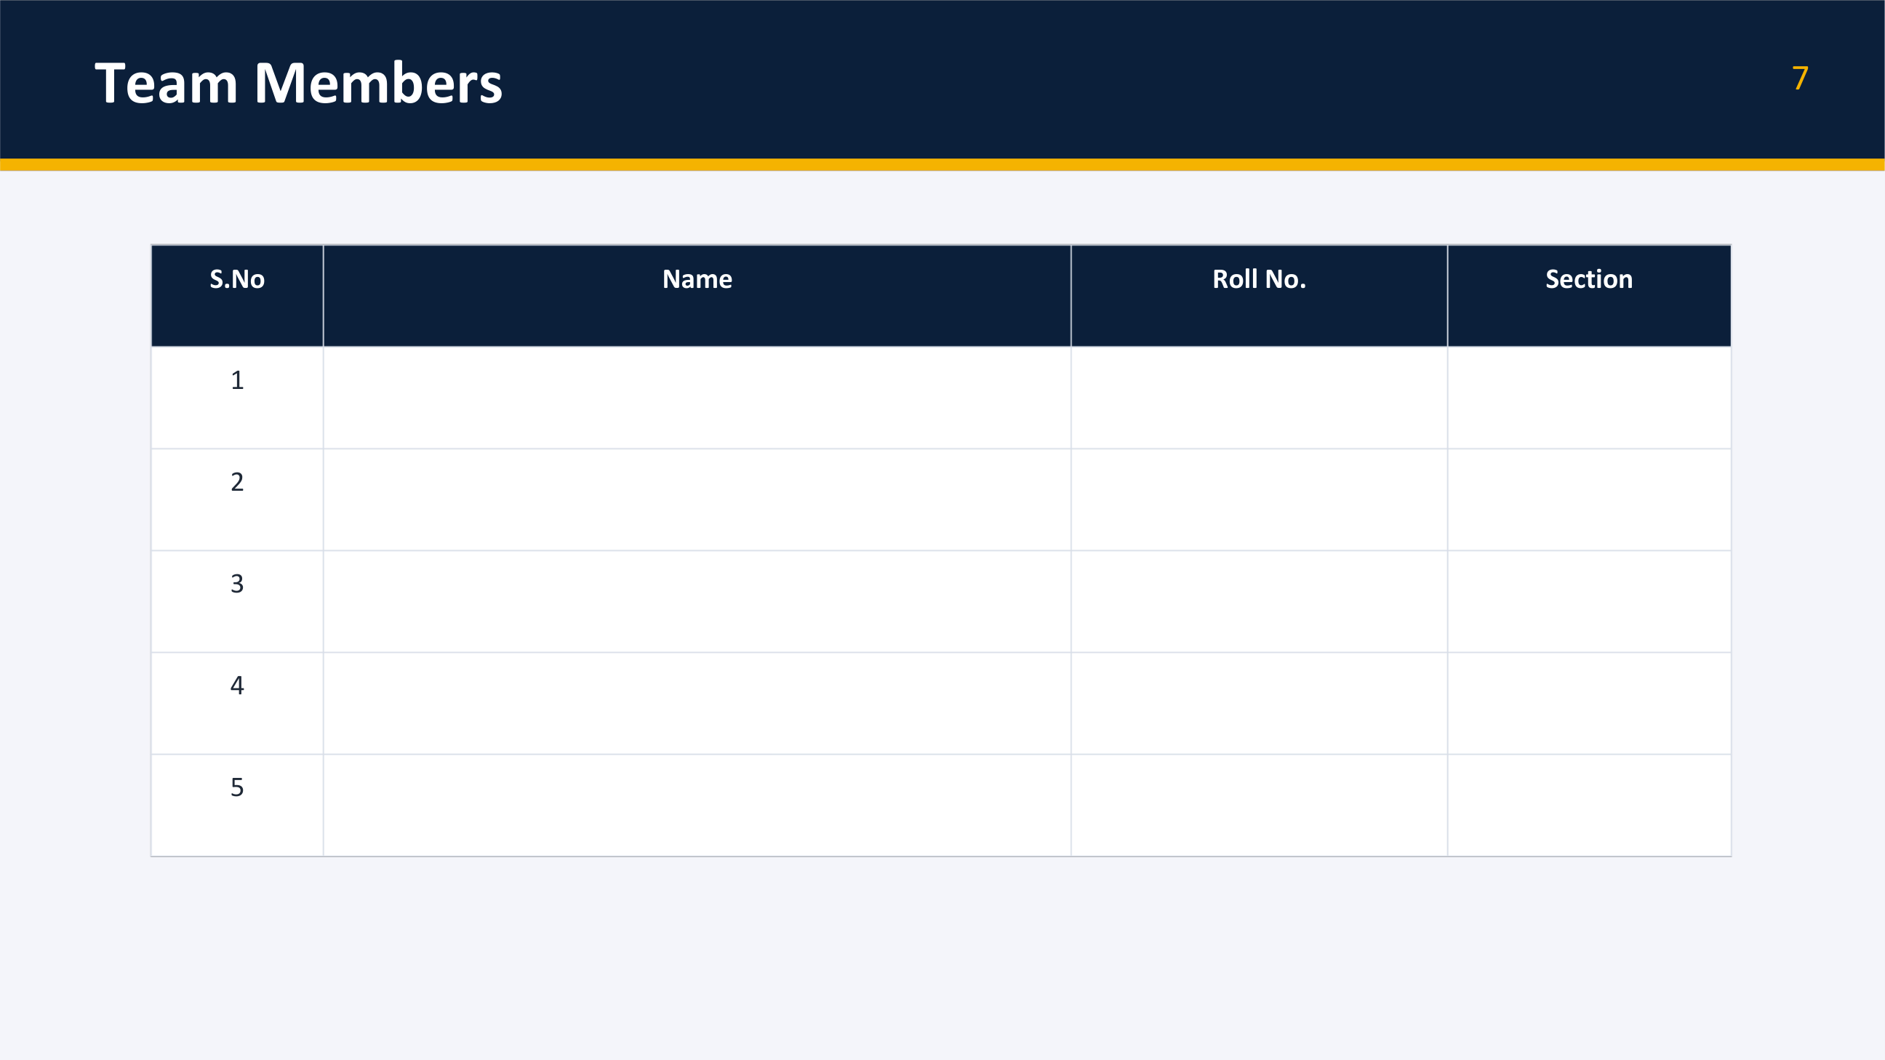
Siri Chandana
2620030346
2
Saikam Nandhini
2620030347
2
Wafa Mehajabeen
2620030428
2
Ande Keerthan
2620030661
2
Anirudh Varma
2620030342
2

