Slide 1

JAVA PROJECT
ATM Transaction Simulator
Understanding logical flow and banking operations through object-oriented Java concepts.
TEAM MEMBERS
BATCH
Ande Keerthan - 2620030661
Mamidi Yuvaraj - 2620030680
Batch - 11

Slide 2


ABSTRACT
System Overview
Core Operations
Technical Focus
The ATM Transaction Simulator is a Java-based application developed to demonstrate essential ATM operations, such as PIN authentication, balance inquiry, cash deposits, and withdrawals. It provides an interactive, menu-driven interface that allows users to select and perform different banking operations. The system verifies the user's PIN, validates transaction amounts, checks the available balance before withdrawals, and updates the account balance after successful transactions. It also maintains transaction records, helping users understand how banking activities are tracked and managed. Through this project, we demonstrate how Java programming concepts can be used to simulate real-world ATM functionality in a simple and organized manner.
The system authenticates users by verifying their PIN and provides a menu of banking services, allowing them to check their balance, deposit money, withdraw cash, and view transaction history. It validates transaction amounts, checks the available balance before withdrawals, and updates the account balance after successful transactions. The application also uses object-oriented programming to organize the code, exception handling to manage errors, and file handling to store transaction records for future reference. By combining these Java concepts, the project demonstrates how ATM transactions are processed systematically and provides a foundation for understanding and developing more advanced banking applications.

Slide 3
Problem Statement
========== ATM MENU ==========
Sequential Steps: Manage user authentication, service selection, and validation.
1. Check Balance
2. Deposit Money
Software Representation: Build a simple, organized system for banking interaction.
3. Withdraw Money
Core Goals: Authenticate via PIN, validate conditions, and provide accurate responses.
4. Transaction History
5. Exit

Slide 4
CO1
Java Foundations
Scanner Class: Reads user input for PIN and amounts.
Scanner sc = new Scanner(System.in);
double balance = 10000.00;
System.out.print("Enter PIN: ");
int enteredPin = sc.nextInt();
if (enteredPin != validPIN) {
System.out.println("Incorrect PIN");
} else ...
Variables & Constants: Manages balance and PIN data.
Data Types: Utilizes int, double, and boolean.
Operators: Arithmetic and comparison validation.
Outcome: Accepts user input and manages ATM data effectively via console.

Slide 5
CO2
Control Flow Concepts
if (amount <= 0) {
System.out.println(“Invalid withdrawal amount.”);
} else if (amount > balance) {
System.out.println(“Insufficient balance.”);
}
while(choice != 5) {
switch (choice) {
  case 1:
  checkBalance(balance);
  break;
}...
if / else-if: Validates pins and checks for insufficient balance.
switch-case: Handles dynamic ATM menu selections.
while Loop: Sustains menu interface until exit command.
Outcome: Controls application logic, validating transactions safely.

Slide 6
CO3
Methods & Modular Structure
public static double depositMoney( double balance, double amount) {
if (amount > 0)
  balance = balance+amount; return balance;
  // Implementation
  balance = depositMoney(balance, deposit);
Methods: Independent functions for ATM operations.
Parameters: Passing balance, amount, and PIN values.
Static Scope: User-defined methods handled directly.
Outcome: Implements reusable, distinct modular blocks for each transaction type.

Slide 7
CO4
Object-Oriented Programming
class ATM {
private double balance;
ATM(double balance) {
  this.balance = balance
}
double checkBalance() {
return balance;
} } ATM atm = new ATM(10000); System.out.println(atm.checkBalance());
Classes & Objects: The ATM class defines the core system.
Encapsulation: Account balance protected via private access.
Constructors: Initialize the ATM with starting parameters.
Exception Handling: try-catch blocks for invalid inputs.
Outcome: Secure application architecture handling runtime errors gracefully.

Slide 8
CO5
String Handling & File I/O
String transaction = "Deposit: Rs. 500";
try {
FileWriter fw = new FileWriter( "transactions.txt", true); fw.write(transaction + "\n");
fw.close();
System.out.println("Saved successfully.");
} catch (IOException e) {
System.out.println("Error saving.");
}
String Handling: Formats and stores transaction details.
File Handling: Writing permanent records to `transactions.txt`.
Appending: Adds new records without data overwrite.
Outcome: Persistently stores ATM transaction details for historical reference.

Slide 9
CO6
Collections & Functional Programming
ArrayList<String> txns = new ArrayList<>();
txns.add("Deposit: Rs. 500");
txns.add("Withdraw: Rs. 200");
System.out.println("Deposit Transactions:"); txns.stream() .filter(t -> t.startsWith("Deposit")) .forEach(t -> System.out.println(t));
ArrayList: Dynamic storage for multiple memory records.
Lambda Expressions: Concise functions for inline processing.
Streams: Efficient filtering of specific conditions.
Outcome: Filters and displays specific history using advanced Java collections.

Slide 10
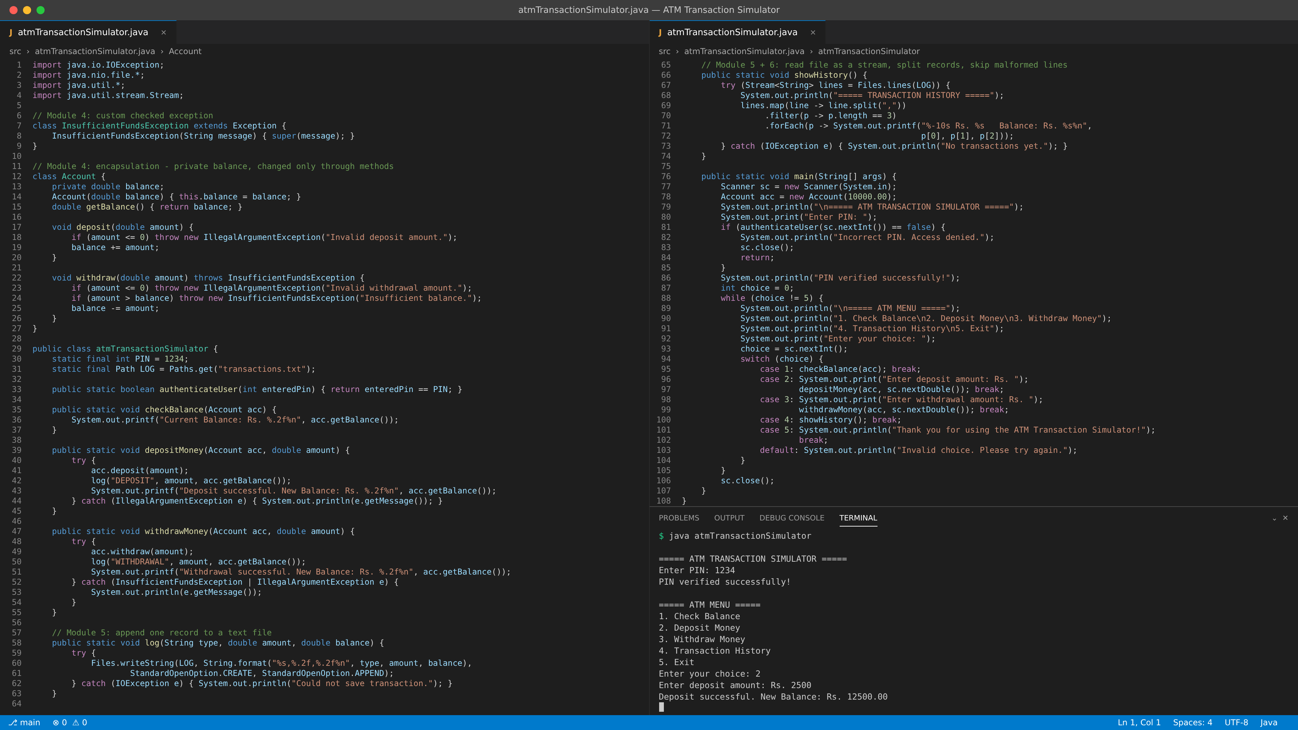
Screen Shots

Slide 11
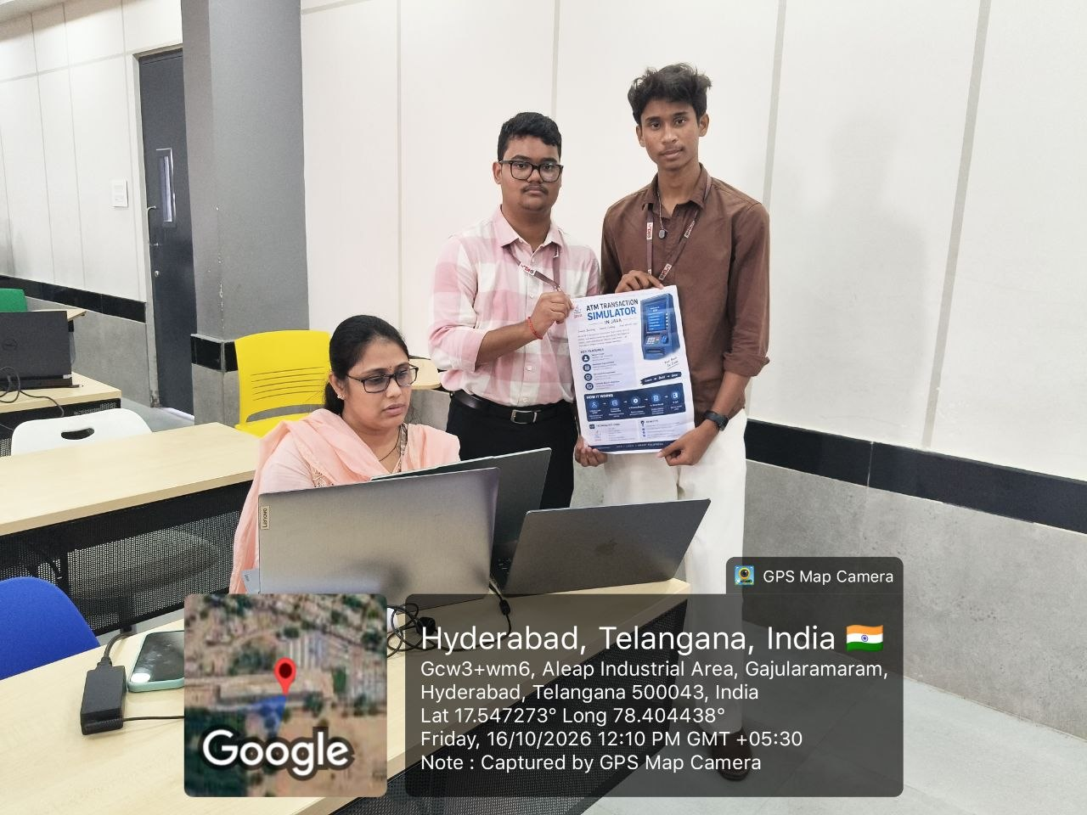
Thank You
The ATM Transaction Simulator serves as a solid foundation for developing comprehensive Java banking applications.
github.com/Keerthan858/KLH-FED-2026-Java-Section-3

