Slide 1
HALF ADDER & FULL ADDER
Digital Logic Design using Logisim
Half Adder | Full Adder | Truth Tables | Logisim Simulation
KLH-FED-2026-Section-2--Batch-8
github.com/Keerthan858/KLH-FED-2026-Section-2--Batch-

Slide 2
TEAM
Group Members
Ande Keerthan
2620030661
Pothuri Nagasai Anirudh Varma
2620030342
Chinthapalli Siri Chandana
2620030346
Saikam Nandhini
2620030347
Half Adder & Full Adder Using Logisim
2

Slide 3
1. What is a Binary Adder?
A combinational circuit that adds binary numbers.
SUM is the result bit; CARRY is the overflow.
A core building block of ALUs, CPUs and calculators.
Two common circuits: Half Adder and Full Adder.
2

Slide 4
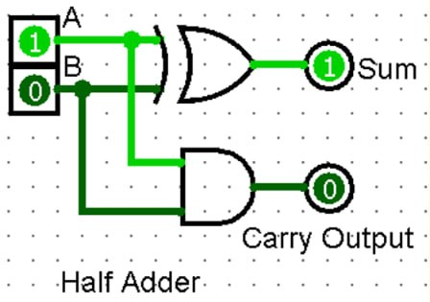
2. Half Adder
Adds two 1-bit binary inputs: A and B
Half Adder is a simple circuit that adds two single bit binary numbers.
Inputs: A, B
Outputs: Sum (S), Carry (C)
SUM is produced by XOR: S = A ⊕ B
CARRY is produced by AND: C = A · B
A | B | SUM (A⊕B) | CARRY (A·B)
0 | 0 | 0 | 0
0 | 1 | 1 | 0
1 | 0 | 1 | 0
1 | 1 | 0 | 1
3

Slide 5
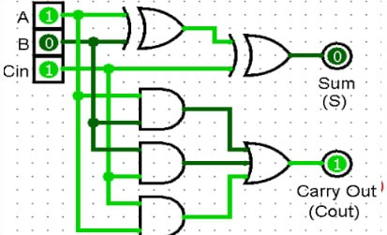
7. Full Adder using Two Half Adders
Two Half Adders + one OR gate — modular, easy to build, test and expand
A full Adder is an advanced circuit that adds three single bit binary numbers.
Inputs: A, B, Cin
Outputs: SUM and Carry-Out (Cout)
SUM = A ⊕ B ⊕ Cin
Cout = AB + Cin(A ⊕ B)
Built from two Half Adders + one OR gate.
8

Slide 6
6. Full Adder Truth Table
A | B | Cin | SUM | Cout
0 | 0 | 0 | 0 | 0
0 | 0 | 1 | 1 | 0
0 | 1 | 0 | 1 | 0
0 | 1 | 1 | 0 | 1
1 | 0 | 0 | 1 | 0
1 | 0 | 1 | 0 | 1
1 | 1 | 0 | 0 | 1
1 | 1 | 1 | 1 | 1
7

Slide 7
THANK YOU
Questions?
Half Adder • Full Adder • Logisim
12

