Slide 1
Employee Data Analysis using Excel
STUDENT NAME:KEERTHANA P
REGISTER NO:2213331042108
DEPARTMENT: COMMERCE
COLLEGE:BHARATHI WOMEN'S COLLEGE

Slide 2
PROJECT TITLE
Employee salary Analysis using Excel

Slide 3


AGENDA
Problem Statement
Project Overview
End Users
Our Solution and Proposition
Dataset Description
Modelling Approach
Results and Discussion
Conclusion
3/21/2024 Annual Review

Slide 4

PROBLEM STATEMENT
The analysis should reveal whether the current pay structure is fair and competitive within the industry. Additionally, the organization wants to ensure that compensation aligns with employee performance and market standards. The goal is to provide actionable insights for HR to adjust salaries if necessary

Slide 5

PROJECT OVERVIEW
The salary analysis project aims to evaluate and assess the current salary structure within the organization. This project involves collecting and analyzing salary data across different departments, job roles, and employee demographics such as experience, education, and location. The objective is to identify patterns, disparities, and potential areas of concern regarding pay equity.
.

Slide 6

WHO ARE THE END USERS?
The end users of the salary analysis project are primarily the organization's Human Resources (HR) team, including HR managers and compensation specialists. They will use the insights to make informed decisions on salary adjustments, pay equity, and compensation strategies. Senior management and executives are also key end users, as they need to ensure that salary structures align with the organization's goals and budget.

Slide 7

OUR SOLUTION AND ITS VALUE PROPOSITION
Our Solution:
Our solution is a comprehensive salary analysis tool that leverages data analytics to assess and optimize the organization's compensation structure. It provides detailed insights into salary trends, disparities, and alignment with industry standards.
Value Proposition:
Our solution empowers organizations to maintain a fair and competitive salary structure, enhancing employee satisfaction and retention. By identifying and addressing pay disparities, it fosters a more equitable workplace, boosting morale and productivity.

Slide 8
Dataset Description
The dataset for the salary analysis project includes employee information from across the organization. Key attributes include employee ID, department, job role, years of experience, education level, and location. It also captures salary details such as base pay, bonuses, and total compensation. Additional columns include demographic data like age and gender to assess diversity and pay equity. Performance ratings are included to correlate compensation with employee performance.

Slide 9

THE "WOW" IN OUR SOLUTION
Our solution delivers a "WOW" factor by revolutionizing how organizations manage and optimize their compensation structures. It offers real-time analytics, enabling instant insights into salary disparities and trends. With an intuitive, interactive dashboard, users can easily visualize complex data, making it accessible even to non-technical stakeholders. The predictive analytics feature stands out by allowing HR teams to simulate the impact of salary adjustments before implementing them.
3/21/2024 Annual Review
9

Slide 10
MODELLING
Modeling in the salary analysis project involves developing statistical and machine learning models to uncover insights from the dataset. The process begins with data cleaning and preprocessing to ensure accuracy and consistency. Regression models are used to identify relationships between salary and factors like experience, education, and performance. Classification models help in predicting salary ranges based on employee attributes.
10

Slide 11
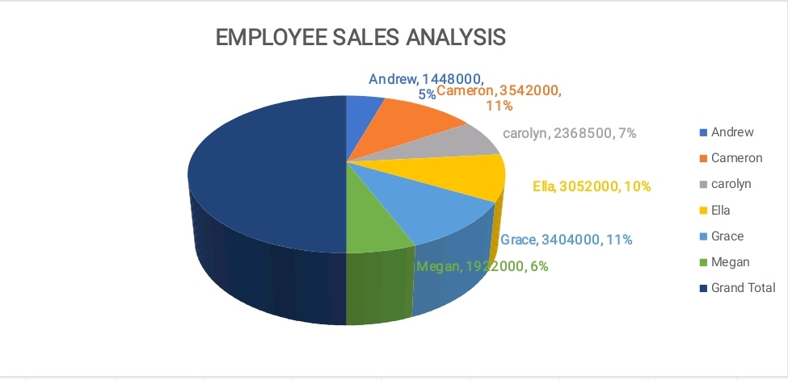
RESULTS
,
11

Slide 12
conclusion
To perform a salary analysis, consider factors such as industry standards, geographical location, experience level, and education. Analyze data trends to identify the median and average salaries for specific roles. Consider the impact of demand and supply for specific skills. Look for discrepancies in gender pay and other inequalities. Assess whether the current salaries align with market trends and employee satisfaction. This analysis helps organizations make informed decisions on salary adjustments, ensuring competitiveness and fairness in compensation practices. Regular reviews are essential to maintain alignment with evolving market conditions.

