Slide 1
CRICSHEET MATCH ANALYSIS
DOMAIN – SPORTS ANALYTICS
Presented By
KEERTHANA A

Slide 2
WORK FLOW
Cricsheet Website
↓
Web Scraping (Selenium)
↓
Data Extraction (JSON Files)
↓
Data Preprocessing (Python & Pandas)
↓
SQLite Database
↓
SQL Analysis (20 Queries)
↓
EDA (Python)
↓
Power BI Dashboard ↓

Slide 3
DATASET OVERVIEW & PREPROCESSING
5,641
3.8M
4
Missing-Value Summary (matches table)
Field | Missing
event_name | 23
city | 493
winner | 364
win_by_runs | 2,969 (no-result / won by wickets)
win_by_wickets | 3,037 (no-result / won by runs)
Total Matches
Ball-by-Ball Deliveries
Match Formats
Match Type Breakdown
Format | JSON Files
IPL | 1,243
ODI | 3,167
TEST | 911
T20 (Intl. T20) | 320
Data Quality Check
Zero duplicate rows found in both matches and deliveries tables.

Slide 4
SQL DATABASE DESIGN
matches
deliveries
• match_id · match_type · gender
• event_name · match_date
• team1 · team2 · venue · city
• toss_winner · toss_decision
• winner · win_by_runs/wickets
• player_of_match
• id · match_id · innings
• over_number · ball_number
• batting_team · batter · bowler
• non_striker
• runs_batter · runs_extras · runs_total
• wicket · wicket_kind · player_out
match_type stores Cricsheet's internal tag rather than the source folder. IPL matches are tagged 'T20' (same as domestic T20), while 'IT20' captures international T20Is separately. Flagged for a future refinement pass using the folder label instead.
Known Data Note
Tables loaded: 5,641 matches · 3,799,833 deliveries · 0 duplicate rows
5

Slide 5
SQL ANALYSIS — TEAM & MATCH INSIGHTS
498.42
Average total runs scored per match
2,909 / 2,732
Matches choosing to Field First vs Bat First at toss
India & England (880)
Most matches played of any team
6

Slide 6
SQL ANALYSIS — PLAYER INSIGHTS
Category | Leaders
Top Run Scorers | V Kohli (33,395) · RG Sharma (23,164) · AB de Villiers (22,798) · DA Warner (21,976)
Top Wicket Takers | JM Anderson (973) · R Ashwin (924) · SCJ Broad (814) · MA Starc (793)
Most Player-of-the-Match Awards | V Kohli (77) · AB de Villiers (55) · RG Sharma (51) · DA Warner (42)
Highest Team Innings | England — 823 runs (highest single-innings total in the dataset)
Virat Kohli leads both run-scoring and Player-of-the-Match awards across the full 2001-2026 dataset, with James Anderson topping the wicket-taking charts — reflecting his volume across a long Test career.
7

Slide 7
SQL ANALYSIS — VENUE, CITY & FORMAT INSIGHTS
Top Cities by Match Count
City | Matches
Mumbai | 233
Colombo | 174
London | 159
Kolkata | 133
Gender Split
Male: 4,933 matches
Female: 708 matches
Format Split:
ODI 3,167
· T20 (incl. IPL) 1,243
· Test 911
· IT20 320
8

Slide 8
SQL ANALYSIS — MATCH OUTCOME PATTERNS
Toss ≠ Guaranteed Win
Toss winner won 2,692 matches vs. lost 2,585 — only a slight edge (~51%)
Dominant Wins (100+ runs)
Australia leads with 127 such wins, ahead of India (112) and South Africa (107)
Dominant Wins (10 wickets)
Australia again leads with 15 ten-wicket victories
9

Slide 9
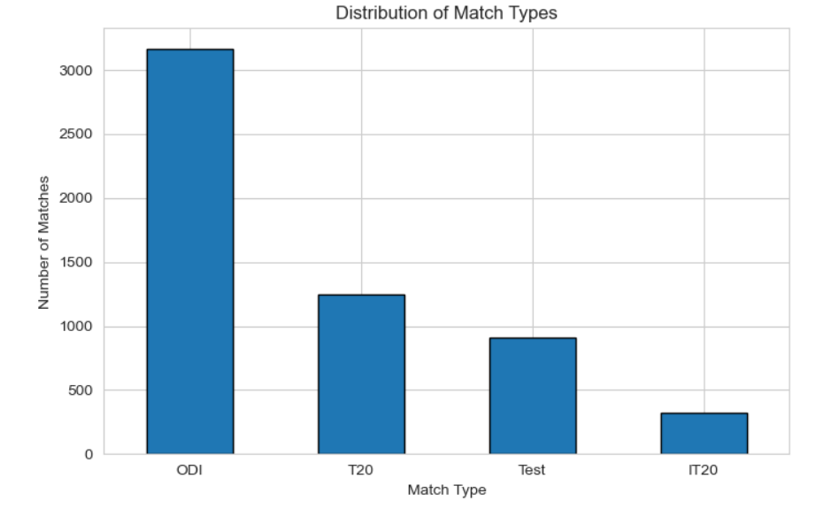
UNIVARIATE ANALYSIS – DISTRIBUTION OF MATCH TYPES
The dataset contains four match formats: ODI, T20, Test, and IT20.
ODI has the highest number of matches in the dataset.
T20 is the second most frequently played format.
Test matches have a moderate count.
IT20 has the lowest number of matches.

Slide 10
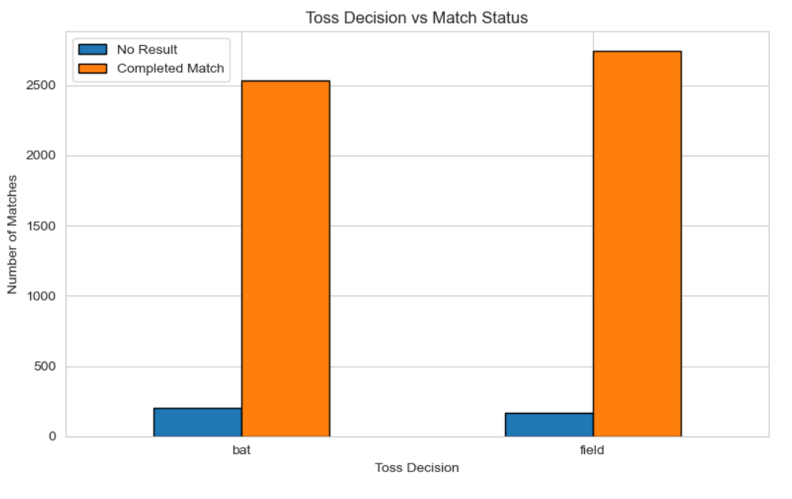
BIVARIATE ANALYSIS – TOSS DECISION vs MATCH WINS
Most matches ended as completed matches regardless of the toss decision.
Teams preferred to field first after winning the toss.
The number of No Result matches was very low.
Choosing to field first was slightly more common than batting first.

Slide 11
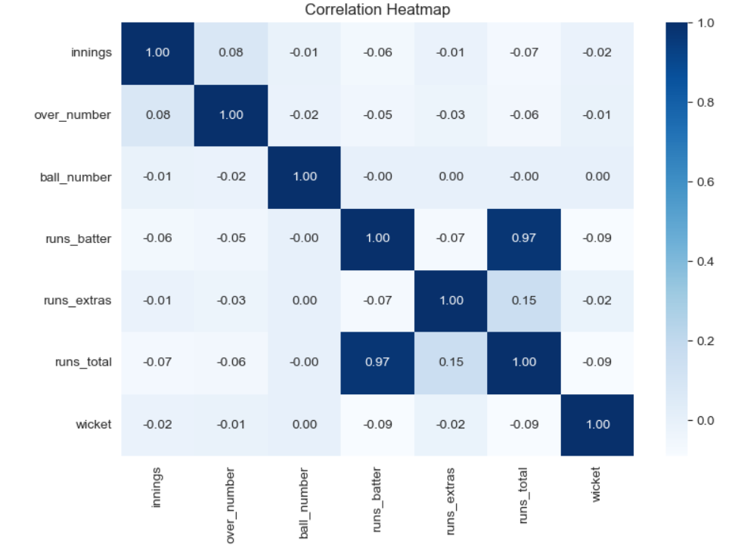
MULTIVARIATE ANALYSIS – CORRELATION HEATMAP
Runs by batter and total runs have a very strong positive correlation (0.97).
Extras have only a weak positive correlation with total runs (0.15).
Variables such as innings, over number, and wickets show very weak correlations.
No strong multicollinearity is observed among most variables.

Slide 12
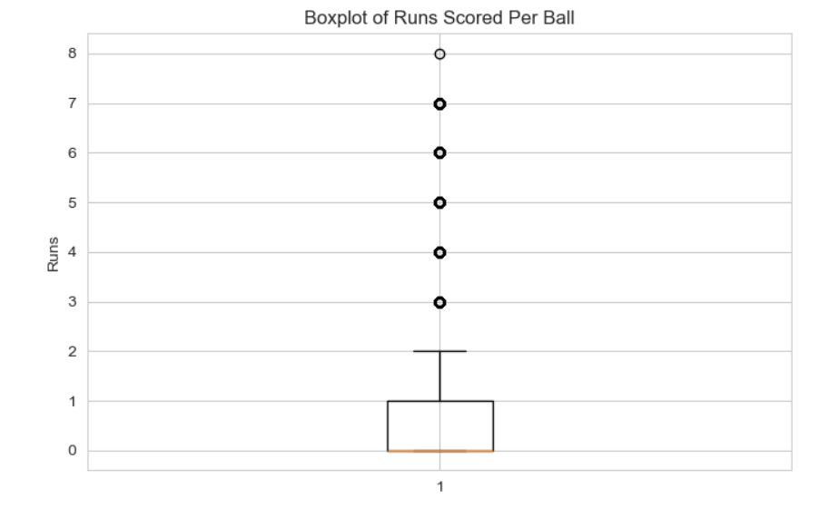
OUTLIER DETECTION
Most deliveries resulted in 0 or 1 run.
A few deliveries recorded 4, 5, 6, 7, and 8 runs, which appear as outliers.
These extreme values represent actual cricket events, not data errors.

Slide 13
EDA — KEY BUSINESS INSIGHTS
ODI is the most frequently played match format in the dataset
Male cricket accounts for the majority of recorded matches
1
2
Mumbai has hosted the highest number of matches among cities
Harare Sports Club is the single most-used venue
3
4
Australia has won the most matches of any team
Virat Kohli is the highest run scorer among all batters
5
6
James Anderson has taken the most wickets in the dataset
Dot balls (0 runs) are the most common outcome for a delivery
7
8
Teams choose to field slightly more often after winning the toss
Match activity has generally increased over time, with a dip around 2020
9
10
12

Slide 14
POWER BI DASHBOARD
Home page is navigation only (buttons to jump into each report) — no charts or KPIs there. The 3 pages below are where all the analysis lives.
ODI PAGE
TEST PAGE
IPL PAGE
Charts
• Top 5 Batsmen by Runs • Top 5 Bowlers by Wickets
Table
• Top 5 Teams by Wins Across Venues
KPI Cards
• Matches Played, Total Runs, 4s, 6s, 100s, 50s • Overs Bowled, Wickets Taken, Economy Rate
Slicers
• Select Batsman
• Select Bowler
Charts
• Top 5 Batsmen by Runs • Top 5 Bowlers by Wickets
Table
• Top 5 Teams by Wins Across Venues
KPI Cards
• Matches Played, Total Runs, 4s, 6s, 100s, 50s • Overs Bowled, Wickets Taken, Economy Rate
Slicers
• Select Batsman
• Select Bowler
• Match Type
Charts
• Top 5 Batsmen by Runs • Top 5 Bowlers by Wickets
Table
• Top 5 Teams by Wins Across Venues KPI Cards
• Matches Played, Total Runs, 4s, 6s, 100s, 50s • Overs Bowled, Wickets Taken, Economy Rate
Slicers
• Select Batsman
• Select Bowler
• Match Type
13

Slide 15
CONCLUSION
✓
Web scraping automated with Selenium across 4 match formats
✓
5,641 matches & 3,799,833 deliveries parsed into a clean SQLite database
✓
20 SQL queries deliver player, team, venue & outcome insights
✓
Python EDA — 10+ visualizations covering trends, distributions & correlations
✓
Power BI dashboard — 4-page interactive report (Home, ODI, TEST, IPL)
✓
Data exported to CSV and connected end-to-end for reporting

