Slide 1
TESLA STOCK PRICE PREDICTION
USING DEEP LEARNING (SimpleRNN & LSTM)
DOMAIN – FINANCIAL ANALYTICS
Presented By
KEERTHANA A

Slide 2
OVERVIEW
Problem & Dataset
Data Cleaning & EDA
Feature Prep & Sequencing
SimpleRNN & LSTM Models
Tuning & Forecasting
NLP Sentiment & Conclusion

Slide 3
PREDICTING TESLA’S CLOSING PRICE
Build deep learning models that learn from Tesla's historical price history and forecast the Adjusted Close price 1, 5, and 10 days into the future — then compare SimpleRNN against LSTM to see which architecture generalizes better.
7
2010-2020
Column: Date,Open,High,Low , close, Adj close, Volume
Data range covered
2,416
0
Daily records
Missing Values /
duplicates found
Clean & explore the daily OHLCV data (2010–2020)
Engineer a 60-day sliding window as model input
Train SimpleRNN and LSTM for 3 forecast horizons
Tune hyperparameters with GridSearchCV
Add an NLP layer: headline sentiment vs. returns
2

Slide 4
DATA CLEANING & PREPARATION
Checked integrity
isnull().sum() and duplicated().sum() confirmed zero missing values and zero duplicate rows in TSLA.csv.
1
Simulated missing-value strategy
On a copy, injected artificial NaNs and resolved them with forward-fill + linear interpolation — the right approach for sequential price data.
2
Datetime indexing
Converted Date to datetime, sorted chronologically, and set it as the DataFrame index.
3
Target selection
Adj Close chosen as the prediction target followed by project specifications.
4

Slide 5
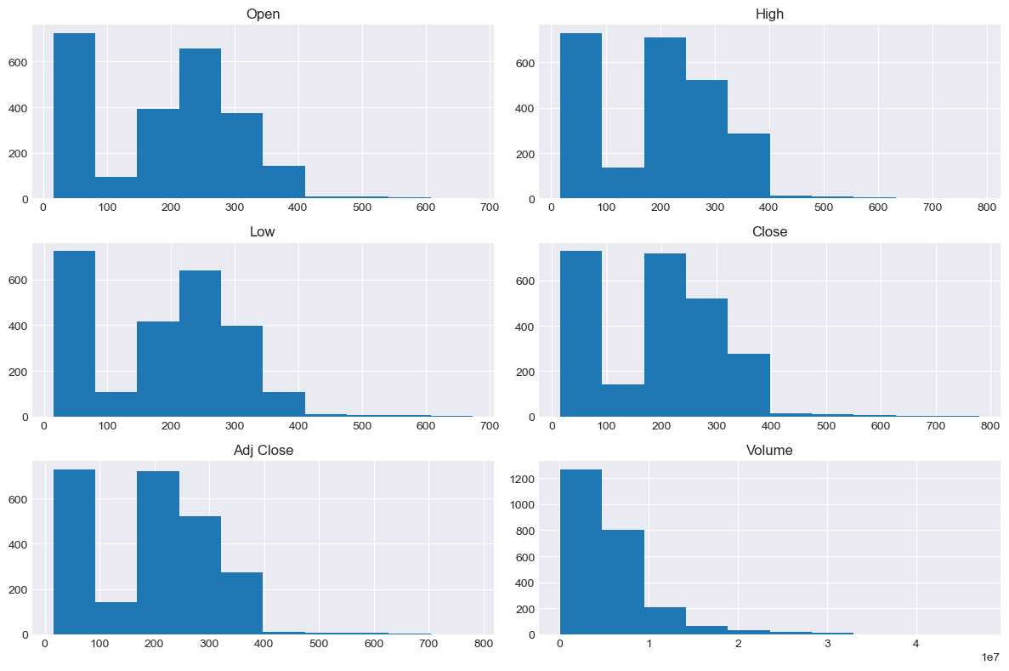
UNIVARIATE ANALYSIS – FEATURE DISTRIBUTION
OBSERVATIONS
Price features show similar distributions.
Most prices are concentrated in lower ranges.
Volume is strongly right-skewed.
Long tails indicate high-value observations.
Histograms showing the distribution of Open, High, Low, Close, Adj Close, and Volume features.

Slide 6
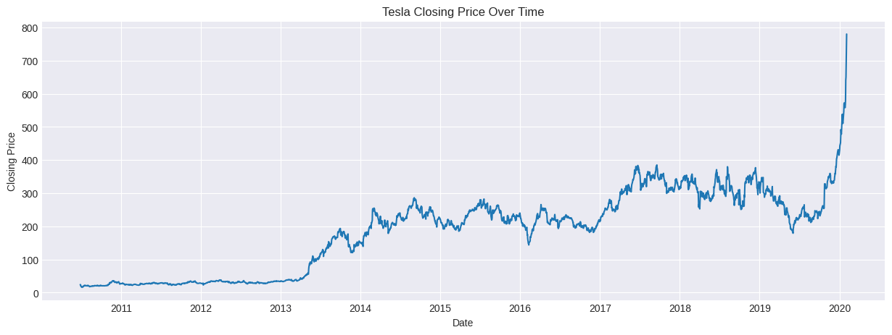
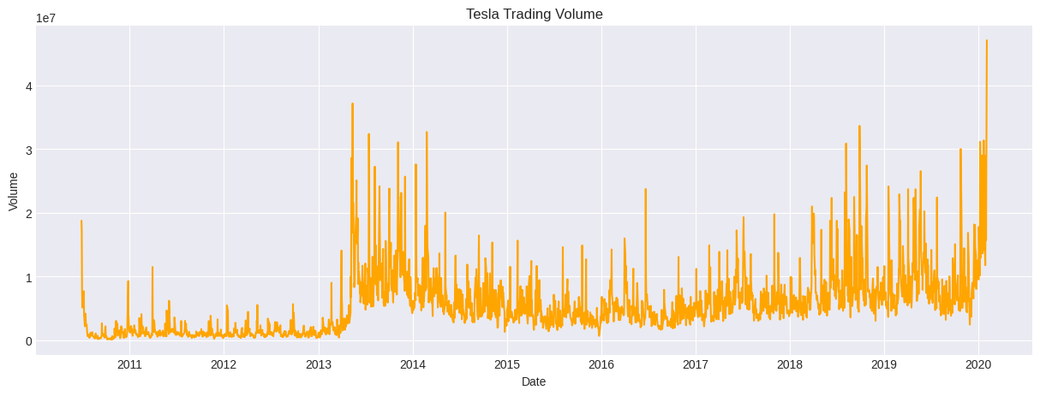
BIVARIATE ANALYSIS- PRICE TREND & TRADING VOLUME
Observations
Strong long-term price growth
Higher volume spikes during major movements
Increased volatility in later years

Slide 7
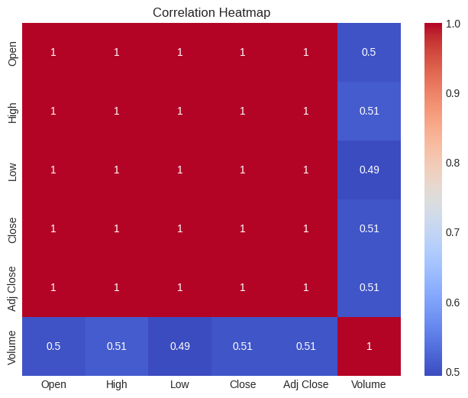
MULTIVARIATE ANALYSIS – CORRELATION HEAT MAP
Strong correlation among price features.
Volume shows moderate correlation (~0.5).
Price features provide similar information.
Volume adds additional information.

Slide 8
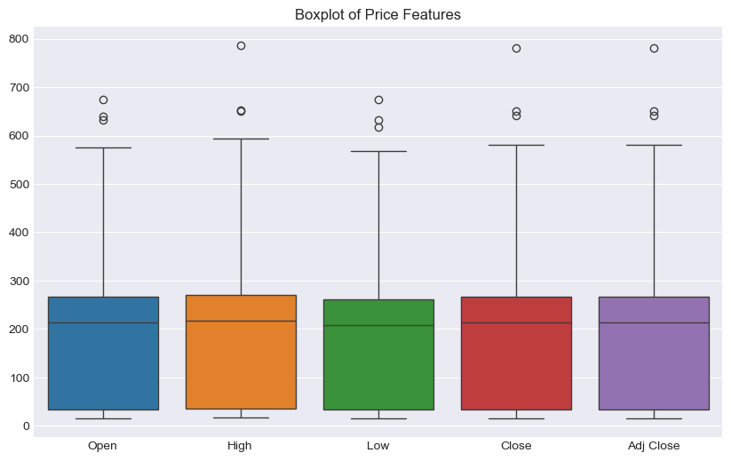
OUTLIER ANALYSIS
Boxplot shows outliers in all price features.
Most values are within the normal range.
High-value points appear as potential outliers.
These may represent actual market price movements.

Slide 9
FEATURE PREPARATION – SCALING & SEQUENCE CREATION
80 / 20 Split
MinMaxScaler
60-Day Window
3 Horizons
Chronological train/test split — no shuffling, since future data must never leak into training.
Fit strictly on the training set, then applied to both train and test — prevents data leakage.
Each input sequence uses the past 60 days of scaled price to predict the target day.
Separate X/y sequence sets built for 1-day, 5-day, and 10-day ahead targets.
Train: 1,872 sequences | Test: 484 (1-day) | 480 (5-day) | 475 (10-day)

Slide 10
SimpleRNN vs LSTM Architecture
SimpleRNN | LSTM
SimpleRNN(64) return_sequences=True | LSTM(64) return_sequences=True
SimpleRNN(32) | LSTM(32)
Dense(1) | Dense(1)
Both models use Adam optimizer + Mean Squared Error loss, with EarlyStopping and ModelCheckpoint during training.

Slide 11
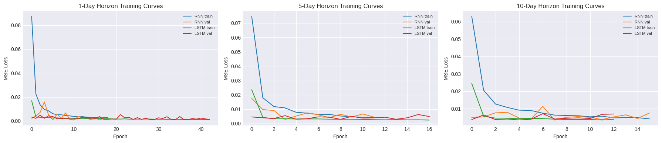
TRAINING CURVES - All 3 HORIZONS
Early stopping halted training once validation loss stopped improving — 6 models trained in total (2 architectures × 3 horizons).

Slide 12
Model Evaluation — MSE / RMSE / MAE per model per horizon
Model | Horizon (days) | MSE | RMSE | MAE | R2 Score
0 | LSTM | 1 | 578.785879 | 24.057969 | 15.724200 | 0.887807
1 | SimpleRNN | 1 | 547.095840 | 23.390080 | 14.235297 | 0.893950
2 | LSTM | 5 | 1425.397644 | 37.754439 | 26.390878 | 0.725598
3 | SimpleRNN | 5 | 891.536157 | 29.858603 | 20.247420 | 0.828371
4 | LSTM | 10 | 2166.074650 | 46.541107 | 33.459266 | 0.586480
5 | SimpleRNN | 10 | 2782.325101 | 52.747750 | 37.560394 | 0.468833
SimpleRNN outperforms LSTM at 1-day and 5-day horizons; performance declines for longer horizons.

Slide 13
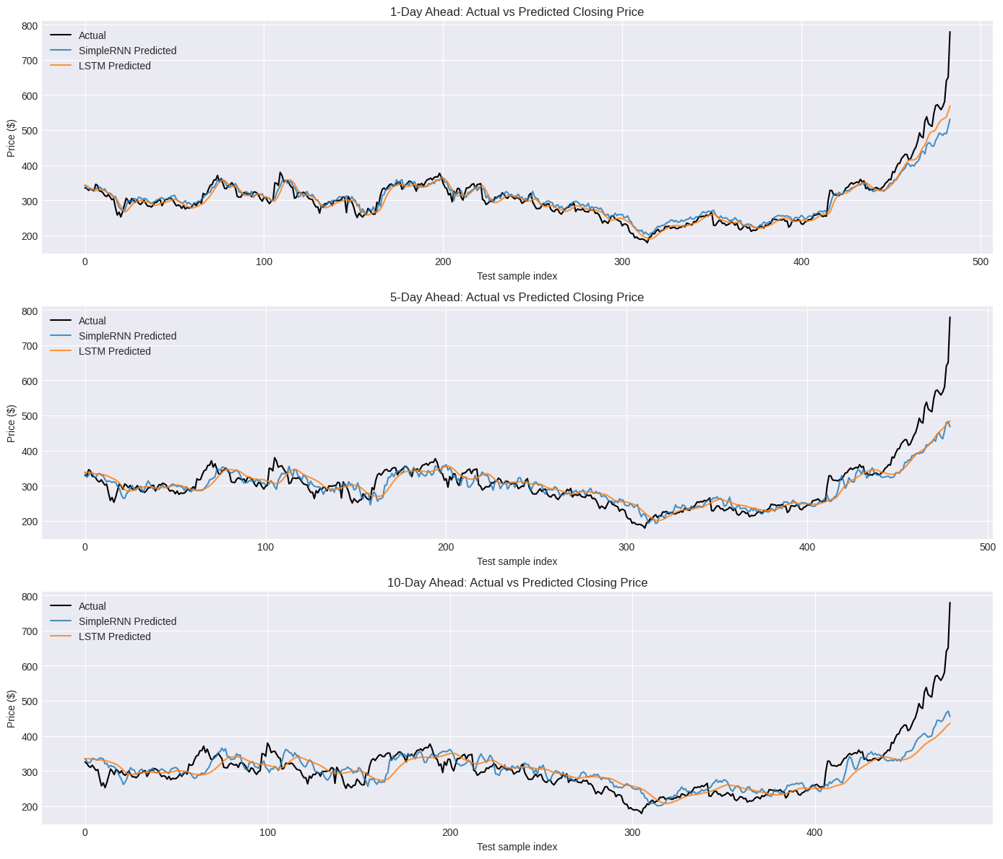
ACTUAL vs PREDICTED CLOSING PRICE
OBSERVATION
1-Day Ahead: Predictions closely follow the actual closing price.
5-Day Ahead: Predictions follow the overall trend but show more deviation.
10-Day Ahead: Prediction error increases, especially during sharp price movements.

Slide 14
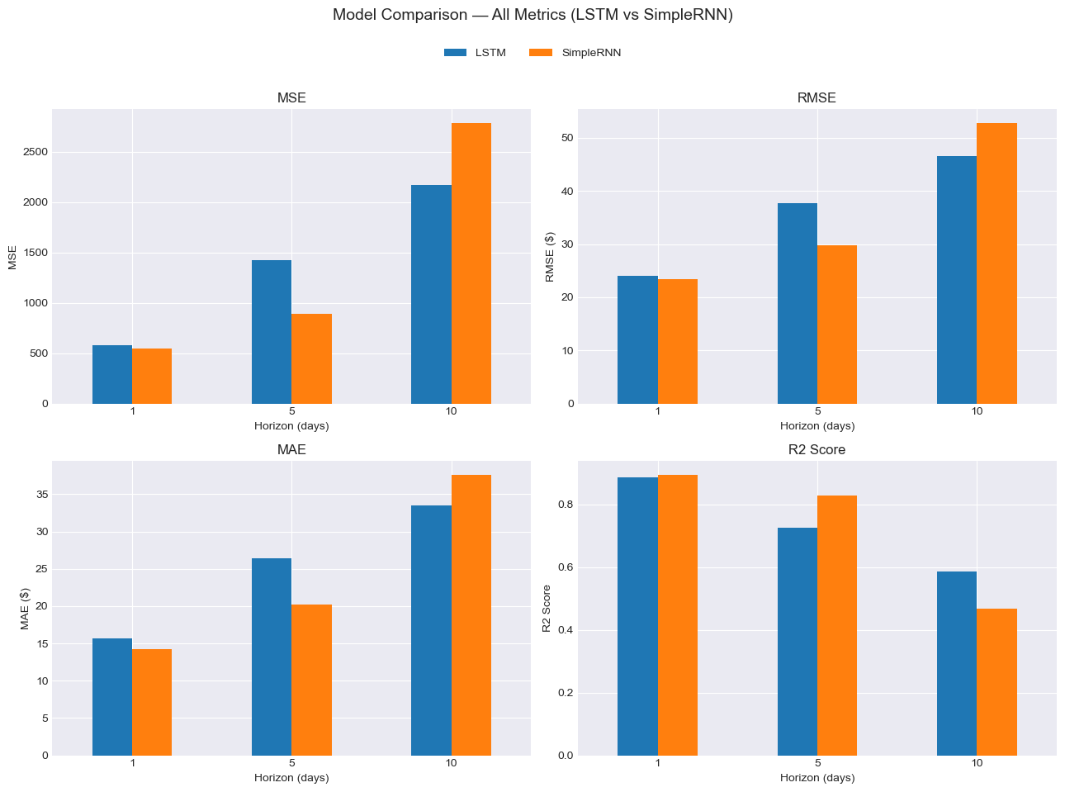
MODEL COMPARISON
OBSERVATION
Compares LSTM vs SimpleRNN across 1-, 5-, and 10-day horizons.
SimpleRNN performs better at 1-day and 5-day horizons.
At 10 days, LSTM performs better across MSE, RMSE, MAE, and R².
Overall, performance decreases as the prediction horizon increases

Slide 15
GRIDSEARCHCV – TUNING RESULTS
01 | 6 Tuning Runs 2 Models × 3 Horizons
02 | Parameters Tuned Units • Dropout • Learning Rate
03 | 1-Day Horizon LSTM ✓ Improved SimpleRNN ✓ Improved
04 | 5-Day Horizon LSTM ✓ Improved SimpleRNN ✗ Not Improved
05 | 10-Day Horizon LSTM ✗ Not Improved SimpleRNN ✓ Improved
06 | Best Performance SimpleRNN – 1 Day RMSE = 18.20
GridSearchCV improved 4 out of 6 model–horizon combinations.

Slide 16
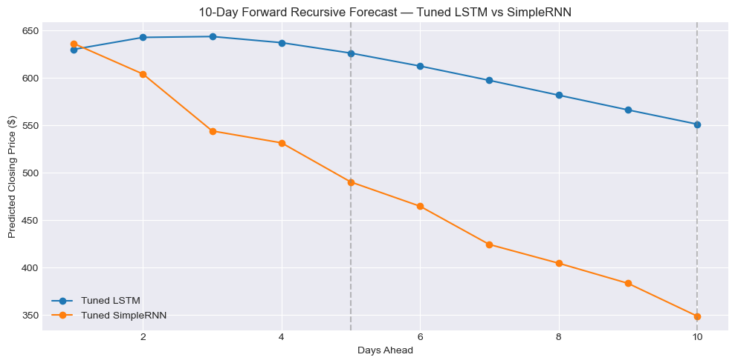
10-Day Forward Recursive Forecast — Tuned LSTM vs SimpleRNN
Compares recursive predictions for the next 10 days.
Tuned LSTM maintains a relatively stable forecast, declining gradually from ~630 to ~550.
Tuned SimpleRNN shows a much sharper decline, reaching ~350 by Day 10.
The models therefore produce substantially different long-horizon forecasts.

Slide 17
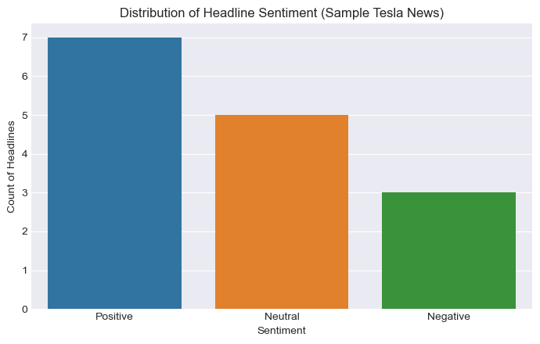
News Headline Sentiment Analysis
Positive: 7 headlines
Neutral: 5 headlines
Negative: 3 headlines
Overall, the sample contains more positive than negative sentiment.

Slide 18
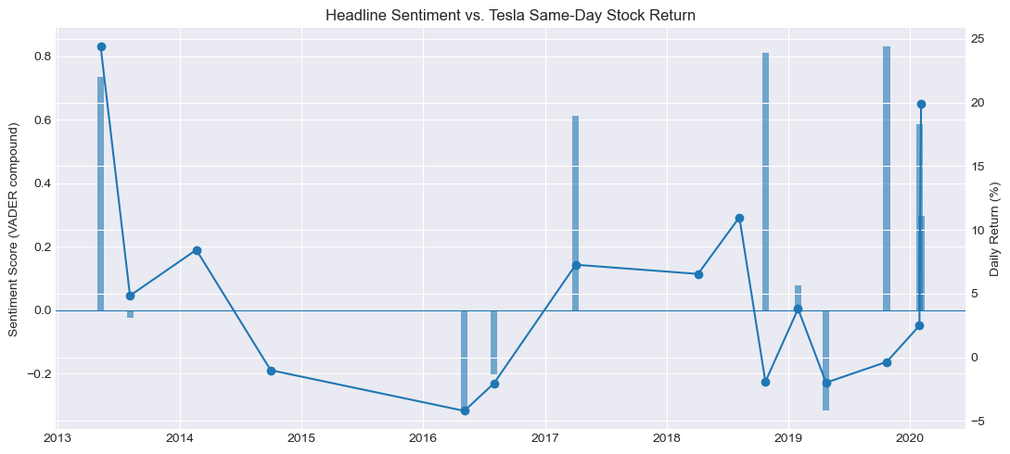
Headline Sentiment vs. Tesla Same-Day Stock Return
Compares headline sentiment (VADER) with same-day stock returns.
Sentiment and returns show mixed movement across the sample period.
Positive sentiment does not always correspond to positive returns.
Indicates that news sentiment alone may not fully explain short-term price movements.

Slide 19
Insights & Conclusion
Short-term forecasting: SimpleRNN performed best at 1-day horizon.
Medium-term forecasting: LSTM showed better improvement at 5 days.
Long-term forecasting: Both models became less reliable as the horizon increased.
Hyperparameter tuning: Improved performance for several model–horizon combinations.
Sentiment analysis: Headlines were mostly positive, followed by neutral and negative.
Overall: Combining price forecasting with news sentiment can support better market analysis.

Slide 20
Business Case
Better forecasting → supports informed investment decisions
Risk reduction → identifies possible price and sentiment changes
Short-term planning → useful for 1-day and 5-day forecasts
News sentiment → adds market context to price predictions
Business value → supports portfolio monitoring and decision-making

