Slide 1
CUSTOMER CONVERSION ANALYSIS FOR ONLINE SHOPPING USING CLICKSTREAM DATA
DOMAIN -E-COMMERCE AND RETAIL ANALYTICS
Presented By
KEERTHANA A

Slide 2
WORK FLOW
Data Collection
↓
Data Cleaning & Preprocessing
↓
Exploratory Data Analysis (EDA)
↓
Feature Engineering
↓
Model Development
↓
Model Evaluation
↓
Deployment (Streamlit)

Slide 3
DATASET OVERVIEW & DATA PREPROCESSING
DATA CLEANING & PREPROCESSING
DATASET DETAILS
Source: Online Shopping Clickstream Data
Records: 132,379 rows
Features: 14 columns
Data Types: Numerical & Categorical
Column Status | Result | Strategy
Numerical Columns | No Missing Values | Median
Categorical Columns | No Missing Values | Mode
Overall Dataset | ✅ Clean Dataset | Outlier detection using Boxplots
KEY FEATURES
Date: Year, Month, Day
Session Info: Session ID, Page
Product Info: Category, Model, Colour
Pricing: Price, Price_2
train_cleaned.csv & test_cleaned.csv saved

Slide 4
FEATURE ENGINEERING & BEHAVIOURAL METRICS
Feature | Description
is_weekend | Indicates whether the session occurred on a weekend (1 = Weekend, 0 = Weekday)
total_clicks | Total number of user interactions per session
avg_price | Average product price viewed in a session
max_page | Maximum page number visited during the session
unique_products | Number of unique products viewed per session
high_price_view | Flags sessions where viewed price is above dataset average
Session-level behavior captured
Time-based user activity identified
Pricing sensitivity modeled
Improved representation of user intent

Slide 5
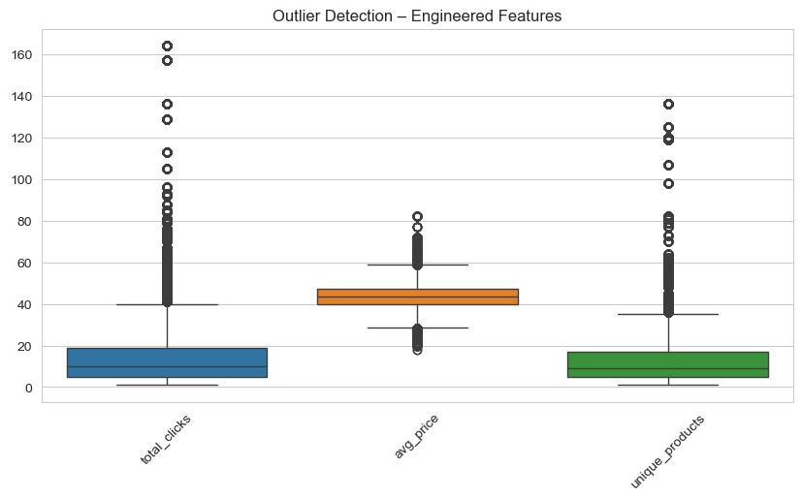
OUTLIER DETECTION
Outlier analysis performed on session-level engineered features
Boxplots used to visualize extreme user behaviors
Outliers retained as they represent genuine customer interactions
No removal applied to avoid information loss

Slide 6
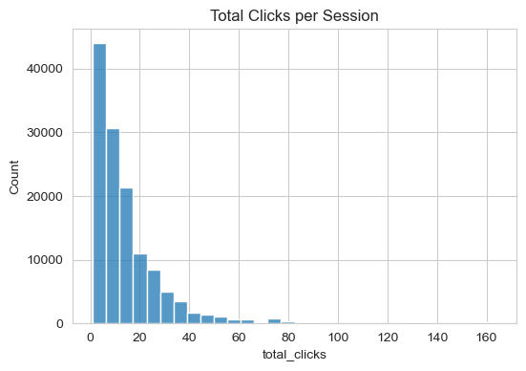
UNIVARIATE ANALYSIS – TOTAL CLICKS
Analyzed distribution of total clicks per user session
Majority of sessions have low to moderate number of clicks
Distribution is right-skewed, indicating few highly active users
Presence of high-click sessions suggests strong user engagement
These values represent valid behavioral patterns, not data errors

Slide 7
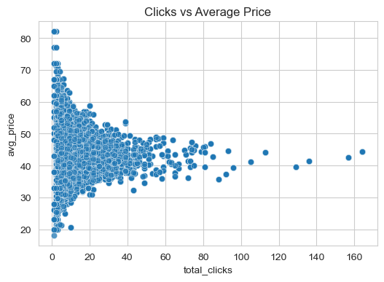
BIVARIATE ANALYSIS – TOTAL CLICKS vs AVERAGE PRICE
Relationship between user engagement and product pricing
Higher clicks mostly occur at moderate price range
Very high-priced products receive fewer interactions
Weak negative correlation observed

Slide 8
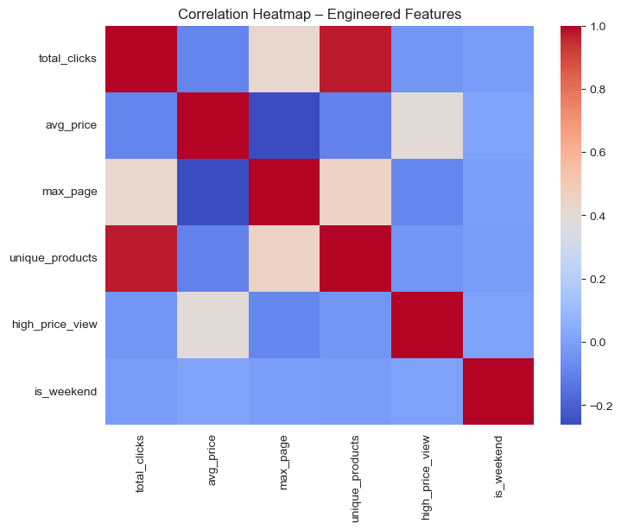
MULTIVARIATE ANALYSIS – CORRELATION HEATMAP
Strong positive correlation between total_clicks and unique_products
avg_price shows weak negative correlation with engagement
is_weekend has minimal impact on user behavior

Slide 9
TARGET CREATION & DATA PREPARATION
Created target variables
Cleaned and prepared data
Applied feature scaling
MODEL BUILDING & BALANCING
Handled class imbalance
Built classification models
Developed regression models
Performed customer segmentation

Slide 10
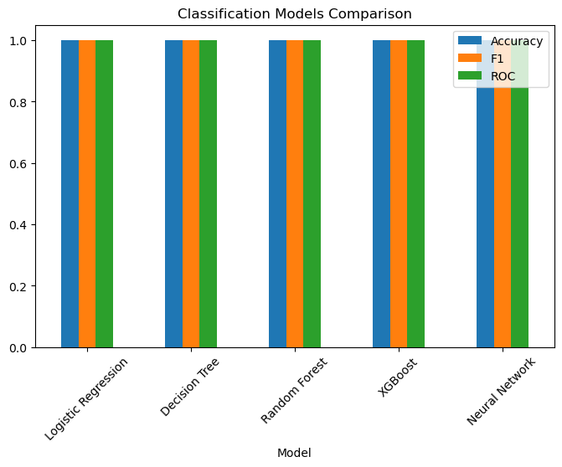
CLASSIFICATION MODEL COMPARISON
MODELS USED :
Logistic Regression, Decision Tree,
Random Forest, XGBoost, Neural Network
METRICS :
Accuracy, F1-Score, ROC-AUC
RESULT :
All models achieved 100% performance
BEST MODEL :
Random Forest
REASON :
Stable and reliable performance

Slide 11
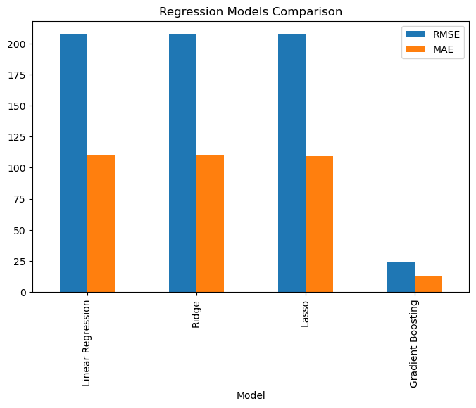
REGRESSION MODELS COMPARISON
MODELS USED:
Linear Regression, Ridge, Lasso, Gradient Boosting
METRICS:
RMSE, MAE, R² Score
RESULT:
Gradient Boosting shows lowest error
BEST MODEL:
Gradient Boosting Regressor
REASON:
Lowest RMSE & MAE and highest R² value

Slide 12
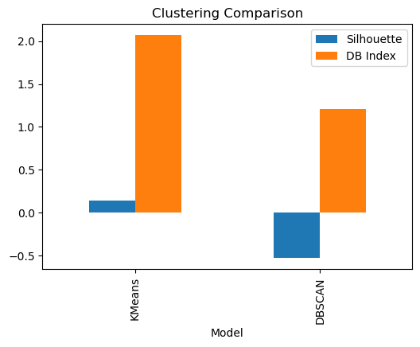
CLUSTERING MODELS COMPARISON
MODELS USED:
K-Means, DBSCAN
METRICS:
Silhouette Score, Davies-Bouldin Index
RESULT:
K-Means performed better than DBSCAN
BEST MODEL:
K-Means Clustering
REASON:
Higher Silhouette Score and lower DB Index

Slide 13
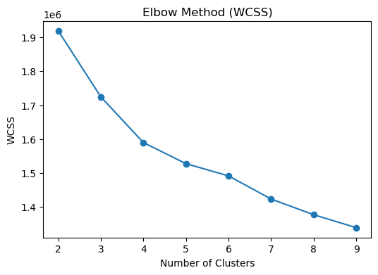
ELBOW METHOD
PURPOSE:
To find optimal number of clusters
METHOD:
Elbow Method using WCSS
OBSERVATION:
Elbow point observed at k = 4
FINAL DECISION:
Optimal number of clusters = 4

Slide 14
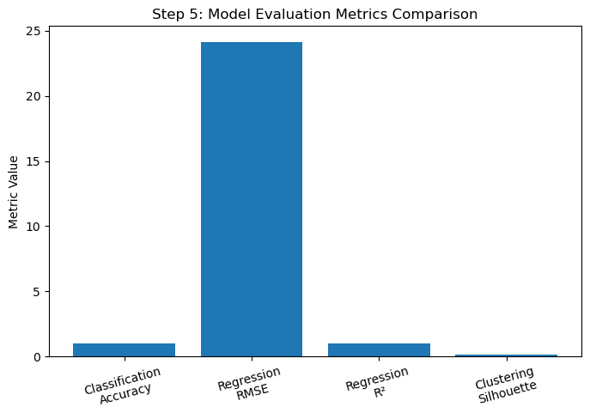
MODEL EVALUATION & HYPERPARAMETER TUNING
INSIGHTS
High classification accuracy
Low RMSE and high R² score
Valid customer segments (silhouette score)

Slide 15
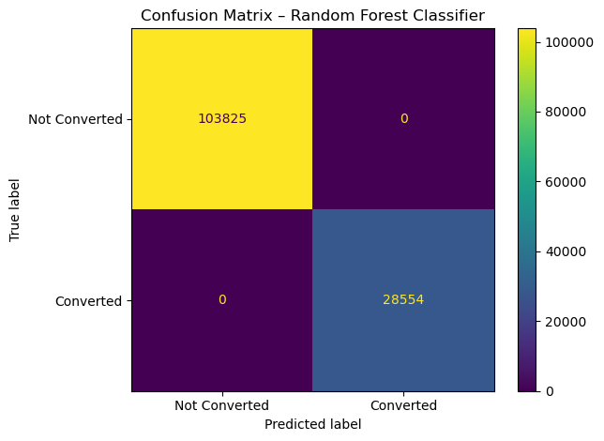
CUSTOMER CONVERSION PREDICTION – CLASSIFICATION EVALUATION
INSIGHTS
Random Forest achieved very high accuracy
Accurately classified majority of converted and non-converted users
Minimal classification errors observed
Strong model performance with clear class separation

Slide 16
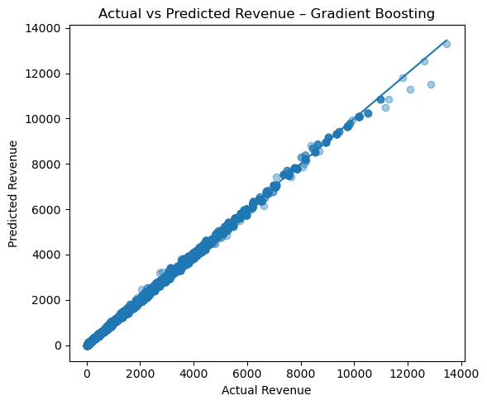
REVENUE PREDICTION – REGRESSION (GRADIENT BOOSTING)
INSIGHTS
Gradient Boosting shows strong prediction accuracy
Predicted revenue closely matches actual revenue
Low error and high model reliability
Suitable for revenue estimation

Slide 17
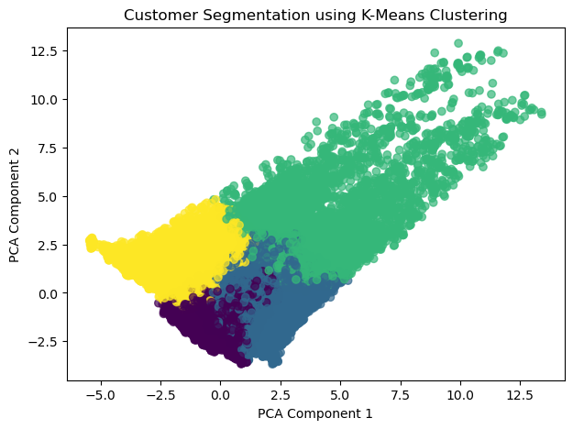
CUSTOMER SEGMENTATION – CLUSTERING
INSIGHTS
Customers are grouped into distinct segments
K-Means identifies similar behavior patterns
Clear separation between segments
Useful for targeted marketing

Slide 18
OVERFITTING CHECK & MODEL DEPLOYMENT
Overfitting Analysis
Compared training and testing performance
Minimal difference between train & test scores
Model generalizes well to unseen data
Web Application Deployment
Model integrated into web application
Users can input data and get predictions
Deployed for real-time revenue prediction

Slide 19
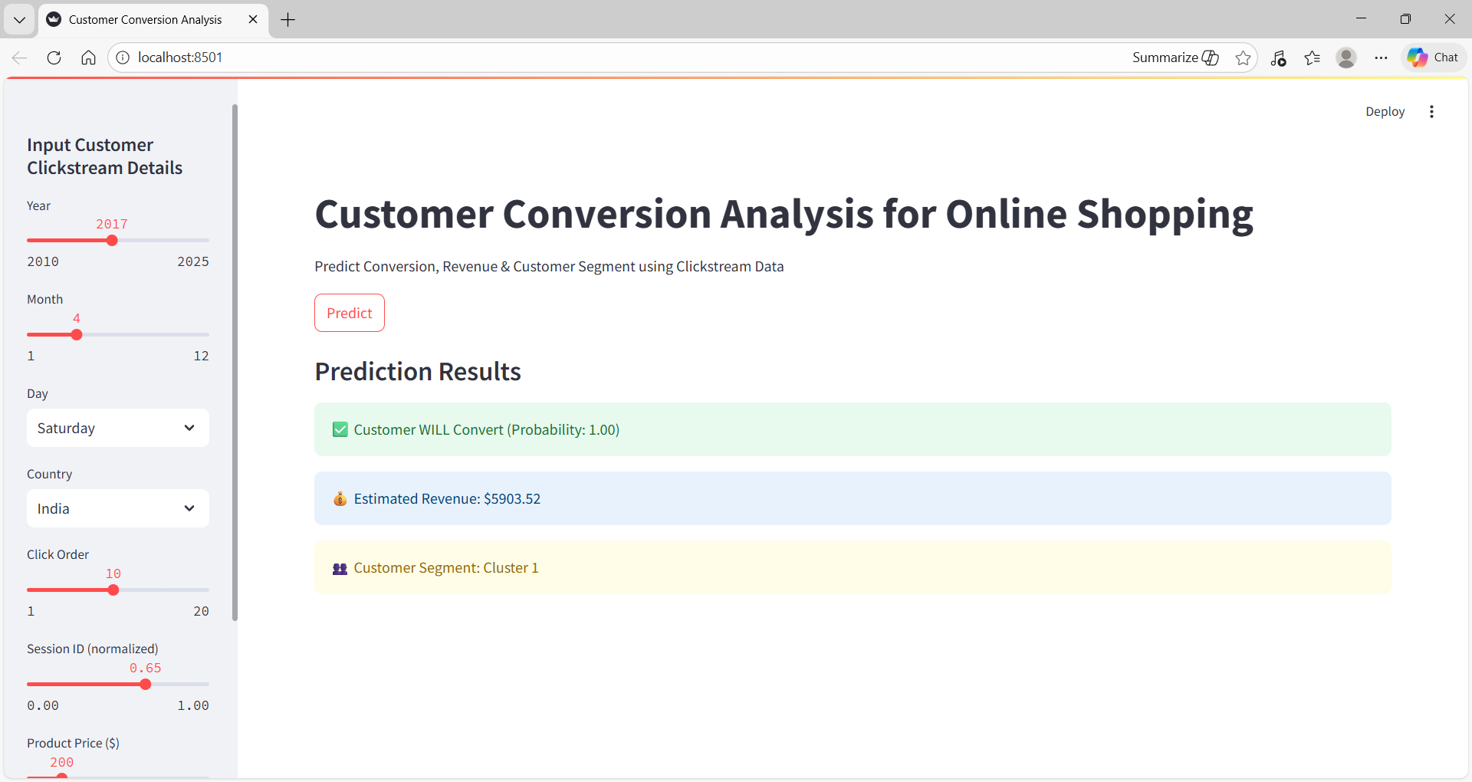
STREAMLIT APPLICATION & USER INTERFACE
DASHBOARD INSIGHTS
Predicts customer conversion probability
Estimates expected revenue
Identifies customer segment
Enables real-time decision making
Figure: Real-Time Customer Conversion Prediction Interface

Slide 20
CONCLUSION
Developed an end-to-end customer conversion prediction system
Achieved accurate insights using ML and clickstream data
Built an interactive Streamlit web application
Enables real-time, data-driven business decisions

