Slide 1
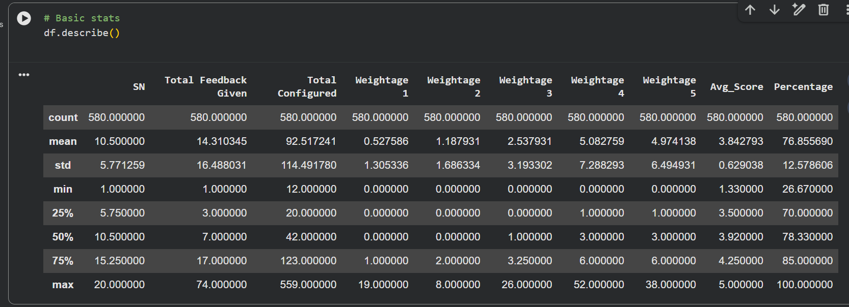
📊 Interpretation of df.describe()
The dataset contains 580 survey records, each representing feedback for a specific question.
Student engagement differs significantly between courses and events.
Most students are satisfied or very satisfied with campus events.
Overall satisfaction is moderate to high, with some areas needing improvement.
The majority of events meet student expectations, though consistency can be improved.
Targeted improvements should focus on low-scoring questions and courses with low participation.

Slide 2
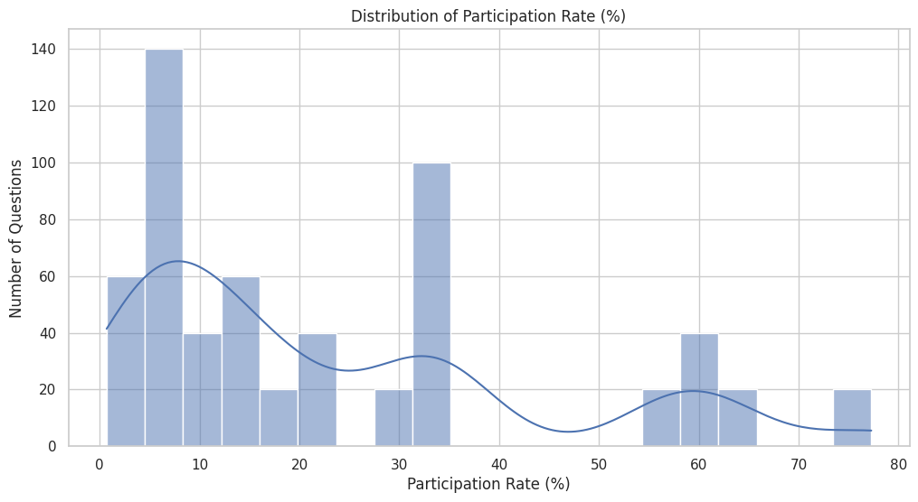
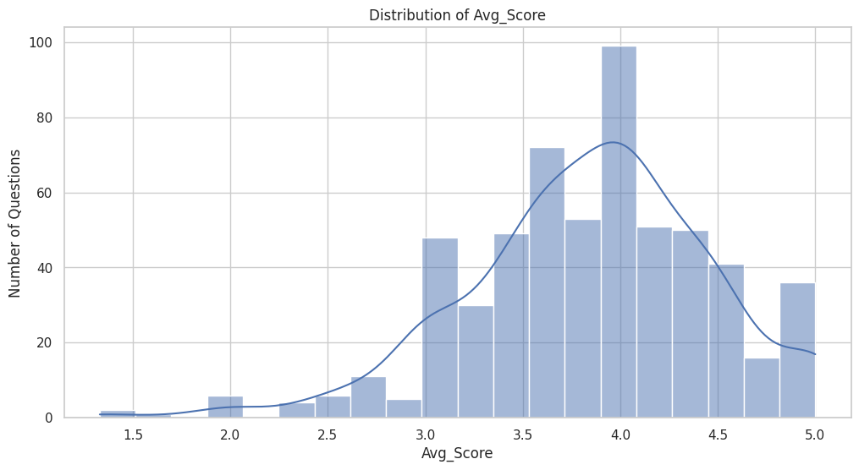
Distribution of Participation Rate (%)
Most questions have a low to moderate participation rate (roughly 5–30%).
A smaller number of questions have high participation (50–75%).
✅ Insight:
Student engagement varies widely across courses and questions. Some events or surveys attract significantly more responses than others.
Distribution of Average Score (Avg_Score)
The scores are centered between 3.5 and 4.5.
Very few questions fall below 2.5.
The distribution is slightly left-skewed toward higher scores.
✅ Insight:
Overall satisfaction is moderate to high, indicating that most students rated events positively.

Slide 3
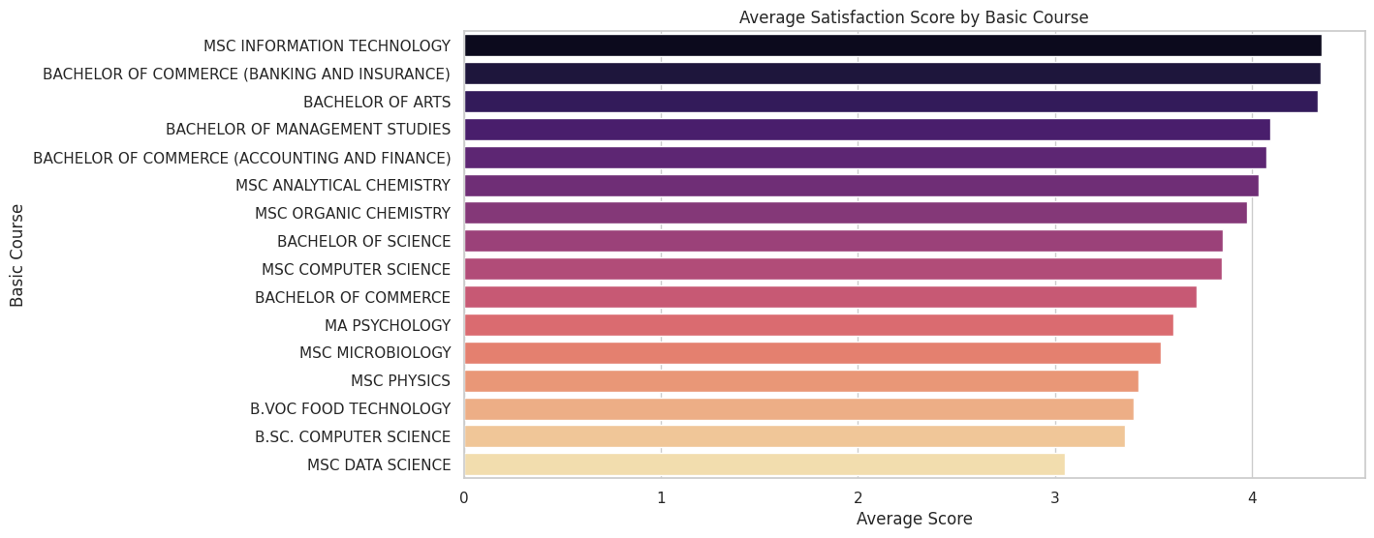
Average Satisfaction Score by Basic Course (Middle-Left)
Courses like MSc Information Technology, B.Com (Banking & Insurance), and BA show higher average satisfaction.
Some courses (e.g., MSc Data Science) have comparatively lower average scores.
✅ Insight:
Student satisfaction differs by course, which helps administrators target course-specific improvements.

Slide 4
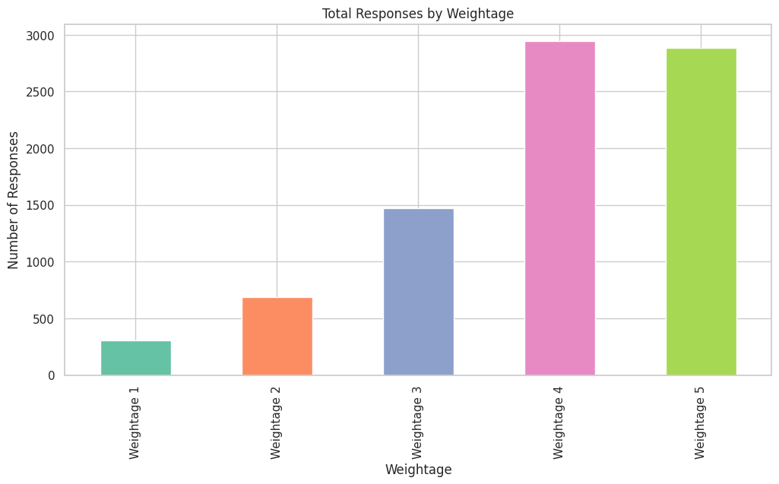
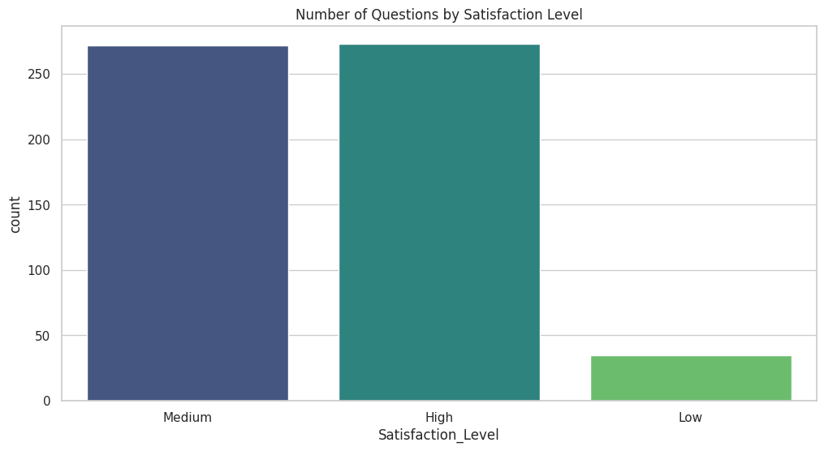
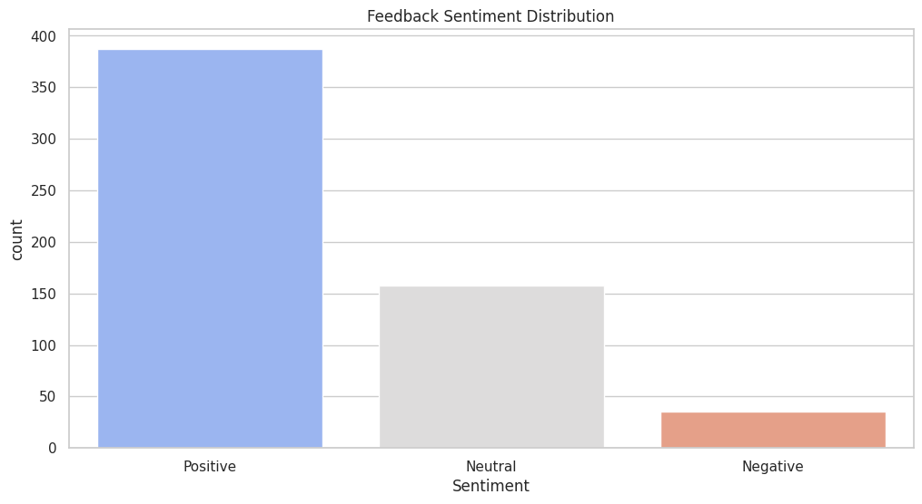
Total Responses by Weightage
Weightage 4 and 5 dominate the responses.
Very few students selected Weightage 1 or 2.
✅ Insight:
Most students rated events as good or excellent, reinforcing the overall positive feedback trend.
Feedback Sentiment Distribution (NLP Output)
Majority of feedback is Positive.
A reasonable portion is Neutral.
Very few responses are Negative.
✅ Insight:
NLP-based sentiment analysis confirms the numeric ratings — students generally have a positive perception of events.
Number of Questions by Satisfaction Level
✅ Insight:
Campus events generally meet student expectations, with only a small set of improvement areas.

Slide 5
Result
The EDA and NLP analysis show that student feedback is largely positive, with average satisfaction scores concentrated between 3.5 and 4.5 and sentiment analysis dominated by positive responses. Participation rates vary significantly across courses, highlighting engagement gaps. While most events are rated good to excellent, a small number of low-scoring questions and courses indicate clear opportunities for targeted improvements.
The EDA shows that student feedback is largely positive, with an average satisfaction score of ~3.8/5 (≈77%), though participation and satisfaction vary significantly across courses, highlighting specific areas for improvement.

