Slide 1
E-Commerce Web App with Inventory Management and Order Tracking
D Sai Keerthana Reddy
27-10-2024

Slide 2
Introduction and objectives
Problem Statement: You are tasked with building a comprehensive e-commerce web app for a fictional retail company called "WiproTechWear". The app should allow users to browse and purchase tech-related products, track their orders, and manage their account information.
Key features:
1.User Registration & Login
2.Product Browsing & Filtering
3.Shopping Cart & Checkout

Slide 3



Technologies used
Frontend: React
Backend: Springboot
Database: MySQL

Slide 4
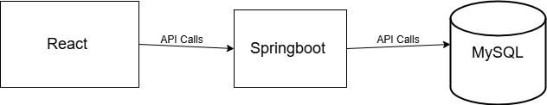
System Architecture
The flow of data between components is shown above.
The data is fetched by making API calls from Springboot framework to MySQL Database.

Slide 5
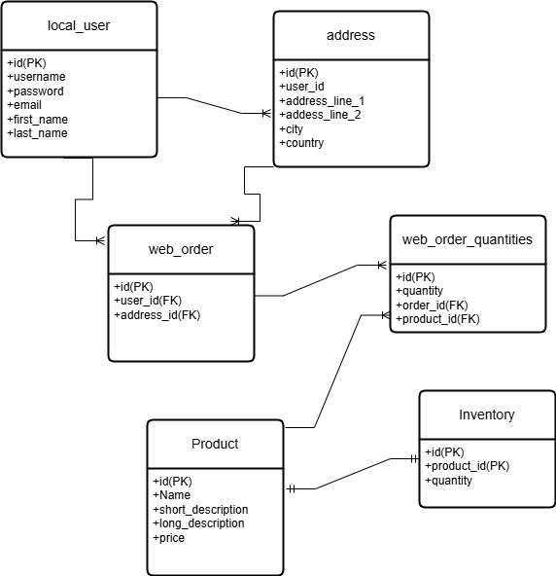
Database Schema(Entity Relationship Diagram)

Slide 6
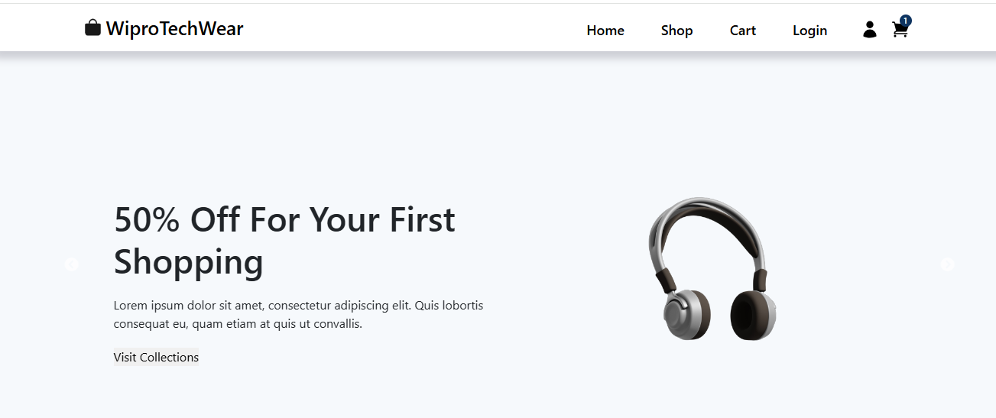
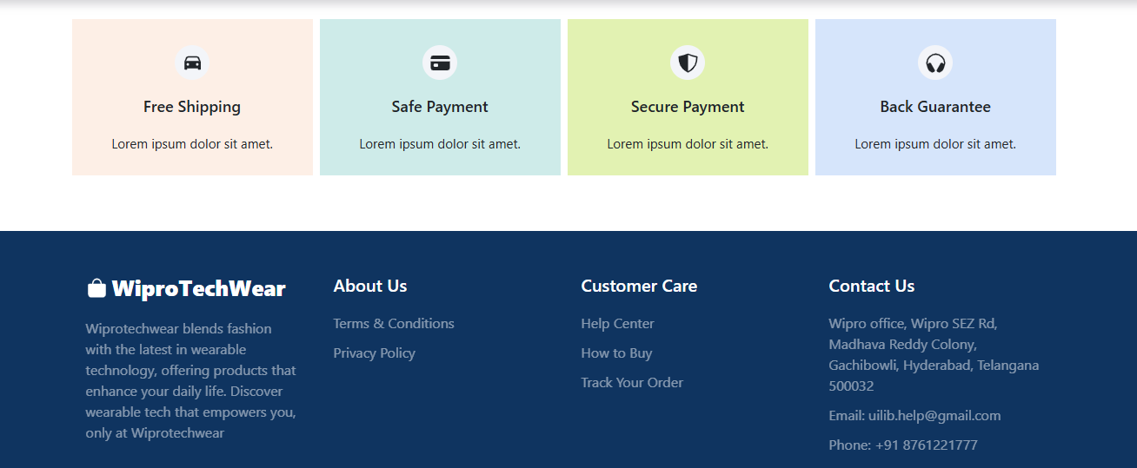
Frontend Design
Homepage

Slide 7
Home page
Components
Navbar(Home,Shop,Cart,Login) component
shared components like footer component
slider component

Slide 8
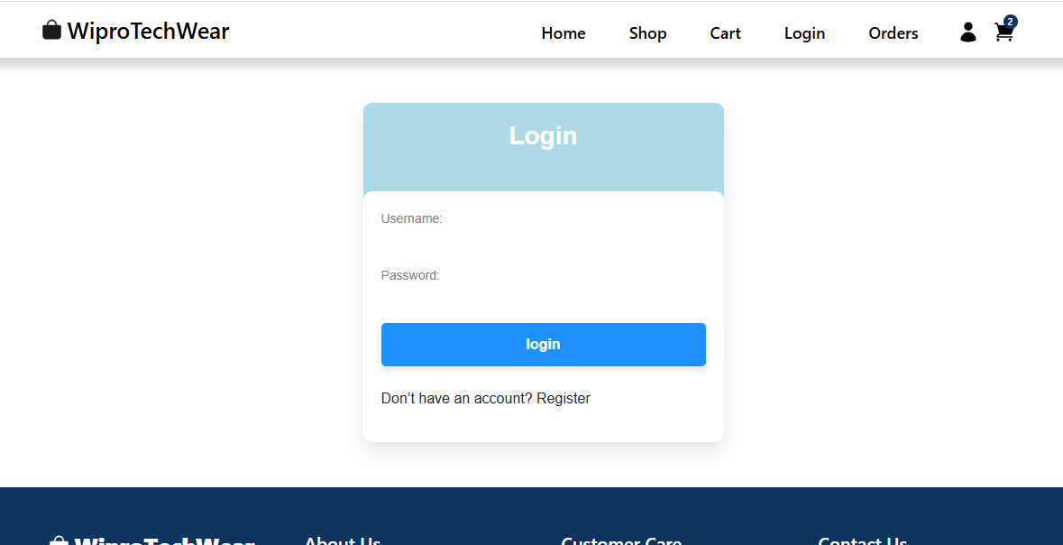
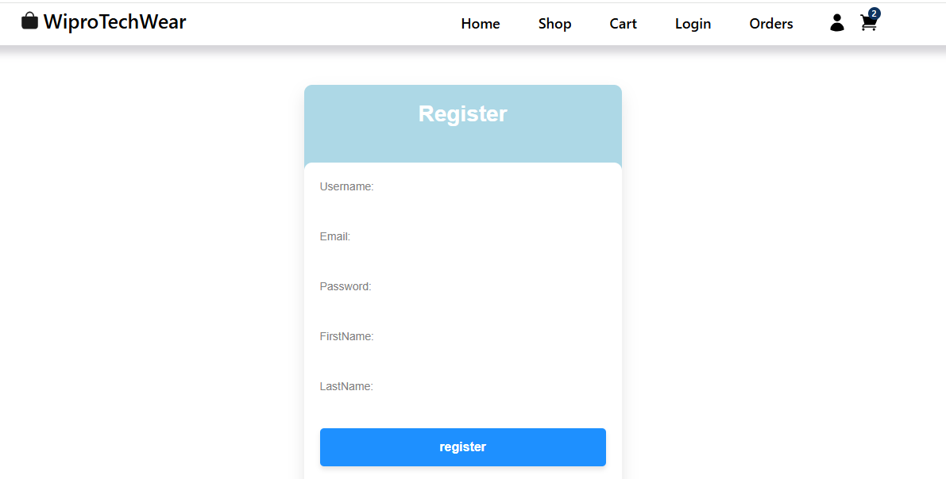
Login and Register page

Slide 9
Register page
New users can register using the registration form, if user already exists it will show that user already exists and user can directly login.
If email or username of existing user is given, it doesn't register
Fields shouldn't be null and blank

Slide 10
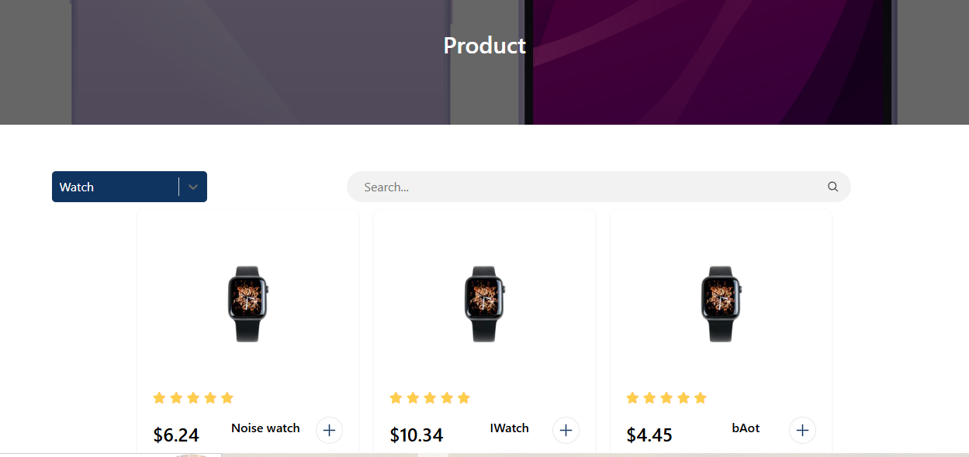
Product page

Slide 11
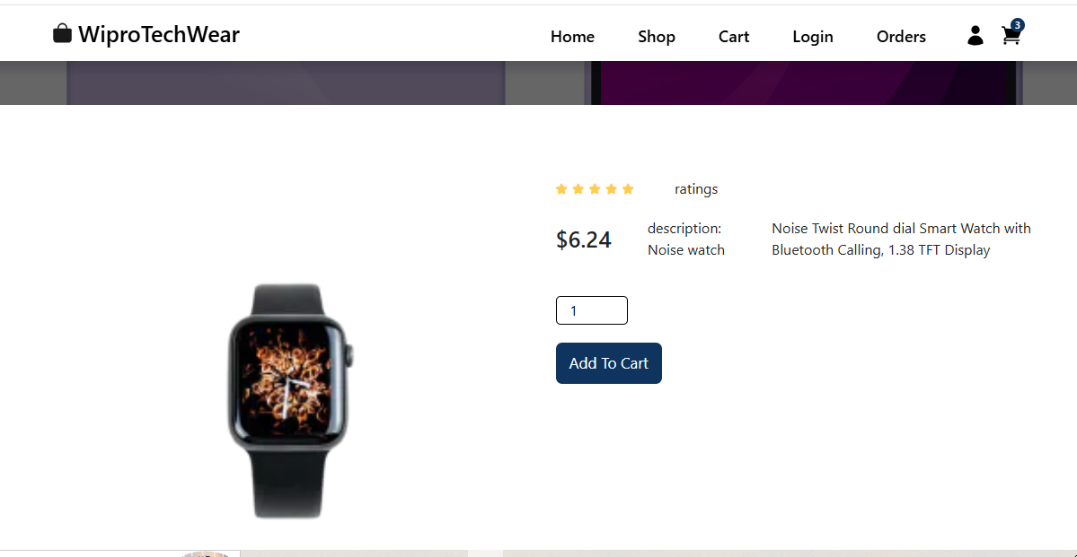

Slide 12
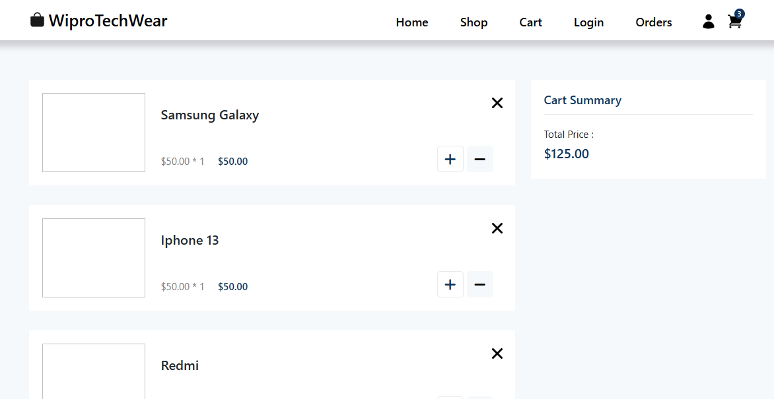
Cart page

Slide 13
Backend API Design
List key REST API endpoints:
/auth/register : for registration
/login : for login
/product : to get products
/order : to get orders

Slide 14
Testing
Unit testing : Unit testing is a method for testing individual components of the application.
Unit testing is done to our project to know the code coverage of our project.
Code coverage: how many lines of code is tested.

Slide 15
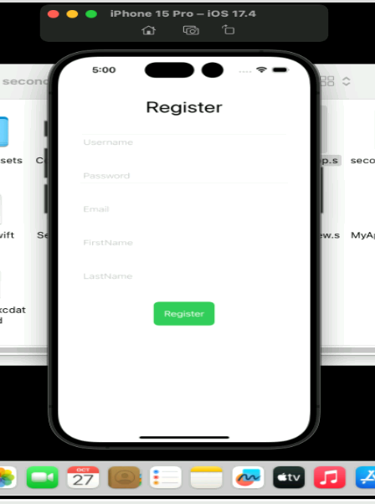
Mobile Application
Registration page
All fields should be filled to register.
After clicking on register it will be navigated to Login page.
Using the swift ui, we can make the page more user interactive.

Slide 16
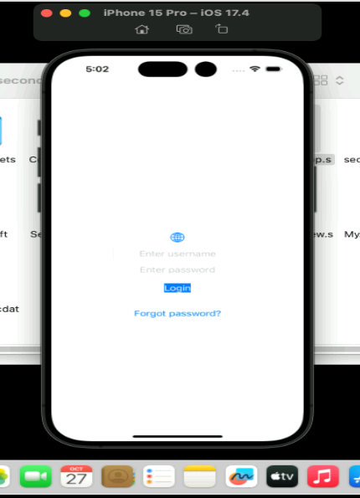
Login page
The username and password should be correct in order to login,
otherwise it shows invalid credentials.

Slide 17
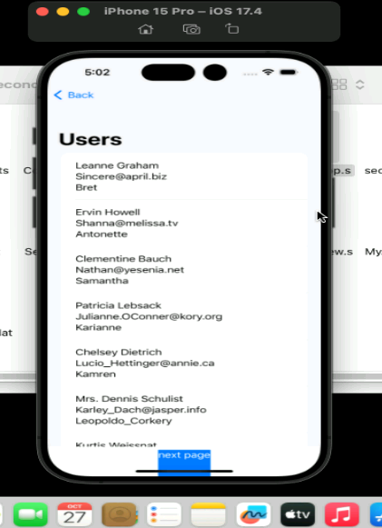
List of users
By making a connection to the server by URLSession we can retrieve the data accordingly.

Slide 18
Q/A

