Slide 1













































Department of Electronics and Communication Engineering
Mini Project (BEC586) Presentation on
“LOCATION GUIDE USING RF -MICROCONTOLLER”
By
AISHWARYA M (4GW23EC008)
AMULYA M S (4GW23EC017)
GAANA N J (4GW23EC048)
KEERTHANA G (4GW23EC062)
Under the guidance of
Dr .RAJENDRA R PATIL
Professor & HOD
Dept. of ECE, GSSSIETW

Slide 2

Contents
Introduction
Literature Survey
Problem statement and solution strategy
Objectives
Methodology
Flow chart of program
Result
Conclusion
Reference

Slide 3
Introduction
GPS is widely used, it has major limitations indoors or in areas with signal blockage.
This project demonstrates how RF technology, combined with microcontrollers and signal strength measurement, can provide accurate tracking with minimal infrastructure .
By implementing this system, we aim to make geo-location solutions more accessible, efficient, and adaptable to various practical applications such as campus navigation, warehouse management, and safety monitoring.

Slide 4
Literature Survey
Authors & Title | Publication details and date | Problem identified & Techniques used | Outcome or performance | Disadvantage or Future Work
Nadia Ahmed, Sadik Kamel Gharghan and others: "IoT-based child tracking using RFID and GPS" | International Journal of Computers and Applications, Taylor & Francis, Published online 22 May 2023 | Developed an affordable IoT-based child safety system using RFID readers, GPS, GSM, Arduino, and a Thinger.io-connected Android app. RFID tracks children in fixed zones, GPS points location, and alerts are sent instantly via SMS | System tested with real devices; RFID detection range about 4.5m per device, 9m between devices, accurate real-time geolocation even without internet,, easy monitoring for parents. | Limited experimental environment, only tested in a specific outdoor area; future work could include large-scale trials and integration of more sensors.

Slide 5
Literature Survey
Authors & Title | Publication details and date | Problem identified & Techniques used | Outcome or performance | Disadvantage or Future Work
Ezeofor C. Joseph, Egbuaba C. Chigozie, and Others: "Prototype Development of Hand Wearable RF Locator with Smart Walking Aid for the Blind" | Indian Journal of Engineering, ISSN 23197757, Vol. 1951, pp. 173-183, Published 24 April 2022, University of Port Harcourt, Nigeria | Visually impaired people suffer loss of mobility and misplace walking aids. Developed a hand wearable RF locator and smart walking stick with Arduino ATmega328P, proximity sensor, buzzer, and 433 MHz RF modules; detects obstacles and locates lost walking aid using sound alarm. | Tested with visually impaired participants; system reliably detected obstacles within 15 cm, sound alarm for lost stick worked well, rechargeable battery functional; enhances independent. | Limited testing scenarios; cannot detect ground holes, future work suggested includes adding alerts for ground pits and applying deep learning for improved obstacle recognition and navigation.

Slide 6
Literature Survey
Authors & Title | Publication details and date | Problem identified & Techniques used | Outcome or performance | Disadvantage or Future Work
Adedotun O. Owojori, Jane O. O. Mebawondu, and Others: "Design of an Obstacle and Location-Based Detector with Microcontroller System" | EJECE, European Journal of Electrical Engineering and Computer Science, Vol. 5 Issue 2, April 2021, Federal University of Technology Akure | Designed a wearable device with Arduino Nano, ultrasonic sensor for obstacle detection, SIM808 module for GPS and GSM, and buzzer. Device detects obstacles, alerts users, and sends location via SMS to guardians using Google Maps link for Visually impaired people. | Simulation and hardware tests successfully showed real-time obstacle detection and location tracking; buzzer alerts users of obstacles; system sends SMS to guardians for location monitoring | Requires outdoor access for GPS fixes; only buzzer alert for obstacles, future work could include ground pit detection and better indoor localization, as well as integration with IoT devices for real-time monitoring.

Slide 7

Literature Survey
Authors & Title | Publication details and date | Problem identified & Techniques used | Outcome or performance | Disadvantage or Future Work
Mangesh Ahire, Rahul Kotwal, and Others: "RFID based E-Tourist Guide" | IRJET, Vol. 8, Issue 3, Mar 2021, Sandip Institute of Technology and Research Centre, Nashik | Tourists face issues like misinformation, language barriers, and unreliable human guides. Designed an autonomous, multilingual E-tourist guide using RFID cards for login, STM32 microcontroller, GSM module for notifications, OLED display, and voice module for stored audio notes. | Provides timely audio, text, and SMS updates to tourists; multilingual support not dependent on internet or GPS for main features; reduces human intervention; low power consumption; | System not widely field-tested beyond demonstration; location features limited if GPS/internet is unavailable; future work could expand language support, enhance robustness.

Slide 8
Literature Survey
Authors & Title | Publication details and date | Problem identified & Techniques used | Outcome or performance | Disadvantage or Future Work
Yusen Fan, Feng Zhang and Others: "Indoor Heading Direction Estimation Using RF Signals" | IEEE ICASSP 2020, University of Maryland & Origin Wireless Inc. | Accurate indoor heading estimation is challenging due to IMU drift and interference, so RF signals from standard Wi-Fi CSI, a 2D octagonal antenna array, and time-reversal (TR) methods are used instead. | Prototype with single access point and 2D array achieved median error of 6.9°, better than IMU sensors, especially in NLOS environments, providing high accuracy and low cost. | Limited by hardware (half octagon array - 6 antennas). Future work: full array use, extension to more environments, address dynamic layout changes.

Slide 9
Problem Statement &
Solution strategy
GPS-based location systems often fail indoors due to signal blockages and interferences.
Existing tracking may be complex or require extensive infrastructure.
There is a necessity for reliable and simple system that can track and guide the position of objects or people using RF signals.
The system should effectively operate in confined or structured areas such as campuses, warehouses, or public spaces.
The project aims to develop a scalable and efficient RF-based geo-location system that ensures accurate real-time tracking and navigation.

Slide 10
Objectives
To design and develop a geo-location system using RF technology for accurate tracking.
To minimize power consumption while maintaining signal strength and communication reliability.
To ensure the system performs efficiently in both indoor and outdoor environment.

Slide 11
Methodology
1. Transmitter Activation
User presses the push button on the RF transmitter.
HT12E encoder generates a coded digital packet for each press.
2. RF Signal Transmission
433 MHz RF module broadcasts the encoded packet as a wireless pulse.
Each button press = one RF pulse.
3. Signal Reception
Receiver module captures the RF signal.
HT12D decoder validates the packet and outputs a clean digital pulse on D0.

Slide 12
Methodology
4. Pulse Timing Measurement
AT89S52 microcontroller records the timestamp of the first pulse.
When the second pulse arrives, it records the second timestamp.
Time gap is calculated using:
GAP = Time₂ – Time₁
5. Distance Classification
Using the time gap, the system categorizes distance as:
Small gap → NEAR
Medium gap → MID
Large gap → FAR

Slide 13
Methodology
6. Data Processing & Display
Microcontroller computes additional values (optional):
Signal strength (HIGH / MED / LOW)
Approximate distance
Results are shown on the 16×2 LCD display.
7. System Reset
After displaying results, the system resets automatically.
Waits for next pair of pulses.
8. Power Management
XIAO-ESP32-C3 provides regulated power supply to all modules for stable operation.

Slide 14
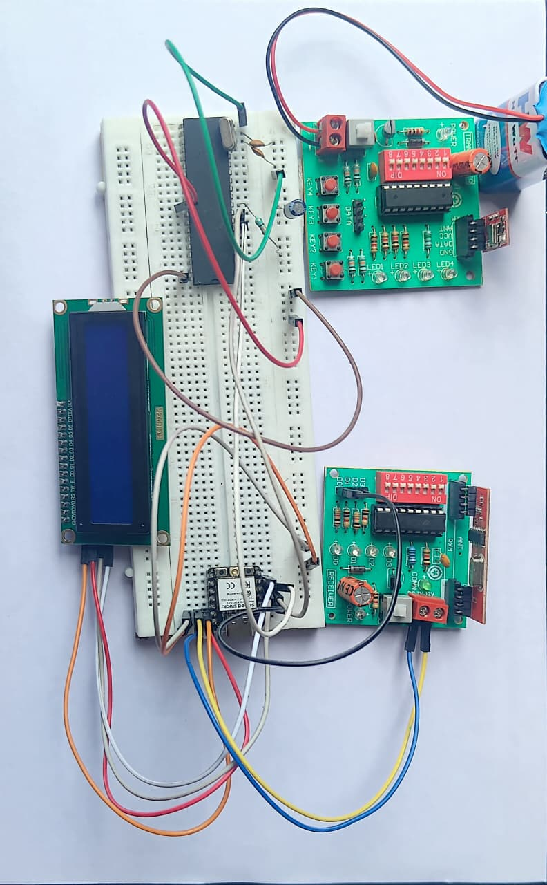
Methodology
FIG-Complete Prototype Setup of RF-Based Distance Indication System

Slide 15
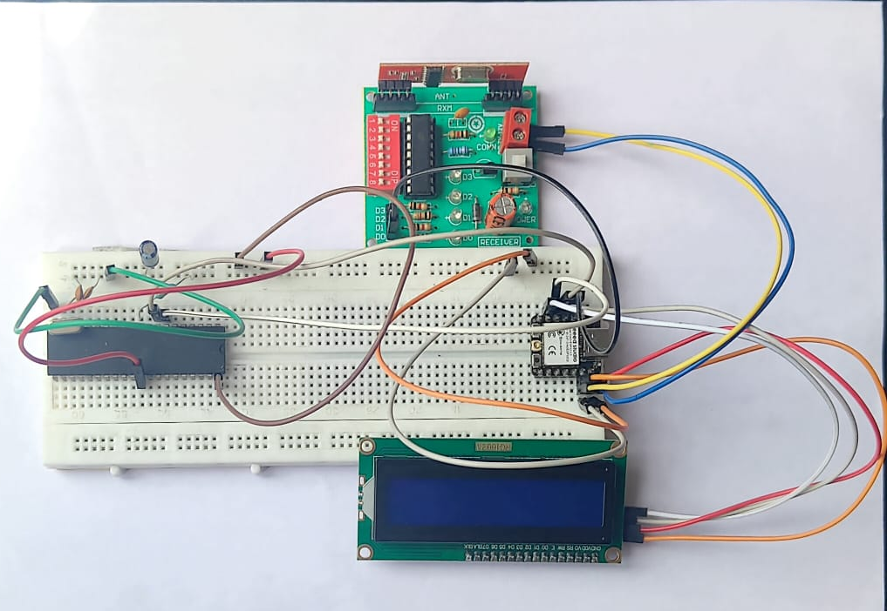
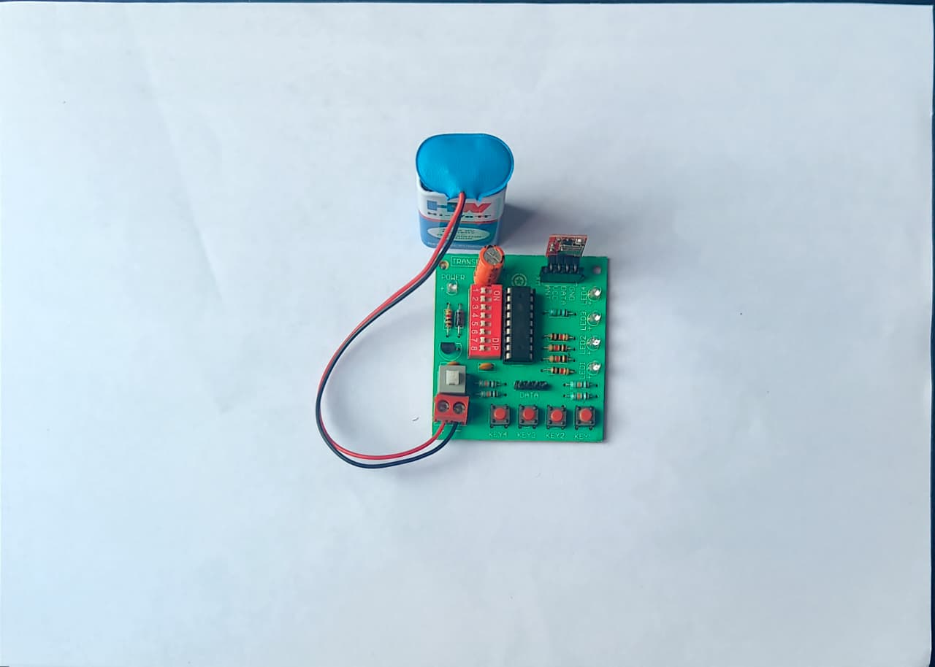
Methodology
FIG.b- Transmitter Hardware Assembly
FIG.a-Receiver Hardware Assembly

Slide 16
Flowchart of the Program
START
↓
Initialize LCD, Serial, I2C
Set RF Input Pin + Interrupt
Display "WAITING FOR SIGNALS"
↓
LOOP
↓
Check if a pulse timestamp arrived?
↓
(If yes) Process pulse:
- First pulse → store t1, show "P1 OK"
- Second pulse → store t2, show "P2 OK"
↓
If both pulses received :gap = t2 - t1
Map gap → NEAR / MID / FAR
Display result on LCD
↓
Wait 2.5 seconds
↓
Reset system → Display "WAITING FOR SIGNALS"
↓
Repeat LOOP

Slide 17
Result
The system successfully classified distance into NEAR, MID, and FAR by measuring the timing gap (ΔT) between two RF pulses.
The AT89S52 microcontroller accurately captured timestamps and computed ΔT with consistent performance.
The 16×2 I²C LCD displayed distance classification and timing results clearly during all tests.
The system worked reliably in different indoor environments, showing stable and repeatable results even with moderate noise and obstacles.
The timing-based method proved more reliable than RSSI-based approaches, confirming that the project offers a robust and practical short-range RF distance indication solution.

Slide 18
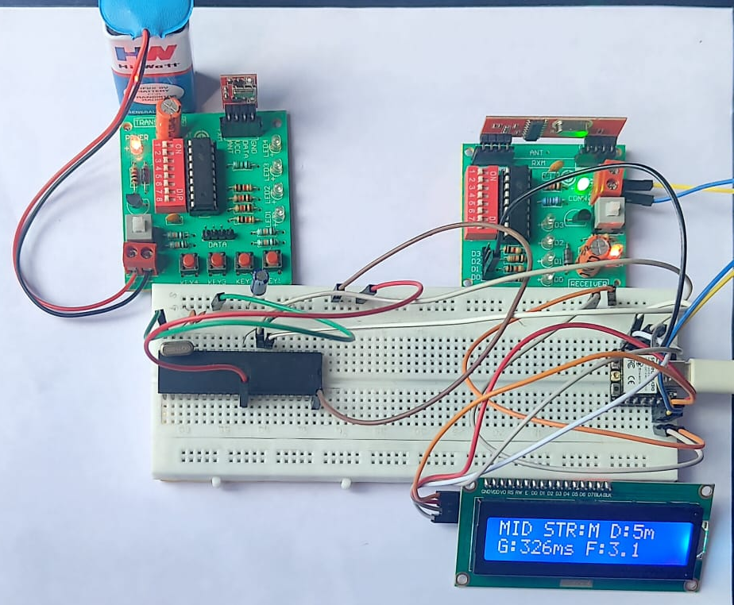
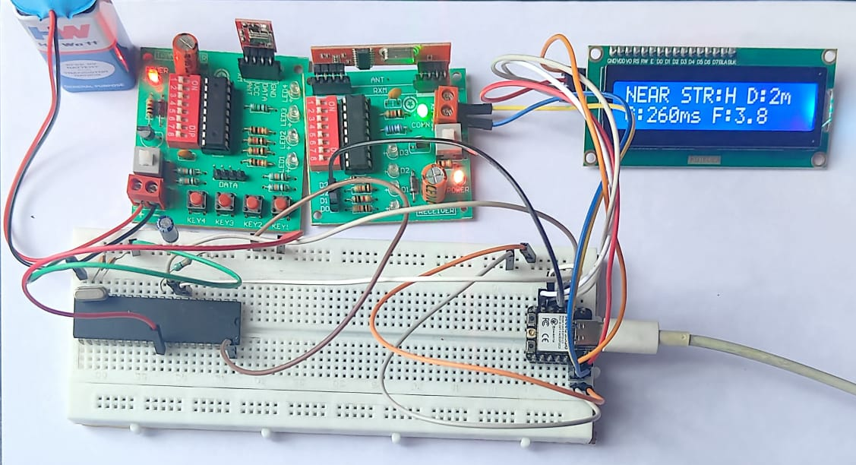
Result
FIG.a-LCD Output Showing NEAR Distance Classification
FIG.b-LCD Output Showing MID Distance Classification

Slide 19
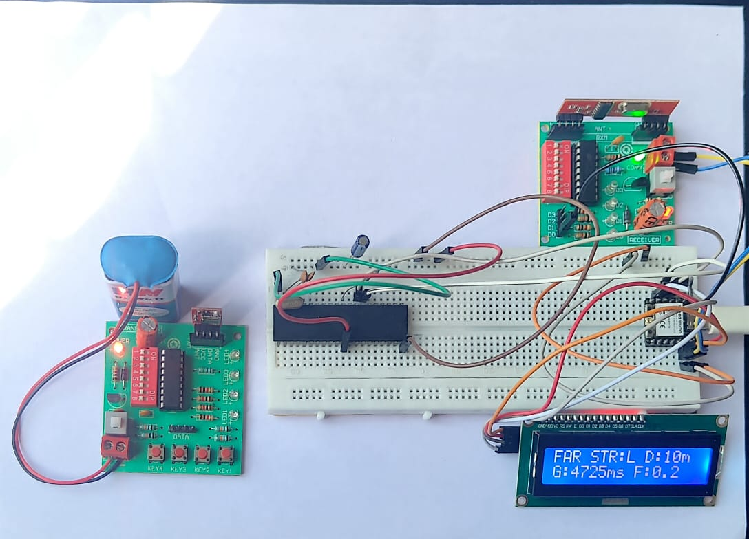
Result
FIG.c-LCD Output Showing FAR Distance Classification

Slide 20
Conclusion
The project successfully provided a simple, low-cost, and GPS-independent method for short-range distance indication using RF communication.
By measuring the timing difference (ΔT) between two RF pulses, the system accurately classified distance into NEAR, MID, and FAR.
The combination of HT12E/HT12D encoder–decoder and AT89S52 microcontroller proved effective for reliable proximity estimation in indoor environments.
The system performed consistently even in moderate noise and obstacles, with the LCD giving clear and stable output.
The ESP32-C3 power module ensured smooth, uninterrupted operation, enabling the project to fully achieve its intended objectives.

Slide 21
References
| IoT-based Child Tracking Using RFID and GPS | Nadia Ahmed, Sadik Kamel Gharghan, Ammar Hussein Mutlag | International Journal of Computers and Applications, Taylor & Francis, DOI: [10.1080/1206212X.2023.2215077] (https://doi.org/10.1080/1206212X.2023.2215077 ), Published online 22 May 2023 [1] |
| Prototype Development of Hand Wearable RF Locator with Smart Walking Aid for the Blind | Ezeofor C. Joseph, Egbuaba C. Chigozie, Jonah I. Uche | Indian Journal of Engineering, 2022, Vol. 19(51), pp. 173–183. Published by Discovery Scientific Society. Link: [http://creativecommons.org/licenses/by/4.0](http://creativecommons.org/licenses/by/4.0 ) [2] |
| Design of an Obstacle and Location-Based Detector with Microcontroller System | Adedotun O. Owojori, Jane O. O. Mebawondu, Jacob O. Mebawondu | European Journal of Electrical Engineering and Computer Science (EJECE), Vol. 5, Issue 2, April 2021. DOI: [10.24018/ejece.2021.5.2.318](http://dx.doi.org/10.24018/ejece.2021.5.2.318 ) [3] |

Slide 22
References
| RFID Based E-Tourist Guide | Mangesh Ahire, Rahul Kotwal, Raj Sutare, Sagar Kambale, Abhay Gaidhani | International Research Journal of Engineering and Technology (IRJET), Volume 8, Issue 3, March 2021. Link: [www.irjet.net](https://www.irjet.net ) [4] |
The title of the paper is "Indoor Heading Direction Estimation Using RF Signals."The authors are Yusen Fan, Feng Zhang, Chenshu Wu, Beibei Wang, and K. J. Ray Liu.This paper is published in the proceedings of the IEEE International Conference on Acoustics, Speech, and Signal Processing (ICASSP) 2020. Link : https://ieeexplore.ieee.org/document/9053033 [5]|

Slide 23
Thank You

