Slide 1


Team –Keras
Prashanth
Keerthana
B V Raju institute of technology

Slide 2
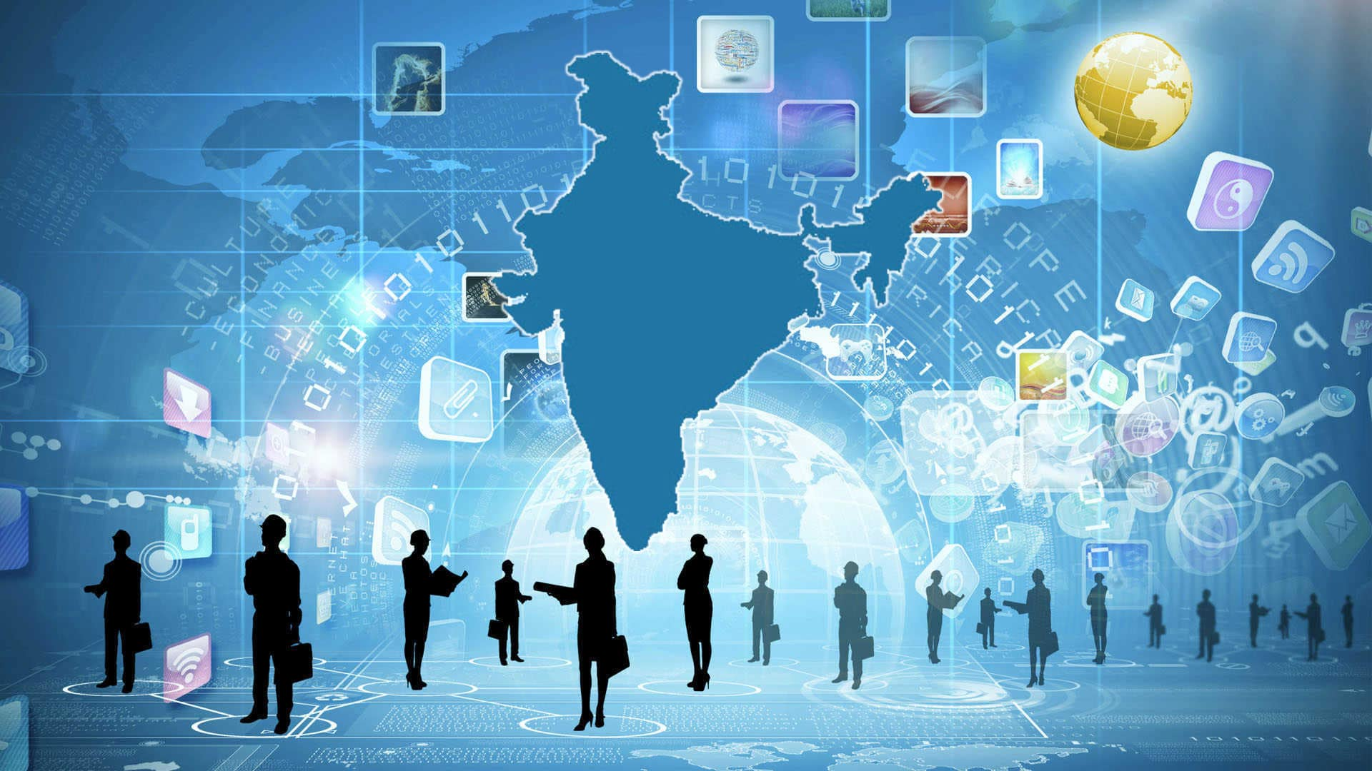
Sentiment analysis and Topic Modelling on Digital India Tweets

Slide 3

Digital india
The Government of India launched the "Digital India" program to bring fast internet to rural areas. On July 1, 2015, Prime Minister Narendra Modi introduced the Digital India Mission as a beneficiary of other government initiatives like Make in India, Bharatmala, Sagarmala, Startup India, Bharat Net, and Standup India.. Cloud computing and mobile applications are two examples of digital technologies that have emerged as global accelerators for rapid economic growth and citizen empowerment. We use digital technologies more frequently in all aspects of our daily life, from government offices to retail establishments. They enable us to communicate with one another and exchange knowledge about the problems and situations we face. In some situations, they also make it possible for those problems to be resolved almost instantly.

Slide 4
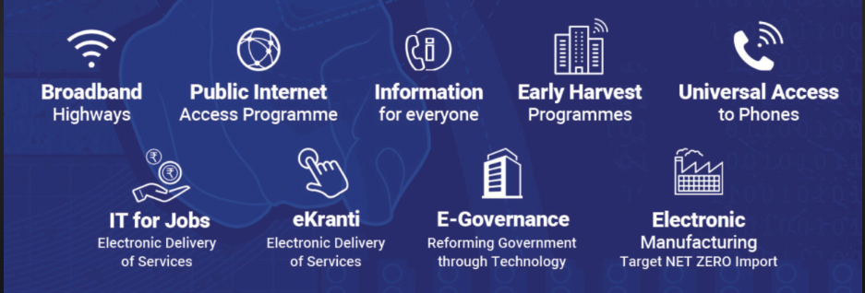
9 pillars of Digital india

Slide 5
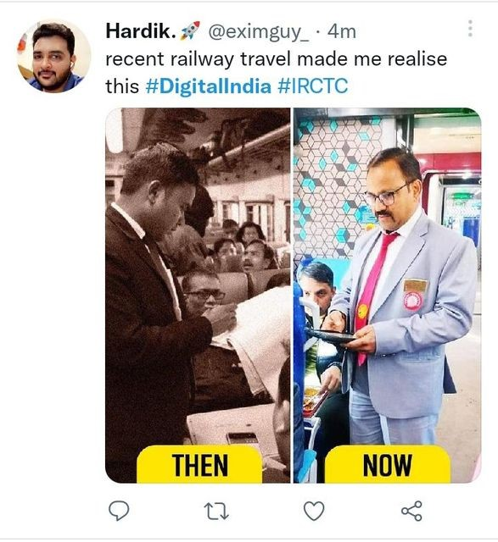
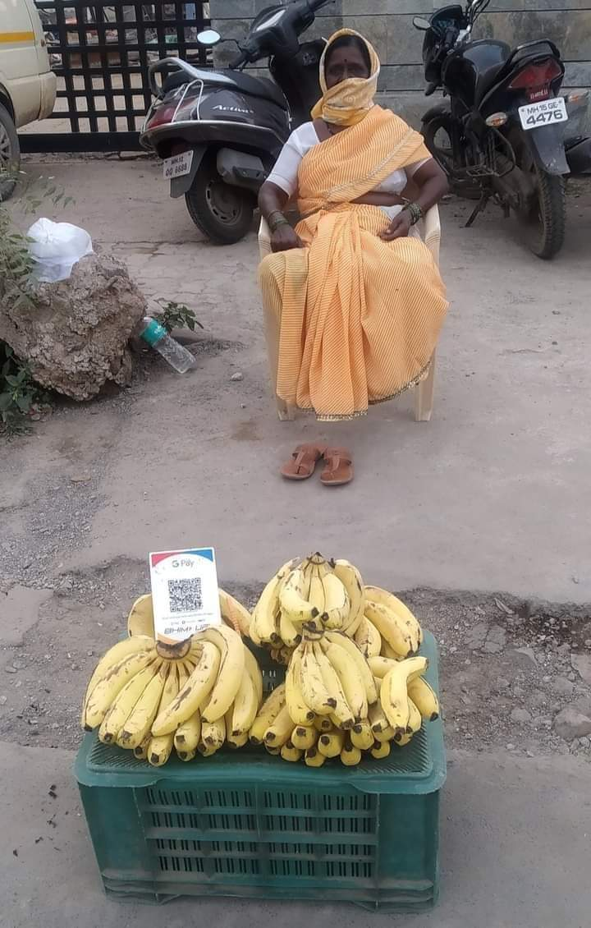
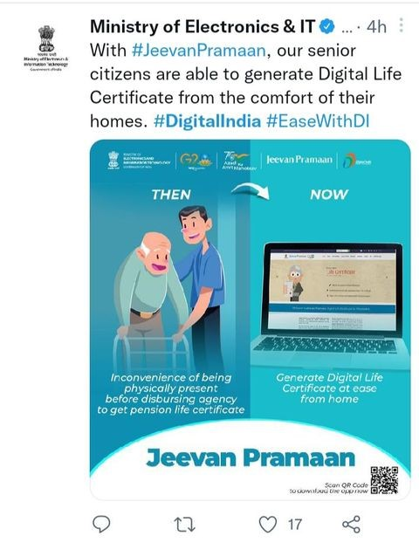
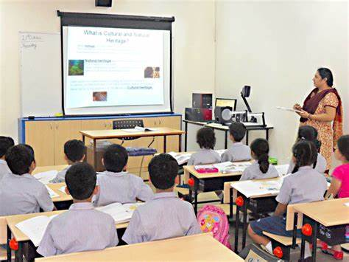
Picture represent changes made by digital india

Slide 6

Data Collection
Data collected from twitter
I have used snscrape Library for data
Collection throw twitter
We must extract the data in order to comprehend emotions and carry out sentiment analysis. As a result, Twitter is where the data is gathered. The information from tweets, comments, and hashtags on Twitter is extracted.
People can express their opinions and learn about current events on the social media site Twitter. Twitter is thus the ideal tool for gathering data for research purposes. For sentiment analysis, a sizable amount of data must be extracted. because when there are more tweets, it produces accurate results. Twitter is the ideal forum for it, therefore

Slide 7
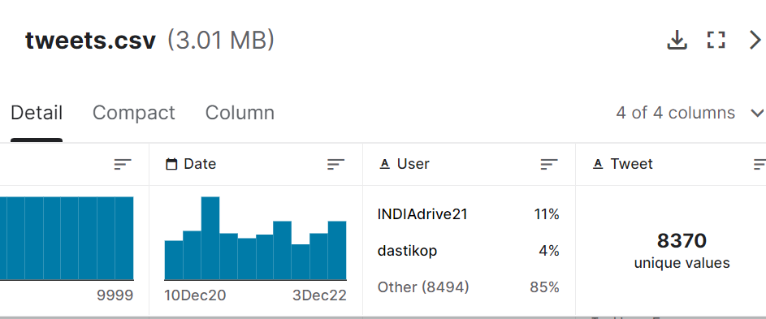
Data Collection
I have collected 10000 tweets from twitter
Tweets.csv contains 8370 unique values
From period 10-dec-20 to 3-dec-22
Label:data,user,Tweet
A scraper for social networking services is called Snscrape (SNS). It retrieves the stuff it has found by scraping information from searches, hashtags, and user profiles

Slide 8
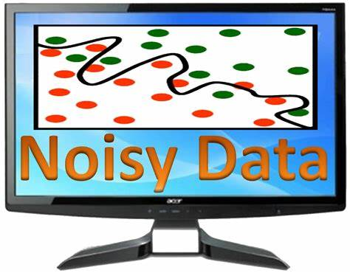
Removing Noise data
The extracted data is inconsistent. Noisy data requires more storage and makes sentiment analysis less accurate. Stop words, hashtags, mentions, and non-English words can all be found in extracted tweets. Therefore, this data must be cleaned before sentiment analysis and topic modeling are performed.

Slide 9
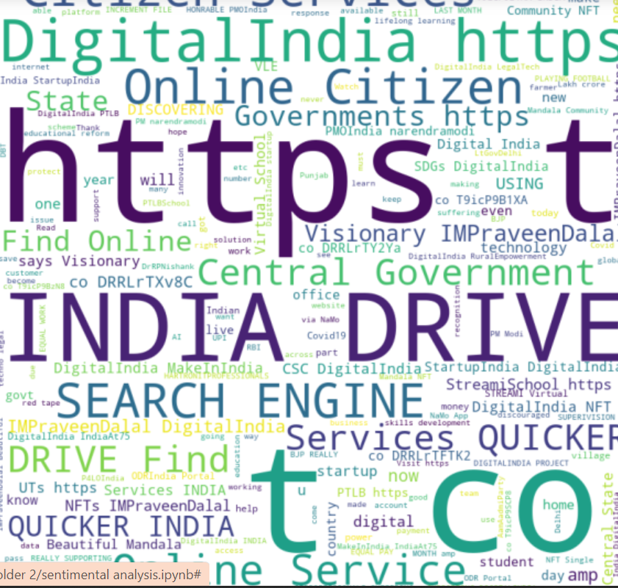
wordcloud
Wordcloud as the name suggests is a cloud of words.

Slide 10
Data preprocessing
Data preprocessing
Removing punctuation
Tokenization
Stemming and lemmatization
Removing
Link
Removing
Stop words
Removing
@special character

Slide 11
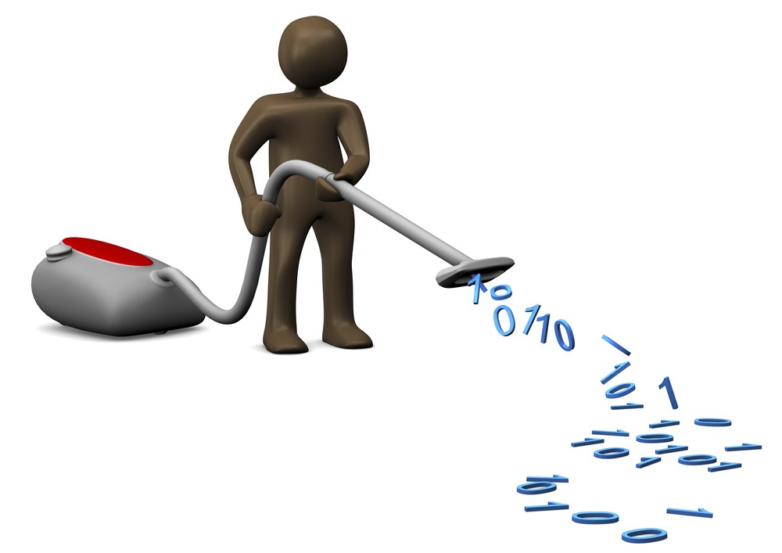
Data cleaning
1 .Removing special symbols and emojis:
• We use Regex to remove characters like #, and @ as collected tweets also contain mentions. Special characters present in the data make them unsuitable for sentiment analysis.
# Remove links
# Remove some special characters
# Remove numbers
# Remove ordinals
2 .Removing punctuations:
Puctuations:#,$%,[//],(),*^&<==,>/?{}@

Slide 12
Data cleaning
3. Tokenization:
In Python, we use the.split() function to divide the contents of an array or list. In NLP, we tokenize words similarly by taking into account white spaces.
Ex: I am reading book
Tokens=[‘I’,’am’,’reading’,’book’]

Slide 13
Data cleaning
4.Removing stopwords:
Stop words are some English words that are not helpful in sentiment analysis, such as "I," "am," "and," and "an." Instead, they result in more storage and inaccurate analysis.
Stopwords=[‘and’,’is’,’this’,’of’…….].
We use nltk (Natural Language Tool Kit) which is a suite that contains libraries to process the textual data.

Slide 14
Data cleaning
5.lemmatization:
The technique of lemmatization involves reducing a word to its simplest form. It is used to eliminate additional tweet noise.
By lemmatization, we can get the most possible accurate frequency distributions.
Ex: I --pron
saw--see
eighteen --eighteen
mice-- mouse

Slide 15
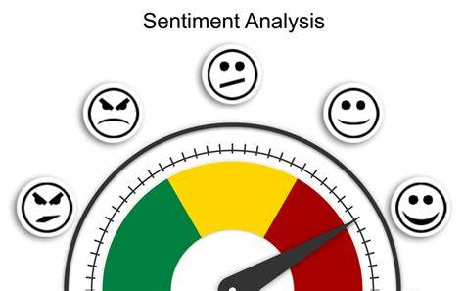

Sentiment Analysis
Sentiment analysis is an automatic method for extracting and analyzing subjective judgments on different aspects of an item or entity. Sentiment analysis helps us understand the premises of the text and the emotions exhibited by the author of the text. Understanding common people’s sentiments regarding a particular aspect, such as a particular health policy, can help governments and policymakers understand whether the policy they implement attracts common people. Sentiment analysis helps us understand the perceptions of common people regarding a particular health policy.

Slide 16

TextBlob
We used text Blob as a modeling approach for sentiment analysis. It is incredibly simple to use and can process the text in only a few lines of code because Text Blob is built on top of NLTK and Pattern. A Python module for processing textual data, Text Blob is open-source and free to use. It provides a straightforward API to access its methods and carry out fundamental NLP operations.
Polarity is a float that lies between [-1,1], where -1 denotes negative sentiment and +1 denotes positive sentiment in the text blob sentiment analyzer's response to a particular input.

Slide 17
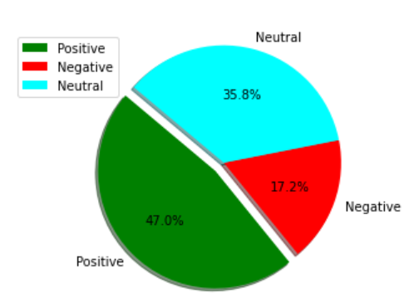
Result
Postive-3579
Negative-1725
Netural-4696

Slide 18
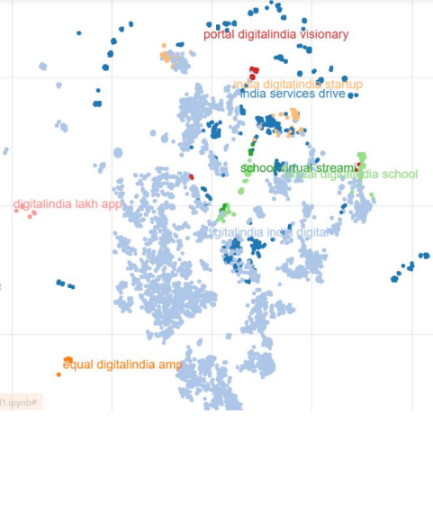
Topic Modelling
1.Latent Semantic Analysis(LSA) :
LSA is basically a technique where we identify the patterns from the text document or in simple words we tend to find out relevant and important information from the text document. it is clearly an unsupervised approach. It uses clursturing method to represent tweets.
Clurstured text:

Slide 19
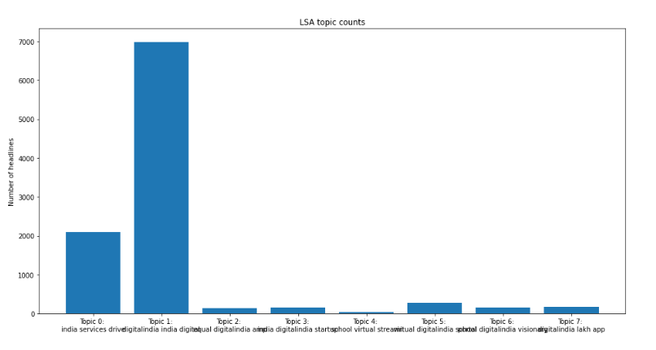
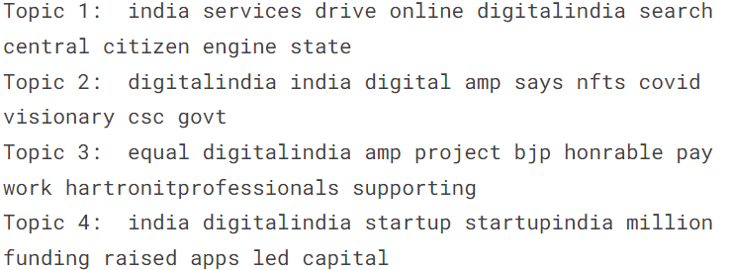
Topic Modelling
N_Topic

Slide 20
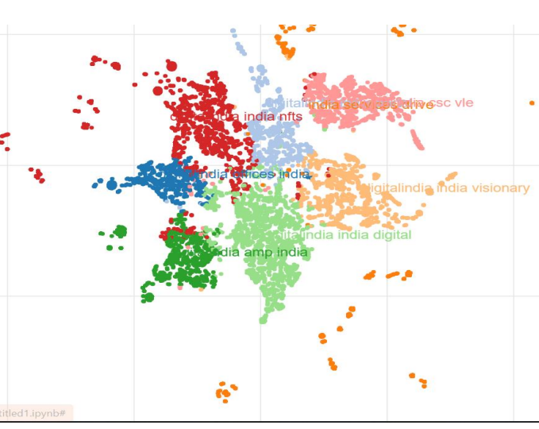
Topic Modelling
2 Latent Dirichilet Allocation(LDA):
It is a probability distribution but is much different than the normal distribution which includes mean and variance, unlike the normal distribution it is basically the sum of probabilities which combine together and added to be 1.
Clurstured text:

Slide 21
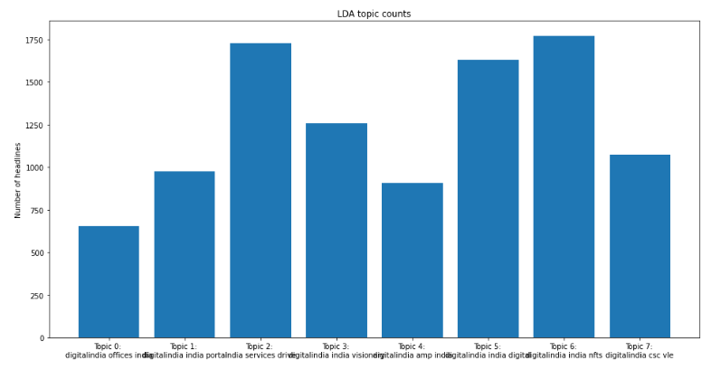
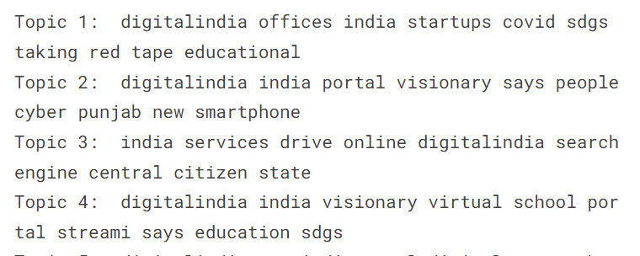
Topic Modelling
N_topic
Most repeated text:Startup,virtual school,service drive…

Slide 22


