Slide 1

Zepto
“Delivering Insights in Minutes – A Deep Dive into Zepto’s Data”
SQL Data Analysis
D Keerthana

Slide 2
Zepto Business Model
Quick commerce platform
Revenue streams: delivery fees, product margins, ads, partnerships
Dark stores for fast logistics

Slide 3

Type of data analysis
Product performance
Pricing & discounts
Inventory & stock
Revenue by category
Demand trends

Slide 4

Dataset Overview
Table Name: Zepto_v2 Rows: 3727 Total Columns: 9 Categorical Columns: 4
Numerical Columns: 5 Key Fields: Product Name, Category, MRP, Discount %, Stock Availability, Weight, Price per Gram

Slide 5
Tools Used
SQL → Data cleaning, Data exploration, Data analysis
Power BI → visualization
PowerPoint → presentation

Slide 6
Work Flow
Database Creation
Table Creation & Data Import
EDA
Actionable Recommendations
Insights
Data Analysis

Slide 7
Let’s dive into the Business Problems

Slide 8
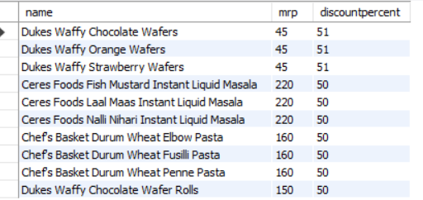
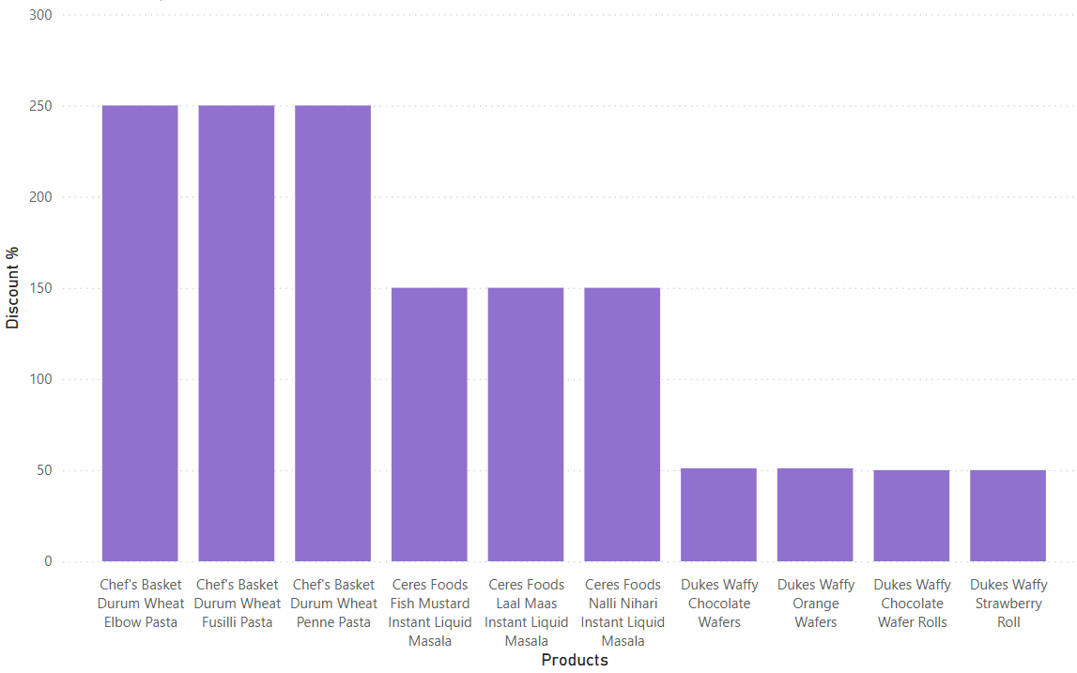
1. Top 10 Best Value Products (Highest Discount %).
Products with the highest discounts attract maximum visibility and sales. Customers strongly prefer discounted items, showing that price sensitivity drives purchasing decisions.

Slide 9
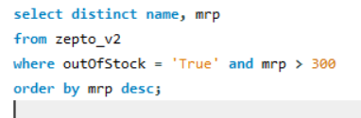
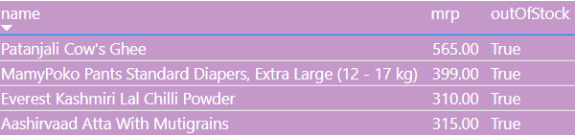
2. Products with High MRP but Out of Stock
Many premium and high-MRP items frequently go out of stock, leading to lost revenue opportunities. This suggests supply chain gaps in premium product categories.

Slide 10
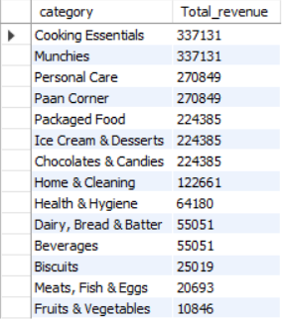
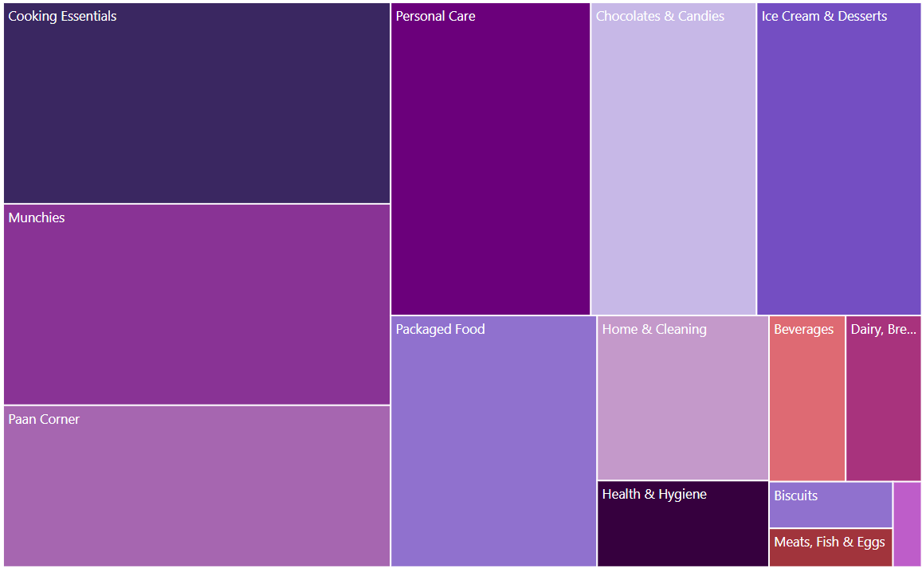
3.Total Revenue for each category
A few categories (like dairy, snacks, beverages) dominate overall revenue contribution. This concentration indicates customer preferences are clustered in essential and impulse-buy categories.

Slide 11
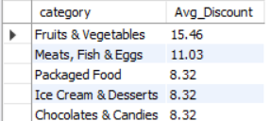
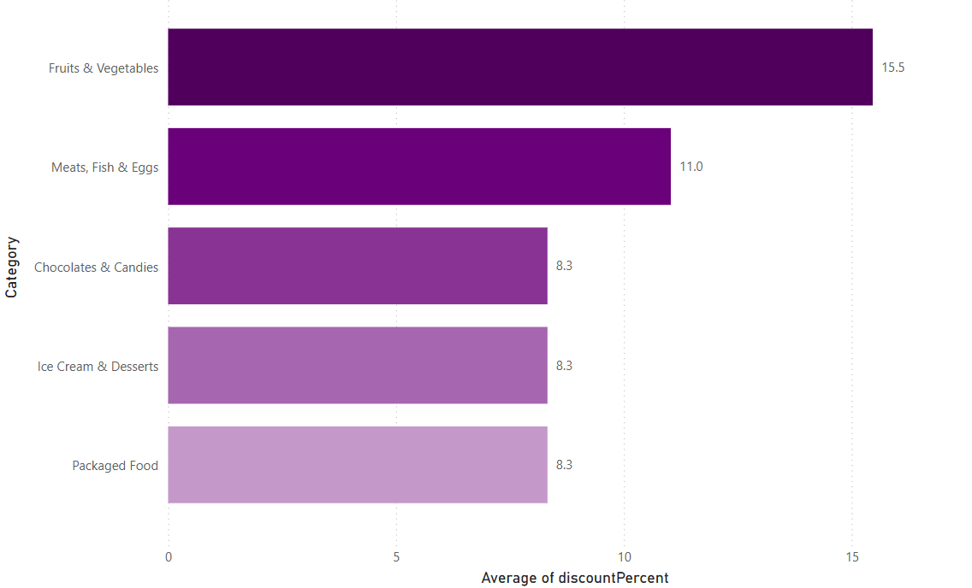
4. Top 5 categories with highest avg. discount %
Categories like snacks and packaged foods offer the highest discounts, indicating they are used as promotional drivers to increase traffic and repeat purchases.

Slide 12
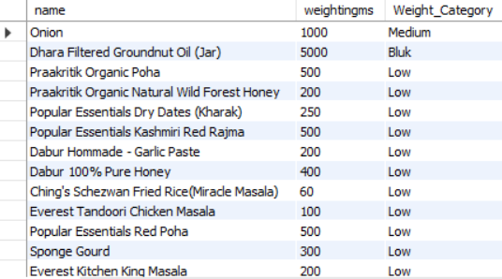
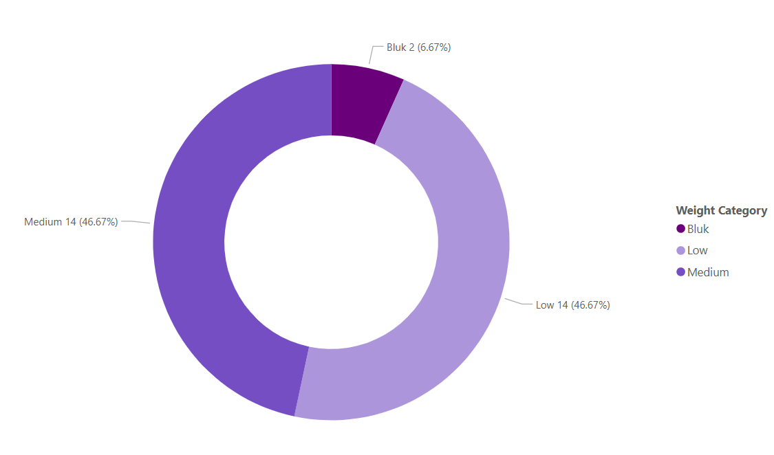
5. Group products into Low, Medium, Bulk categories
Bulk categories provide higher value per unit, while low-quantity products cater to quick, single-use needs. Segmenting helps in tailoring promotions—bulk for savings, small packs for convenience.

Slide 13
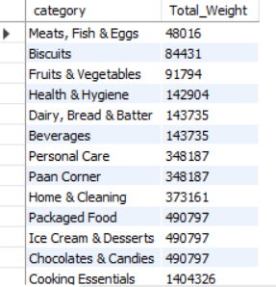
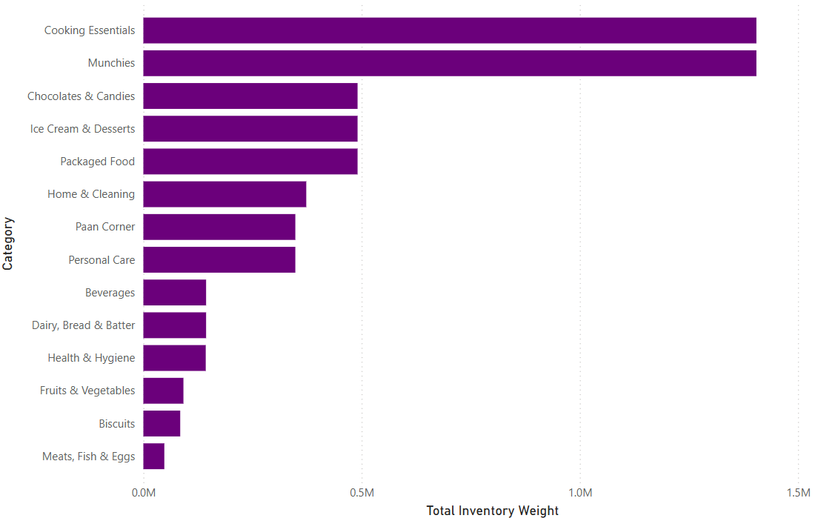
Certain categories (like beverages, grains, dairy) contribute disproportionately to inventory weight, impacting storage and logistics. Efficient warehouse planning is required to manage heavy categories.
6. Total Inventory Weight Per Category

Slide 14
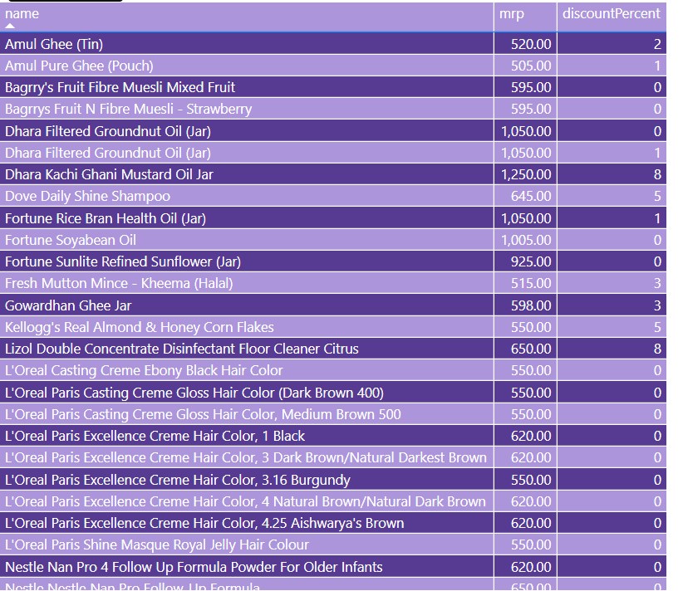
7. Products where MRP < 500 and discount < 10%
Budget-friendly products with minimal discounts still maintain steady sales. Customers buy these as daily essentials, showing less dependency on discounts.

Slide 15
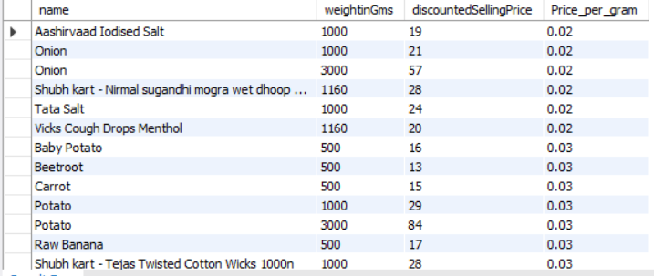
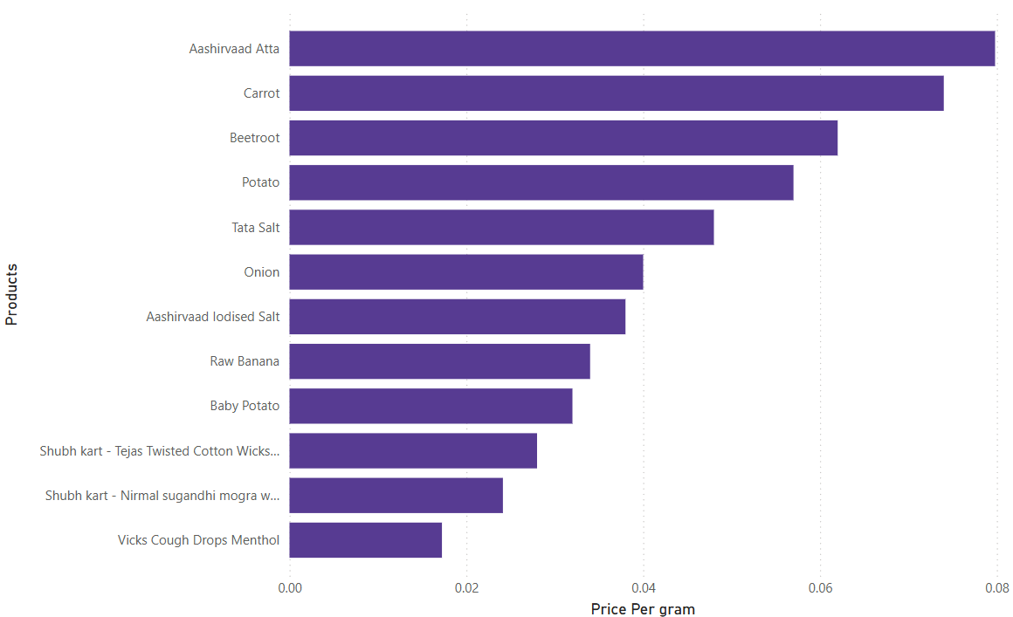
8. Price per gram for products >100g (best value sort)
Bulk packs generally offer better price per gram, making them cost-effective for customers. This aligns with consumer preference for larger packs in essentials.

Slide 16
Top Key insights
Discounts drive top product rankings
Stock gaps in premium/high-MRP items
Certain categories dominate revenue
Premium products show selective positioning
Weight-based segmentation offers value insights

Slide 17
Actionable Recommendations
Optimize stocking to reduce out-of-stock losses
Use targeted discounts to improve sales
Launch campaigns & offers for trending categories
Encourage bulk-buying through incentives
Adopt segmentation strategies for customer targeting

Slide 18
THANK YOU

