Slide 1

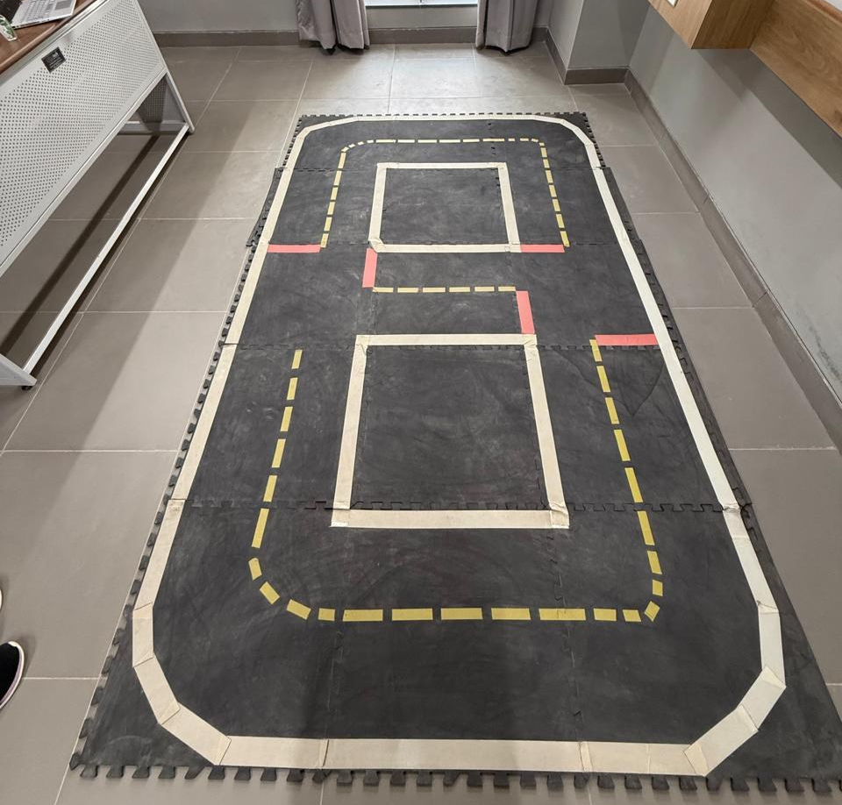
Navbot
LLM-Vision Guided Semantic Delivery and Navigation for Duckiebots
entebot209 · DB21J Duckiebot
N Sukhitha Bhushan · 1RVU23CSE293
R Keerthana Prasad · 1RVU23CSE363
Rakshitha K · 1RVU23CSE369
Sathyashree KV · 1RVU23CSE412

Slide 2
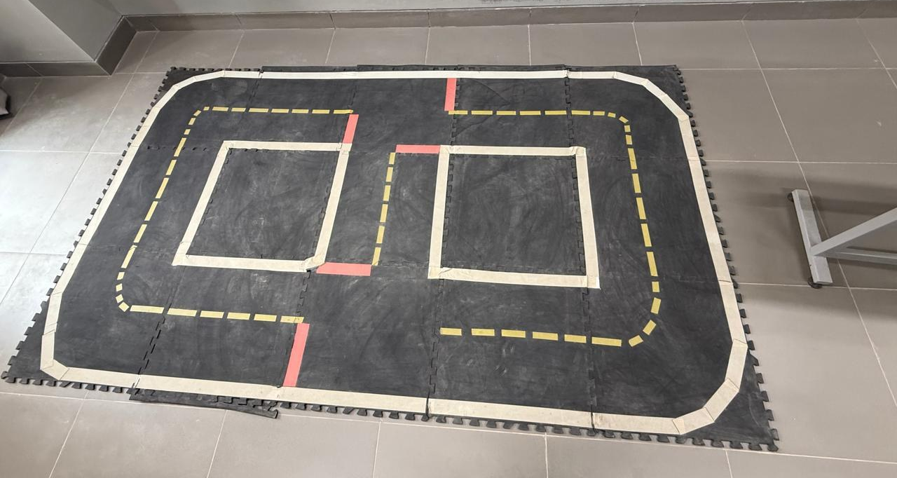




The problem: safe, purposeful driving on an unknown track
Duckietown is a miniature city of foam tiles: cream edge lines, a dashed yellow centre line, red stop lines and AprilTag signs.
The stock software can follow a lane, but it cannot:
Remember the track or plan a route to a destination
Take goals in plain language such as “go to the kitchen”
Treat obstacles as a first-class safety concern
Recover reliably when the robot drifts or loses the lines
Our Duckietown mat (layout B): two loops joined at red-line intersections
Constraint: one camera, wheel encoders, one front ToF sensor, Jetson Nano
Notes:
Explain the gap. Duckietown's baseline demo only follows lanes. It does not remember the road network, plan routes, accept natural goals, or stop for obstacles as part of the loop. Our constraint was to do all of this with the robot's cheap sensors and its CPU.

Slide 3



Six objectives
1 Lane perception
2 Lane control
3 Learn the track
Estimate offset d, heading φ and confidence; detect stop lines and exits
Hold the right lane, never cross yellow, recover from drift
Build a topological map by itself and route to named places
4 Never crash
5 Plain-language goals
6 Verify
Fuse YOLO and ToF; slow, stop, resume; stale sensor = obstacle
On-device Needle model + rule fallback, plus a web dashboard
Offline simulation tests, then on-robot tests on two layouts
Notes:
Walk through the six objectives. Each maps to a module and a test later in the talk.

Slide 4
What the literature gives us, and the gap we fill
Capability | Classical lane detection [Aly 2008] | Duckietown baseline [Paull 2017] | AprilTag EKF-SLAM [Olson; Thrun] | Navbot
Lane following on a CPU | ✓ | ✓ | – | ✓
Drift and line-loss recovery | – | partial | – | ✓
Learned road map + routing | – | – | metric map only | ✓
Natural-language goals | – | – | – | ✓
Fail-safe obstacle stopping | – | – | – | ✓
All on robot, no GPU / cloud | ✓ | ✓ | ✓ | ✓
Each building block exists on its own. The gap is integrating them on one low-cost robot with a strict safety layer.
Notes:
Summarise the literature review from Chapter 2 of the report. Lane detection, the Duckietown stack, AprilTags and EKF-SLAM, YOLO and topological maps are all established. Nobody combines learned road maps, natural goals and fail-safe obstacle stopping on the robot's own CPU.

Slide 5


Hardware and software stack
Hardware
Software
DB21J Duckiebot “entebot209”
NVIDIA Jetson Nano: 4 ARM cores, 3.87 GB RAM
Front camera 8MP, 0.10 m high, tilted 12°
Wheel encoders: 135 ticks/rev, r = 0.0318 m, baseline 0.102 m
Front time-of-flight range sensor
Duckietown mat: lane width 0.23 m, 0.065 m AprilTags
ROS Noetic in the Duckietown dt-core image (ente)
Docker + Duckietown Shell (dts 6.2.27)
Python 3 · OpenCV · NumPy · dt-apriltags
ONNX Runtime 1.12.1 · YOLO11n duck detector
Cactus Needle tool-calling model + regex fallback
Flask dashboard on port 8090
Notes:
Hardware and software from Chapter 3. Point out the constraints: CPU-only inference and the pinned ONNX Runtime version, which forced us to convert the YOLO model from opset 18 to 17.

Slide 6
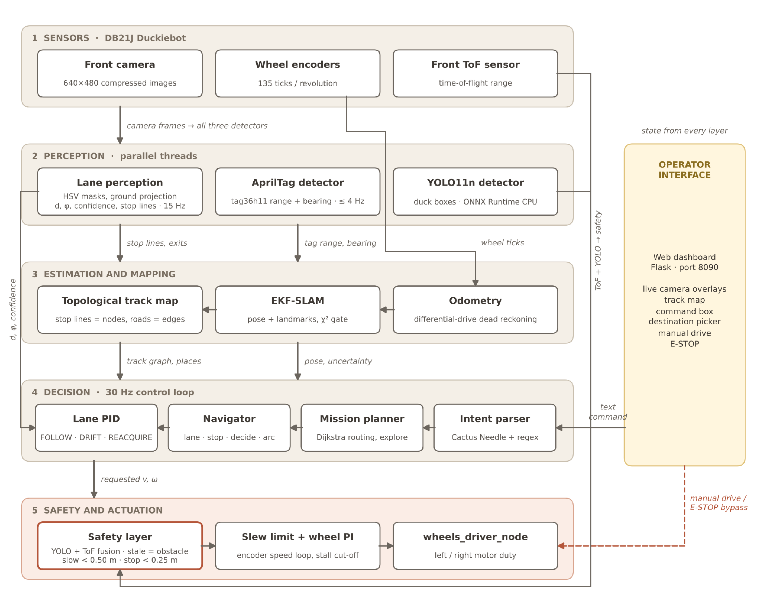
Architecture: five layers, one ROS node
1
Sensors
camera, encoders, ToF
2
Perception
lanes 15 Hz · tags ≤ 4 Hz · YOLO
3
Estimation
odometry, EKF-SLAM, track graph
4
Decision
intent → route → navigator → PID
5
Safety + actuation
overrides every command
Manual drive and E-STOP bypass the decision layer; the dashboard reads state from every layer.
Notes:
The whole system is one ROS node, ente_brain, inside the dt-core container. Data flows top to bottom. Every autonomous command passes the safety layer before reaching the motors. Manual commands stop after 0.4 seconds without a browser update.

Slide 7
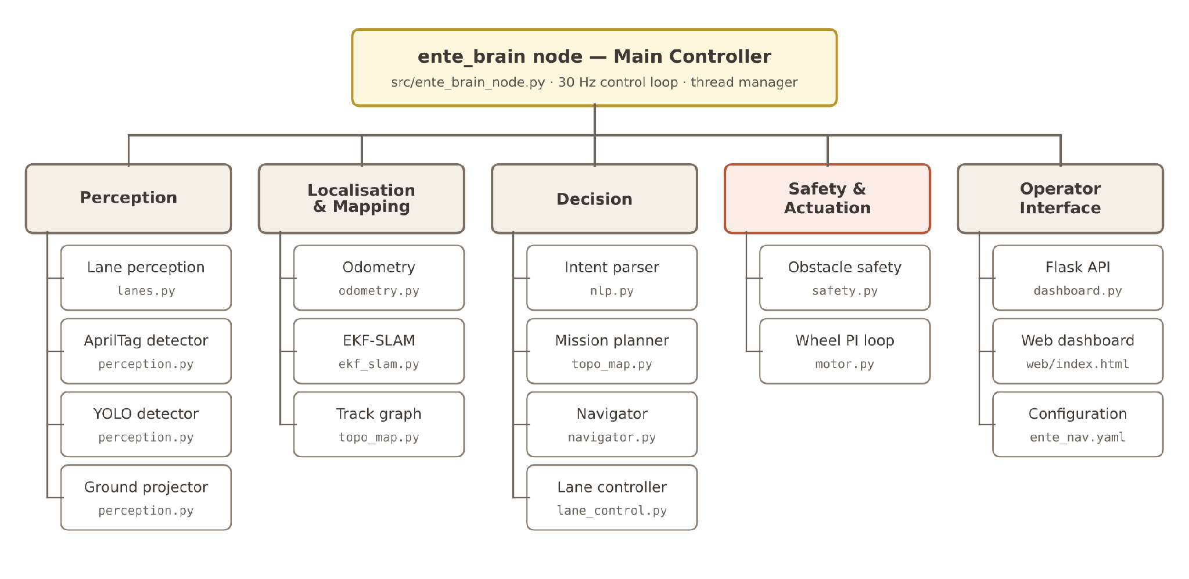
Module structure
Notes:
Each subsystem is a plain Python class in its own file, so every module can be imported and tested off the robot. The main node wires them together and runs the 30 Hz loop.

Slide 8
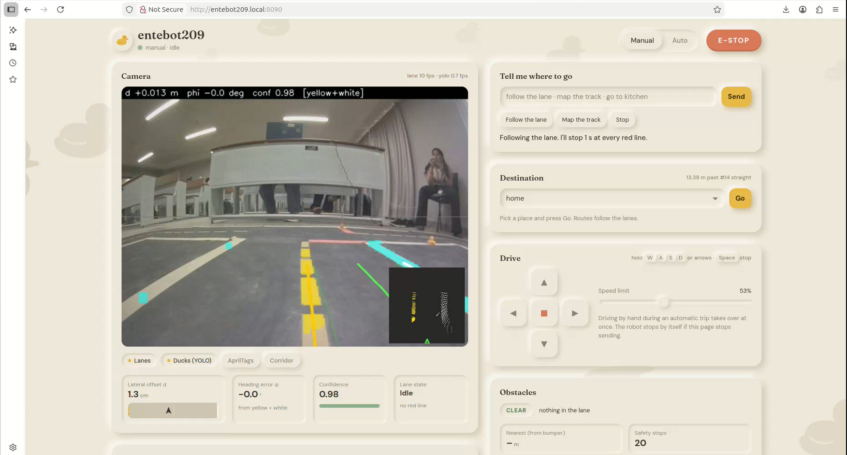
Lane perception: from pixels to offset d and heading φ
1
Crop + downscale
¼ resolution, bottom half only
2
HSV colour masks
cream · yellow · red, tuned on 81 real frames
3
Ground projection
homography, scale 1.36, 0.06–0.45 m ahead
4
Robust line fits
3 cm inliers; 7 cm gate once locked
Yellow + white detected: d = +1.3 cm, φ = 0.0°, confidence 0.98 (bird's-eye inset, bottom right)
Lane pose
d, φ, confidence + stop line + exits
If yellow and white disagree by > 6 cm, confidence drops; odometry predicts d and φ between frames.
5
Notes:
The camera image is very desaturated, so tuning on real frames mattered. The Lab b* check stops cream tape being mistaken for yellow. Only floor points 6 to 45 cm ahead are used, where a curve is close to straight.

Slide 9
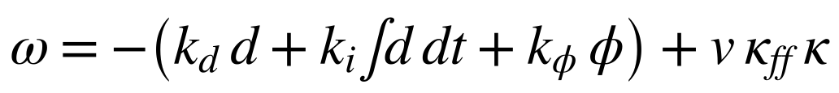
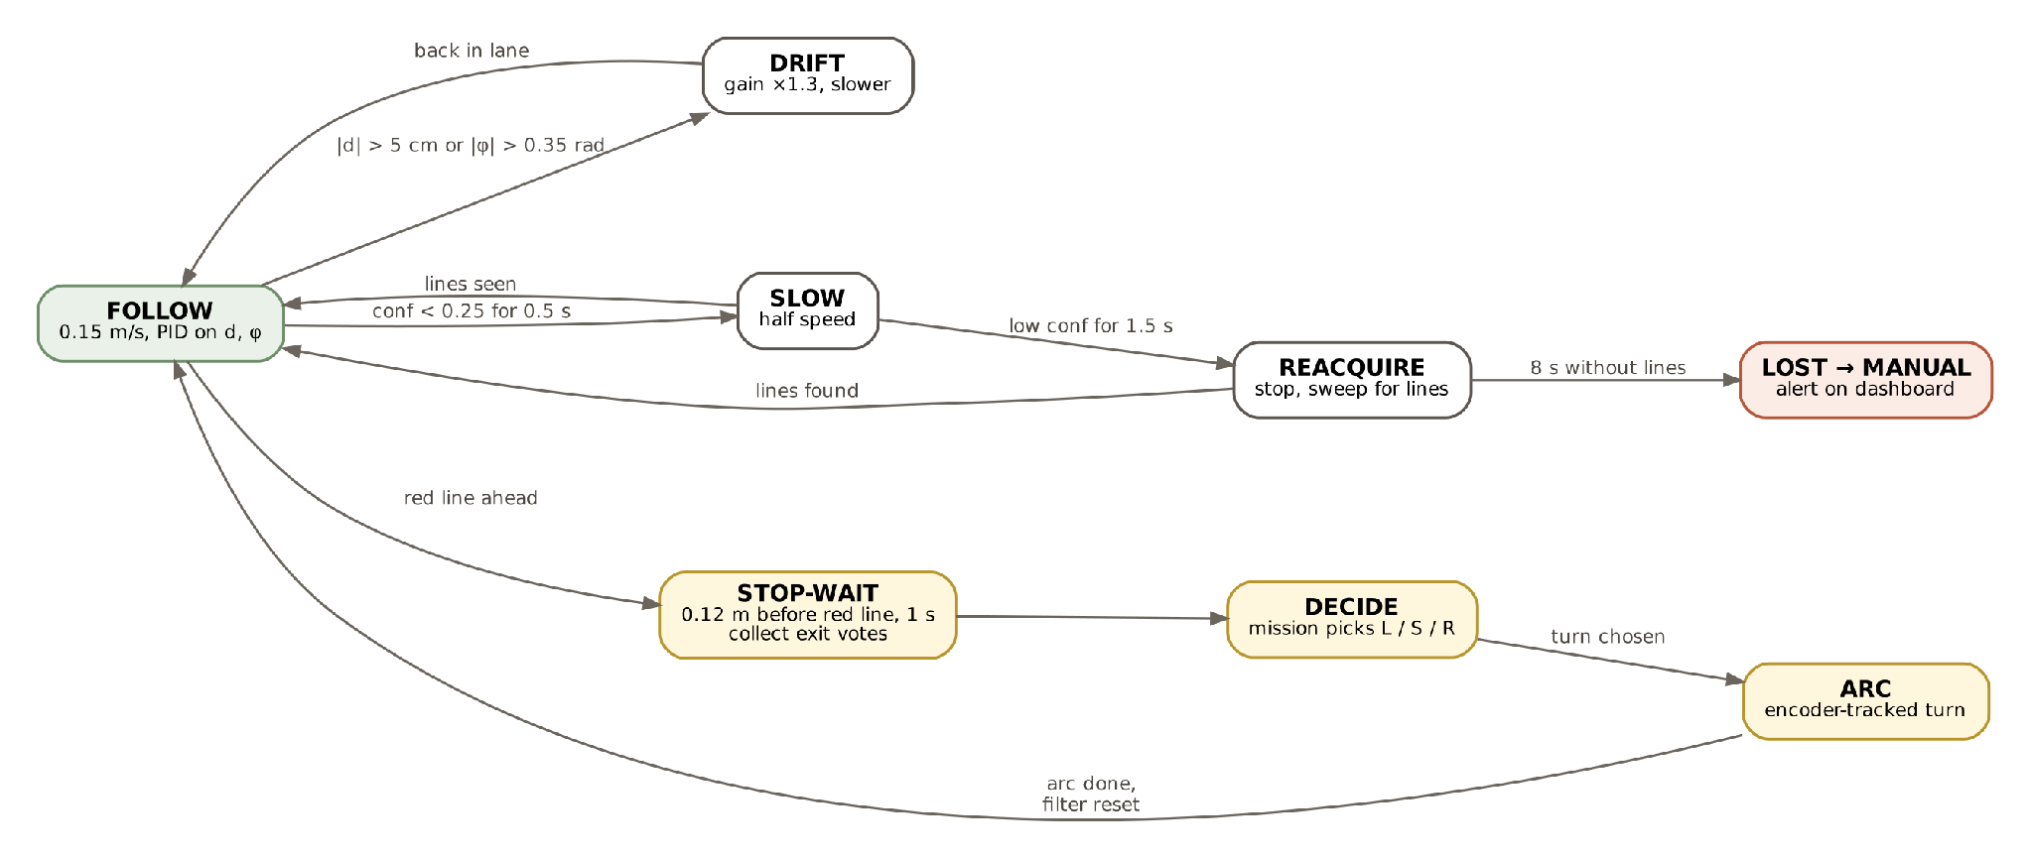
Lane control: PID with drift recovery
Steering law
k_d = 5.0 · k_φ = 2.0 · k_i = 0.2 (anti-windup)
speed v = v_nom / (1 + |ω| / 2.5)
4.5 cm
yellow guard: no further left steering
0.15 m/s
nominal lane speed
States: FOLLOW → DRIFT (|d| > 5 cm) → SLOW (conf < 0.25) → REACQUIRE → LOST; red line → STOP-WAIT → DECIDE → ARC
8 s
without lines → hand over to manual
Notes:
The PID integral cancels residual wheel trim. The yellow guard means the robot never crosses the centre line. The state machine slows, then sweeps to re-acquire, and finally hands control back to the operator instead of driving blind.

Slide 10
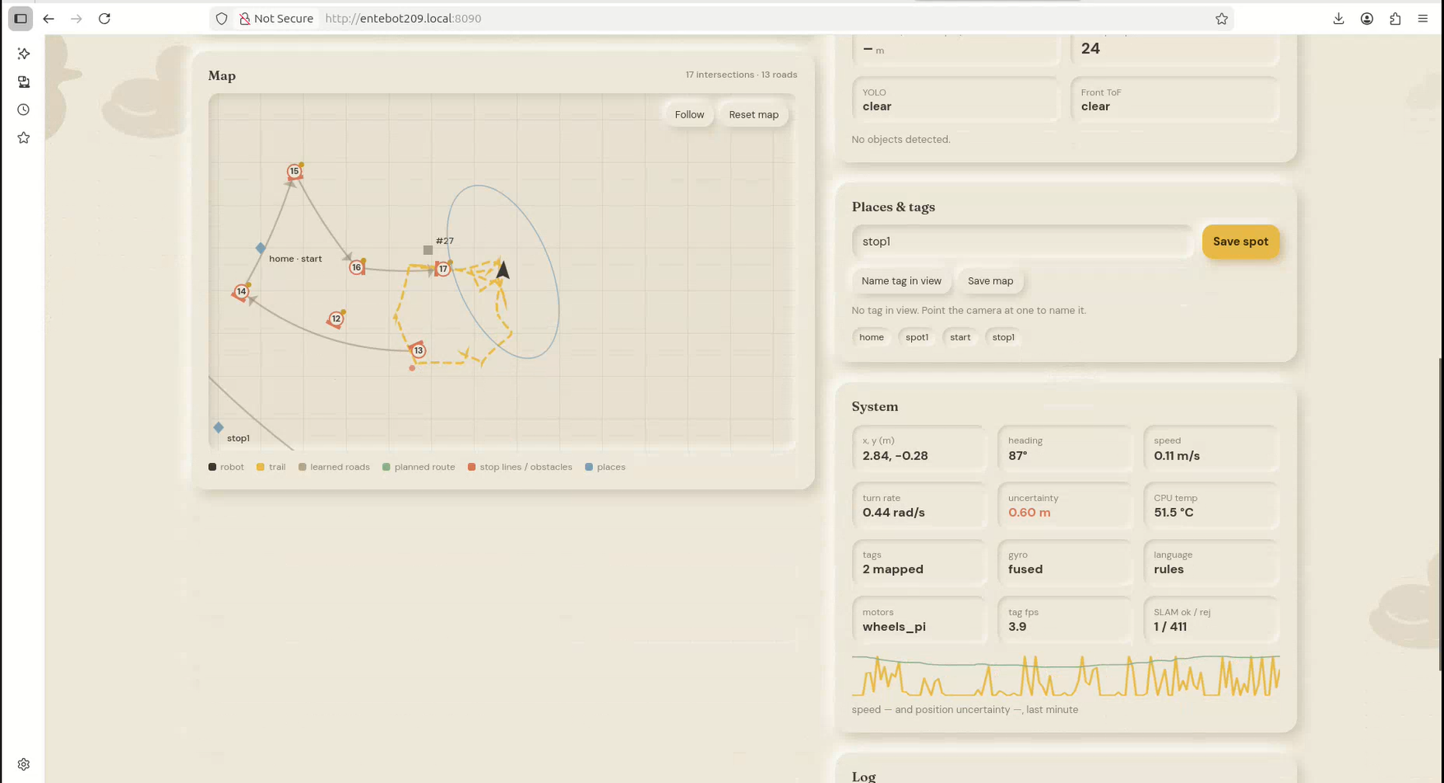
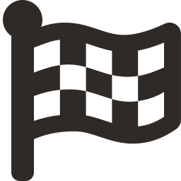

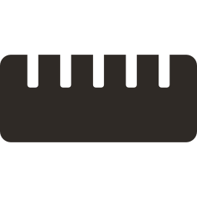

Learning the track: stop lines become a graph
Nodes
red stop lines, matched within 0.40 m and 0.6 rad (0.80 m on a known edge)
Edges
(node, turn) → next node, with the driven lane distance
Places
“metres after A” or “metres before B”, robust to drift
Routing
Dijkstra, small 0.05 turn cost to prefer straight runs
Learned map on the dashboard: 5 intersections, 13 roads, saved places
Map the track
visit unexplored exits (right, straight, left) until complete
At a red line: stop 0.12 m before, wait 1 s, vote on open exits, then an encoder-tracked arc.
Notes:
Topological beats metric here. Odometry drifts over a lap, but a place stored as a distance along a road is still found. The map is saved to /data/ente_map.json and reloaded next time from the same start mark.

Slide 11
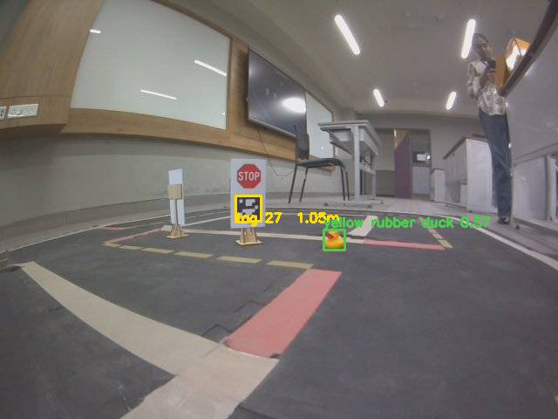
Obstacle safety: YOLO + ToF, and silence means stop
0.50 m
0.25 m
1.5 s
slow down
hard stop
clear → resume
YOLO boxes projected to the floor, kept only inside the lane corridor (½ lane + 3 cm)
ToF gives a fast range; both measured from the front bumper
YOLO takes ~3 s per frame, so its distances are aged by how far the robot has driven
A source is stale after max(3 s, 2.5 × its cycle) — and stale counts as an obstacle
YOLO11n duck (0.57) and AprilTag 27 at 1.05 m, live on the robot
Notes:
YOLO alone is too slow on the CPU, so the ToF is the real-time safety sensor. The key design rule: a sensor that stops reporting is treated as an obstacle, never as a clear road.

Slide 12

Making a robot move smoothly and know where it is
Closed-loop wheel speed
Odometry + EKF-SLAM
0.25 duty
χ² = 13.8
motors stall below this on foam, so open-loop commands stall or lurch
gate (2 DOF, 99.9 %) that rejects bad AprilTag detections
Feed-forward from wheel calibration + 0.15 friction offset
PI loop on encoder speed (k_p 1.2, k_i 3.0)
Stall cut-off: > 0.45 duty for 1.5 s without turning
Acceleration limit 0.6 m/s² and 6 rad/s²
State: robot pose + every tag position
Tags observed by range and bearing
Tags on other Duckiebots = moving obstacles, never mapped
Uncertainty > 0.35 m → spin to find a landmark
Notes:
Closed-loop wheel speed was the single biggest improvement: it made slow lane speeds smooth. The IMU was left out because it reported about 5 degrees for a real 360 degree turn; encoders carry heading.

Slide 13
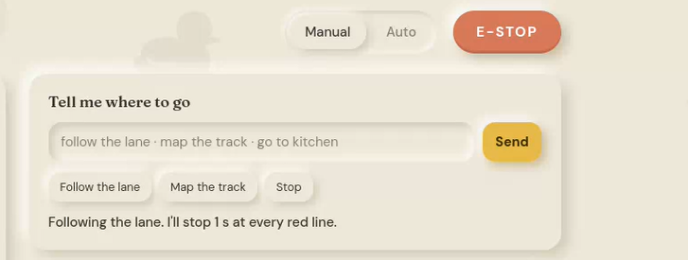

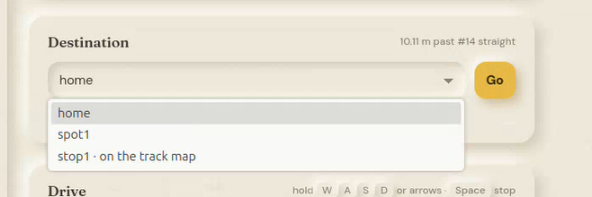
Plain-language commands and the dashboard
Cactus Needle → 13 tools
follow_lane · map_track · go_to · go_to_xy · drive_forward · turn_left · turn_right · stop · explore · save_location · set_speed · name_tag_in_view · manual_mode
Tools only record an intent; the node validates it before acting
Regex fallback handles the same commands if Needle is missing
Dashboard: live overlays, lane metrics, obstacle status, map, manual drive
Neumorphic beige design with an original duck parallax
Command box, quick actions, destination picker and E-STOP
Notes:
The language model can never drive the motors directly; it only proposes an intent. Show the dashboard live if possible: http://entebot209.local:8090.

Slide 14

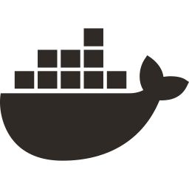
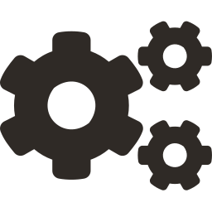

From laptop to robot
1. Bring-up
2. Calibrate
3. Install
4. Prepare model
5. Build + run
6. Tune + test
flash, discover, keyboard test
intrinsics, extrinsics, wheels
install.sh into dt-core (ente)
YOLO11n opset 18 → 17
dts devel build / run -L ente-nav
grab frames, tune lanes, sim tests
dts devel build -H entebot209 → dts devel run -H entebot209 -L ente-nav → entebot209.local:8090
Notes:
The deployment workflow from Chapter 5. Port 8080 is taken by the Duckietown dashboard, so ours runs on 8090.

Slide 15
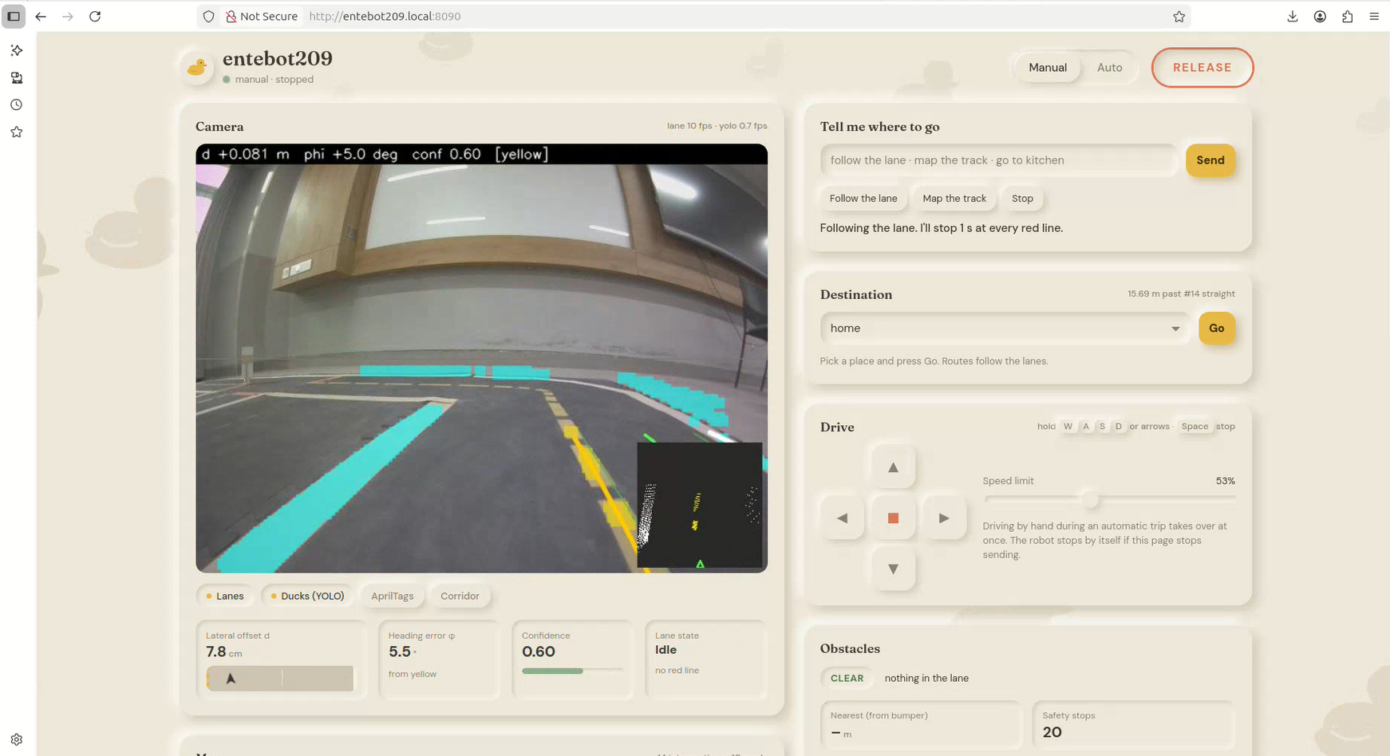
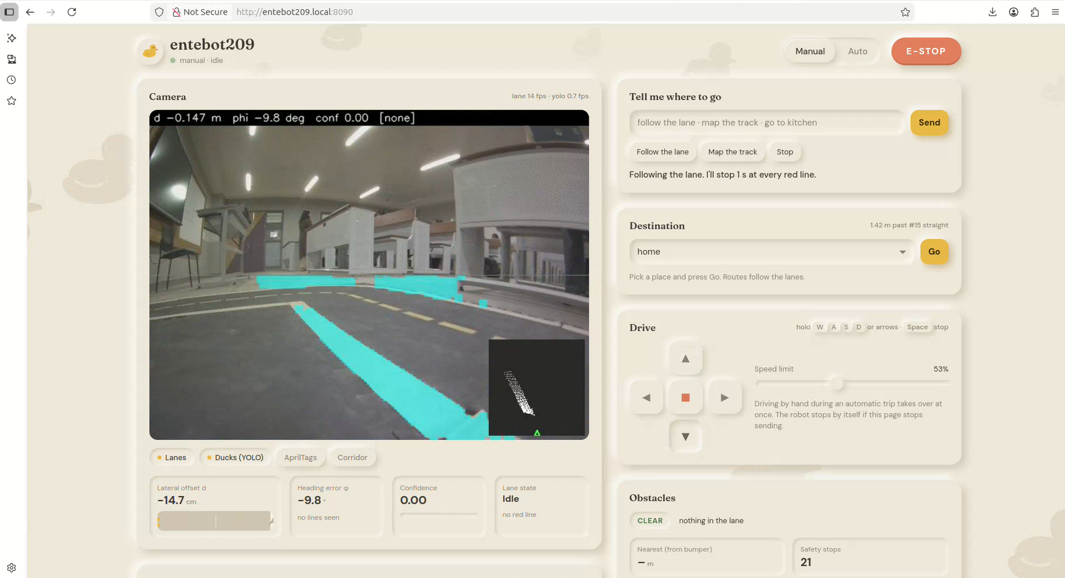
Drift and line loss are detected, not ignored
Drift: only yellow visible, d = +7.8 cm, φ = +5.5°, confidence 0.60 → DRIFT state steers back to centre
Line loss: no line passes the thresholds (confidence 0.00) → slow, then sweep to re-acquire instead of driving blind
Notes:
Two real dashboard frames. On the left, the robot has drifted and only sees the yellow line; it still estimates d and phi. On the right, glare removes all lines; the controller reacts by slowing and searching.

Slide 16
On-robot results against targets
Metric | Target | Result
Lane loops without leaving the lane | 10 of 10 | 10 of 10
Yellow-line crossings | 0 | 0
Mean |d| (lateral offset) | < 3 cm | ≈ 2 cm
Red lines detected and stopped at | 100 % | 100 %
Stop error vs 0.12 m target | < 3 cm | ≈ 2 cm
Intersection turns back in lane | > 90 % | ≈ 95 %
“Go to place” missions reaching it | > 90 % | ≈ 90 %
Obstacle (duck) collisions | 0 | 0
Commands parsed to the right intent | > 90 % | ≈ 95 %
0
collisions with ducks placed in the lane
1 run
to map the whole track graph
Placeholder values from the draft — replace with your measured numbers before presenting
Notes:
IMPORTANT: these result values come from the draft and are marked as assumed. Replace them with your measured numbers (and delete the yellow note) before presenting.

Slide 17

Testing: every level passed
9
7
5
unit tests
integration tests
system tests
lane pose, controller, safety, wheel PI, Dijkstra — offline on the laptop
camera→lanes, lanes→PID→wheels, YOLO+ToF→safety, intent→mission, E-STOP
full loop, mapping, source→destination, obstacle in lane, fail-safe
Simulation tests ran before every deploy, so on-robot sessions were spent on tuning, not debugging.
Notes:
Unit tests: test_full_loop_stays_in_lane, test_drift_recovery, test_never_crosses_yellow, test_line_loss_timeline, test_stop_resume_and_stale and others. Integration and system tests are in Tables 6.4 and 6.5 of the report.

Slide 18
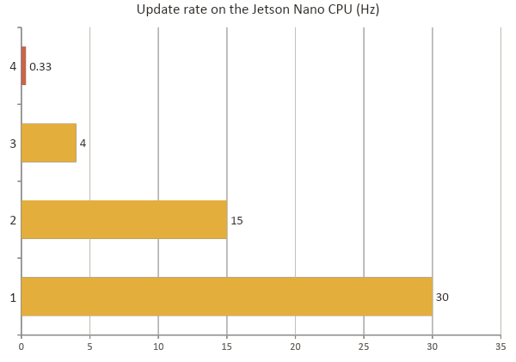
Where the GPU time goes
Why YOLO is not the safety sensor
YOLO11n runs about one frame every 3 s on the GPU
The ToF reacts within one 33 ms control cycle
Fusion + distance aging + stale = obstacle stopped the robot before every duck
Notes:
The control loop and lane perception dominate; AprilTags are capped at 4 Hz to leave CPU for lanes. Moving YOLO to TensorRT on the GPU is the top future enhancement.

Slide 19

Limitations and future work
Limitations
Future enhancements
YOLO lags at ~3 s per frame on the CPU
Map frame tied to the start mark
HSV thresholds tuned to one room's lighting
Intersection arcs are open-loop on encoders
IMU unused; software versions pinned
TensorRT YOLO on the GPU; multi-class model for bots, signs, lights
Small segmentation network for lanes
Visually tracked turns at intersections
Fixed IMU fusion; AprilTag global localisation
Multi-robot traffic, signals and voice input
Notes:
Be honest about the limitations; each one maps to a concrete next step on the right.

Slide 20
Project Demo and Code
Project Demo
https://drive.google.com/drive/folders/1cwp5bkR2QPPG_AACTA0Bh2uPE25M_ded?usp=sharing
Project Code
https://github.com/Keerthana-prasad/duckietown-navbot
Notes:
Be honest about the limitations; each one maps to a concrete next step on the right.

Slide 21

Thank you
Modular pipeline with a safety layer that overrides everything
Closed-loop wheel speed beats the motor dead-band
A stock Duckiebot that follows lanes, learns its roads, goes where you tell it
Topological map keeps routing robust to drift
Questions?

