Slide 1
Employee Attrition Analysis using Excel Dashbord
STUDENT NAME: Keerthana S
REGISTER NO: 312220858
DEPARTMENT: III- B.Com. Accounting and Finance
COLLEGE: Annai Violet College of Arts and Science

Slide 2
PROJECT TITLE
Employee Attrition Analysis using Excel Dashboard

Slide 3


AGENDA
Problem Statement
Project Overview
End Users
Our Solution and Proposition
Dataset Description
Modelling Approach
Results and Discussion
Conclusion
3/21/2024 Annual Review

Slide 4

PROBLEM STATEMENT
Many organizations are experiencing high rates of employee turnover, which can negatively impact productivity, morale, and overall business performance. Understanding the factors contributing to attrition is crucial for implementing effective retention strategies

Slide 5

PROJECT OVERVIEW
.Project Goal-To identify the primary factors contributing to employee attrition within a specific organization or industry and develop targeted strategies to improve retention.
Project Scope: Data Collection, Data Analysis,Root Cause Analysis, Strategy Development, Implementation and Evaluation
Project Deliverables:
Comprehensive data analysis report,
Identification of key drivers of attrition
Recommendations for retention strategies
Implementation plan
Evaluation metrics and reporting

Slide 6
PROJECT OVERVIEW

Slide 7

WHO ARE THE END USERS?
1. Human Resources (HR) Department: HR Managers and Directors
Recruiters Compensation Specialists
2. Line Managers: Department Heads,Team Leaders
3. Executives and Senior Management:CEO,CFO,CIO
4. Employees: Current Employees,Potential Candidates
5. External Stakeholders: Investors, Customers, Partners

Slide 8
OUR SOLUTION AND ITS VALUE PROPOSITION
A large technology company implemented a comprehensive attrition solution that included: 1. Data-Driven Analysis: Using HR analytics tools, the company analyzed employee data to identify key drivers of attrition, such as low job satisfaction and limited career growth opportunities.
2. Targeted Interventions: The company implemented initiatives to improve employee engagement, including team-building activities, mentorship programs, and flexible work arrangements.
3. Continuous Evaluation: The company regularly monitored attrition rates and employee satisfaction to measure the effectiveness of its interventions.

Slide 9
Dataset Description
Key Considerations When Selecting a Dataset:
Relevance: Ensure that the dataset contains the relevant attributes to address your research questions.
Quality: Check for data quality issues, such as missing values or inconsistencies.
Sample Size: A sufficiently large sample size is necessary for meaningful analysis.
Diversity: A diverse dataset can provide a more comprehensive understanding of employee attrition.

Slide 10
THE "WOW" IN OUR SOLUTION
Leveraging Data Analytics:
A powerful approach to tackling employee attrition is through data analytics. By analyzing vast datasets from various sources, organizations can gain valuable insights into employee behavior, satisfaction, and the factors driving turnover.
A WOW solution in this context involves a comprehensive data-driven approach that:
Data Collection and Integration: Multiple Data Sources, Data Quality, Data Integration.
Data Analysis and Insights: Descriptive Analytics, Predictive Analytics
Actionable Insights: Targeted Interventions,Continuous Improvement
3/21/2024 Annual Review
10

Slide 11
MODELLING
Improved Compensation and Benefits,
Enhanced Career Development,
Improved Work-Life Balance,
Positive Work Environment.
It's important to note that the specific results of employee attrition analysis will vary depending on the organization's unique circumstances. By conducting regular analysis and implementing targeted interventions, organizations can effectively address the root causes of attrition and create a more positive and productive work environment.
11

Slide 12
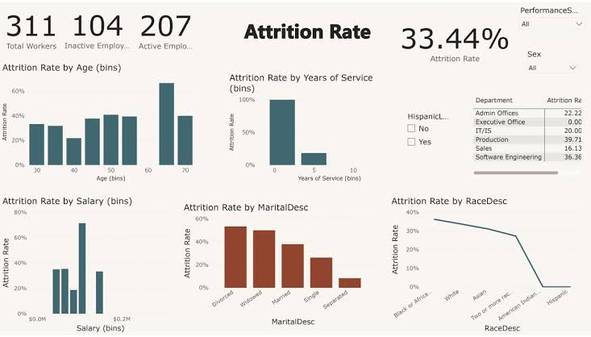
RESULTS
12

Slide 13
conclusion
A data-driven approach to employee attrition analysis is essential. By leveraging data from various sources, organizations can identify key drivers of attrition, such as low job satisfaction, lack of career growth, and poor work-life balance. This information can then be used to implement targeted interventions, such as improved compensation, enhanced career development opportunities, and flexible work arrangements.

