Slide 1
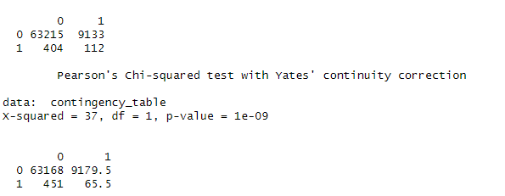
Correlation between the percentage of Group quarters and the prevalence of Food deserts.
Chi-square (GOF) between GroupQuartersFlag and LILATracts_1And10:
Conclusion:
low p-value - reject the null hypothesis
thus there is a significant association or correlation between "GroupQuartersFlag" and "LILATracts_1And10."

Slide 2
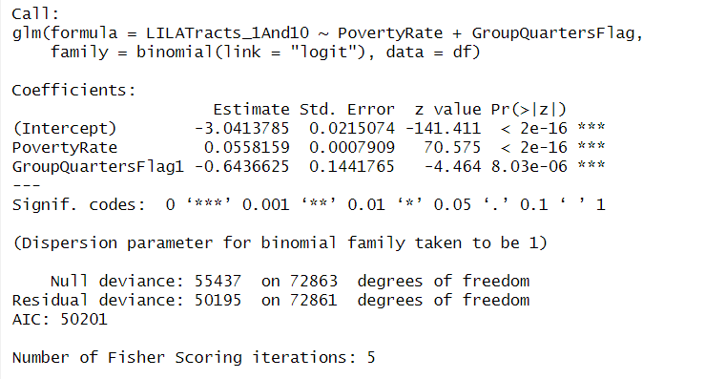
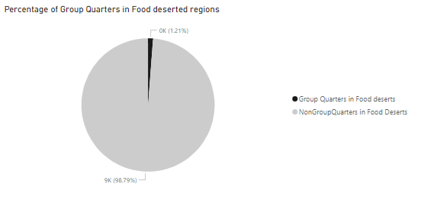
Impact of Group Quarters on Food desert.
GroupQuartersFlag of 1 is associated with a decrease of 0.643663 in the log-odds of the response variable being 1.
For a one-unit increase in GroupQuartersFlag1, the odds ratio decrease by a factor of approximately 0.5253647.
GroupQuartersflag negatively affect the Food deserts likelihood.

Slide 3
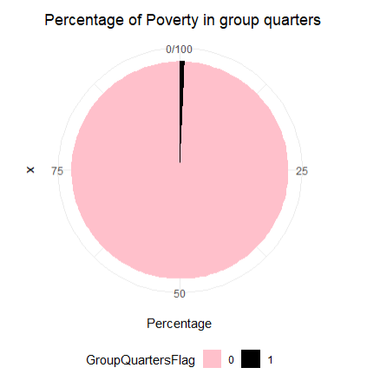
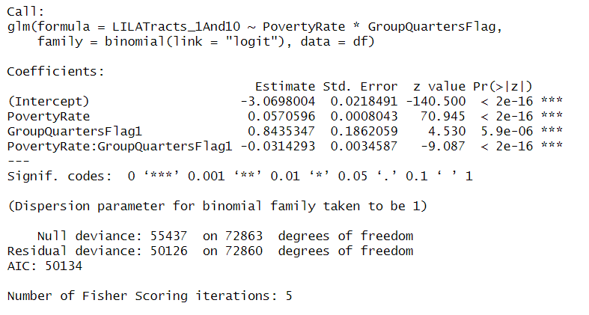
Impact of Group Quarters and Poverty rate on Food desert.
In Non GroupQuarters (GroupQuartersFlag is 0), one unit increase in PovertyRate is associated with a relatively larger increase (0.0570596) in the log-odds of the response variable being 1.
In GroupQuarters (GroupQuartersFlag is 1), one unit increase in PovertyRate is associated with smaller increase (0.0256303) in the log-odds of the response variable being 1.

Slide 4
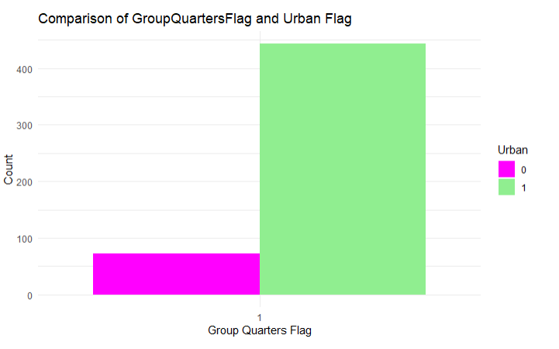
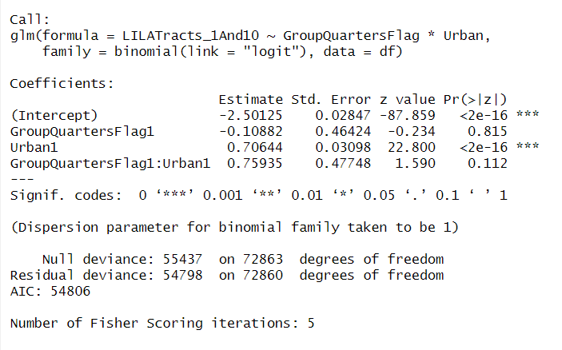
Impact of Group Quarters and Urban on Food desert.
The positive coefficient (0.75935) suggests that the presence of group quarters has a stronger positive effect on the log-odds in Urban, but this effect is not statistically significant at the conventional levels

Slide 5
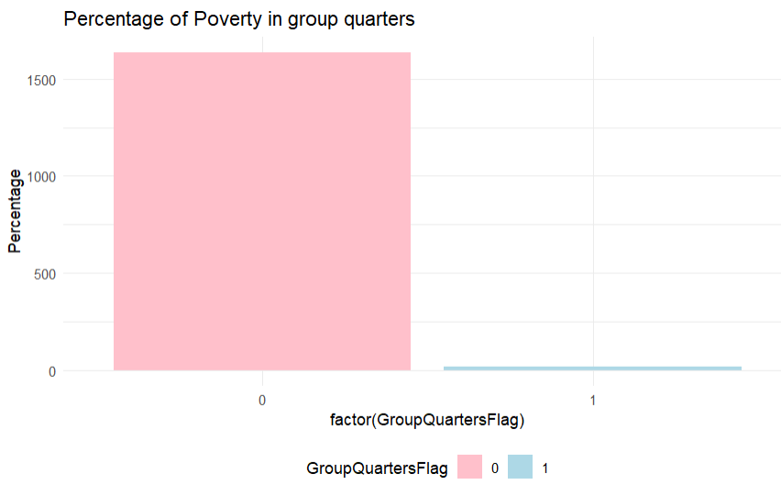
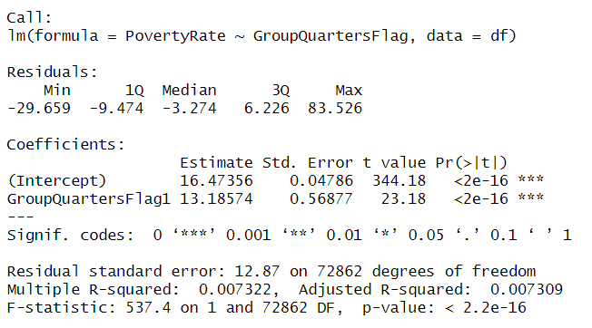
Impact of Group Quarters on Poverty Rate.
The odds ratio for GroupQuartersFlag1 is 532713.2. This value represents the ratio of the odds of the predicted poverty rate when GroupQuartersFlag=1 to the odds when GroupQuartersFlag=0.

Slide 6
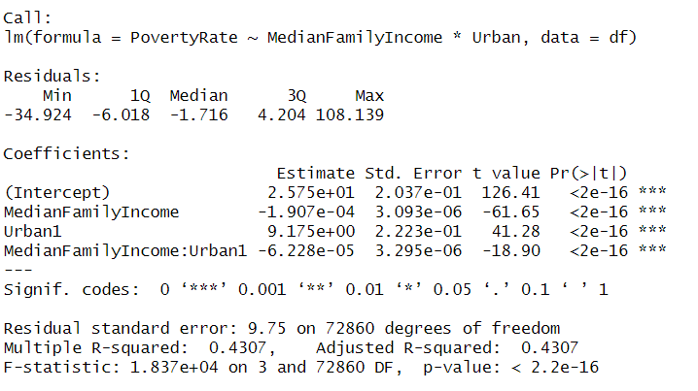
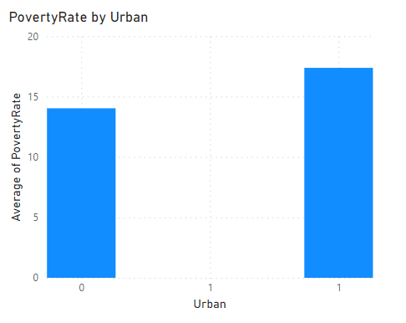
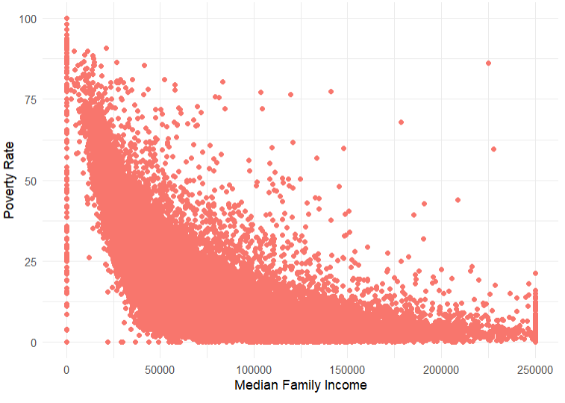
Impact of Median Family income and Urban on Poverty Rate.
Median Family Income increases by one unit, the Poverty Rate is expected to decrease by approximately 0.0001907 units.
Compared to non-urban areas, urban areas have a higher predicted "PovertyRate" by 9.175 units

Slide 7
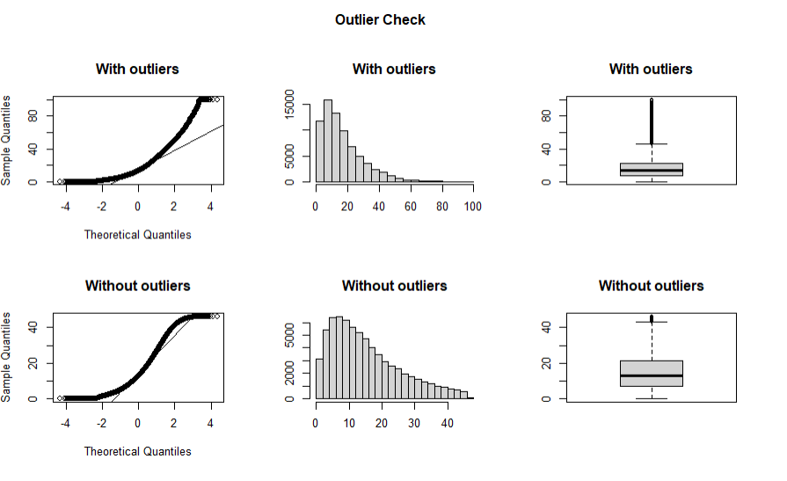
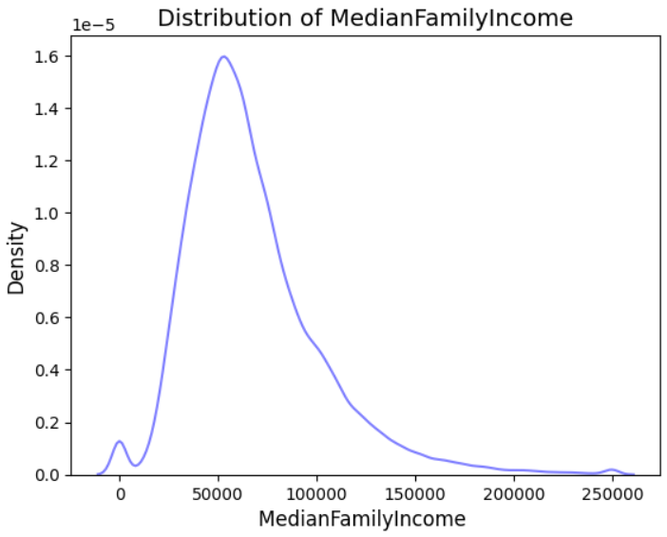

Slide 8
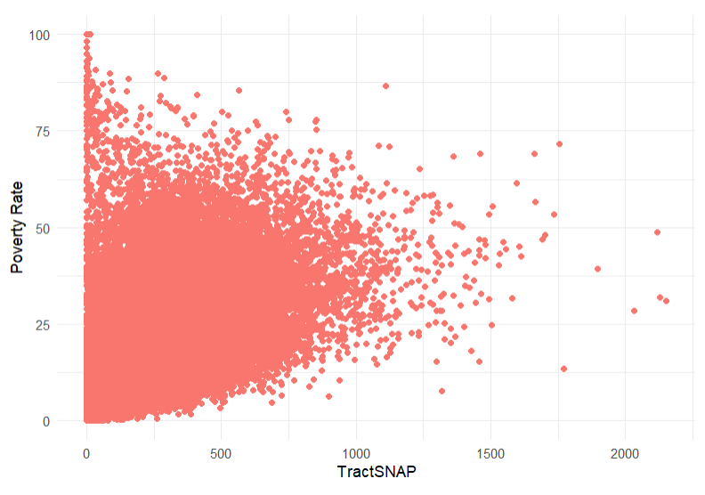
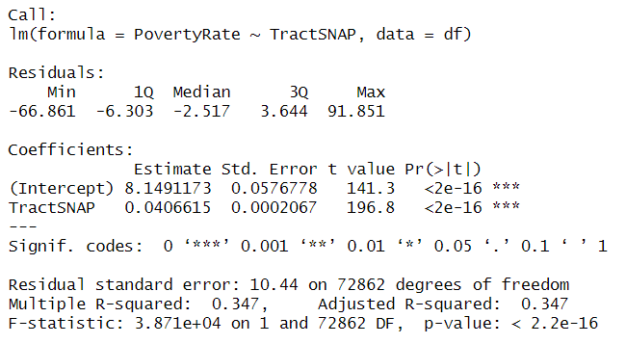
Impact of Tract SNAP on Poverty Rate.
For each one-unit increase in TractSNAP, the predicted poverty rate increases by 0.0406615.

Slide 9
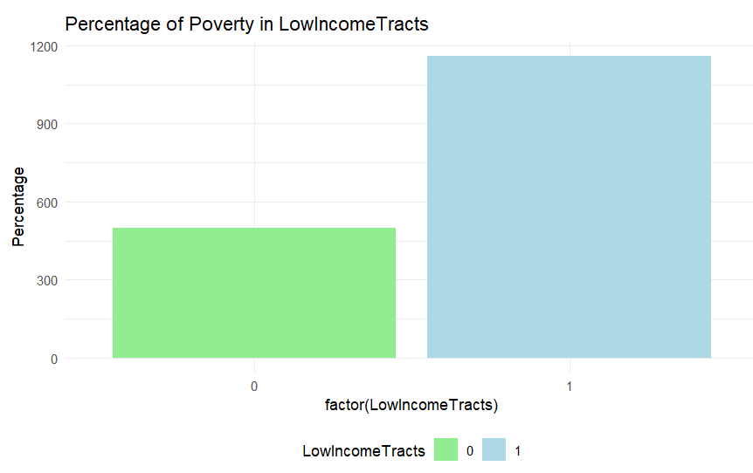
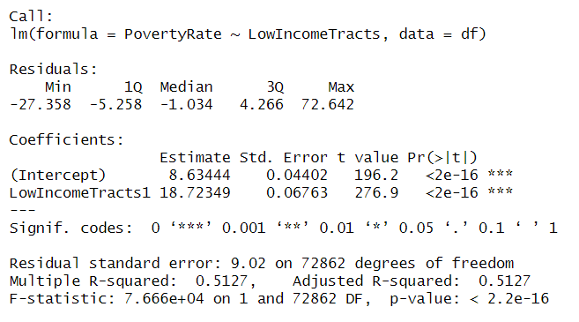
Impact of LowIncomeTracts on Poverty Rate.
The presence of low-income tracts is associated with an increase of 18.72349 unit in the predicted poverty rate compared to areas without low-income tracts.

Slide 10
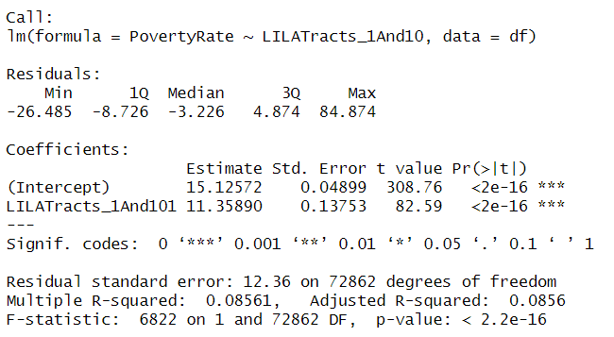
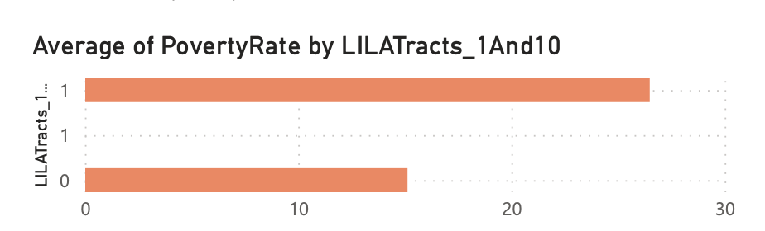
Impact of Food desert on Poverty Rate.
On average, the presence of Food desert is associated with an increase of 11.35890 units in the predicted poverty rate compared to areas without such tracts.

