Slide 1
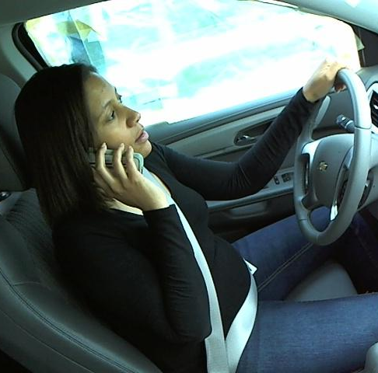
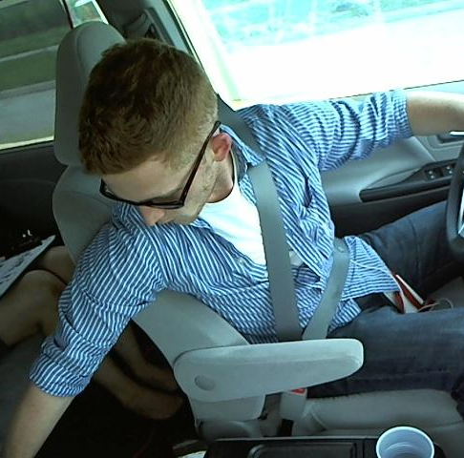
State Farm Distracted Driver Detection
Kaggle Competition : https://www.kaggle.com/competitions/state-farm-distracted-driver-detection
By
Keerthana Aravindhan,
Tulasi Thotakura

Slide 2
Introduction
Road safety problems in developing countries is a major concern and human behavior is ascribed as one of the main causes and accelerators of road safety problems.
Driver distraction has been identified as the main reason for accidents.
According to the CDC motor vehicle safety division, one in five car accidents is caused by a distracted driver. Sadly, this translates to 425,000 people injured and 3,000 people killed by distracted driving every year.
State Farm hopes to improve these alarming statistics, and better insure their customers, by testing whether dashboard cameras can automatically detect drivers engaging in distracted behaviors.

Slide 3
Dataset
Dataset of 2D dashboard camera images, each taken in a car with a driver doing something in the car
The 10 classes to predict are:
c0: safe driving
c1: texting - right
c2: talking on the phone - right
c3: texting - left
c4: talking on the phone - left
The training set has ~22.4 K labeled samples and 79.7 K unlabeled test samples.
c5: operating the radio
c6: drinking
c7: reaching behind
c8: hair and makeup
c9: talking to passenger

Slide 4
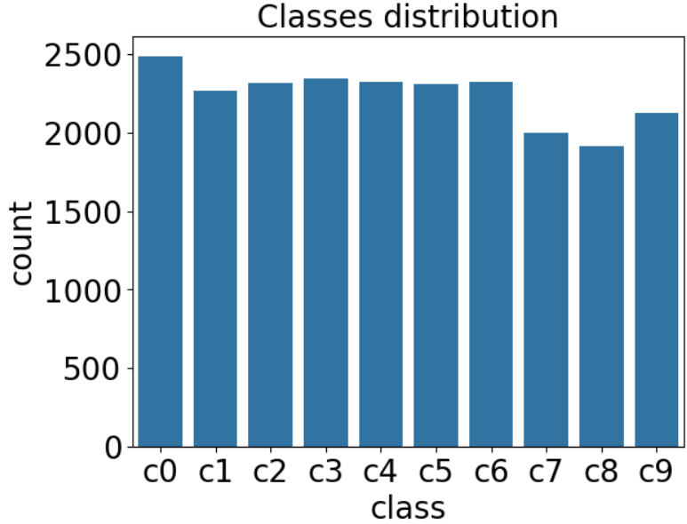
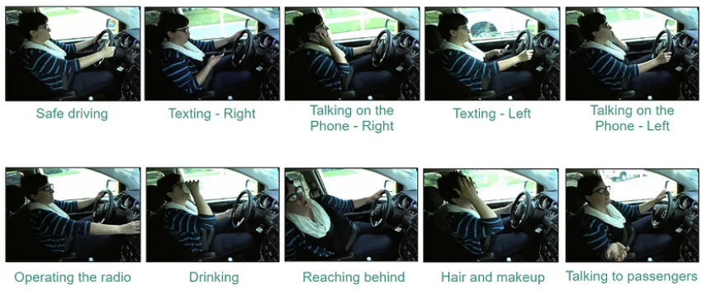
Analysis of Data

Slide 5
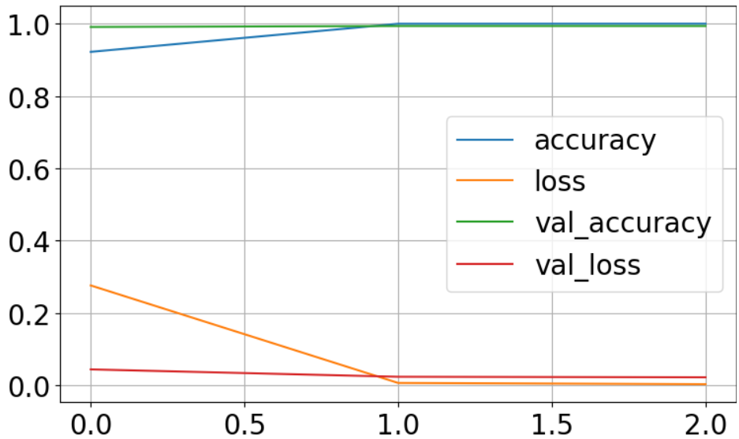
Scratch CNN
Accuracy and Loss chart
 | Loss | Accuracy
Train | 0.0027 | 0.9998
Validation | 0.0219 | 0.9938

Slide 6
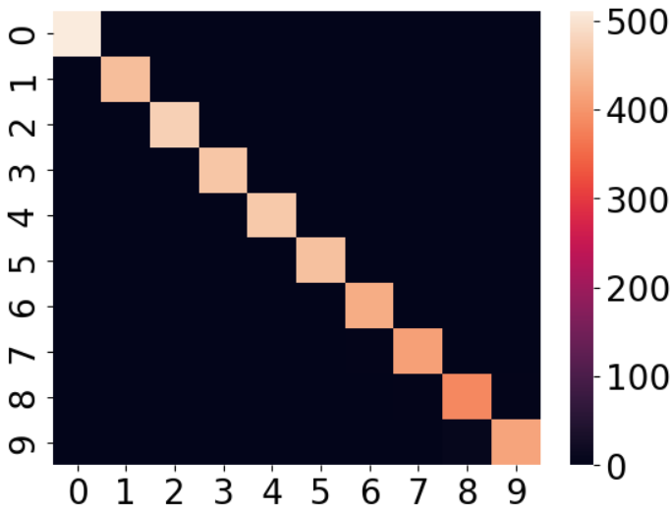
Confusion matrix

Slide 7
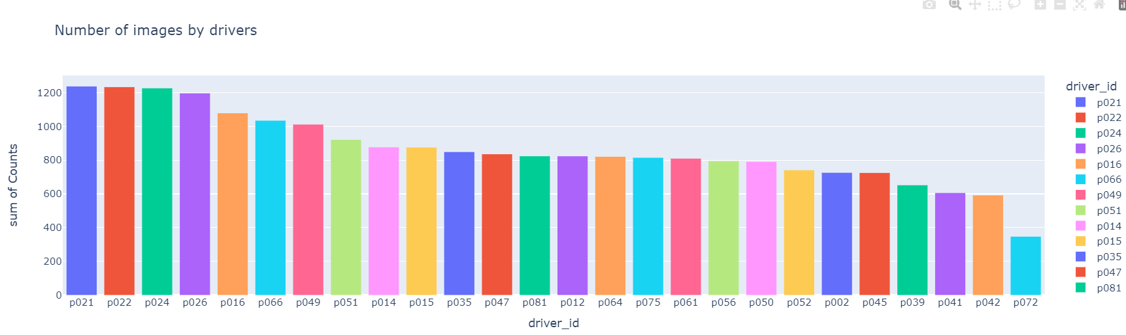
Scratch CNN
splitting train and validation according to drivers.

Slide 8
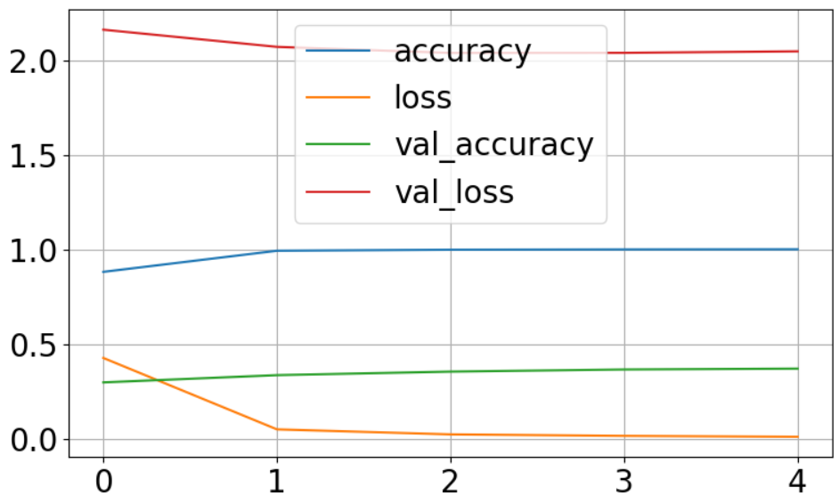
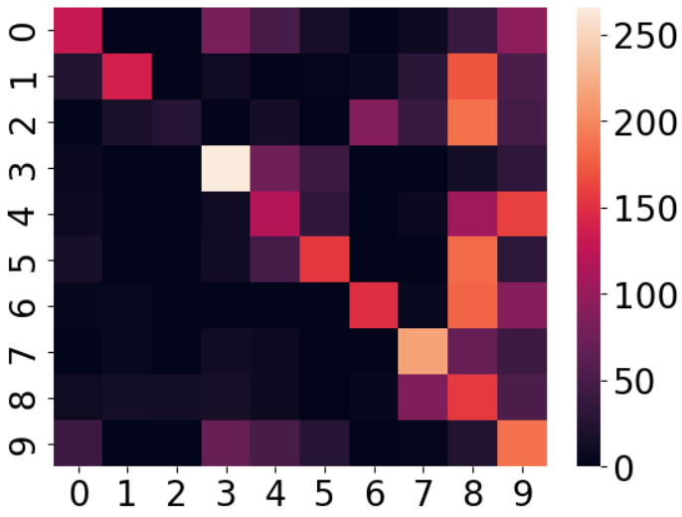
 | Loss | Accuracy
Train | 0.0096 | 0.9998
Validation | 2.0458 | 0.3694

Slide 9
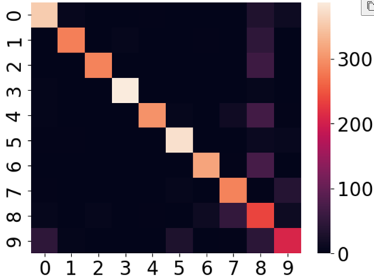
ResNet50 Model
Accuracy and Loss
 | Loss | Accuracy
Train | 0.5404 | 0.8250
Validation | 0.5300 | 0.8220

Slide 10
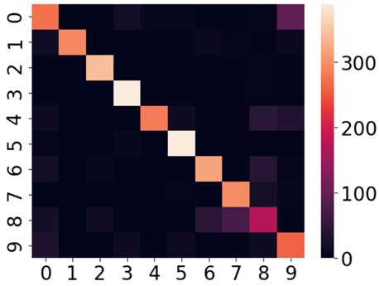
MobileNet Model
Accuracy and Loss chart
 | Loss | Accuracy
Train | 0.4343 | 0.8561
Validation | 0.4041 | 0.8573

Slide 11
Xception Model
Accuracy and Loss chart
 | Loss | Accuracy
Train | 0.4666 | 0.8431
Validation | 0.5516 | 0.8170

Slide 12
VGG16 Model
Accuracy and Loss chart
 | Loss | Accuracy
Train | 0.6563 | 0.7694
Validation | 0.5041 | 0.8472

Slide 13
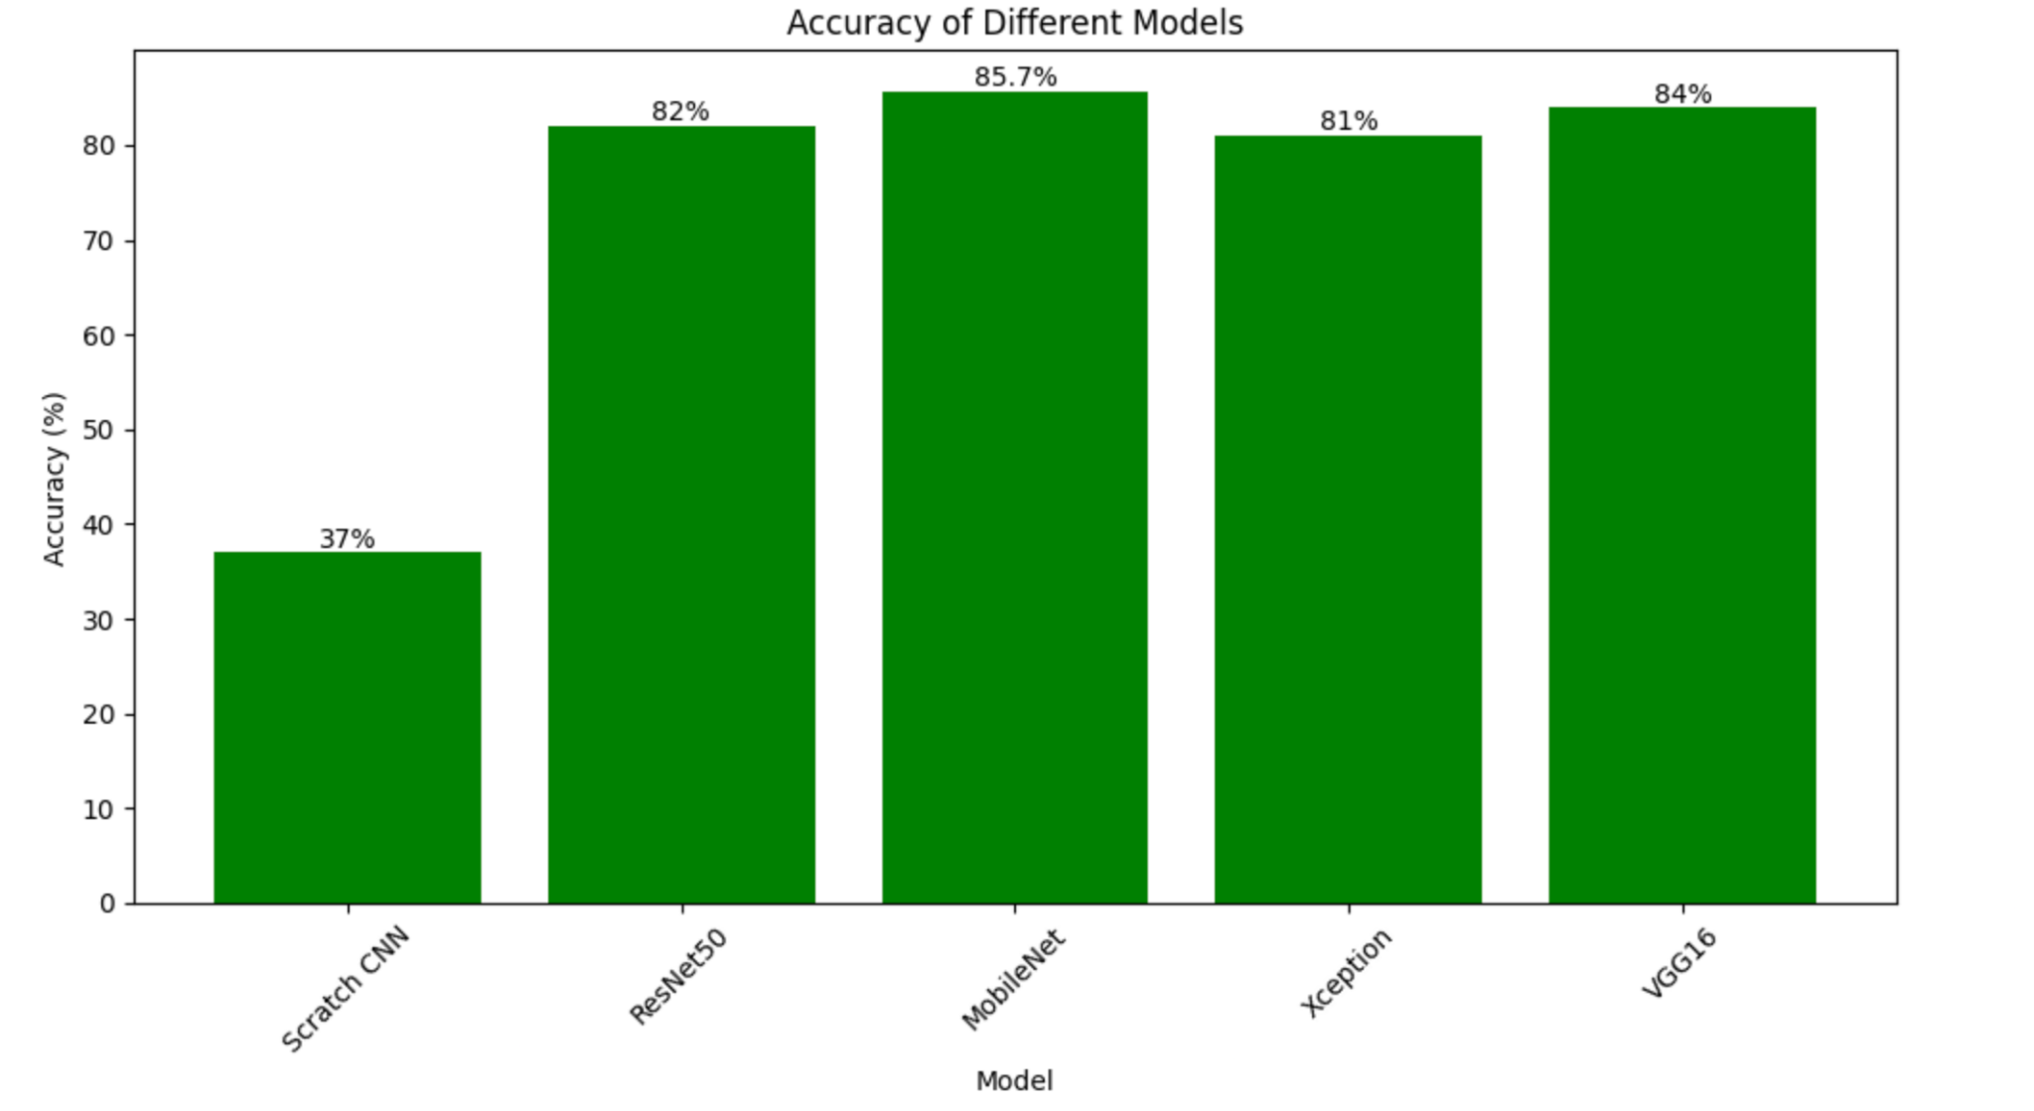
Final results
Performance of the Transfer Learning Models
 | Accuracy | Loss
ResNet50 | 82% | 0.53
MobileNet | 85.7% | 0.4
Xception | 81% | 0.55
VGG16 | 84% | 0.5

Slide 14
Comparing the Best Models
 | ResNet50 | MobileNet | Xception | VGG16
safe driving | 84.3% | 72% | 73% | 54%
texting - right | 95% | 100% | 94% | 96%
talking - right | 98% | 94% | 100% | 94%
texting - left | 98.4% | 92% | 98% | 98%
talking - left | 97.4% | 96% | 75% | 77%
operating radio | 89.5% | 90% | 95% | 97%
drinking | 95.2% | 84.2% | 80% | 90%
reaching-behind | 80% | 78.4% | 100% | 81%
hair and makeup | 40.7% | 55.6% | 40% | 66%
taking to passenger | 72.7% | 62% | 59% | 83%

Slide 15
Conclusion
MobileNet pretrained model gave a better accuracy than other models
Learning capabilities of the transfer learning model can be improved by using additional layers and fine tuning parameters.
Furthermore, ensemble approach with multiple pre-trained models can yield substantial improvements.

Slide 16
References
https://www.kaggle.com/code/praveenmaripeti/state-farm-distracted-driver-detection-with-keras
https://medium.com/r/?url=https%3A%2F%2Ftowardsdatascience.com%2Ftransfer-learning-using-mobilenet-and-keras-c75daf7ff299
https://arxiv.org/ftp/arxiv/papers/2204/2204.03371.pdf

Slide 17
THANK YOU

