Slide 1




Predicting Health Insurance Premiums in the US
DATAS6103 – Data Mining Project
Keerthana Aravindhan | Vamsidhar Boddu| Amit Sopan Shendge
Source: https://www.kaggle.com/datasets/sridharstreaks/insurance-data-for-machine-learning/data

Slide 2

Health Insurance:
Health insurance is a type of coverage that helps individuals manage and mitigate the financial risks associated with medical expenses.​
In 2022, the U.S. health insurance industry was valued at $1.6 trillion, with an expected CAGR of 6.08% projected annually.​
Americans allocate 11.6% of their annual income toward health insurance expenses.​
Yet approximately 8.4% or 27.6 million adults in the United States lacked healthcare coverage at some point in 2022.​
The South had the highest proportion of working-age adults without health insurance, representing 7.7%, followed by the West at 4.2%.​
Reasons behind not having an insurance is high cost of coverage (70%), ineligibility for insurance (26%), lack of necessity or desire for health insurance (24%), difficulty or confusion in the sign-up process (20%), inability to find a suitable plan (18%)

Slide 3
Variables in Dataset :
BMI
SMOKER
AGE
Family medical history
GENDER
Coverage level
Medical history
Region
Exercise frequency
occupation
CHILDREN
Charges

Slide 4
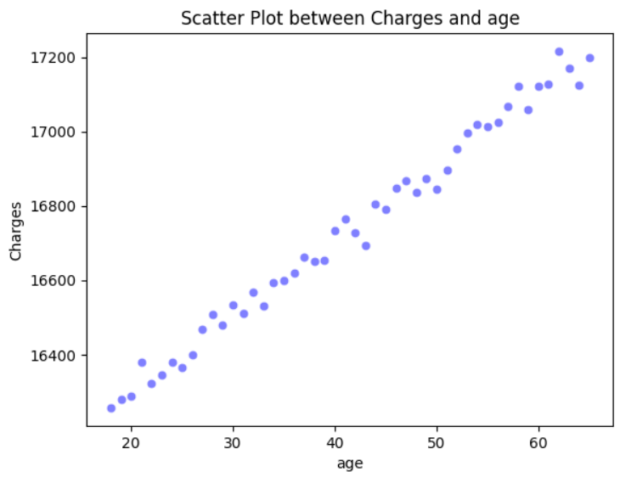
Scatterplot of age vs charges:
Average charges for each age.
Charges increases with increase in age.

Slide 5
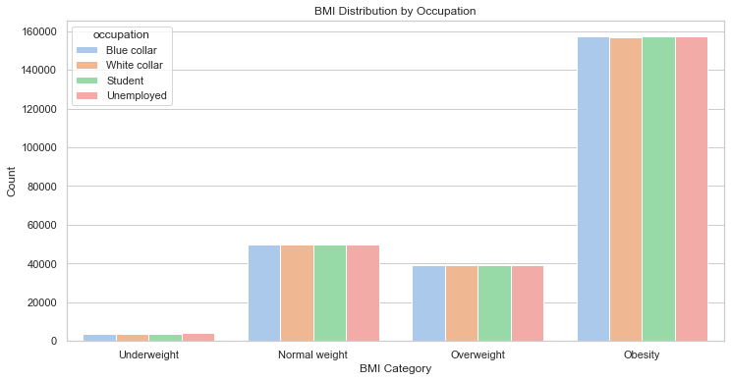
Distribution of Body Mass Index (BMI) by Occupation:
The visualizations clearly indicate that a significant portion of individuals, regardless of their occupation, is predominantly categorized as obese.
These results suggest that there are statistically significant differences in insurance charges among the various occupation groups.
ANOVA test on Occupation and Charges:
F-statistic: 10960.740716743454
P-value: 0.0

Slide 6
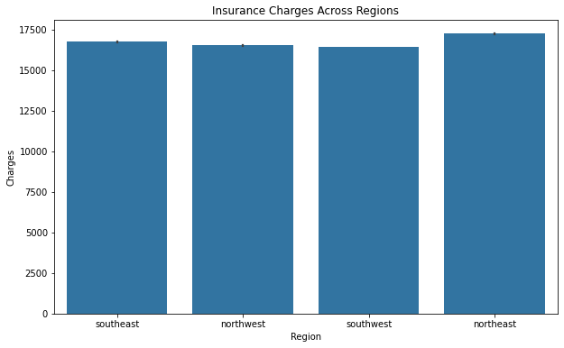
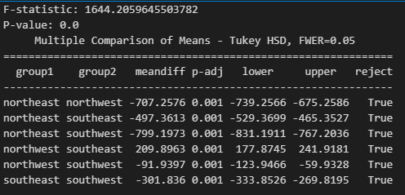
distribution of Region on Charges
The ANOVA test revealed significantly different mean insurance charges among four regions
Subsequent Tukey HSD analysis indicated specific pairwise differences in mean charges.

Slide 7
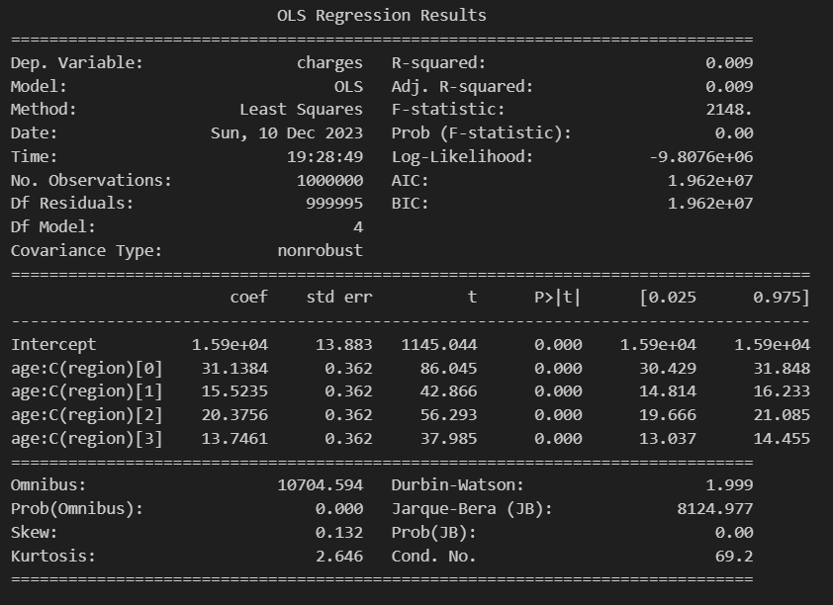
charges ~ age : region

Slide 8
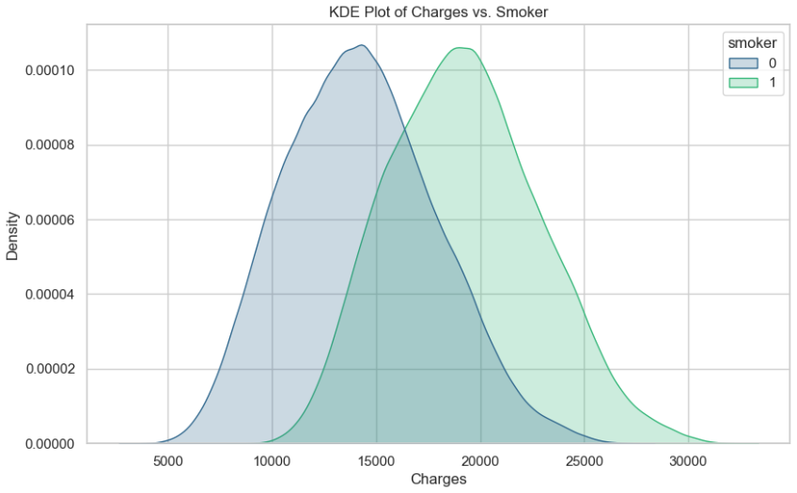
analyzing CHARGES VS SMOKERS
The plot clearly illustrates that more of Smokers tend to incur higher charges compared to non-smokers.
From T- Test:
T-statistic: 686.935
p-value: 0.0
Also, from the t-test we could find that there is significant difference in charges between smoker.

Slide 9
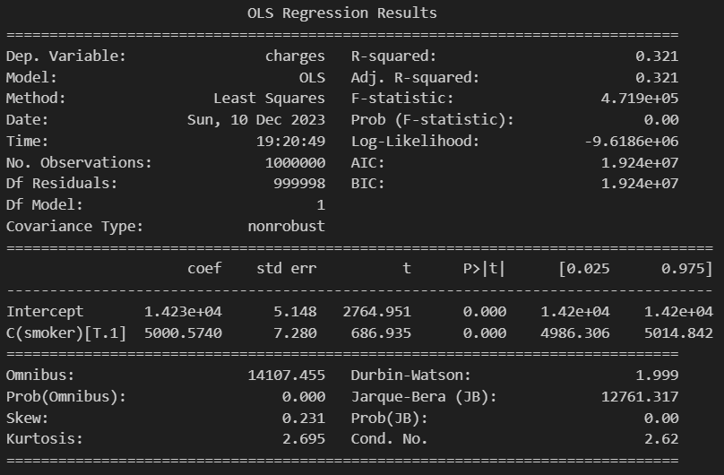
Charges ~ smoker

Slide 10
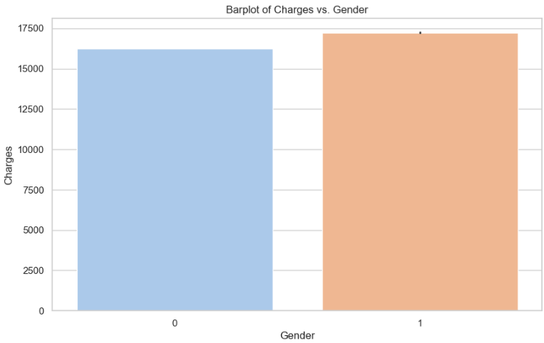
analyzing gender on charges
On average, males tend to give higher charges than females.
This states that in general there is gender-based disparities.
Also, from the t-test we could find that there is significant difference in charges between gender.
From T- Test:
T-statistic: -114.264
p-value: 0.0

Slide 11
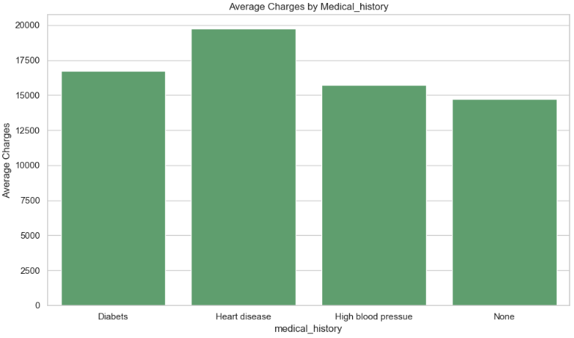
analyzing medical history on charges
The average charges are notably higher for individuals with heart disease, followed by those with diabetes.
ANOVA:
F-statistic: 73302.91023395509
P-value: 0.0
These results suggest that there are statistically significant differences in insurance charges among the different levels of "Medical History."

Slide 12
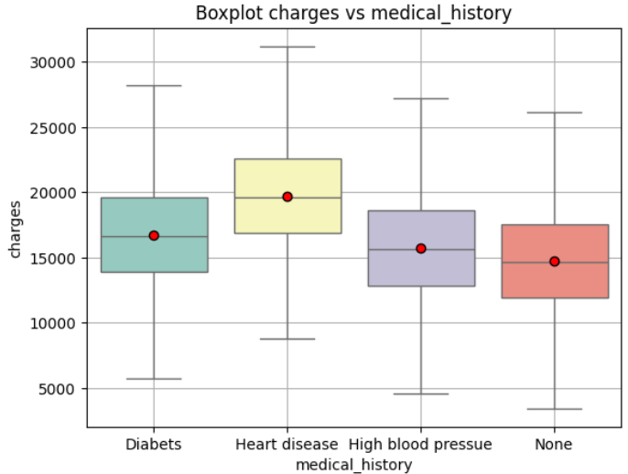
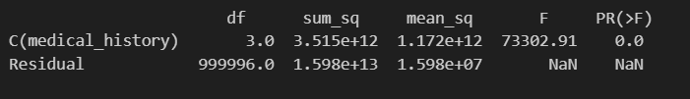
ANOVA TEST BETWEEN MEDICAL HISTORY AND CHARGES
There is significant difference among the means of medical history groups of charges
The Tukey HSD test further confirms that all pairwise differences are statistically significant.

Slide 13


Chi-square test for independence between gender and medical history:
Chi-square test for independence between smoker and medical history:
There's no significant association between gender and medical history of an individual
There's no significant association between smoker and medical history of an individual
13

Slide 14
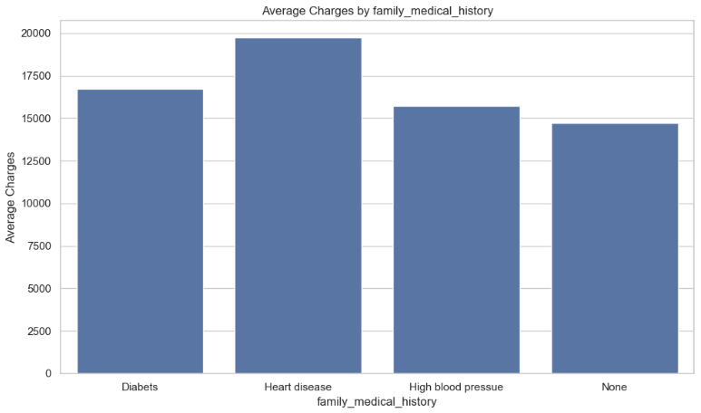
analyzing CHARGES VS FAMILY MEDICAL HISTORY
The average charges are notably higher for individuals with heart disease, followed by those with diabetes in family_medical_history also.
From One-way Anova test, there is significant difference among the means of family medical history groups of charges
ANOVA:
F-statistic: 73302.91023395509
P-value: 0.0

Slide 15
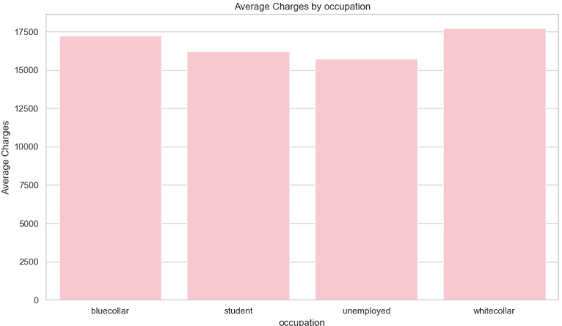
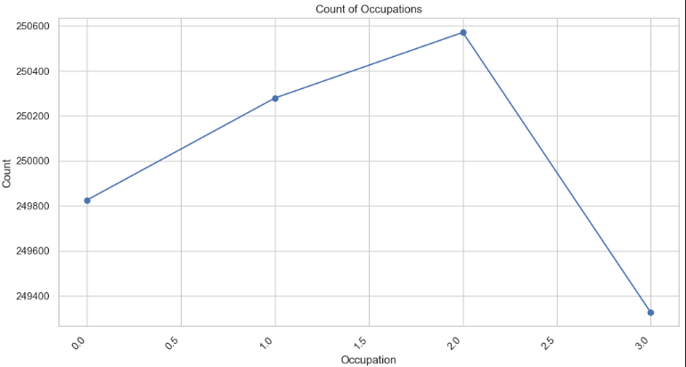
analyzing CHARGES VS OCCUPATION
The average charges are notably higher for white collar occupation, followed by those in blue collar and student.
Unemployed pay less charges. Also, according to dataset, Unemployed are in more count.

Slide 16
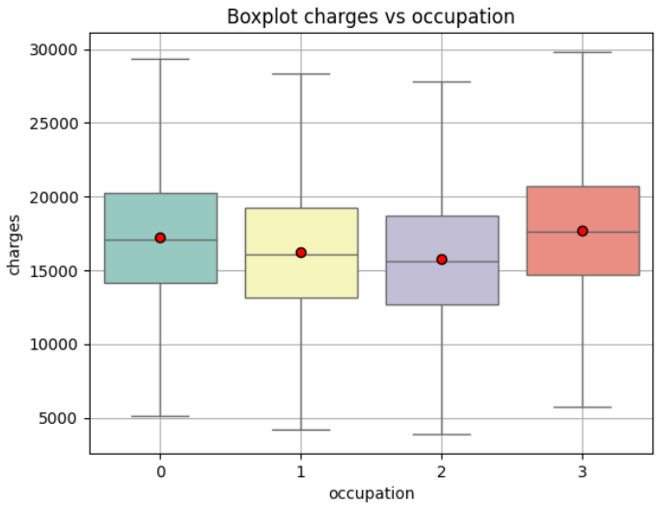

ANOVA TEST BETWEEN OCCUPATION AND CHARGES
There is significant difference among the means of occupation groups of charges
The Tukey HSD test further confirms that all pairwise differences are statistically significant.

Slide 17
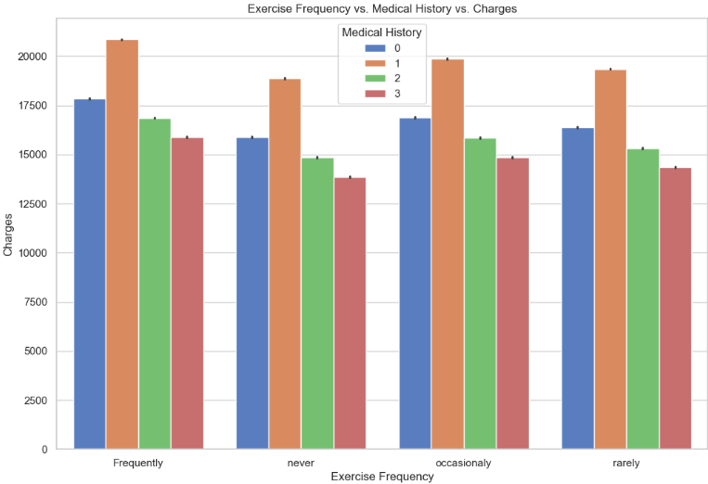
CHARGES ACCORDING TO MEDICAL HISTORY AND EXERCISE FREQ
Individuals who engage in frequent exercise and have a history of heart disease tend to incur higher charges. Following this, those who exercise occasionally and have a history of heart disease exhibit the high charges.
Conversely, the lowest charges are observed among individuals with no exercise regimen and no reported medical history.
Diabetes- 0 Heart disease- 1
High blood pressure- 2 None- 3

Slide 18
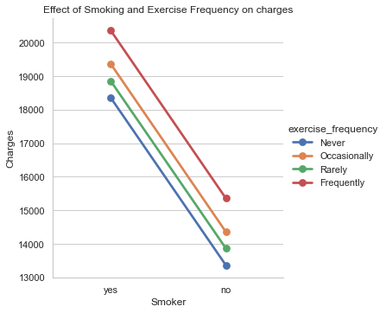
CHARGES ACCORDING TO SMOKING AND EXERCISE FREQ
Individuals who engage in frequent exercise and have a smoking habit tend to incur higher charges. Following this, those who exercise occasionally and rarely and have smoking habit exhibit the highest charges.
Conversely, the lowest charges are observed among individuals with no exercise regimen and no smoking habit.

Slide 19
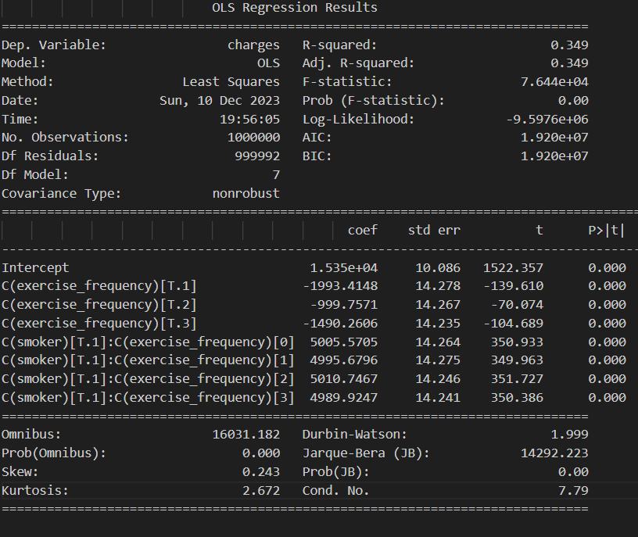
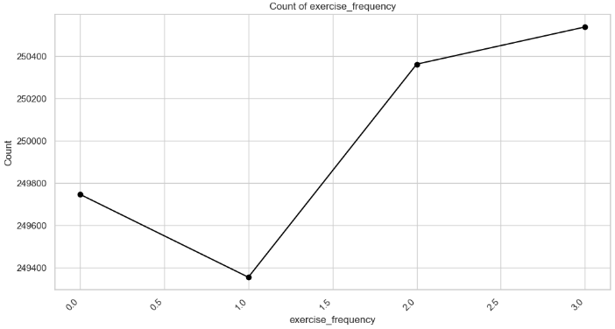
Charges ~ exercise freq : smoker
occasionally - 0 never - 1
frequently - 2
rarely- 3

Slide 20

Chi-square test for independence between smoker and exercise frequency:
There's Significant association between smoker and exercise frequency in an individual
20

Slide 21
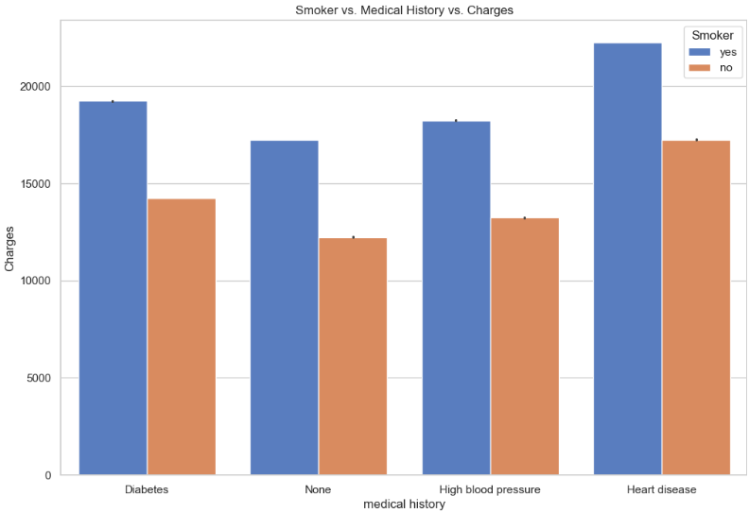
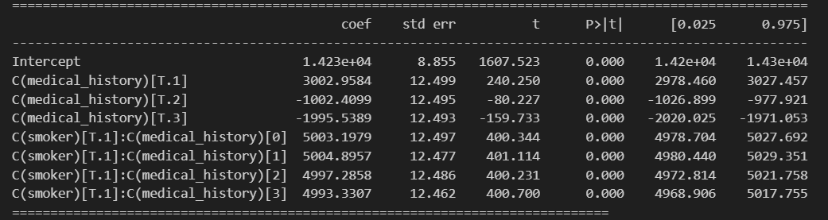
CHARGES ACCORDING TO SMOKING AND MEDICAL HISTORY
Individuals who have heart disease and have a smoking habit tend to incur higher charges.
Conversely, the lowest charges are observed among individuals with no medical history and no smoking habit.

Slide 22
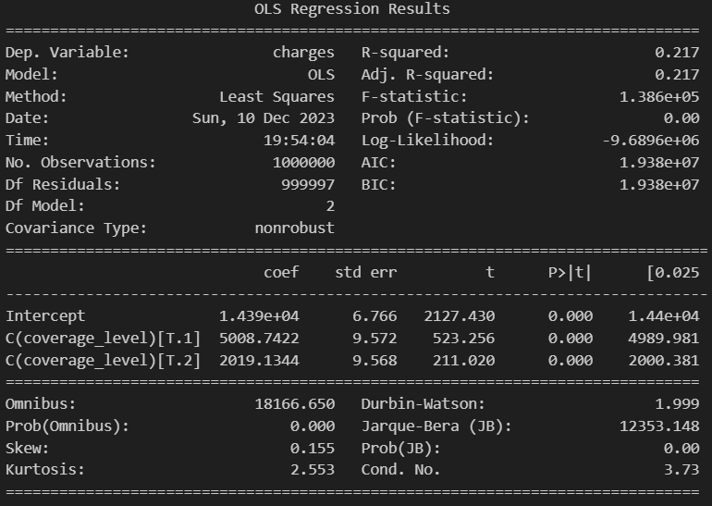
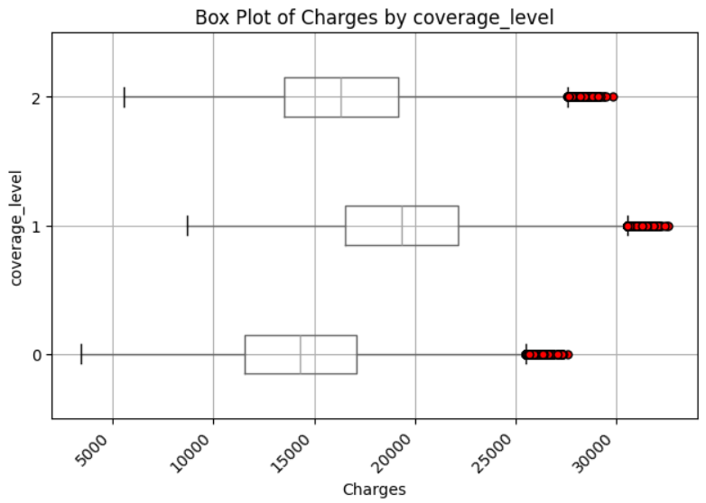
CHARGES BY COVERAGE LEVEL
0 – basic
1 – premium
2 - standard
The analysis exactly reveals that Premium customers incur the highest charges, trailed by Standard and Basic customers in descending order.

Slide 23
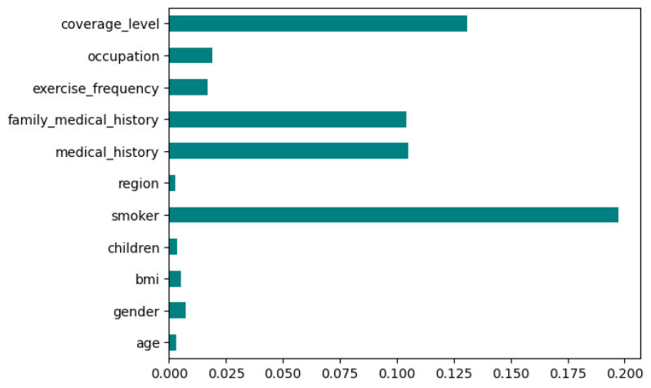
FEATURE SELECTION
mutual_info_regression feature selection :
Top features influencing charges
Smoker
coverage_level
medical_history
family_medical_history

Slide 24
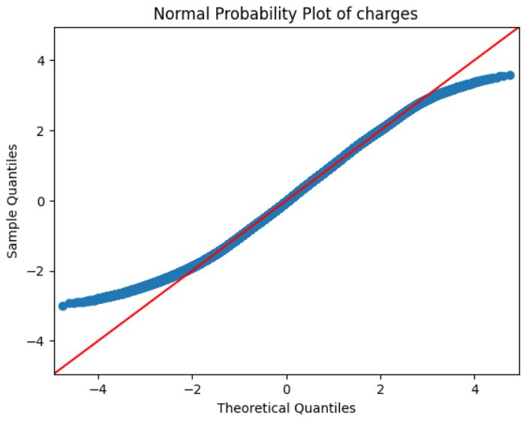
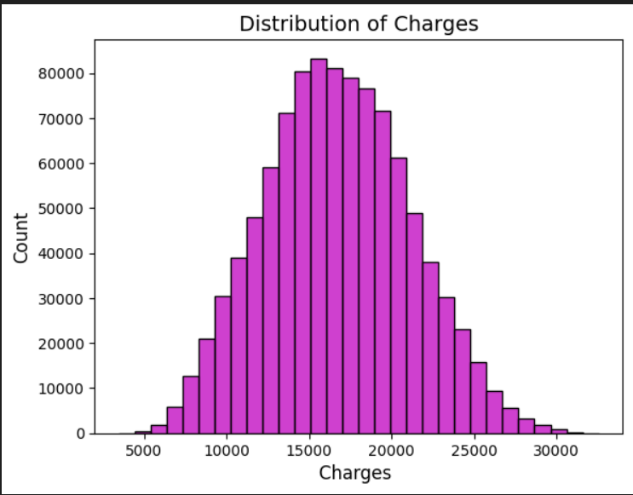
Assumptions of lr
The dataset exhibits a notable absence of outliers, and the distribution of charges aligns closely with a normal distribution.

Slide 25
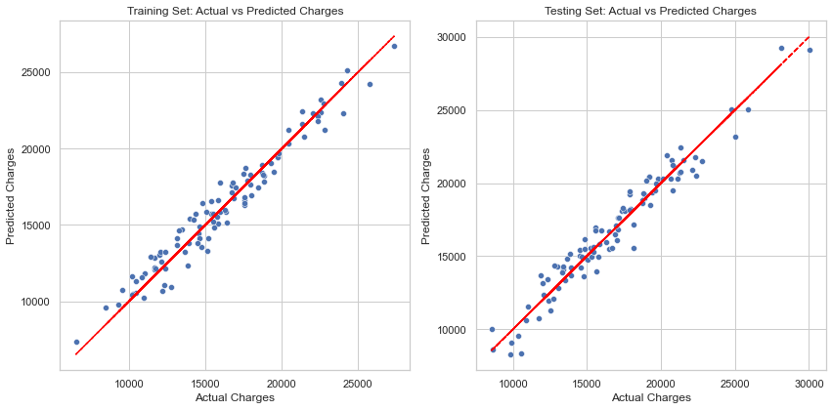
LINEAR REGRESSION model
Results:
Mean squared error: 839240.23
MAPE : 4.85
Accuracy: 95.15 %.
Train R2 score: 0.9568
Test R2 score: 0.9568

Slide 26
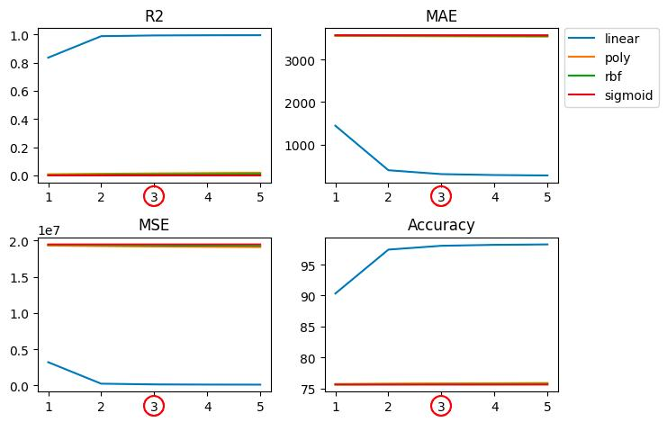
Support Vector Regressor model
kernel: linear
C (regularization parameter): 3
gamma: scale
Results:
Mean squared error: 85577.88
MAPE : 1.63
Accuracy: 98.36 %.
Train R2 score: 0.9955
Test R2 score: 0.9948

Slide 27
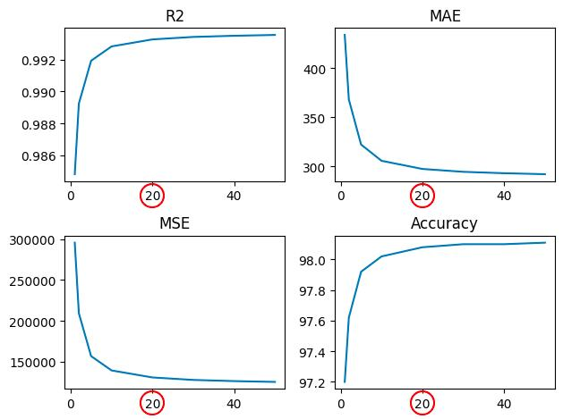
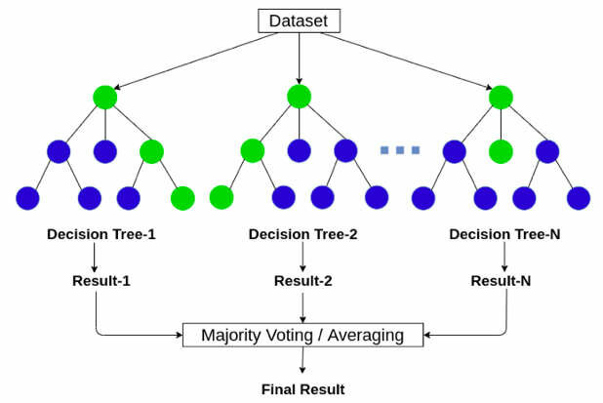
Random forest regressor model
Results:
Mean squared error: 130913.70
MAPE : 1.92
Accuracy: 98.08 %.
Train R2 score: 0.9989
Test R2 score: 0.9932

Slide 28
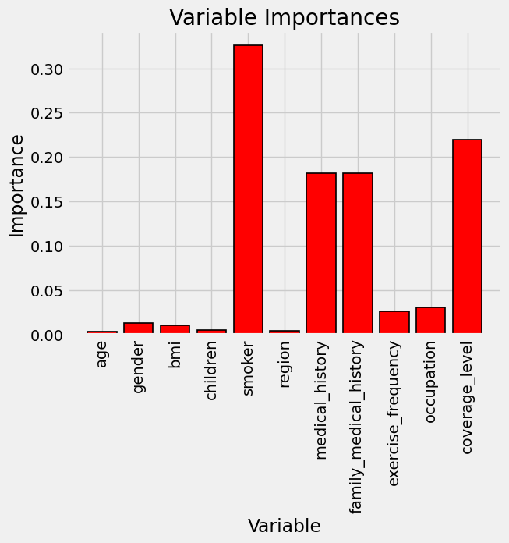
Gradient Boosting Regression model
After hyper tuning :
GradientBoostingRegressor(n_estimators=25, learning_rate=0.8, subsample= 0.9, max_depth=9, random_state=1)
Results:
Mean squared error: 126511.28
MAPE : 1.89
Accuracy: 98.10 %.
Train R2 score: 0.9941
Test R2 score: 0.9935

Slide 29
XG Boost Regression model
After hyper tuning :
XGBRegressor(n_estimators=200, gamma=0.3, max_depth=4, random_state=1)
Results:
Mean squared error: 85635.95
MAPE: 1.63
Accuracy: 98.37 %.
Train R2 score: 0.9958
Test R2 score: 0.9956

Slide 30
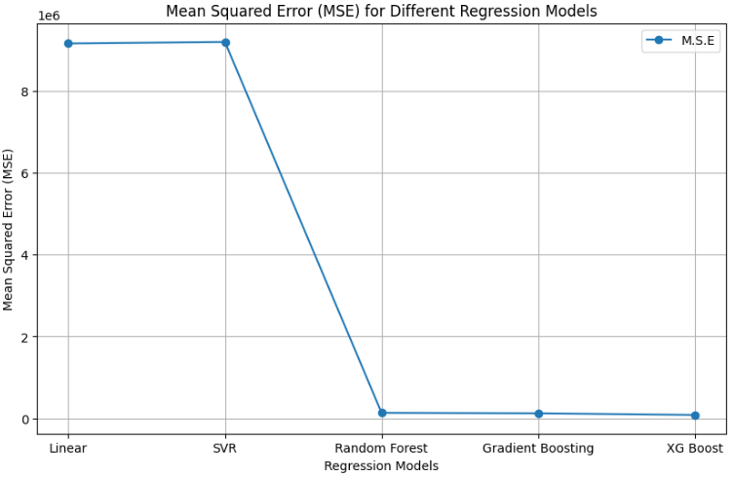
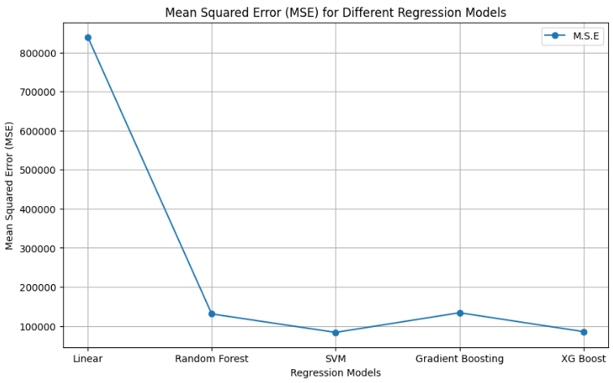
Results :
Without scaling and one hot encoding
With scaling and one hot encoding

Slide 31
Using prediction of health insurance premiums
Train machine learning models using historical data to predict insurance premiums.
Utilize features such as age, gender, health conditions and other relevant factors and implement below applications
Web Application.
Mobile App integration.
For online policy application.
These applications provide real-time predictions for users with the feature values provided.

Slide 32

Thank You!

