Slide 1
Stage I – Case study
Keerthana S -

Slide 2
Agenda
Problem Statement
Challenges
Solutions
Conclusion

Slide 3
Problem Statement
Country X contributes to approximately 10% of Company X's global product sales, making it a high-potential market.
Company X has a diverse product line that is sold to retailers through distributors (agencies). Thousands of different wholesalers-SKU/product combinations exist.
Company X needs an accurate forecast of demand at the SKU level for each distributor in order to plan its production and distribution, as well as to assist wholesalers with their planning.
Sales executives now assess demand based on past experience. They have a "vibe" for the market and it can predict the net effect of supply, demand, and other external factors.
The better a sales executive is at estimating, the more experience he has in that industry. The new Head of Operations at Company X wants to use data science to revolutionize demand forecasting

Slide 4
Challenges
Determine the most important trends and factors.
Propose two SKUs that Agency 06 and Agency 14 could sell. These two agencies are brand new, and the corporation needs to figure out which two items will work best for them.
Create visual representations of the data.

Slide 5
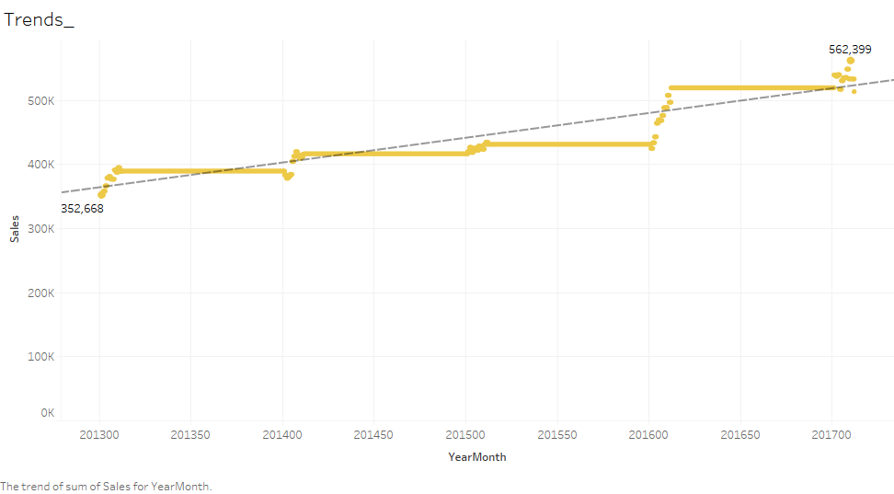
Solutions
Most important trends and factors:
As we can see, there is an upward trend so sales are very high for the year 2017/10 and on. Thus, this is the top trend.
Looking at the line chart, sales are highest in the 10th month of every year or in the months closest to it.
As a result, sales are higher in the 10th month of 2017. So we have to focus more on the production at that time.
We have been observed that it has been booming from the beginning of October to December. There are no ups and downs in sales from October to December each year. There are ups and downs from January to August.
Place any supporting images, graphs, data or extra text here.

Slide 6
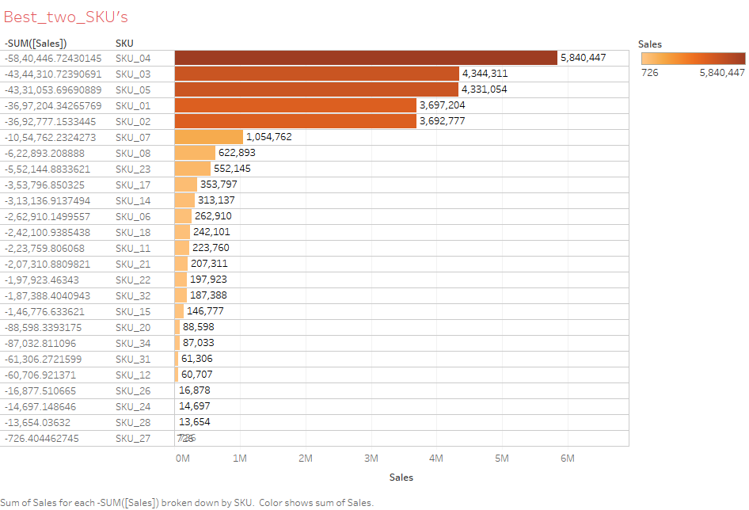
Solutions
Two SKU recommended for agency 06
and agency 14:
SKU_04 and SKU_03 are primarily in the top two when it comes to overall SKU viewing, as we can see.
Thus from bar diagram, SKU_04 and SKU_03 are largely in the top two. We can recommend these.
Place any supporting images, graphs, data or extra text here.

Slide 7
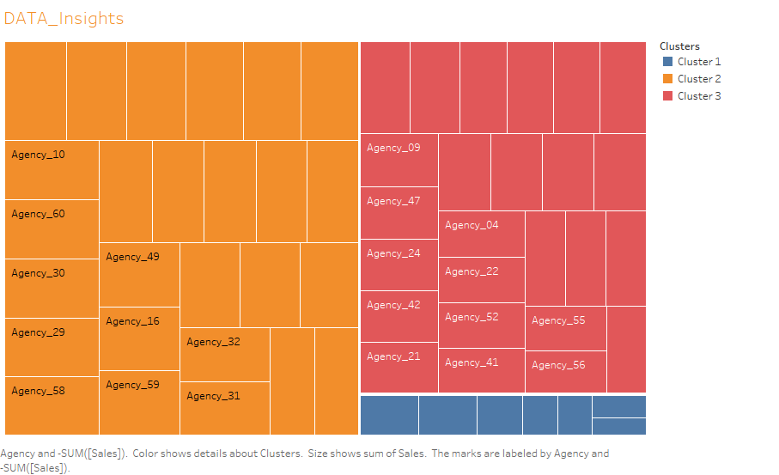
Solutions
Visual representations based on the
data:
From this Treemap, cluster_01 are low sales agents. It consists of agency_35, agency_37, agency_40, amongst others. So we need to focus more on these under-selling agencies.
Following that, cluster_02 are high net sales agents. Consisting of agency_57, agency_48, and agency_10 amongst others, they should be taken care of without any hindrance.
Cluster_03 has middle selling agents. As seen, it consists of agency_39, agency_09, agency_47, and so on. Therefore, care should be taken not to reduce their sales.

Slide 8
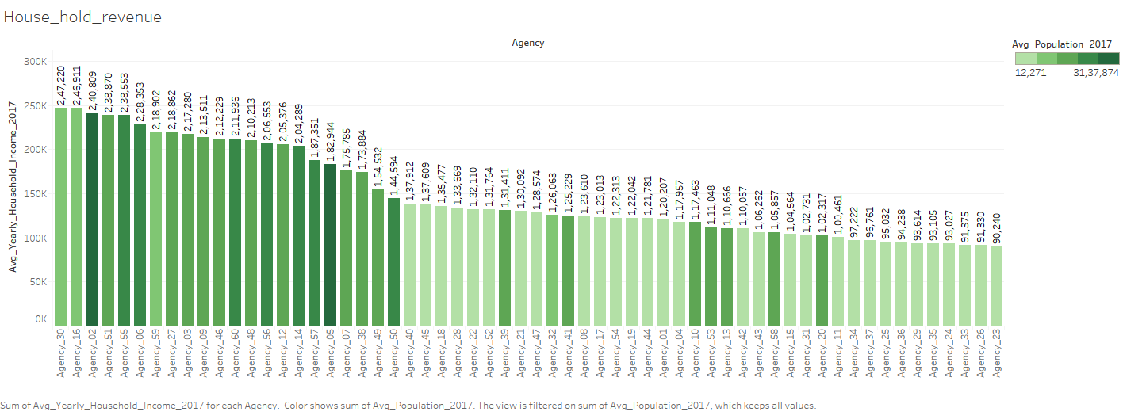
Solutions
Visual representations based on the
data:
From the bar chart, company X’s performance is based on agency population and revenue.
As we can see, agency_30 has a below-average population of 10,94,349 and a very high income of $ 2,47,220. The same goes for agency_16 and some of them. Therefore, these agencies should be appreciated.
Agency_05 has the largest population of 30,44,268 and an average income of $ 1,82,944. The same goes for agency_50 and some of them. So these agencies should be encouraged to generate more revenue.

Slide 9
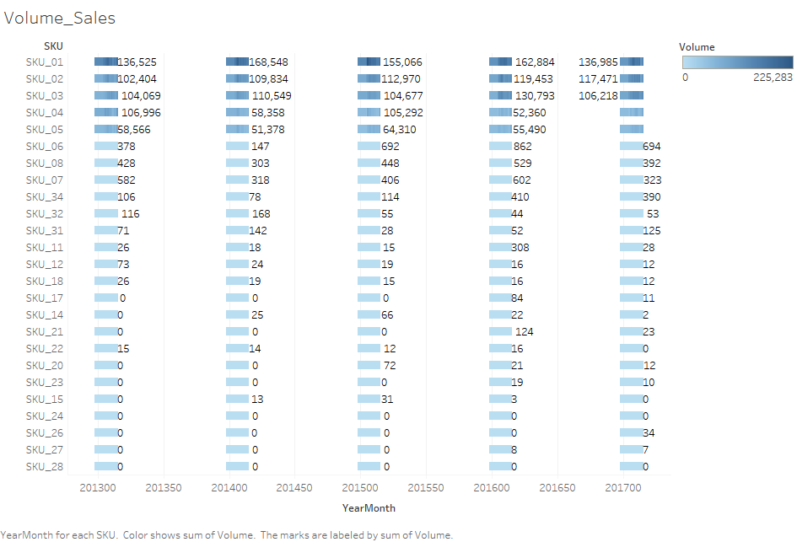
Solutions
Visual representations based on the
data:
From the table we can observe traders in a particular period of time (i.e) 2013, 2014, 2015, 2016, 2017.
SKU_01 has turned off most trades ever since. Hence the production of SKU_01 should be increased.
At the same time, no trading is observed for SKU_28, thus its production can be stopped or reduced. SKU_23 has no trading in 2013, 2014, 2015 and is very low in 2016, 2017. Hence this production can be reduced.

Slide 10
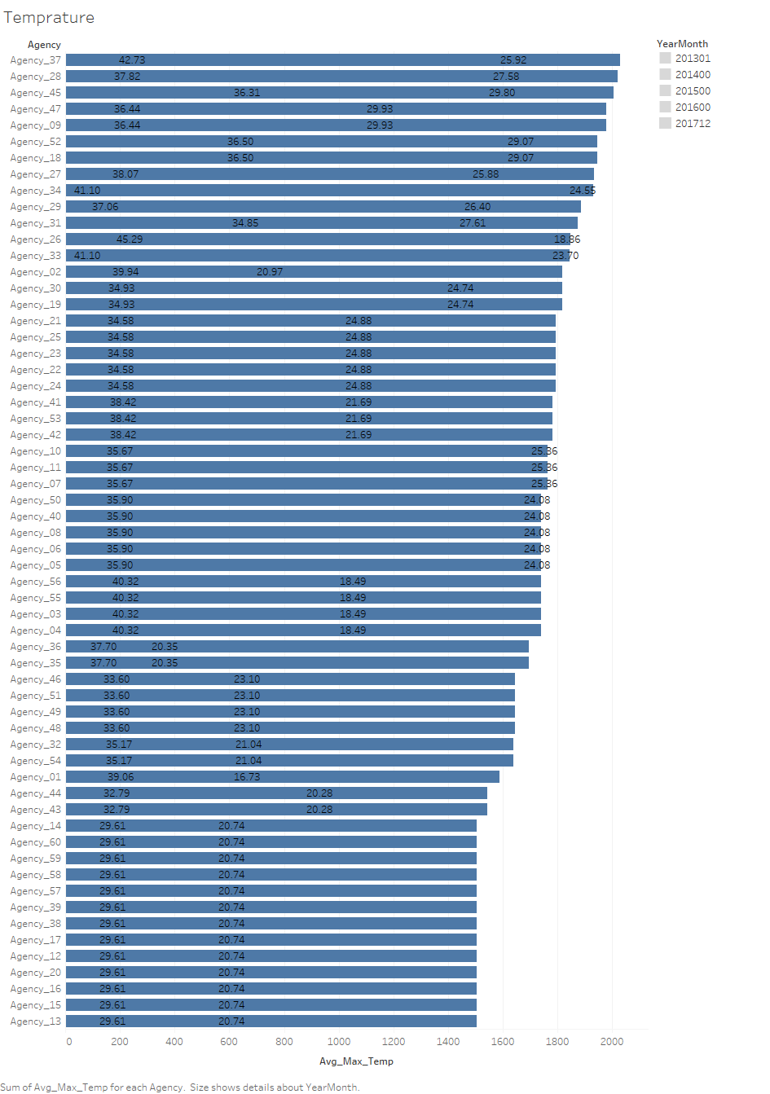
Solutions
Visual representations based on the
data:
From the table, we can observe the temperatures in 2013, 2014, 2015, 2016, 2017.
As we can see, agency_13, and some of them. So far the temperature is very low. Thus, avoid giving a lot of SKUs to this agency in advance. Therefore there is a possibility of any damage caused by the weather.
Agency_09, and some of them. So far the temperature is good. Hence giving SKU in advance to this agency will not cause any impact due to weather.

Slide 11
Conclusion
Agency_04 and Agency_14 should be preferred and hence more attention should be given. These are new agencies.
We can do something to encourage a few salespeople to make more sales. Similarly, we should try to do something to encourage SKU_26, SKU_24, SKU_28, SKU_27 as well.
Increase revenue by focusing more on a low-income agency with a large population.
We can focus on cost reduction by reducing the production of low selling products and increasing the production of high selling products based on 2013, 2014, 2015,2016,2017.
Temperature can also be monitored by avoiding pre-delivery of products to agencies where the temperature is bad.

Slide 12
Thank you

