Slide 1

DEPARTMENT OF ELECTRICAL AND ELECTRONICS ENGINEERING
Report on IoT using Arduino
“LDR SENOR ”
Submitted by,
Aishwarya S Kolhar 1EW23EE400
Bhavya J 1EW23EE402
Harshitha L 1EW23EE405
Vijayalakshmi A 1EW23EE426
Under The Guidance Of :
Mr. Nagesh B

Slide 2
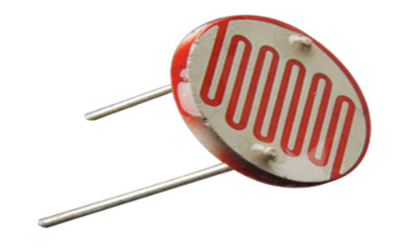
LDR SENSOR
An LDR sensor (Light Dependent Resistor), also known as a photoresistor, is a light-sensitive device whose resistance decreases when light intensity increases.
How It Works:
In darkness or low light, the resistance is high (can be in the megaohms).
In bright light, the resistance drops significantly (to a few hundred ohms or less).
This change in resistance is used to detect and measure light levels.

Slide 3
Basic Properties
Property | Description
Type | Passive electronic component
Sensitivity | Visible light (some can detect UV/IR)
Material | Often made from cadmium sulfide (CdS)
Response time | Slow (milliseconds to seconds)

Slide 4
Common Uses
Street lights that turn on/off based on light level
Light meters in cameras
Automatic brightness control in displays
Security systems (e.g. beam-break detection)

Slide 5
Hardware Required:
1 × LDR (Light Dependent Resistor)
1 × 10kΩ resistor
1 × LED
1 × 220Ω resistor (for the LED)
Arduino board (Uno, Nano, etc.)
Breadboard & jumper wires

Slide 6
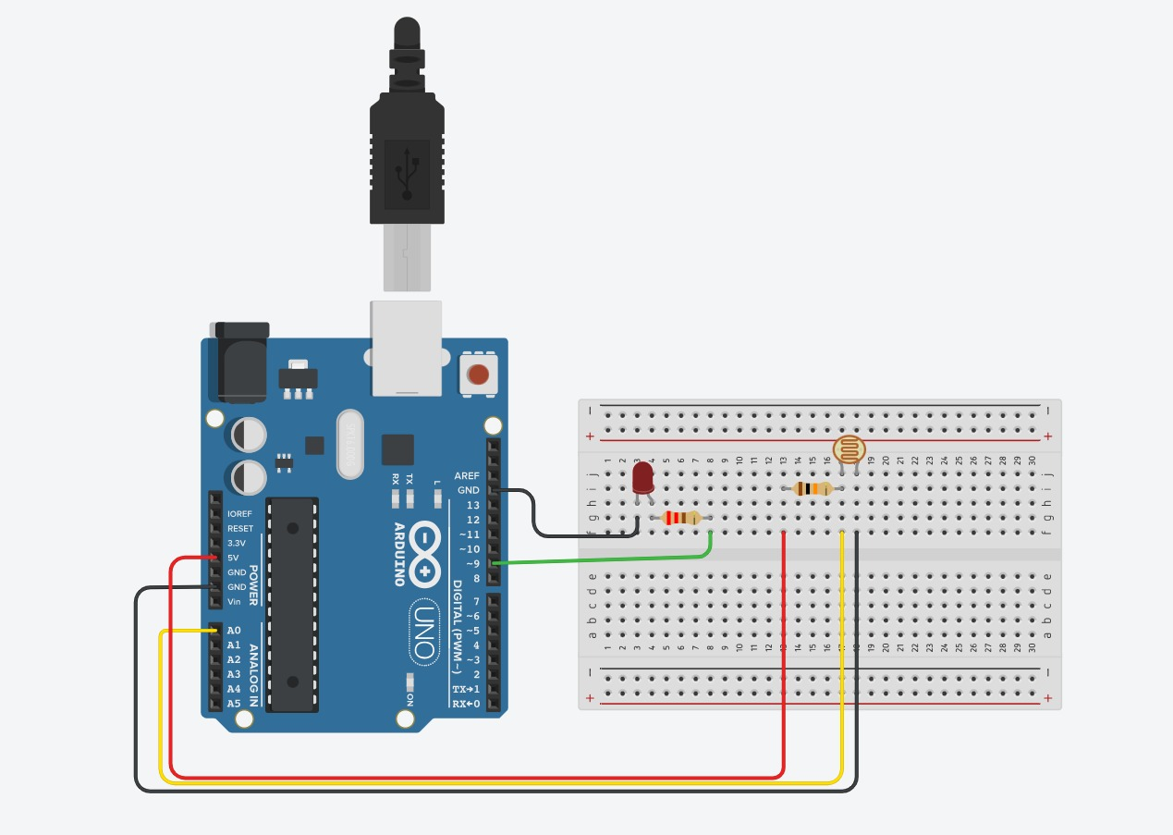
OUT PUT

Slide 7
Conclusion
LDR Sensor with Arduino
The LDR (Light Dependent Resistor) is a simple and effective sensor for detecting light levels. By integrating it with an Arduino, you can build smart systems that respond to ambient light, such as:
Automatic street lights
Night-mode systems
Light-activated alarms
In this project, we:
Created a voltage divider using an LDR and a 10kΩ resistor.
Used analogRead() on pin A0 to measure light intensity.
Programmed the Arduino to turn on an LED when it gets dark.
This demonstrates how LDRs can be used in real-world applications to automate systems based on environmental light changes.

Slide 8


