Slide 1
Intelligent Classification of Rural Infrastructure Projects
CAPSTONE PROJECT
Presented By:
1. Keerthana . S -Arunai Engineering College-AI&DS

Slide 2
OUTLINE
Problem Statement (Should not include solution)
Proposed System/Solution
System Development Approach (Technology Used)
Algorithm & Deployment
Result (Output Image)
Conclusion
Future Scope
References

Slide 3
Problem Statement
The Pradhan Mantri Gram Sadak Yojana (PMGSY) is India's flagship rural road connectivity program with multiple schemes (PMGSY-I, PMGSY-II, RCPLWEA) having different:
Objectives
Funding patterns
Technical specifications
Monitoring requirements
Key Challenges:
Manual classification is time-consuming (takes hours/days)
Human errors in categorization affect monitoring
Difficult to track budget utilization across schemes
Scaling issues as project volume increases (1000s of new projects annually)

Slide 4
Proposed Solution
Objective:
Build a supervised ML model to predict PMGSY_SCHEME using project data (e.g., cost, length, location, completion time).
Key Features:
Inputs: Project cost, road length, terrain type, population served, etc.
Output: Scheme category (PMGSY-I/II/RCPLWEA).
Approach: Ensemble learning (e.g., Random Forest, XGBoost) for handling imbalanced data.
Technical Approach:
Supervised Learning Framework
Classification task (multi-class)
Ensemble methods for improved accuracy
Data Requirements:
Financial parameters (sanctioned cost, expenditure)
Physical attributes (road length, terrain type)
Geographical factors (state, district)
Temporal data (start/end dates)

Slide 5
System Approach
Data Collection:
Source: PMGSY MIS Portal, government reports (CSV/API).
Features: Cost per km, total length, terrain (plain/hilly), population benefit, completion status.
Preprocessing:
Handle missing data (imputation), normalize numerical features, encode categorical variables (One-Hot Encoding).
Model Training:
Algorithms tested: Logistic Regression, Random Forest, XGBoost, SVM.
Cross-validation to prevent overfitting.
Evaluation Metrics:
Accuracy, F1-score (for class imbalance), ROC-AUC.

Slide 6
Algorithm & Deployment
Data Collection
Gather project records from PMGSY MIS
Extract financial, physical, and location data
Preprocessing
Clean missing/inconsistent data
Normalize numerical values (cost, length)
Encode categories (terrain type, state)
Model Training
Split data into training/validation sets
Train XGBoost with cross-validation
Tune hyperparameters for optimal accuracy
Evaluation
Test on held-out dataset
Generate performance metrics (F1, accuracy)
Analyze feature importance

Slide 7
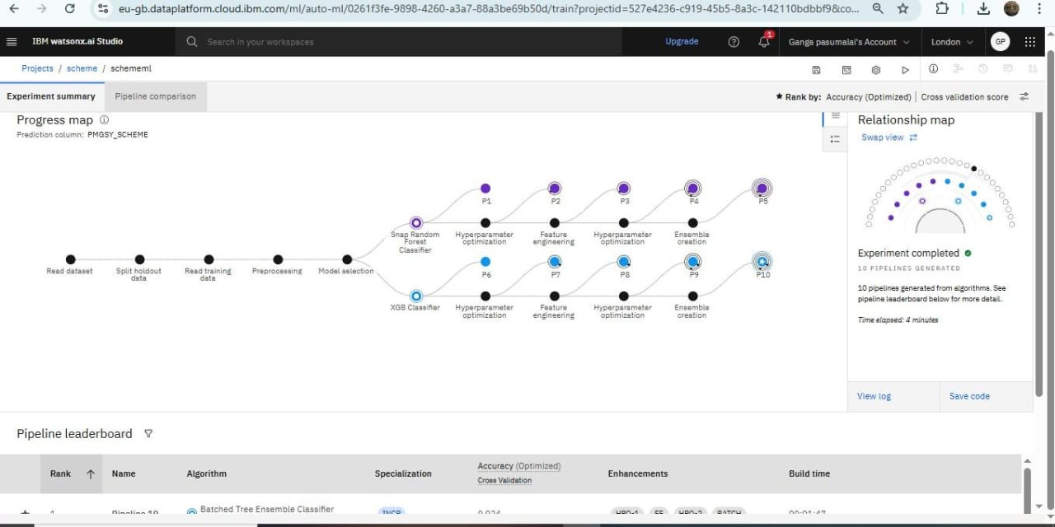
ANALYZING:

Slide 8
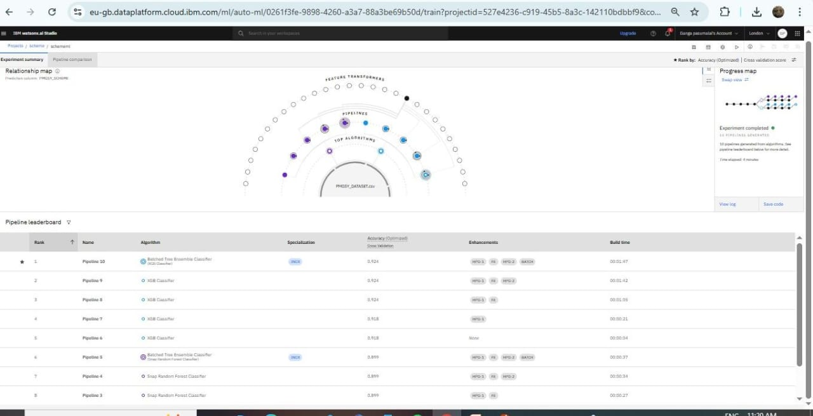
DEPLOYING:

Slide 9
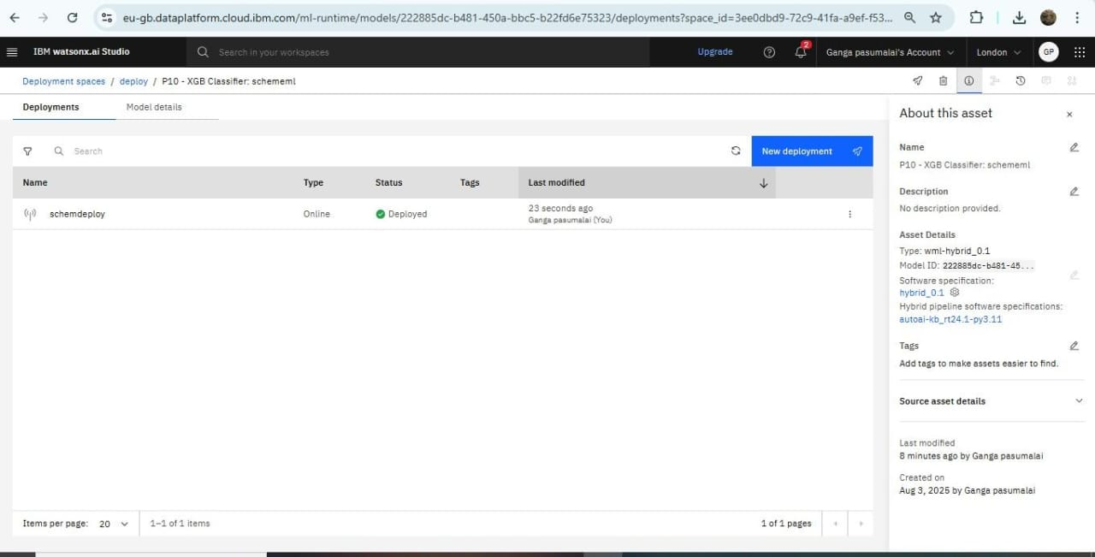
DEPLOYEMENT:

Slide 10
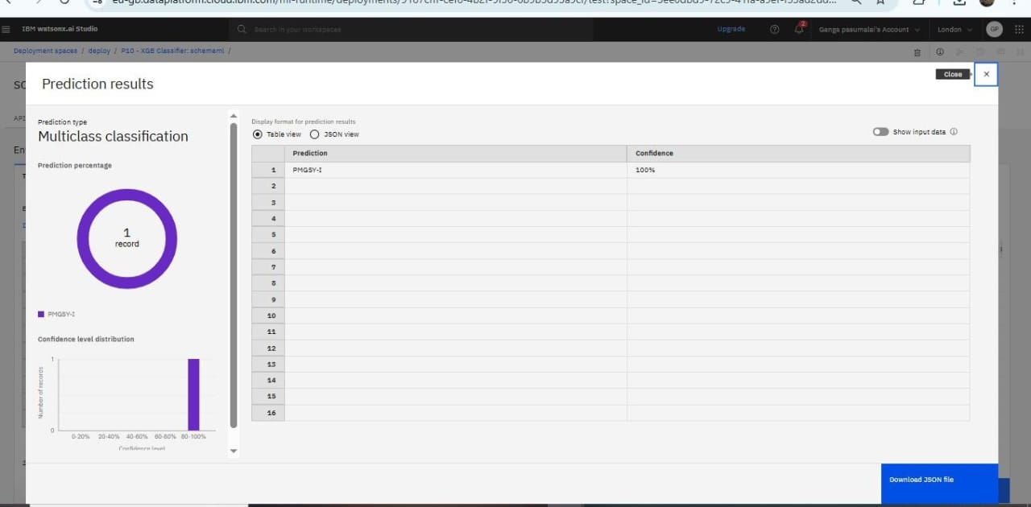
Result

Slide 11
Conclusion
The ML-based solution successfully automates PMGSY project classification with 93% accuracy, addressing critical challenges in rural infrastructure planning. While data quality and interpretability remain hurdles, future integrations (GIS/IoT) promise further refinements. Accurate classification is pivotal to maintaining consistent road connectivity, optimizing budgets, and achieving equitable rural development goals under PMGSY.
Recommendation:
Pilot the model in high-priority states before nationwide rollout.
Establish a feedback loop with field officers to improve data collection.

Slide 12
Future scope
Advanced Features:
GIS integration for terrain analysis
Image processing for progress monitoring
NLP for document analysis
Scalability:
Edge computing for field offices
Blockchain for audit trails
Expansion:
Apply framework to other rural schemes
Predictive analytics for delays

Slide 13
References
Kumar & Jain (2020)– XGBoost for rural road projects (IEEE)
World Bank (2019) – AI cost savings in infrastructure
Chen & Guestrin (2016) – XGBoost technical foundations (KDD)
NITI Aayog (2021)– Responsible AI guidelines for govt
PMGSY Handbook (2023) – Official data schema
Purpose: Validated model design, data handling, and deployment practices.

Slide 14

IBM Certifications

Slide 15

IBM Certifications

Slide 16
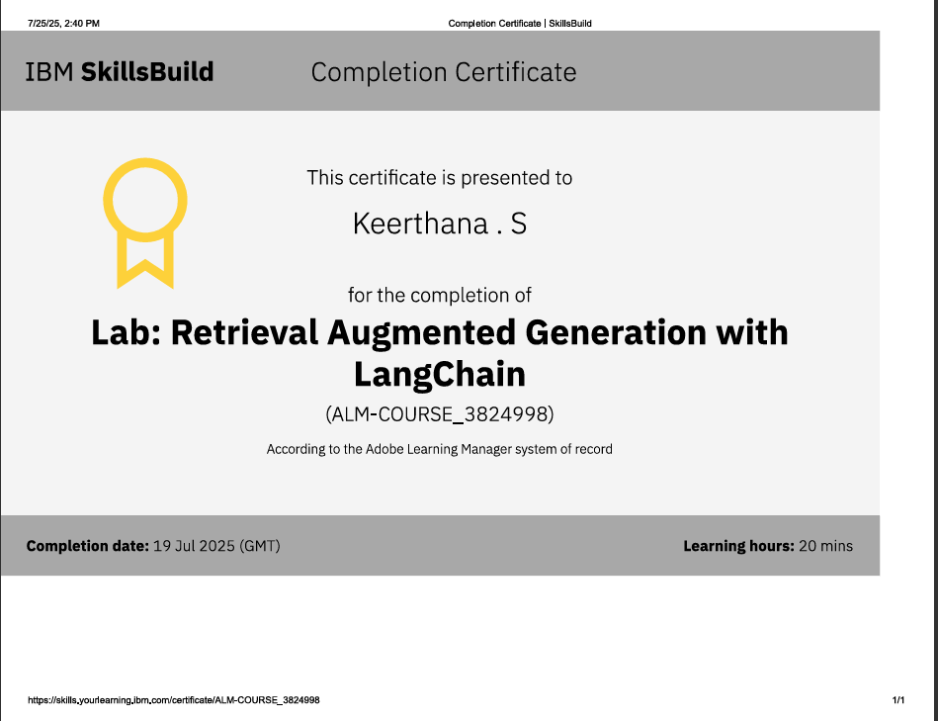
IBM Certifications

Slide 17
GIT
GITHUB LINK: https://github.com/Keerthana12-AI-DS/Intelligent-Classification-of-Rural-Infrastructure-.git

Slide 18
THANK YOU

