Slide 1
TASK 5
PART 2
CYS BASICS
KEERTHANA E
AIE 21021

Slide 2
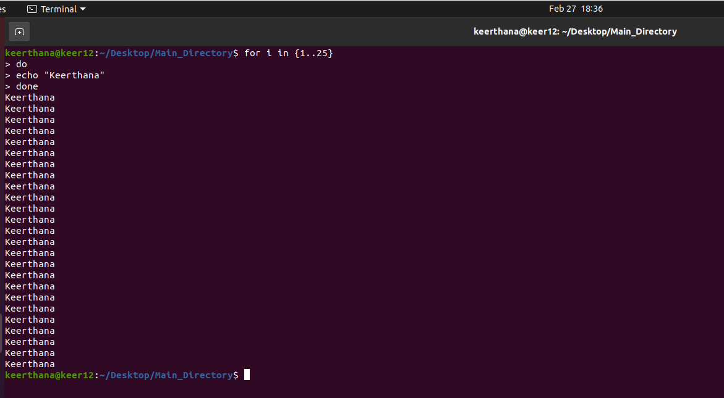
Write a bash script to echo your name 25 times

Slide 3
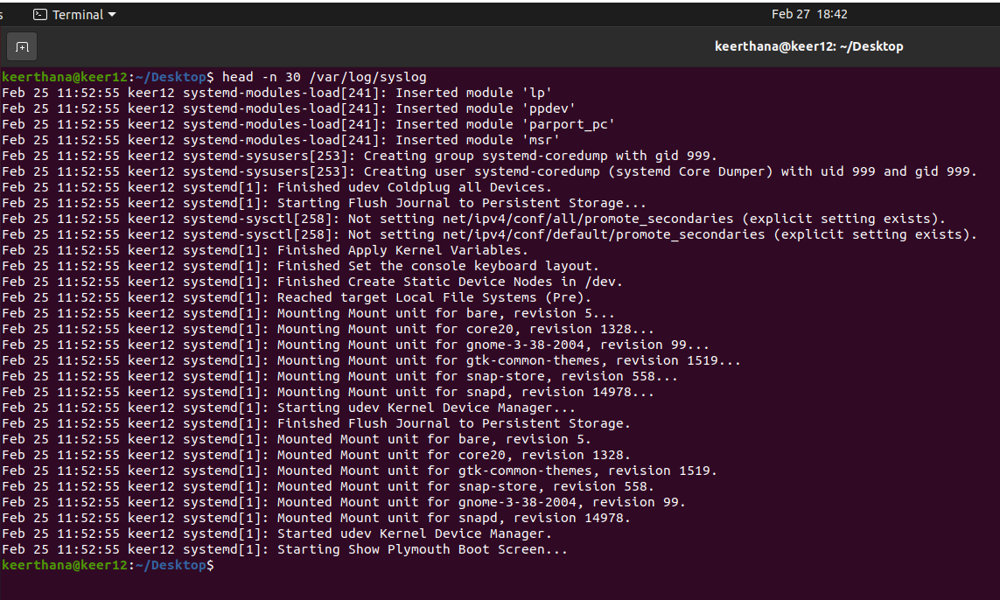
What command should be used to display the first 30 entries of syslog file?
COMMAND : head -n 30 /var/log/syslog

Slide 4
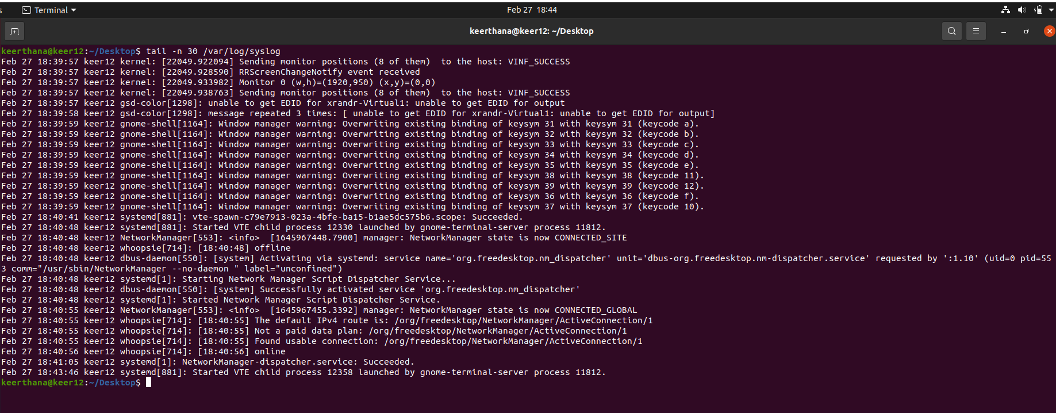
What command should be used to display the last 30 entries of syslog file?
COMMAND : tail -n 30 /var/log/syslog

Slide 5
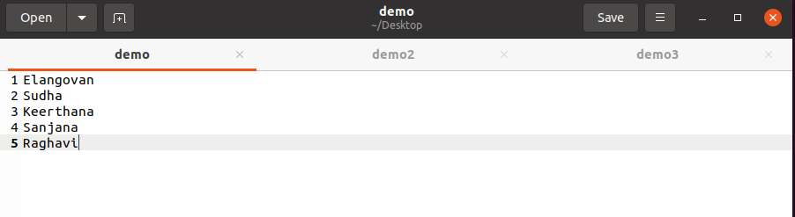
What command should I use to arrange the entries of a file
The text file has been created and named as “demo”

Slide 6
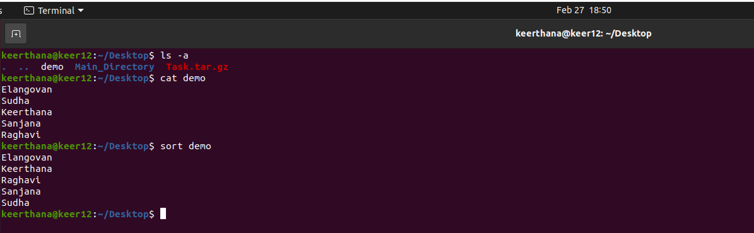
What command should I use to arrange the entries of a file
Alphabetically
COMMAND : sort filename
(filename –the file which you need to sort out)

Slide 7
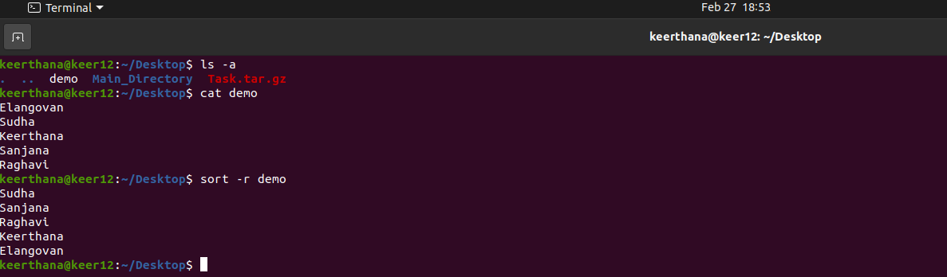
What command should I use to arrange the entries of a file
Reverse order
COMMAND : sort –r filename
(filename –the file which you need to sort out)

Slide 8
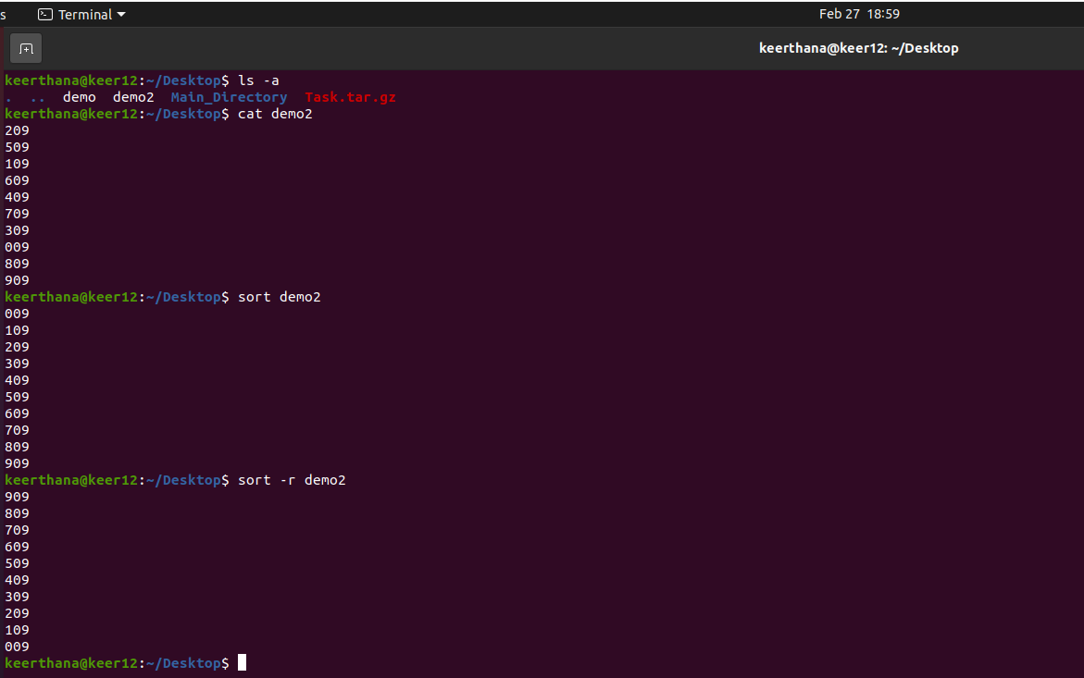
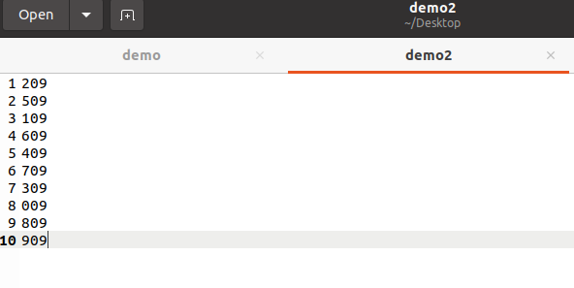
What command should I use to arrange the entries of a file
Numerical order
COMMAND : sort filename & sort –r filename
(filename –the file which you need to sort out)

Slide 9
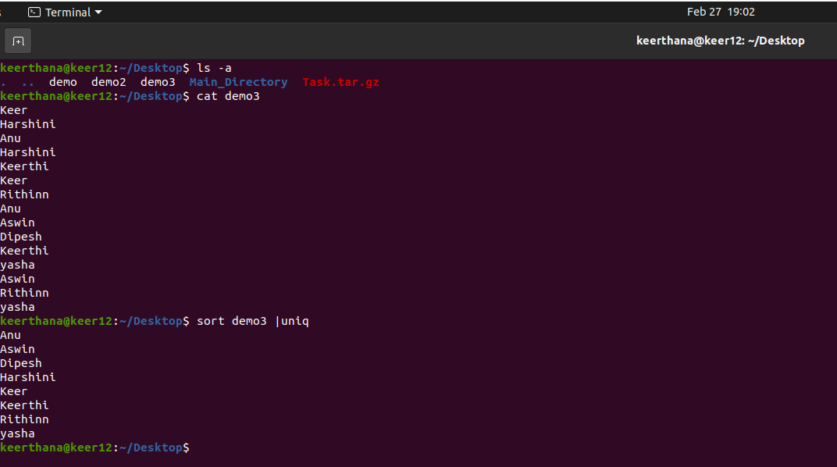
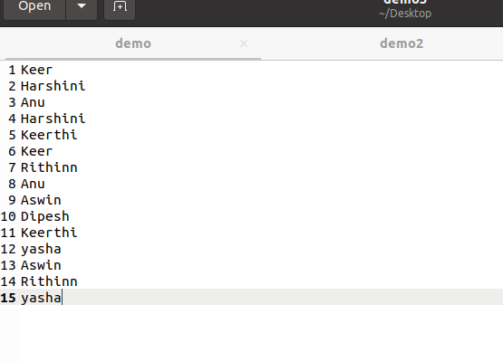
Copee is a hard-working cop. He found a case and almost at the verge of cracking it. It could be his best breakthrough. He has the list of criminals but lots of duplicates are there. He needs to find the only one that is different. He sought your help. How will you sort this issue?
COMMAND : sort filename | uniq
(filename –the file which you need to sort out)

Slide 10
What are the Three parts of file's permission?
READ : USER CAN READ THE FILE AND LIST IN DIRECTORY
WRITE : USER CAN WRITE NEW FILES IN THE DIRECTORY
EXECUTE : USER CAN ACCESS AND RUN THE FILE IN DIRECTORY

