Slide 1

COVID-19
Data Analysis
TEAM MEMBERS
Ankit Patel
Kashyap Dev Nath
Keerthana
Pratik Patel

Slide 2
PROBLEM
1
PHASES
2
DATA ANALYSIS
AGENDA
3
INSIGHTS
4
CHALLENGES FACED
5

Slide 3
Problem Statement
Covid-19 second wave was much more devastating for India than the first wave, with shortages of hospital beds, vaccines, oxygen cylinders, and other medical supplies. Analyzing the Covid19 data will help better prepare to deal with future threats.

Slide 4
PHASES
DATA PARSING | DATA CLEANING | DATA ANALYSIS | DATA VISUALIZATION
Retrieving data from the JSON files using the request module. | Cleaning and manipulating the data using pandas. | Analyzing the data using SQL. | Visualizing the data using Excel.

Slide 5
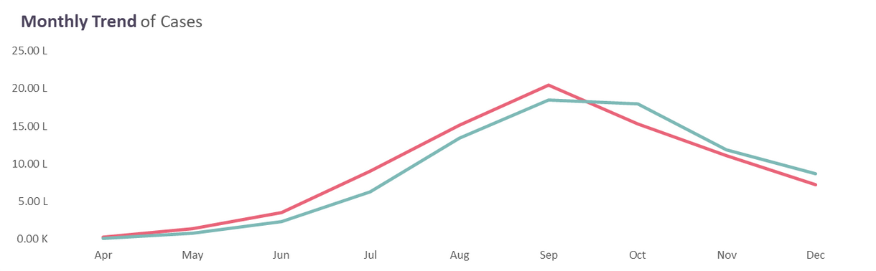
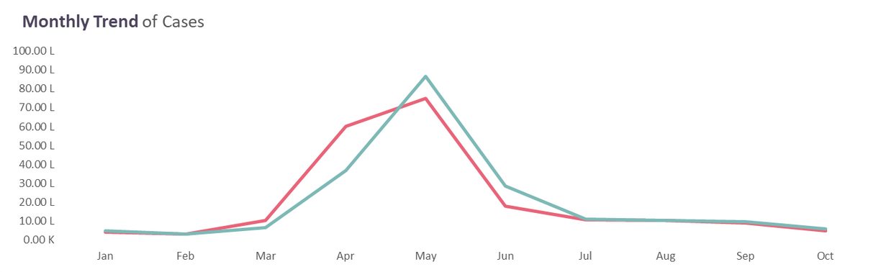
DATA ANALYSIS
2020
2021

Slide 6
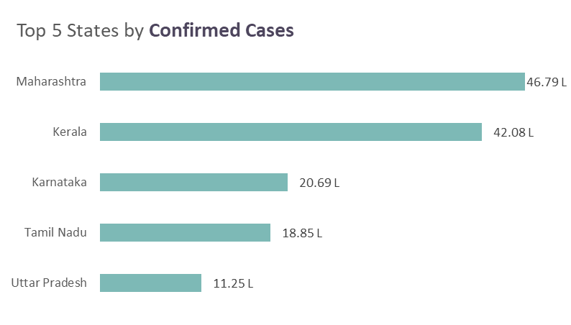
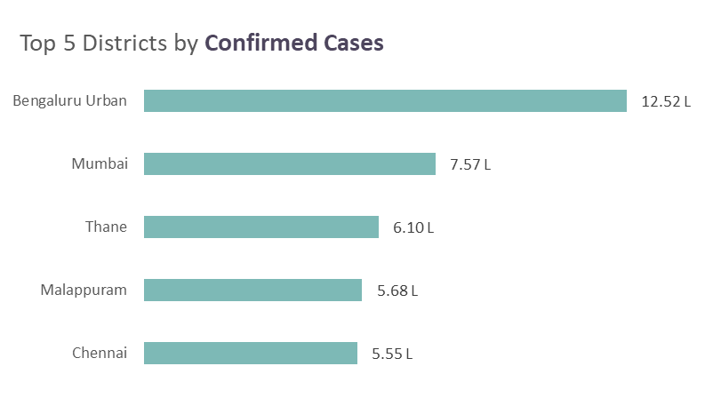
DATA ANALYSIS
1%
Case Fatality Rate
5%
Total Positive Rate
99%
Recovery Rate

Slide 7
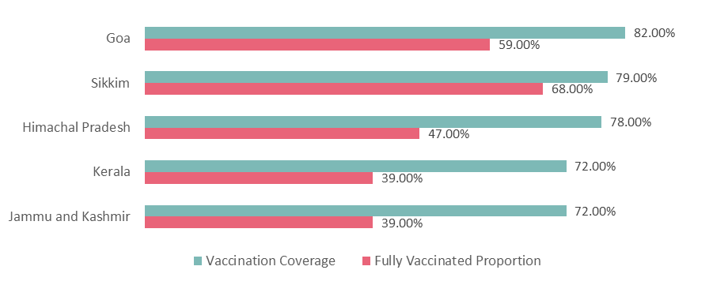
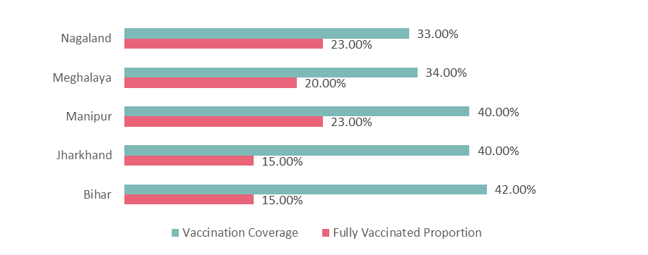
HIGHEST VACCINATION COVERAGE
A look at top 5 states
LEAST VACCINATION COVERAGE
A look at bottom 5 states

Slide 8
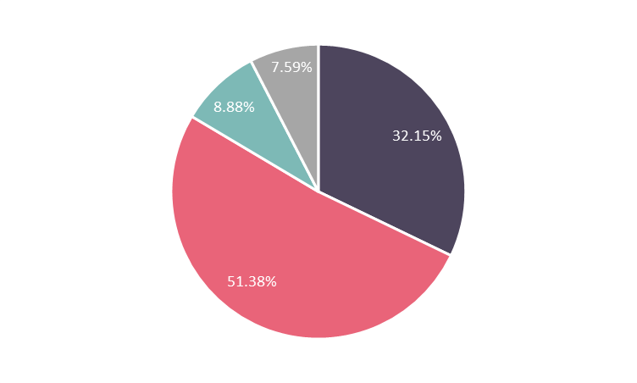




PERCENTAGE OF DEATH BY TESTING RATIO CATEGORY
Category A - >=0.05 & <=0.1
Category B - >0.1 & <=0.3
Category C - >0.3 & <=0.5
Category D - >0.5 & <=0.75

Slide 9
Maharashtra, Kerala, Tamil Nadu, Karnataka, and Uttar Pradesh were among the states most severely affected by the COVID-19 pandemic in India.
1
A month-wise analysis shows that in May 2021, there were high numbers of confirmed cases and deaths due to COVID-19 in India, with approximately 75 lakh confirmed cases and 1 lakh deaths reported.
2
Covid-19 Data Analysis
3
The case fatality rate for COVID-19 in India stands at 1% and the total positive rate for COVID-19 in India is 5%.
Insights
In states like Goa, Sikkim, Himachal Pradesh, Kerala, and Jammu & Kashmir, more than 70% of the population have received at least one dose of the COVID-19 vaccine.
4

Slide 10
However, in states such as Nagaland, Meghalaya, Manipur, Jharkhand, and Bihar, less than 50% of the population have received at least one dose of the COVID-19 vaccine.
5
Based on the data, it appears that a higher testing ratio is associated with a lower number of deaths from COVID-19 in different categories.
6
Covid-19 Data Analysis
Districts in category B have a significantly higher COVID-19 death rate (51.38%) compared to those in category D, which have the lowest rate (7.59%).
7
Insights
Mumbai, Thane, Bengaluru urban, Chennai, and Malappuram were among the districts most severely affected by the COVID-19 pandemic in India.
8

Slide 11
CHALLENGES FACED
Due to different team members having varying time availability, we faced challenges in managing our project timeline effectively. To overcome this, we created a flowchart of work and allocated tasks accordingly.
1
Time Management
2
Technical Challenge
We faced difficulty in extracting data from the JSON file and overcame it by referring to relevant articles and successfully extracting the required data.

Slide 12
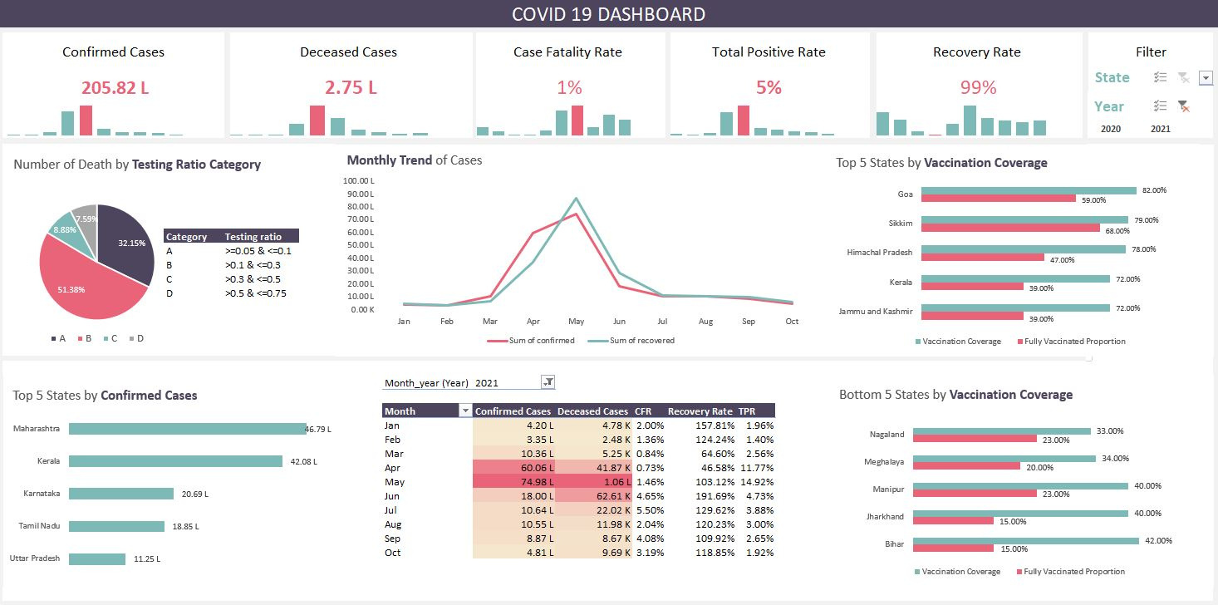

Slide 13

Any questions
Thank You

