Slide 1
Catering Reservation and Ordering System
Flavours Inn Caterers
By Keerthana.M
UNID: CRIN2301113

Slide 2
OBJECTIVES
The goal of this project is to establish a portal that will allow users to buy catering from the admin and change product information securely using a mobile device. Catering is given priority in order to allow them to develop their skills and promote our traditional Indian culture.
Catering is a website that allows counter developers to promote and sell their catering. Rural towns would be able to sell their commodities to the rest of the globe as a result of this.

Slide 3
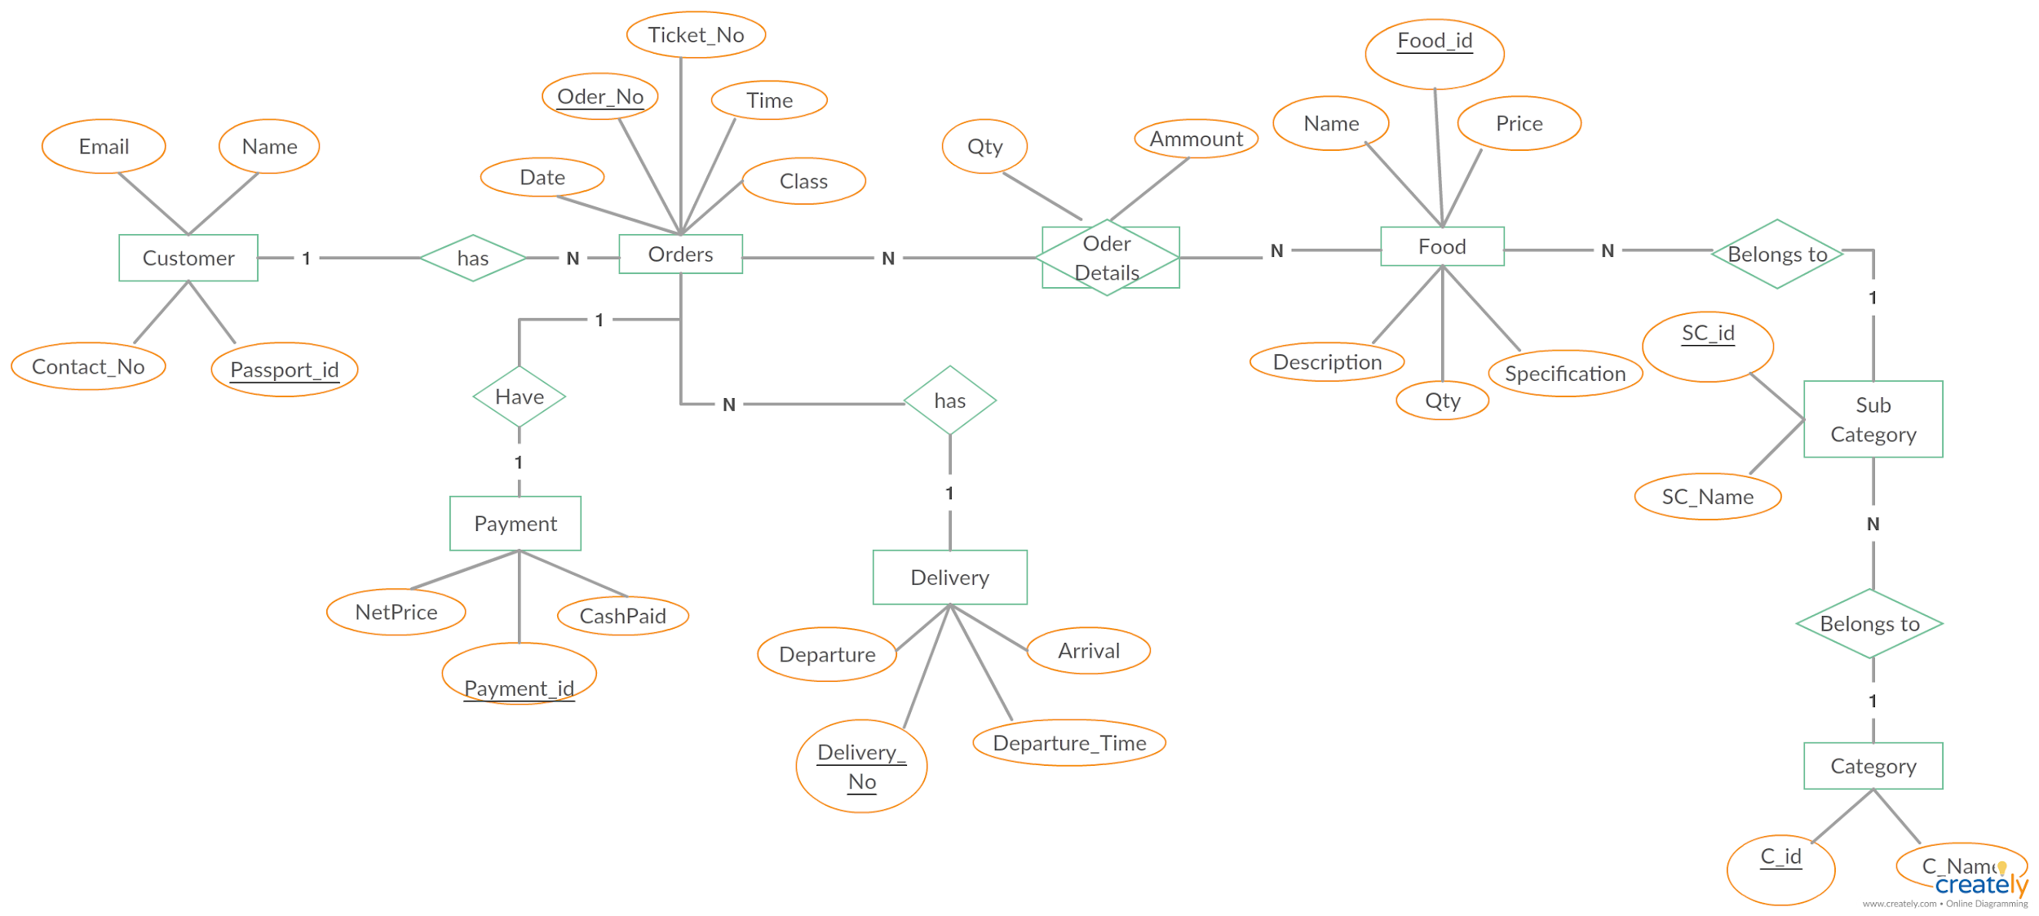
SYSTEM ARCHITECTURE

Slide 4
System Modules:
Admin
● Register and login
● View Product
● Add to cart
● My order
● Place order
● My profile
User
● Register and login
● Upload Product details
● View Order

Slide 5
TECHNOLOGIES USED
FRONTEND
HTML
CSS
JavaScript
BACKEND
Firebase

Slide 6
WEEKLY REPORT FIRST WEEK
RT FIRST WEEK
KLY REPORT FIRST WEEK
FIRST WEEK
Collect the information required for the software development.
Construct software design and optimize it.
Start the development process.
SECOND WEEK Implement the required HTML and create various HTML documents. Link each HTML document to each other. Optimize HTML document and construct structure of webpage.

Slide 7
THIRD WEEK
Implement CSS Code optimize the CSS by taking reference of other application.
FOURTH WEEK
Implement the JavaScript into the document to make webapp interactive. Optimize the JavaScript each time it is tested. Create a database and connect to the webapp. Firebase Realtime database used to store and retrieve Realtime data from the cloud. Test the whole system and troubleshoot maximum issues.

Slide 8
Features
Secure Login
Realtime Database management using firebase at backend
Menu/Dishes Categories
Menu Pricing List
System Information
Add to Cart
Wishlist
Admin Details/Credentials

Slide 9
Future scope
User interaction can be increased using a chatbot.
Payment System can be made more easier and fast,
My Orders section can be made more interactive.
Website can be made more dynamic using ajax and react js.
Drive Sales with Social Media Mobility and Ease Phone Orders Outstripped Home Deliveries Increased

Slide 10
CONCLUSION
In the "Online Food Ordering Project," every effort is made to meet all the demands of the restaurant. Because it is straightforward and adaptable, the project is successful. Any type of restaurant can utilize our software. By automating meal ordering,billing, and inventory control, the restaurant management system assists the restaurant manager in
managing the restaurant more successfully and efficiently.
The system handles the transaction and stores the data produced.

Slide 11
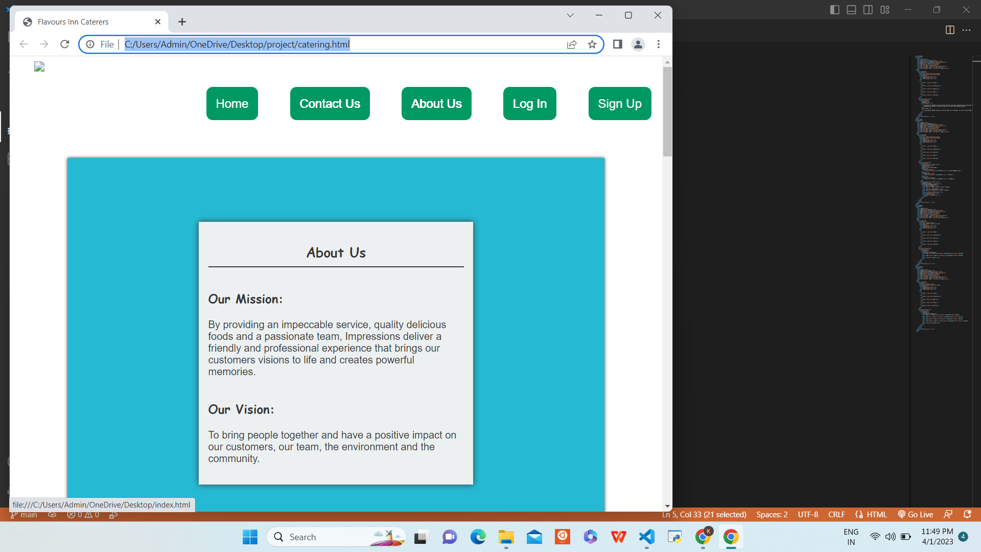
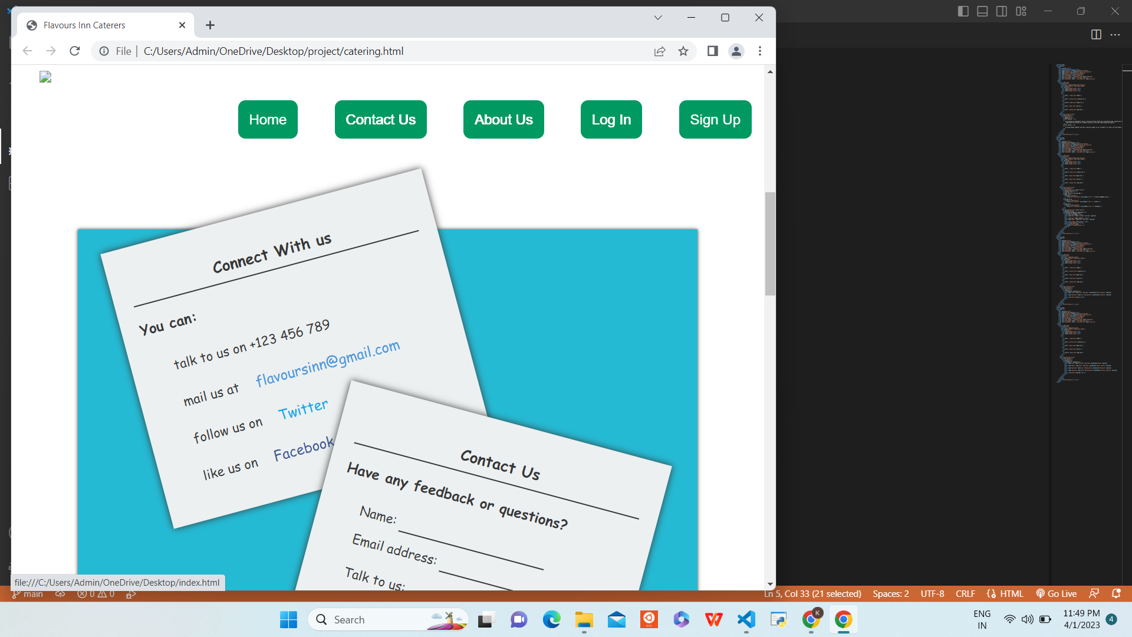
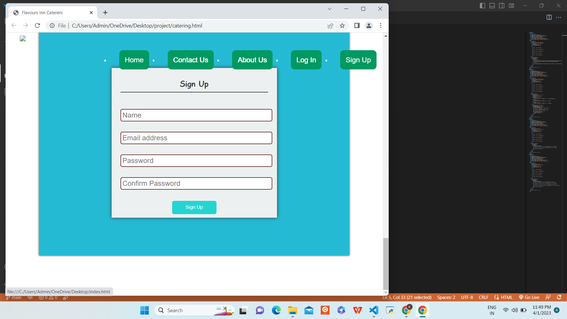
snapshot

Slide 12
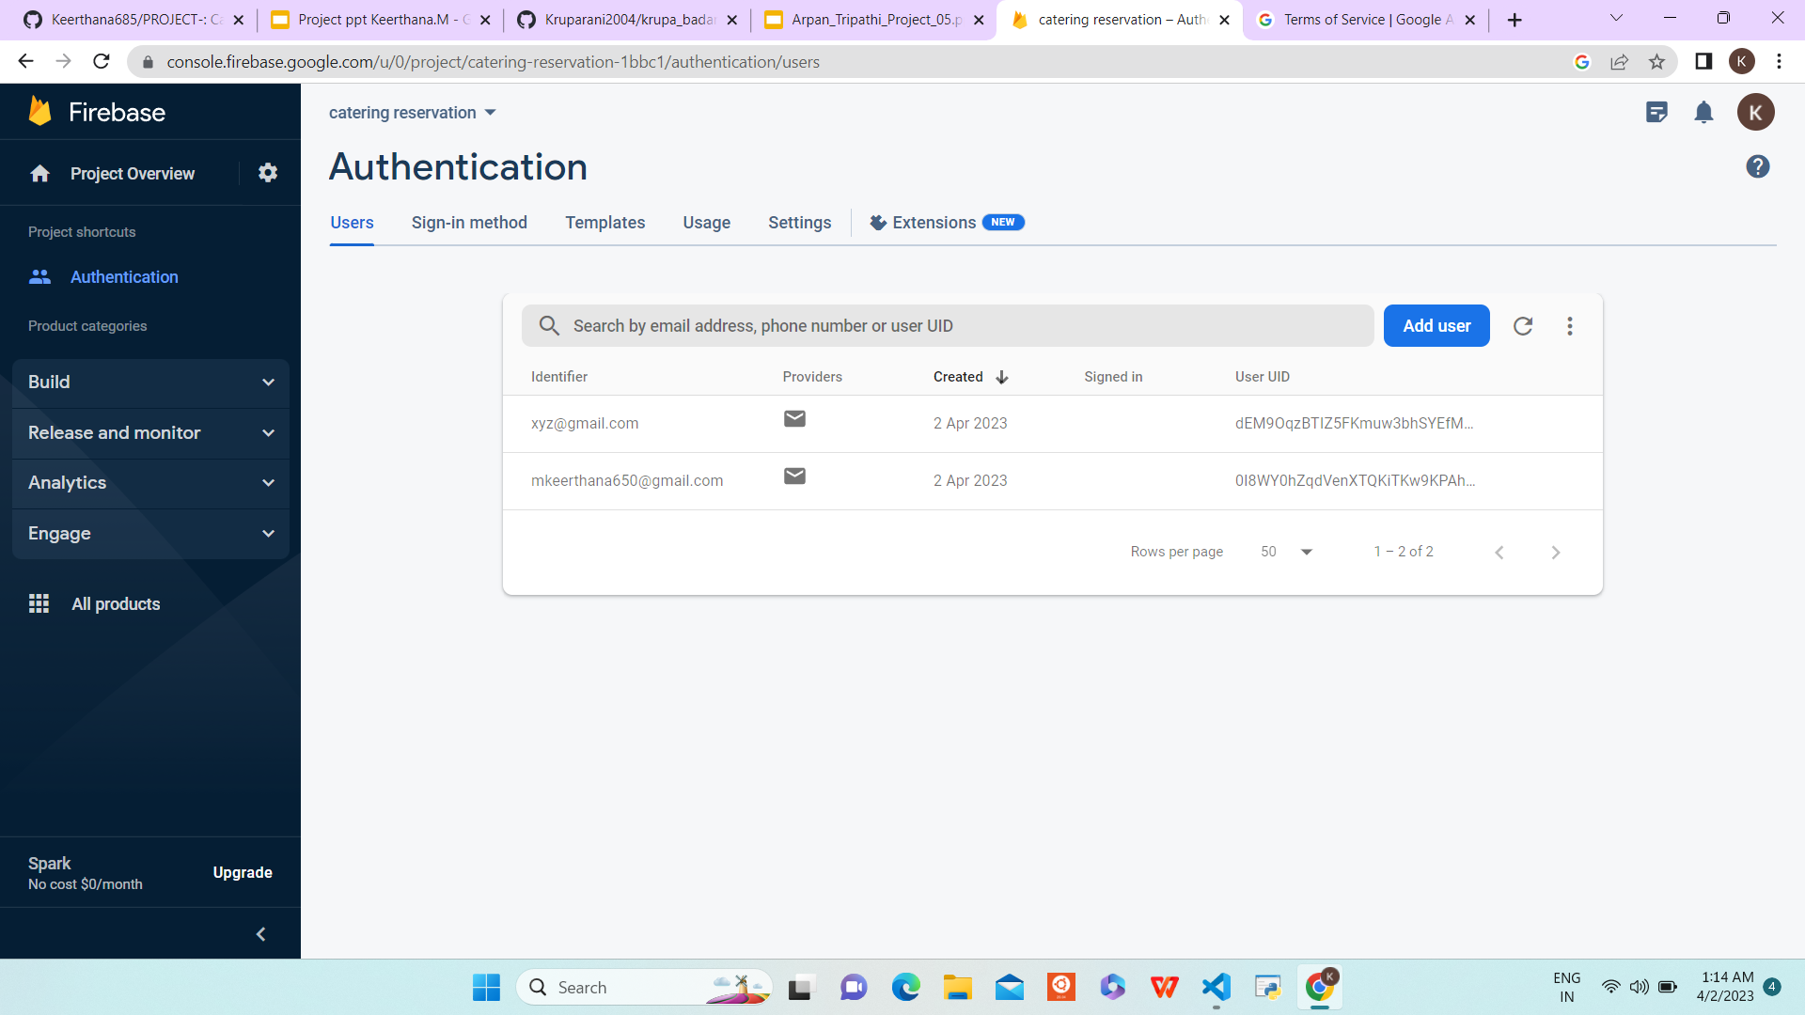
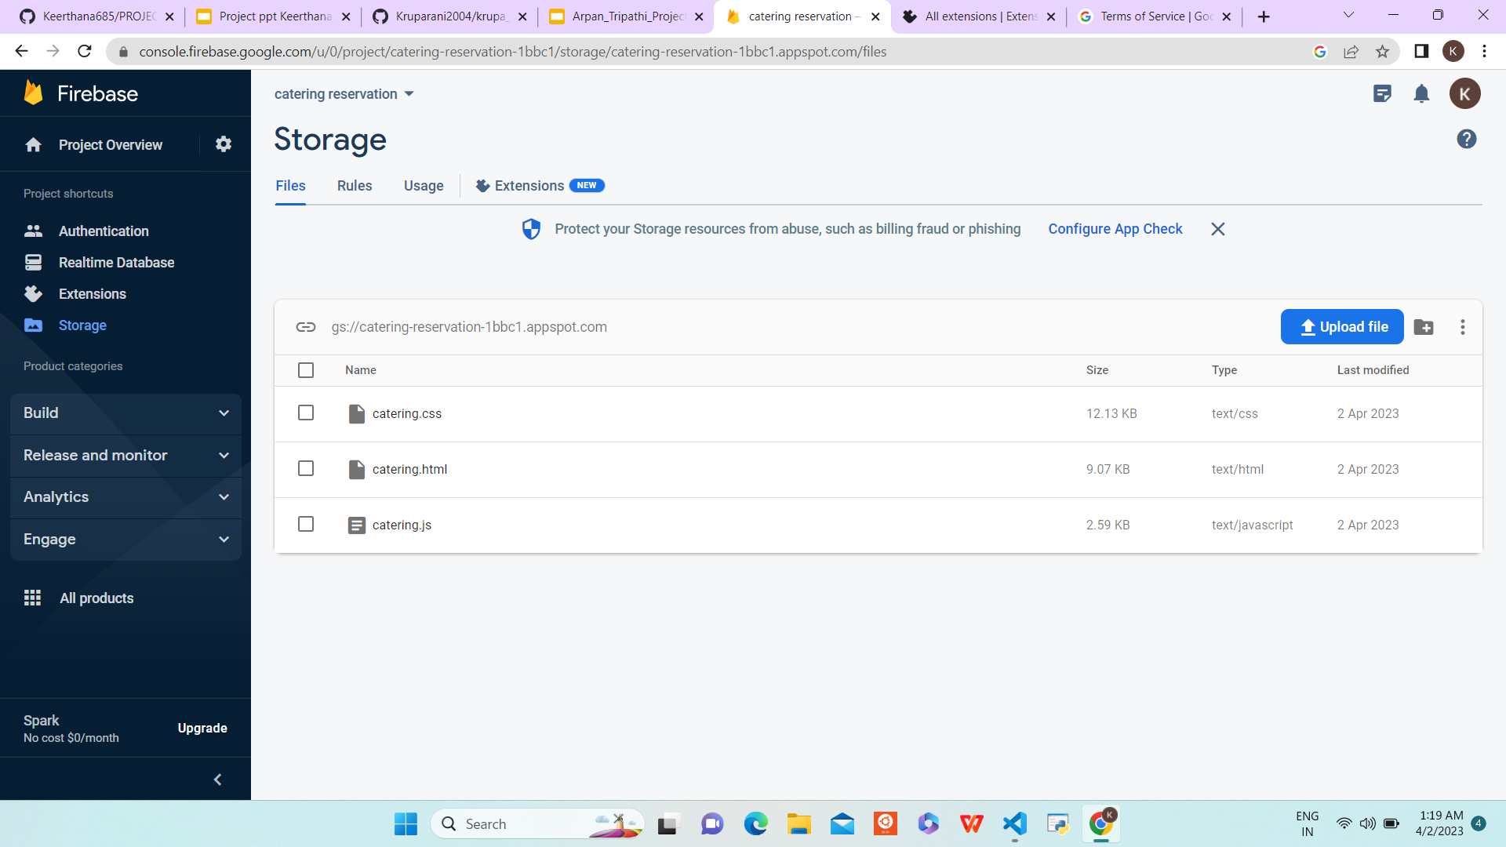
Using firebase

Slide 13
Services offered
Online Payment
Free Home Delivery
Available Offline also
Online booking
GITHUB LINK
https://github.com/Keerthana685/PROJECT-.git

