Slide 1
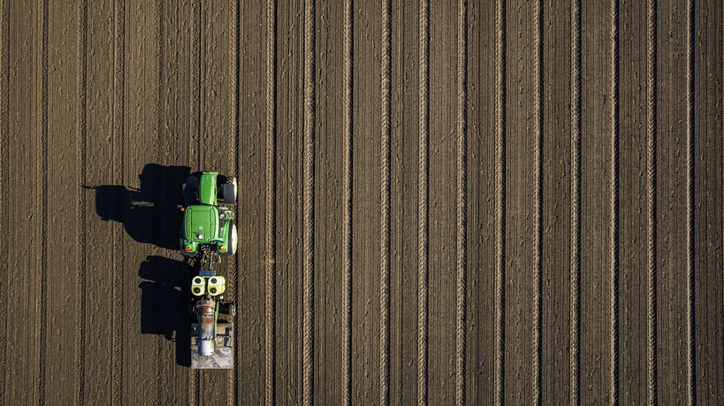
A B2B MODEL FOR AGRICULTURAL PRODUCTS

Slide 2
ABSTRACT
Agriculture is one of the biggest market in the world.
We are now only focusing on B2B model where B2B models are form of transactions between wholesaler and retailers
2 point channels
This model is built using modern MERN Stack technology
It provides direct connections with the end users
User friendly, Flexible and easily maintainable
This is purely B2B models not a supply chain management

Slide 3
INTRODUCTION
Agricultural logistics found it difficult to meet customer demands during the pandemic due to a global disruption in the flow of goods.
Now that B2B services for logistics have been developed, farmers can speak with shipping agents directly and market their products.
This also solves the storage issues for perishable crops. Farmers and wholesale customers are connected by B2B business models. Farmers can now keep the profit instead of having to sell their produce through middlemen, freeing them from that obligation.
Retailers and grocers can purchase products directly from producers using B2B websites.

Slide 4
BACKGROUND WORK
Agricultural market Before the pandemic
Agricultural market After the pandemic
This model focuses on B2B (Business to Business)
Role of agricultural technology
Evergreen market with the man power

Slide 5
EXISTING AND PROPOSED SYSTEM
EXSTING SYSTEM
PROPOSED SYSTEM
It follows traditional way of marketing
Lack of information about fast growing market in the world
It takes more man power than proposed system
There is always middleman
It does not helps to get outsiders like individual vendors
It follows latest way marketing with the emerging technologies
Simple and ease of use
No middle man
Farmers can have direct contact with the wholesalers or retailers
Background verification (KYC)
Quantitative and Qualitative analysis
It helps to reach individual vendors

Slide 6
REQUIREMENTS
FUNCTIONAL REQUIREMENTS
NON-FUNCTIONAL REQUIREMENTS
These are the requirements that the end user specifically demands as basic facilities that the system should offer.
These are represented or stated in the form of input to be given to the system, the operation performed and the output expected.
Examples : modules that are defined in the project
These are basically the quality constraints that the system must satisfy according to the project contract.
Examples :
Maintainability and Scalability
Performance
Reusability
Flexibility

Slide 7
TOOLS AND TECHNOLOGIES
FRONTEND
BACKEND
HTML AND CSS
BOOTSTRAP
EJS
REACTJS
NODEJS
EXPRESSJS
MONGODB
APIs
OTHER TOOLS : VSCODE , POSTMAN AND MONGODB COMPASS

Slide 8
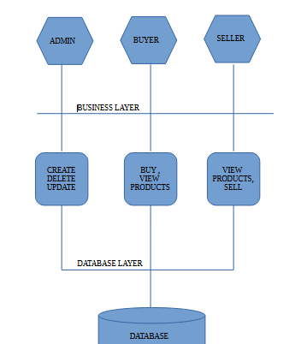
SYSTEM DESIGN
This system is only for B2B transactions. It does not includes end customers.
We have designed in a way such easy to use and we have re-used some modules that saved our time while designing.
This is a simple as you can see it gives clear idea about the system without using it.

Slide 9
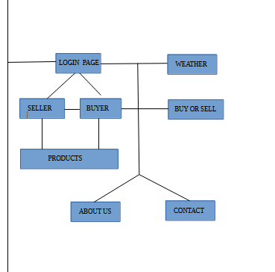
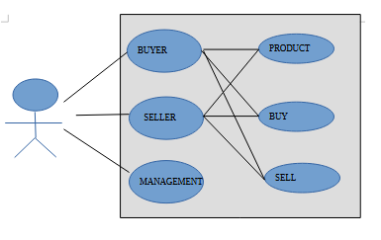
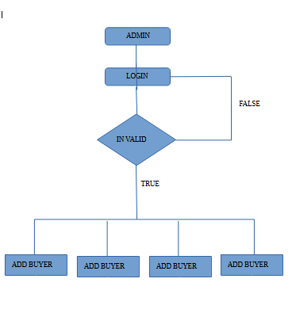

Slide 10
IMPLEMENTATION
Implementing a software project entails turning the conceptual design and specifications into a concrete and practical application.
The frontend and backend components are both developed during this process. Using a programming language like Python, Java, or Node.js, the architecture is realized on the backend by building a structured directory structure, database schema, and application logic.
Data communication is made easier by the design and implementation of APIs, while CRUD operations are made possible by database connections.
To guarantee secure access, user authentication and authorization mechanisms are integrated. A frontend library like React, Angular, or Vue.js is used in conjunction with HTML, CSS, and other frontend technologies to create interactive user interfaces on the front end.
State management tools are used to build and connect UI components to enable dynamic user experiences.

Slide 11
IMPLEMENTATION
Main Modules that are implemented are listed below :
Registration module
Login module
Home module
Products module
Buy module
Sell module
Weather module

Slide 12
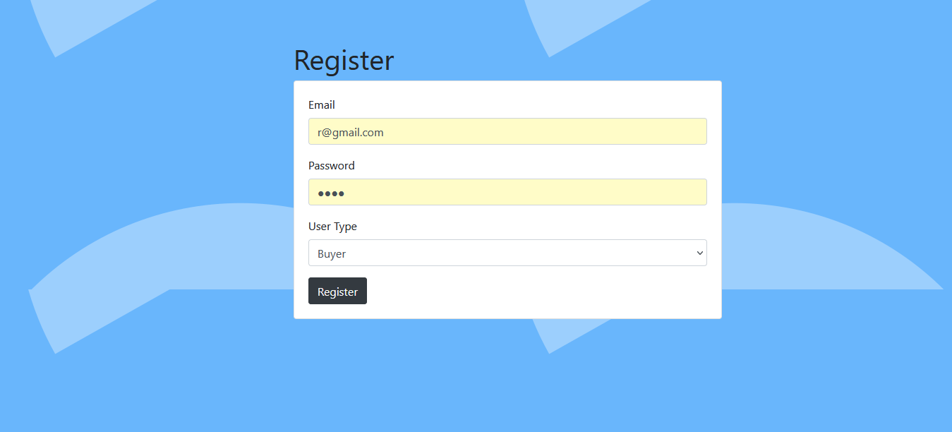
SCREENSHOTS AND WORKING

Slide 13
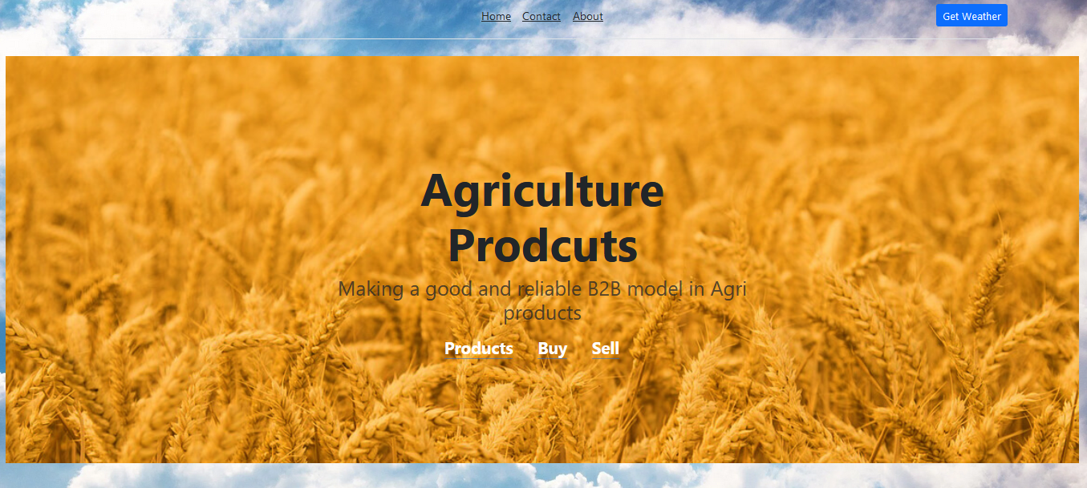
SCREENSHOTS AND WORKING

Slide 14
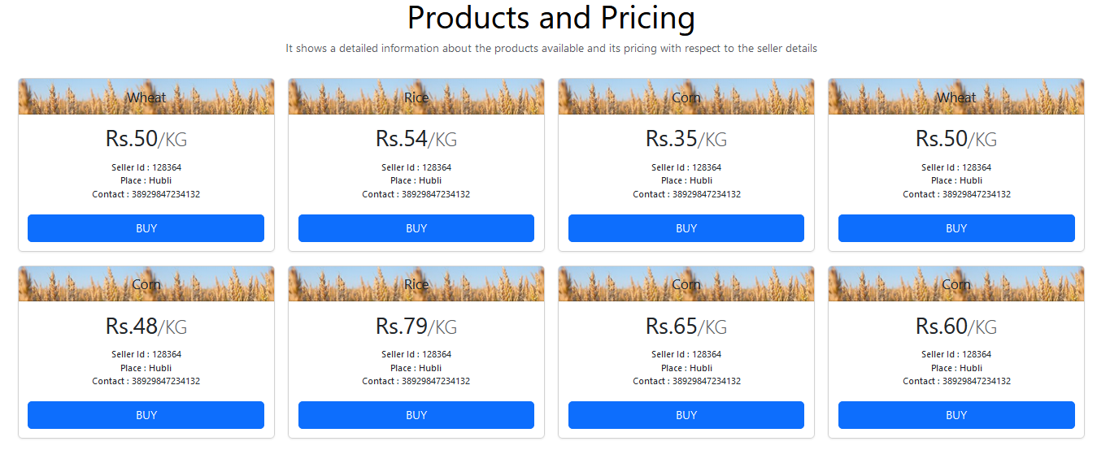
SCREENSHOTS AND WORKING

Slide 15
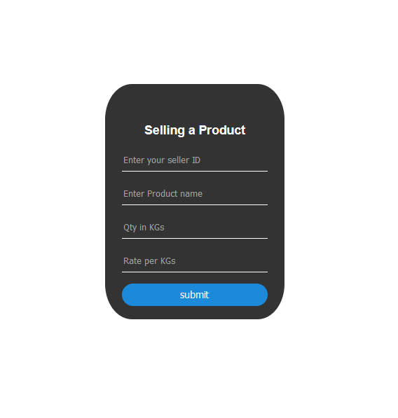
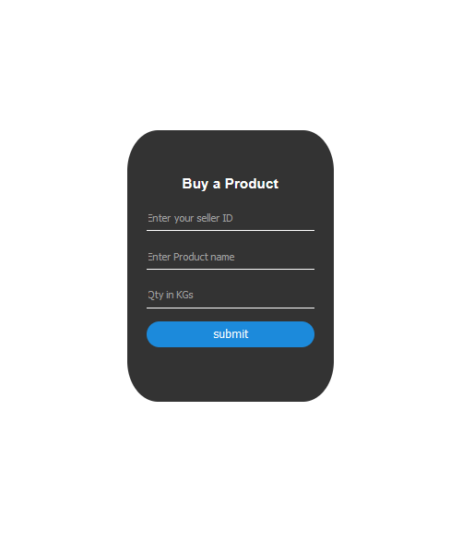
SCREENSHOTS AND WORKING

Slide 16
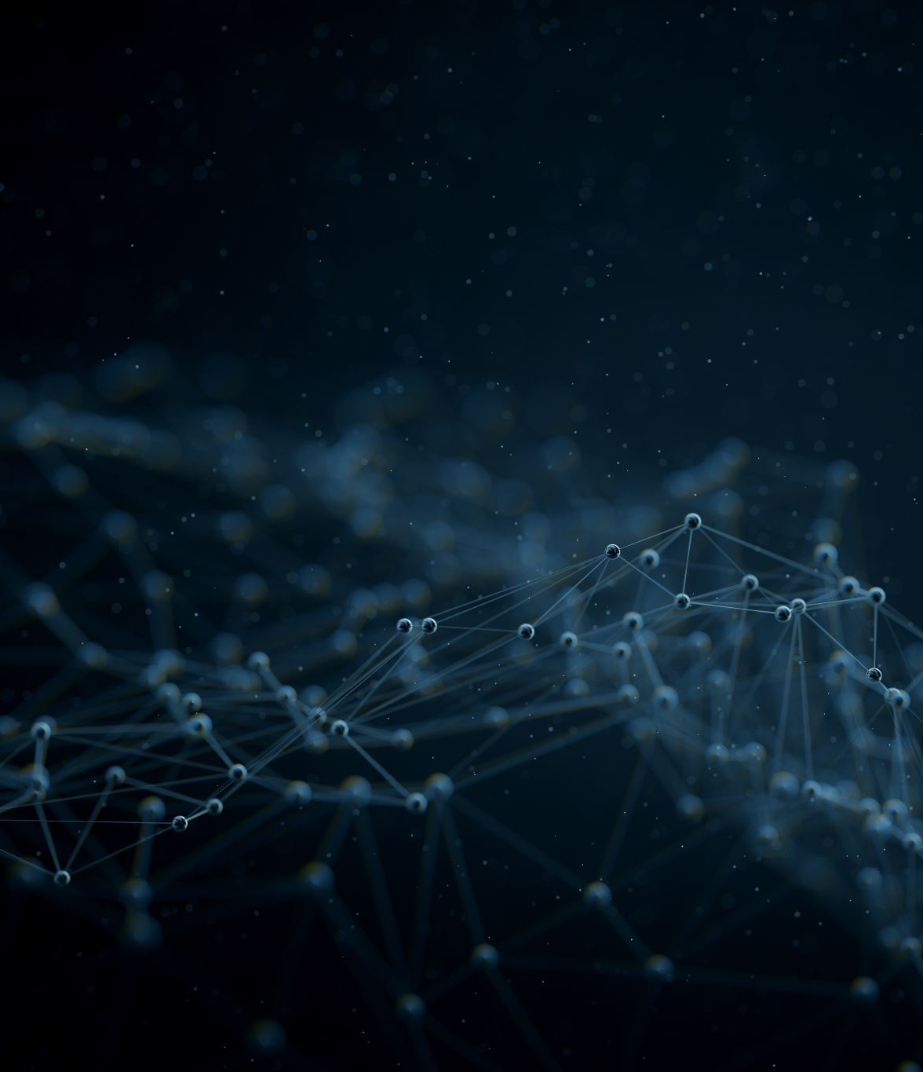
CONCLUSION
In conclusion, the "B2B model for agriculture products" project will offer a straightforward and user-friendly website.
By providing specialized tools, technologies, and solutions, B2B companies assist farmers and agribusinesses in increasing their productivity.
The collaborative nature of B2B transactions in the agriculture sector encourages cooperation, knowledge sharing, and continuous improvement.
We have created a straightforward and user-friendly website. It offers a wide variety of agricultural products, and users can buy or sell them with ease. The end user who are regular customers cannot use this B2B model.

Slide 17
FUTURE ENHANCEMENT
Z
There is a growing need to fully comprehend the adoption and application of AI to advance business-to-business (B2B) marketing as artificial intelligence (AI) gains popularity and transforms B2B marketing.
The four stages of the customer life cycle—reach, acquisition, conversion, and retention—are covered by this study's analysis of AI techniques and applications in B2B marketing.
Introducing some premium plans like Gold, Silver and Bronze
Where each plan differs in factors like quality and quantity in production, stock management and land
Then we make it more user attracted by going through UI/UX. Because this is market or area that technologies is not improved when compared to others areas.

