Slide 1

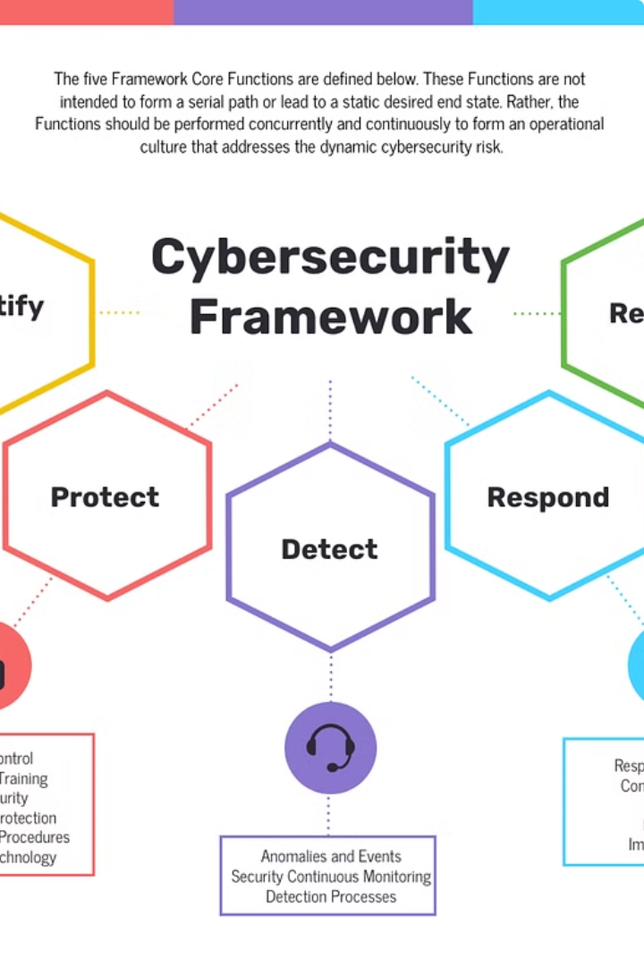
Keylogger Project: Risks and Mitigation Strategies
Enhancing cybersecurity awareness is crucial in today's digital landscape. This presentation delves into the risks posed by keyloggers and outlines strategies to mitigate these threats, empowering users to safeguard their sensitive information.
Presented BY
JAYA KEERTHANA ALAGANURU

Slide 2
Agenda
1
Introduction
2
Problem Statement
What are keyloggers and how do they work?
Exploring the threats and the lack of user awareness.
3
Project Overview
4
End Users
Developing a comprehensive detection and prevention solution.
Identifying the key stakeholders who benefit from the project.

Slide 3
Understanding Keyloggers
What are Keyloggers?
Types of Keyloggers
How Do They Work?
Keyloggers are a type of spyware that record every keystroke made by the user, potentially exposing sensitive data.
There are two main types: software keyloggers (more common) and hardware keyloggers (require physical access).
Keyloggers capture keyboard input and can transmit this information to the attacker, compromising user privacy and security.

Slide 4
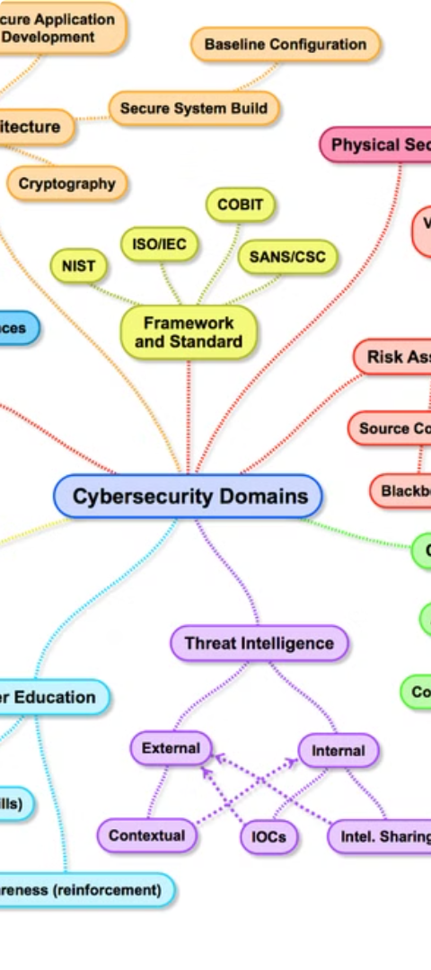
The Keylogger Threat
Risk Description
Lack of Awareness
Keyloggers can secretly record passwords, financial data, and other sensitive information, leading to identity theft and financial losses.
Many users are unaware of keyloggers and their potential impact, making them more vulnerable to these attacks.
Inadequate Security
Existing security solutions may not effectively detect and prevent sophisticated keylogger threats, leaving users exposed.

Slide 5

Introducing the Keylogger Project
1
Objective
Develop a comprehensive keylogger detection and prevention solution to enhance security and protect sensitive information.
2
Features
Advanced monitoring capabilities and proactive prevention measures to identify and mitigate keylogger threats.
3
Impact
Empower users, IT professionals, and businesses to safeguard their digital assets and maintain privacy.

Slide 6



Targeted Users
IT Security Professionals
Business Executives
Remote Employees
Need to safeguard sensitive company data and digital infrastructure.
Access company systems from personal devices, requiring enhanced protection.
Responsible for protecting organizational networks and devices.

Slide 7
Our Comprehensive Solution
Comprehensive Security
Enhanced Privacy
Customizable Settings
Identifies and prevents unauthorized access to sensitive information, ensuring digital privacy is protected.
Monitors all keyboard input to detect and alert users to potential keylogger threats in real-time.
Allows users to configure monitoring and alerting options to meet their specific needs and preferences.

Slide 8




The "Wow" Factor
Advanced Machine Learning
Proactive Detection
Unparalleled Protection
Employs techniques like deep learning and anomaly detection to identify threats before they can cause harm.
Utilizes cutting-edge algorithms to identify and neutralize evolving keylogger threats with seamless user experience.
Delivers unmatched security by going beyond traditional detection methods and staying ahead of the curve.

Slide 9

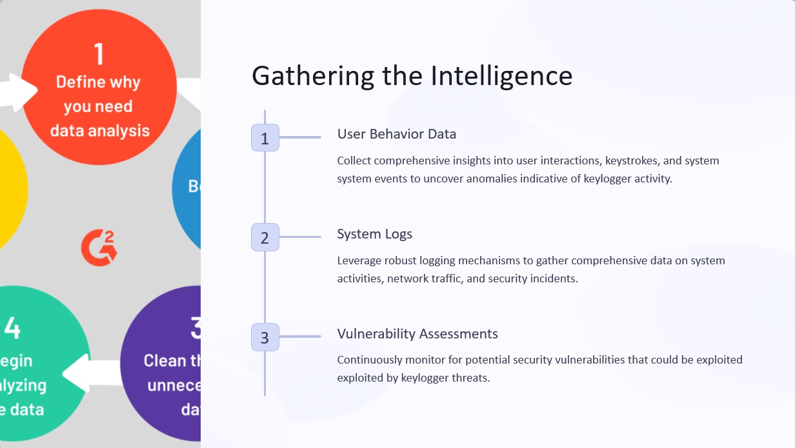

Slide 10
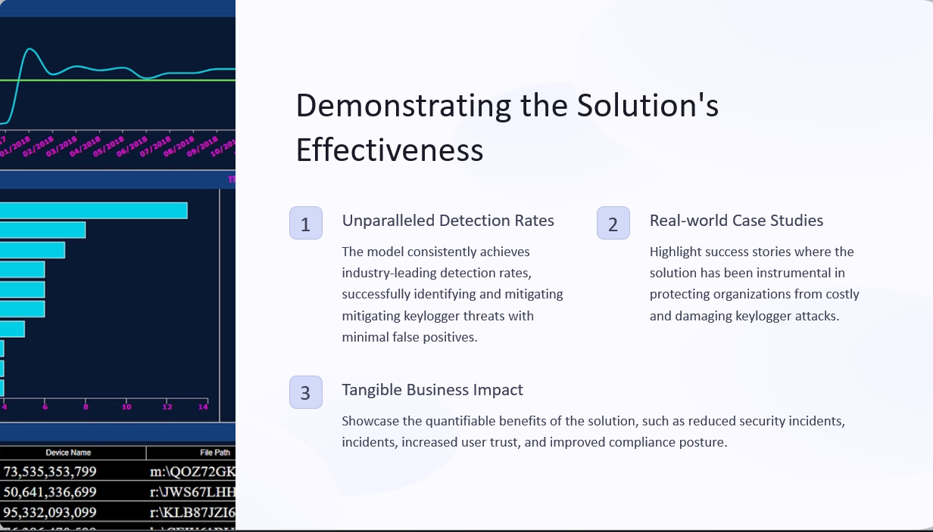

Slide 11
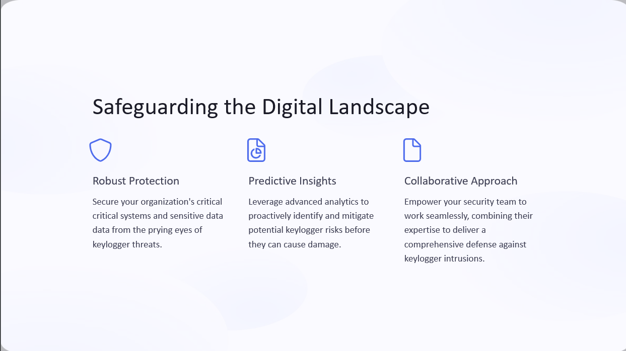

Slide 12
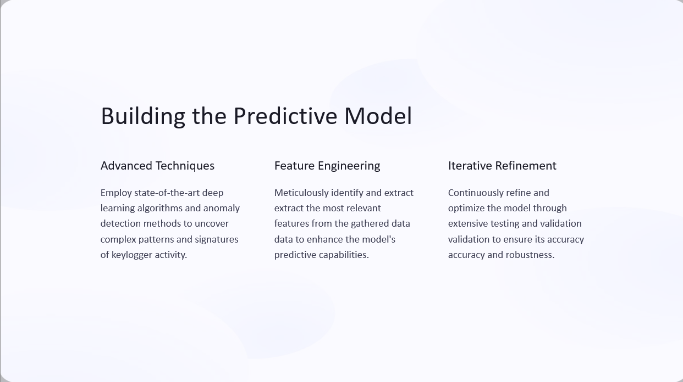

Slide 13
Conclusion
In today's digital landscape, the risks posed by keyloggers are ever-present. Our comprehensive solution empowers users, IT professionals, and businesses to safeguard their sensitive information and maintain digital privacy. By leveraging advanced technologies and proactive detection, we are committed to staying ahead of evolving threats and providing unparalleled protection.

Slide 14
PROJECT LINK :
https://github.com/KeerthanaAlaganuru/CS

Slide 15
THANK YOU

