Slide 1
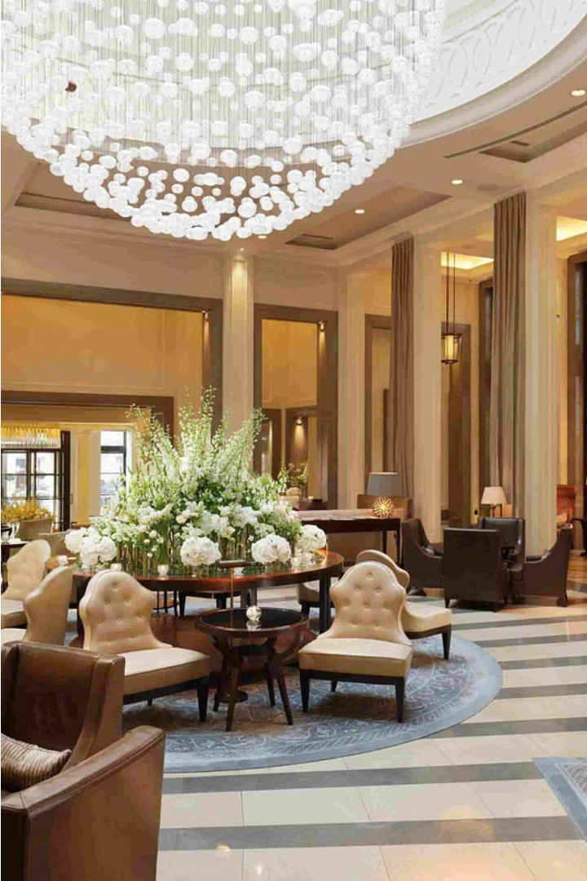
Hotel Reservation System
This presentation provides an overview of a Hotel Reservation System, showcasing its key features and functionalities to streamline the booking process for guests.
Presented By
JAYA KEERTHANA ALAGANURU
26/06/2024

Slide 2
Booking a Room
Room Selection
Guests can choose from a variety of room types, including single and double rooms, based on their preferences and needs.
Guest Details
Guests can input their name, contact information, and the number of days they wish to stay.
Reservation Confirmation
The system will confirm the booking and provide details such as the room number, reservation date, and total cost.

Slide 3
Reservation Management
1
View Reservation
Guests can view their existing reservations, including details like room number, guest name, and reservation date.
2
Cancel Reservation
Guests can easily cancel their reservation if needed, with the system updating the room's availability.
3
Cost of Stay
Guests can check the total cost of their stay based on the room type and number of days booked.

Slide 4
Room Management
Room Database
Room Availability
Room Updates
The system maintains a database of available rooms, including their type, number, and booking status.
The system tracks the availability of rooms, ensuring that guests can only book rooms that are not currently occupied.
The system allows hotel staff to update the status of rooms, such as marking them as booked or available.

Slide 5


Database Integration
SQL Database
Secure Connections
Data Integrity
The system utilizes a SQL database to store and manage all reservation and room information.
The system ensures secure connections to the database, protecting guest data and reservation details.
The system maintains data integrity by validating inputs and handling errors during database operations.

Slide 6
Error Handling
1
Input Validation
2
Exception Handling
3
User Feedback
The system validates user inputs, such as room numbers and guest details, to ensure data integrity.
The system provides clear and informative feedback to users, such as successful booking confirmations or error messages, to enhance the user experience.
The system includes robust exception handling to gracefully manage and report any errors that may occur during the reservation process.

Slide 7



Object-Oriented Design
Encapsulation
Inheritance
Polymorphism
The system utilizes the principles of encapsulation to hide the implementation details of room and reservation management.
The system employs inheritance to create different types of rooms, such as SingleRoom and DoubleRoom, with their own unique characteristics.
The system leverages polymorphism to handle different types of rooms and reservations through a unified interface.

Slide 8
Technologies Used
Java for application logic.
JDBC for database connectivity.
MySQL for data storage.

Slide 9
THANK YOU

