Slide 1

YOUTUBE ANALYTICS
Presented BY
Jaya Keerthana Alaganuru

Slide 2
ABSTRACT
In today's digital world, YouTube is a major platform for video content, greatly influencing how people interact online. For YouTube creators, marketers, and analysts, it's important to understand how well YouTube channels are performing to stay competitive.
The project aims to create a simple and easy-to-use analytics dashboard for YouTube channels.
The final product will be an interactive dashboard showing key metrics such as total views and engagement rates.

Slide 3
KEY POINTS..
Data Collection - Using YouTube API to gather information about a channel's performance.
Data Preprocessing - Cleaning and preparing the collected data to make sure it's accurate and reliable.
Exploratory Data Analysis - Finding useful patterns and trends in the channel's performance.
Interactive Dashboard - Creating an easy-to-use dashboard that shows important information clearly.
Metrics Tracking - Allowing users to keep track of important numbers like total views and engagement rates.
Actionable Insights - Giving advice and tips to help improve the channel’s content and overall success.

Slide 4
INTRODUCTION
In this project, we are exploring data from YouTube channels.
We use the YouTube API to gather information about different channels, like how many subscribers they have, how many views their videos get, and more.
By analyzing this data, we can learn interesting things about popular YouTube channels

Slide 5
CONT…
Importance of YouTube Data Analysis
Understanding Viewers:
Analyzing YouTube data helps us know how viewers watch and interact with videos. This includes how long they watch and which parts they like.
This helps video makers create content that viewers enjoy more.
Knowing What Works:
Looking at data tells us which videos are popular based on views, likes, and comments.
Creators can make more videos that their audience loves.
Seeing Growth:
Tracking numbers like subscriber count,views,likes over time shows how a channel is growing.
This helps in planning and setting goals for the future.

Slide 6
MOTIVATION
YouTube is one of the most popular platforms where people share videos. Many people want to understand which videos are popular and why. By studying YouTube data, we can find out what makes a video successful, which can help creators make better content and viewers find the best videos to watch.
To Understand:
Audience Engagement: Understanding metrics such as watch time, likes, comments, and shares provides insights into how viewers engage with content, which can guide improvements and foster stronger community interaction.

Slide 7
CONT..
Content Strategy: Detailed analytics can reveal which types of content resonate most with audiences, guiding creators to produce more of what works and experiment with new ideas.
Decision-Making: Data-driven insights enable creators to make informed decisions, reducing guesswork and enhancing the strategic planning process.
Goal Setting: Tracking progress against predefined goals (e.g., subscriber growth, view counts) helps creators stay focused and motivated.

Slide 8
LITERATURE
Understanding YouTube
YouTube's Popularity: Over 2 billion monthly users since its launch in 2005.
Content Variety: Includes vlogs, educational videos, live streams (Burgess & Green, 2018)
Importance of Data Analysis
User Behavior & Content Performance: Factors like titles, thumbnails, views, likes, and comments influence video popularity (Arthurs et al., 2018).
YouTube API
Data Extraction: Allows collection of large datasets for analysis (YouTube Data API, 2021).
Research Applications: Sentiment analysis in comments (Thelwall et al., 2012), metadata impact on views (Zhou et al., 2016).

Slide 9
CONT..
Data Preprocessing
Ensuring Data Quality: Handling missing values and correcting formats for accurate analysis (Chatzopoulou et al., 2010).
Exploratory Data Analysis (EDA)
Summarizing Data: Using graphs to identify patterns and trends (Tukey, 1977).
YouTube Insights: Trends in views, likes, and comments aid content strategy (Khan, 2017).
Visualization and Dashboards
Interactive Dashboards: Tools like Looker Studio for visualizing key metrics (Few, 2006).

Slide 10
CONT..
Case Studies
Educational Impact: Enhances student engagement (Snelson, 2011).
Influencer Marketing: YouTube personalities affect brand perception (Freberg et al., 2011).
REFERENCES
YouTube Data API (2021). Retrieved from
https://developers.google.com/youtube/v3

Slide 11
CONTRIBUTION
1. Understand Dynamics: We can analyze the dynamics of YouTube videos and channels.
2. Identify Popular Channels: It will provide insights into the most popular channels.
3. Content Analysis: We can determine which content types get the most views.
4. Trend Analysis: We can track how video statistics change over time.
5. Benefit to the Creators: It offers valuable insights for content creators.
6. Aid Marketers: It help marketers optimize their strategies.

Slide 12
MODULE-1 : API INTEGRATION
CONCEPT :
API stands for Application Programming Interface.
It allows different software applications to communicate with each other.
In this project, we use the YouTube API to get data about YouTube channels.

Slide 13
EXPLANATION :
You Make a Request :
Just like you tell the waiter what dish you want, you send a request to the YouTube API asking for specific information. For example, you might ask for the number of views on a particular video.
API Processes Your Request :
The YouTube API, like a waiter, takes your request and goes to the kitchen (the YouTube database) to get the information you asked for.
You Receive Data :
The waiter brings your food to your table. Similarly, the API sends the requested data back to you. This data could include information like video titles, view counts, comments, likes, and more.

Slide 14
MODULE-2 : DATA PROCESSING & CLEANING
CONCEPT:
Before we can analyze the data, we need to make sure it is clean and in the right format. This process is called data preprocessing and cleaning.
EXPLANATION:
In our YouTube Analytics project, we extract data from the YouTube API, which may come with issues like missing values, incorrect data types, or inconsistencies.
Data preprocessing involves handling these issues to ensure the data is ready for analysis. For example, we might convert string numbers to integers, fill in missing values, or ensure date formats are consistent.

Slide 15
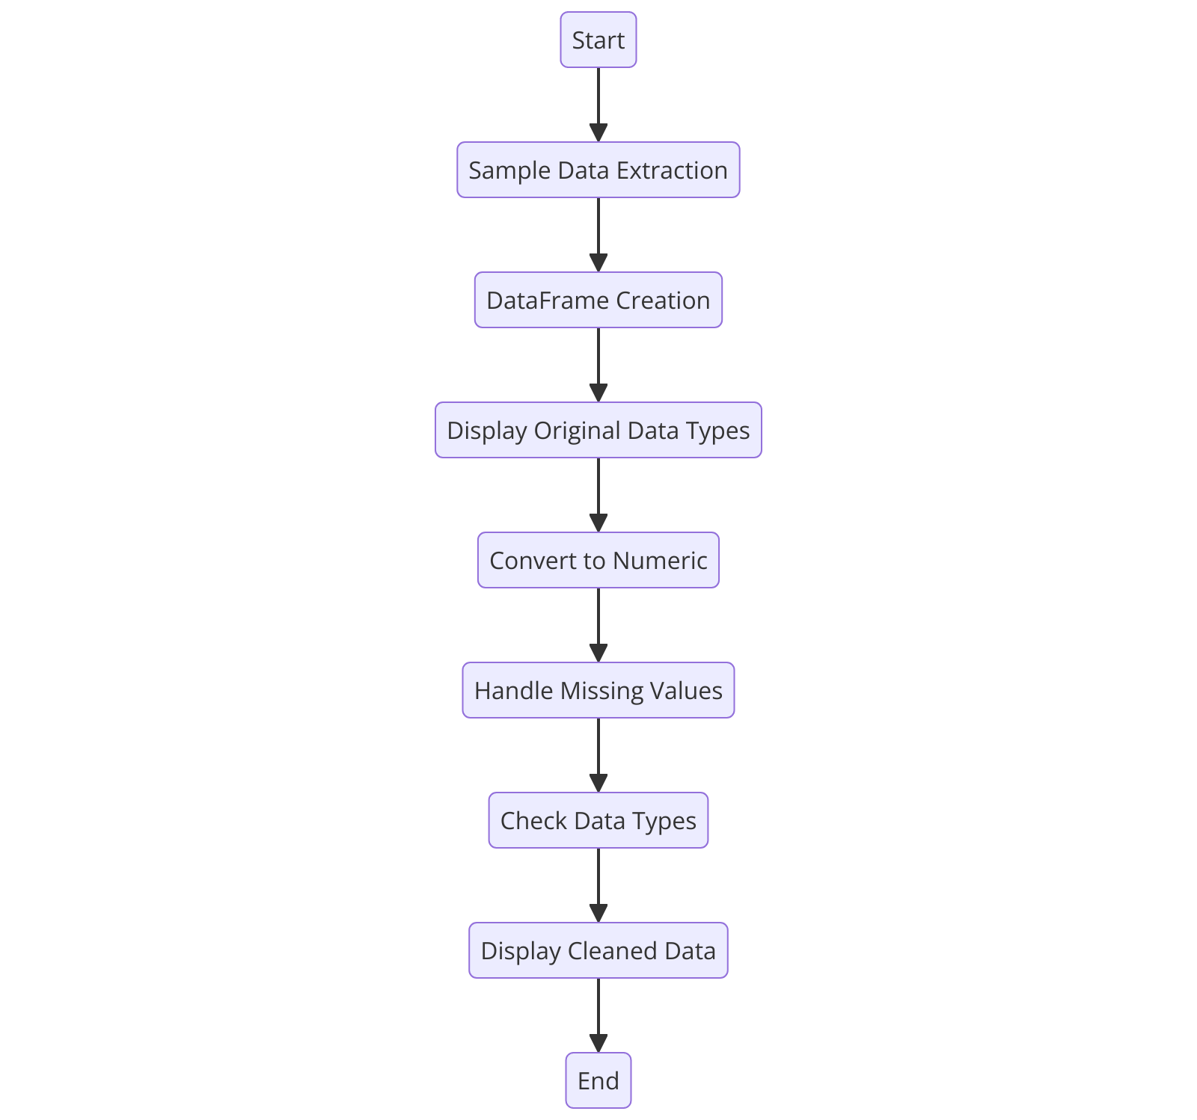
HOW THIS WILL WORKS??...

Slide 16
MODULE – 3 : EXPLORATORY DATA ANALYSIS
CONCEPT:
EDA is the process of exploring the data to understand its main characteristics. We use visual methods to see patterns and trends in the data.
EXPLANATION:
In our YouTube Analytics project, EDA involves taking a closer look at the data we have collected from the YouTube API. This helps us understand which channels have the most subscribers, which videos have the most views, and other important patterns. We use graphs and charts to make these insights easy to see and understand

Slide 17
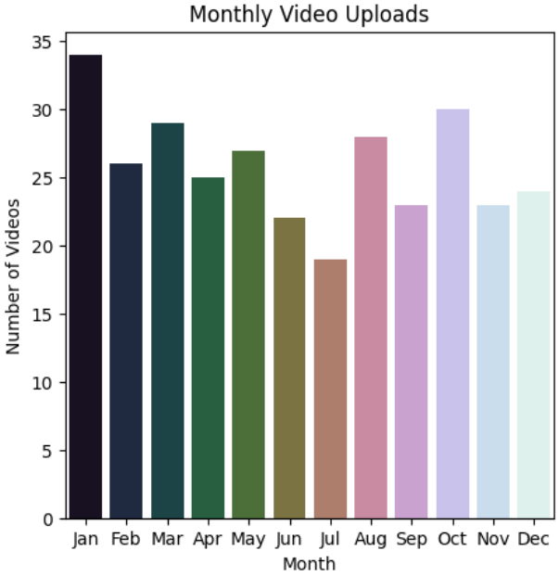
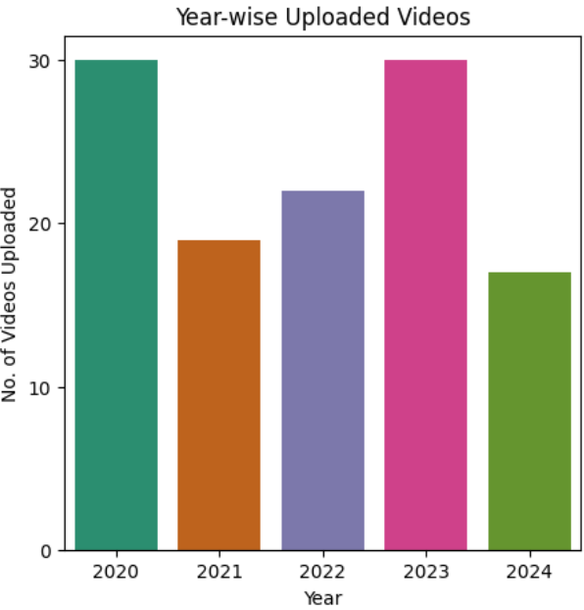
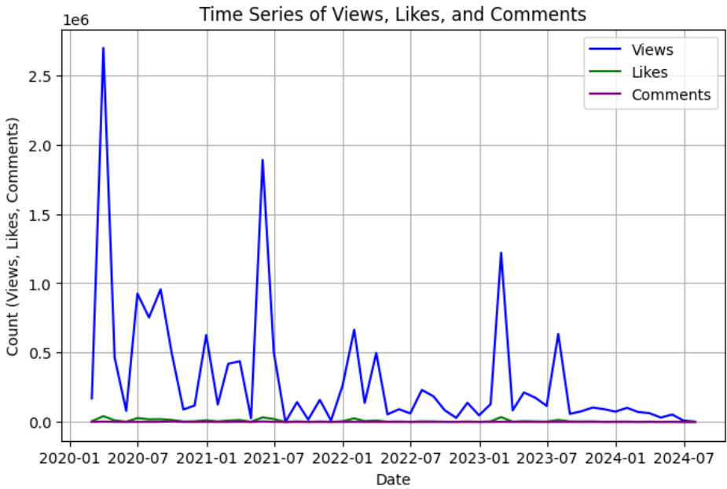
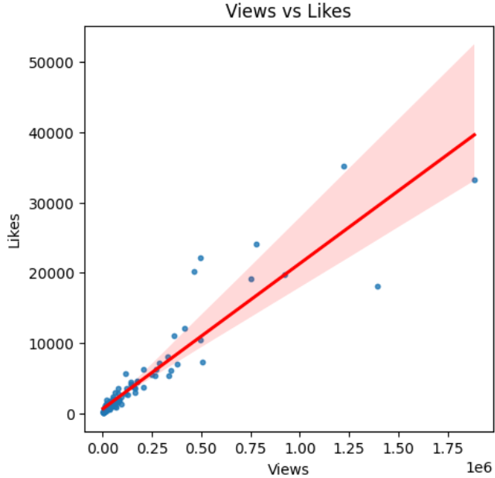
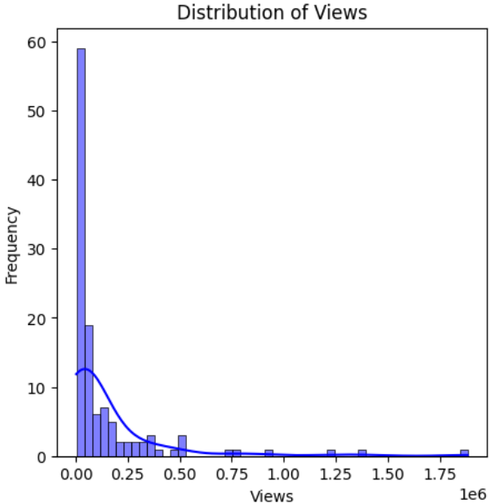
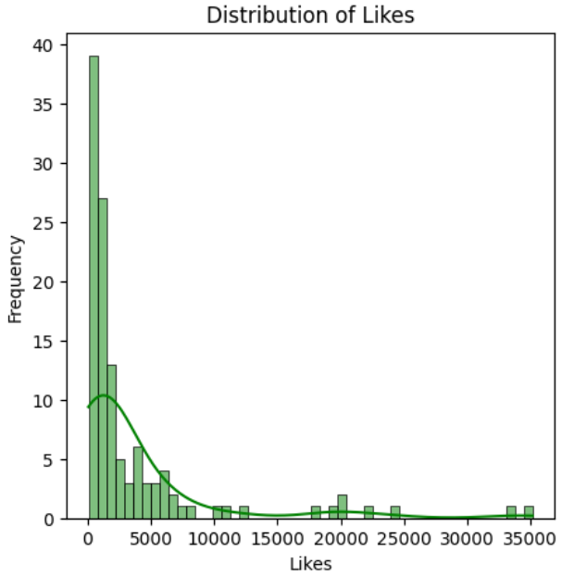
Visualisations from EDA

Slide 18
MODULE-4 : DASHBOARD CREATION
Used Looker Studio to create a dashboard that displays all the important information in one place.
The dashboard includes : Scorecards for total views, total videos, total likes, and total comments.
A table showing video titles along with their views and likes.
Line charts to track video performance over time.
A chart showing the top 15 videos by views.
A time series chart for videos uploaded over the years.
A pie chart for videos uploaded over different months.
A scatter chart showing the relationship between views, likes, and comments.

Slide 19
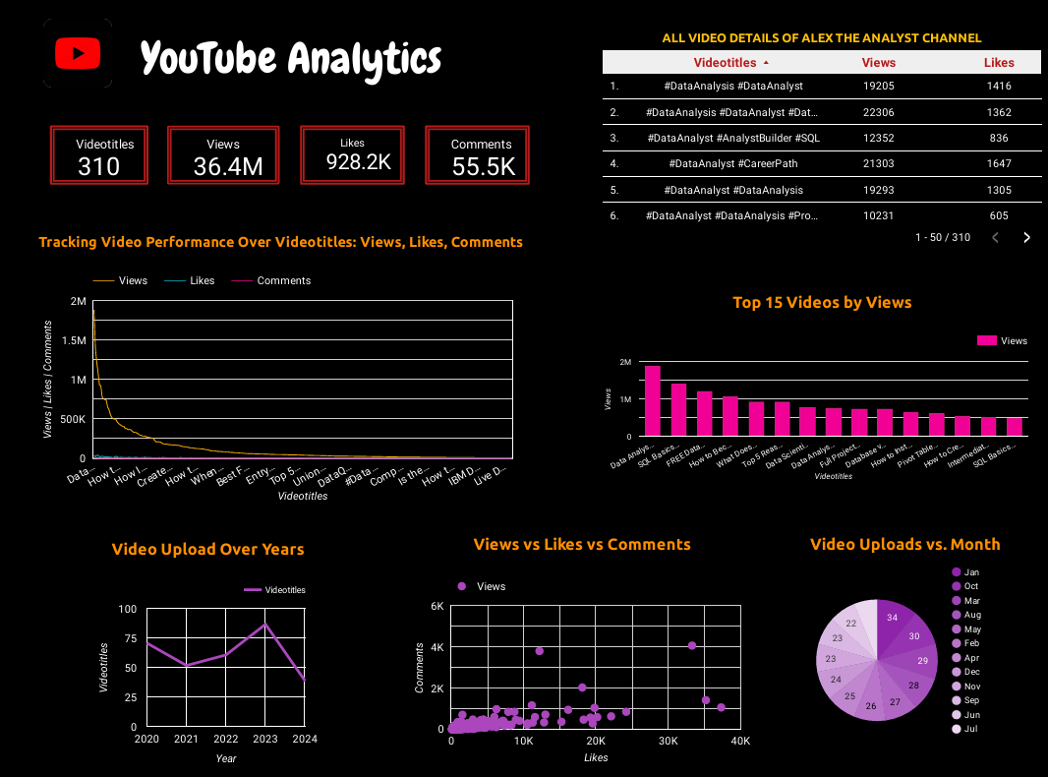
YouTube Content Analysis Dashboard

Slide 20
CONCLUSION
In this YouTube Analytics project,I successfully used the YouTube API to extract data from various YouTube channels, cleaned and preprocessed the data to ensure its quality, and conducted Exploratory Data Analysis (EDA) to uncover patterns and trends.
This analysis provided valuable insights into channel performance, such as subscriber counts, view counts, and video production rates. By visualizing this data with graphs and charts, we were able to easily interpret and communicate these findings.

Slide 21
FUTURE ENHANCEMENTS
Sentiment Analysis:
Analyze viewer comments for sentiment using NLP techniques.
Time-Series Analysis:
Track channel growth and engagement over time.
Identify seasonal trends and the impact of events on viewership.
Advanced Machine Learning:
Predict future trends in views, likes, and subscribers.
Cluster viewers based on engagement patterns.
Competitive Analysis:
Compare performance of similar channels.
Analyze niche-specific performance metrics.
Real-Time Dashboards:
Develop dynamic dashboards with tools like Looker Studio or Tableau.
Enable continuous monitoring and instant insights.
Monetization Insights:
Explore the relationship between views, ad revenue, and monetization strategies.
Analyze the impact of different content types on earnings

Slide 22
REFERENCES
YouTube Data API (2021)
Retrieved from https://developers.google.com/youtube/v3
Provides documentation and details about the YouTube API used for data extraction.
YouTube (2021). YouTube for Press.
Retrieved from https://www.youtube.com/intl/en-GB/about/press/
Offers official statistics and information about YouTube's user base and content variety.

Slide 23

THANK YOU

