Slide 1
CASE STUDY - LEADSCORING
GROUP MEMBERS
G KEERTHANA
RAKESH SINGH
Data source files:
Leads Data Dictionary.csv
Leads.csv

Slide 2
Problem statement
X Education sells online courses to industry professionals.
The typical lead conversion rate at X education is around 30% which is very poor. the company wishes to identify ‘Hot Leads’.
The company requires to build a model wherein we need to assign a lead score to each of the leads such that the customers with higher lead score have a higher conversion chance and the customers with lower lead score have a lower conversion chance.
The CEO, in particular, has given a ballpark of the target lead conversion rate to be around 80%.

Slide 3
Analysis approach
To increase the Lead conversion rate from 30% to around 80%, Machine learning model has to be built based on the previous data available in the company which helps predict the conversion of the customer with the accuracy required.
As this is a classification problem, a Logistic Regression model has to be built with the response variable as Conversion and others as feature variables.

Slide 4
Solution Methodology
Understanding of the data.
Data Cleaning:
1. Check and handle duplicate data.
2. Drop columns that: a) does not help much towards the analysis
b) If it contains large number of missing values.
3. Drop features that are updated by the sales team in the data as the model building is based on the data collected
from the student online.
4. Check and handle NA and missing values.
5. Check and handle outliers in the data.
Splitting the data to Test and Train
Model Building: logistic regression used for building the model and RFE technique is used for feature reduction.
Prediction on train and test data
Validation of the model- Confusion matrix , area under ROC curve
Drawing conclusions and recommendations.

Slide 5
Data Cleaning
Total Number of Rows =37, Total Number of Columns =9240.
Column lead Number has been dropped as it does not help in building the model.
As the model building should be based on data collected from the customers online, we can drop features that are updated by the Sales team such as :
“Last activity”, “Last notable activity”, “Lead profile”, “Tags”, “Lead quality”, “Asymmetrique Activity Index”, “Asymmetrique Profile Index”, “Asymmetrique Activity Score” and “Asymmetrique Profile Score”.
We observed that the percentage of missing values in few features is above the threshold level of 40 percent which has been dropped such as:
“How did you hear about X Education”, “Lead Profile”
Features with above 99% data imbalance have been dropped such as:
“Do Not Call”, “Receive More updates About Our Courses”, “Update me on Supply Chain Content”, “Get updates on DM Content” and “I agree to pay the amount through cheque”.
Imputed missing values with median and mode however relevant and treated the outliers by dropping the outliers.

Slide 6
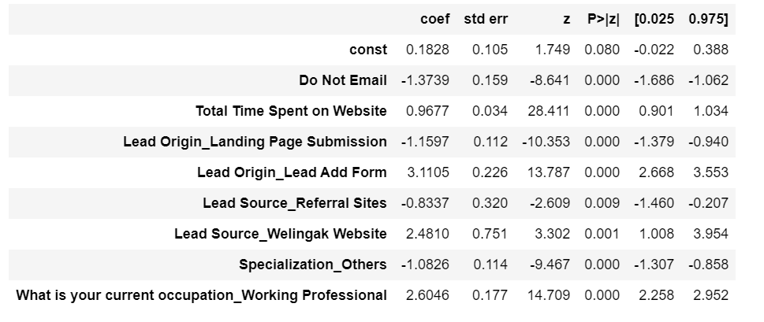
Logistic regression Model results
From the given 35 feature variables in the data, using Logistic Regression techniques, 8 feature variables have been identified to have a greater impact on predicting the conversion of the customer. The 8 features along with their coefficients are listed below:

Slide 7
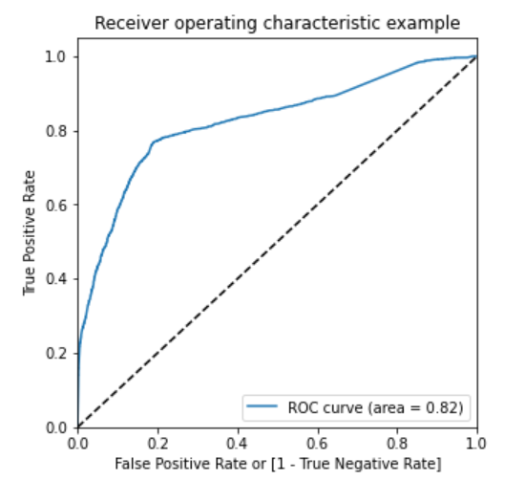
Model evaluation metrics
On model built we predicted the probability on train data and considered 0.3 as a cut off. Implies if the probability is greater than 0.3 it will be considered as 1 (one, lead) and less than 0.3 is considered as 0 ( no lead).
Additionally, based on above calculation the confusion matrix was built and sensitivity of the model was checked, which is around 77.4%
ROC CURVE: On plotting the ROC Curve, the area under the curve is 0.82 which is considered a satisfactory value

Slide 8
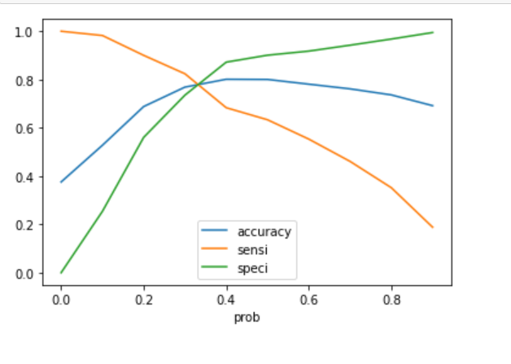
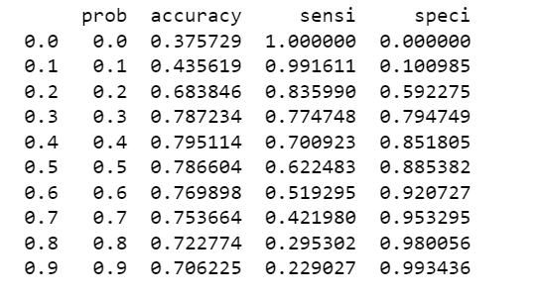
Model evaluation metrics
Post which we calculate the accuracy sensitivity and specificity for various probability cutoffs and try to plot accuracy sensitivity and specificity for various probabilities and observe the curves meet between 0.2 - 0.4. This implies our initial assumption of 0.3 cut off is right as it is the optimum point to take it as a cutoff probability
Sensitivity and Specificity for Reference

Slide 9
predictions on the test set
Logistic Regression Model Build:
Target Variable = 0.1828-1.3739(Do Not Email)+0.9677(Total Time Spent on Website)-1.1597(Lead Origin_Landing Page Submission)+3.1105(Lead Origin_Lead Add Form)-0.8337(Lead Source_Referral Sites)+2.4810(Lead Source_Welingak Website)-1.0826(Specialization_Others)+2.6046(What is your current occupation_Working Professional)
We try to predict the test values based on the above model and we get accuracy of 0.79 and sensitivity of 0.80

Slide 10
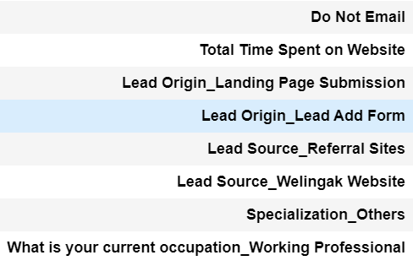
Conclusion
The important features came from the Model are:
The lead conversion rate achieved is around 80.6% as the accuracy on the test data is 80.6%

