Slide 1
EMPLOYEE BURNOUT ANALYSIS
CAPSTONE PROJECT
Presented By:
JELLA KEERTHANA ,MALLA REDDY COLLEGE OF ENGINEERING FOR WOMEN ,CSE(BTECH)

Slide 2
OUTLINE
Problem Statement
System Development Approach
Algorithm & Deployment
Result
Conclusion
Future Scope
References

Slide 3
Problem Statement
Employee burnout is a serious issue that hurts productivity and well-being at work.
This project aims to find and understand the main reasons for burnout by looking at factors like resource use, mental tiredness scores, company type, and the availability of work-from-home options.
By studying these factors, we hope to learn more about what causes burnout.
The insights from this project can help us think about ways to reduce burnout in the future.

Slide 4
System Approach
System requirements
Hardware:
Minimum 8GB RAM
Multi-core Processor
Sufficient storage for data files
Software:
Operating System: Windows/Linux/MacOS
Data Analysis Tools: Google Colab, Jupyter Notebook
Data Visualization: Power BI, Tableau
Python Environment
Library required to build the model
Pandas: For data manipulation and analysis.
Matplotlib: For creating various types of plots and charts.
Seaborn: For making attractive and informative statistical graphics.
NumPy: For numerical computing and handling arrays.
Scikit-learn: For machine learning tasks:
train_test_split: Splits data into training and testing sets.
StandardScaler: Standardizes features.
LinearRegression: Implements linear regression.
mean_squared_error, r2_score, mean_absolute_error: Evaluates regression models.

Slide 5
Algorithm & Deployment
Data Collection:
Gather data on resource use, mental fatigue, company type, and work-from-home availability.
Data Preprocessing:
Handle missing values and remove duplicates.
Convert categorical variables to numerical values.
Exploratory Data Analysis (EDA):
Identify patterns and correlations.
Visualize data with histograms, scatter plots, and heatmaps.
Data Modeling:
Split data into training and testing sets.
Standardize features using StandardScaler.
Model Development:
Choose and train models (e.g., Linear Regression).
Model Evaluation:
Evaluate performance with MSE, MAE, and R2.
Results Interpretation:
Analyze model outputs to find key burnout factors.
Draw conclusions from the analysis.
Visualization:
Present results with bar graphs, pie charts, and line charts.

Slide 6
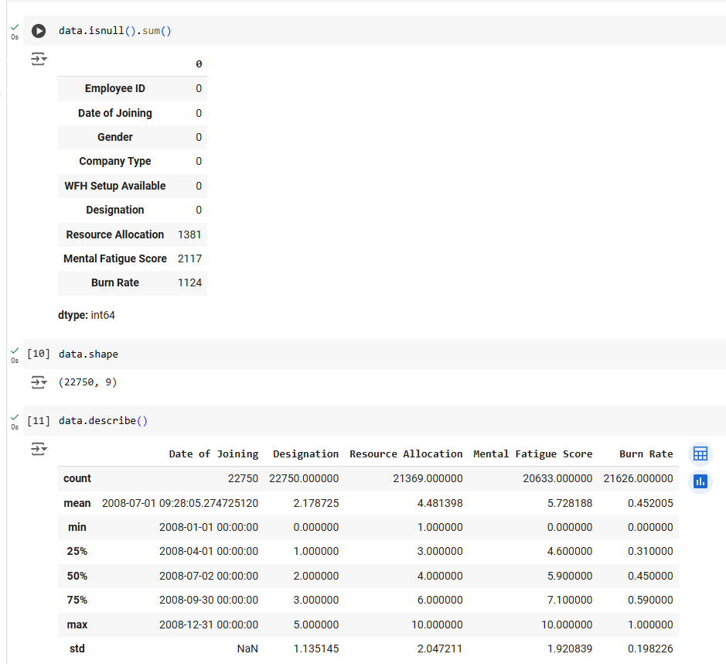
Result
Employee Burnout Analysis: Data Quality Overview
The image highlights key findings from the data analysis:
Missing Values:
Resource Allocation: 1,381 missing
Mental Fatigue Score: 2,117 missing
Burn Rate: 1,124 missing
Dataset Size:
Rows: 22,750
Columns: 9
Summary Statistics:
Key metrics for numerical columns, including mean, median, and standard deviation.

Slide 7
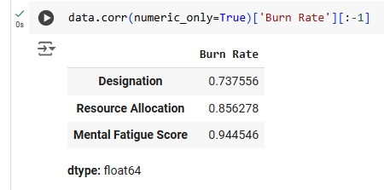
Result
Correlation Analysis (Burn Rate) This table displays the correlation between various features and the "Burn Rate" in the dataset. Key findings indicate:
Mental Fatigue Score has the highest correlation (0.9445), suggesting a strong relationship with employee burnout.
Resource Allocation (0.8563) and Designation (0.7376) also exhibit significant positive correlations. These insights help identify critical factors contributing to burnout.

Slide 8
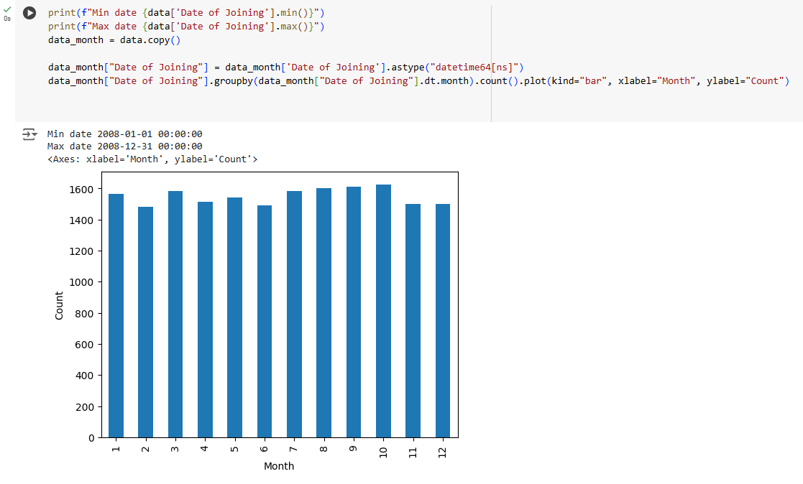
Result
Monthly Distribution of Employee Joining Dates This bar graph represents the count of employees joining the organization, grouped by month. Observations include:
The data spans from January to December 2008.
Employee joining trends are consistent throughout the year, with no significant spikes or dips in any particular month. This analysis ensures a balanced dataset for further evaluations.

Slide 9
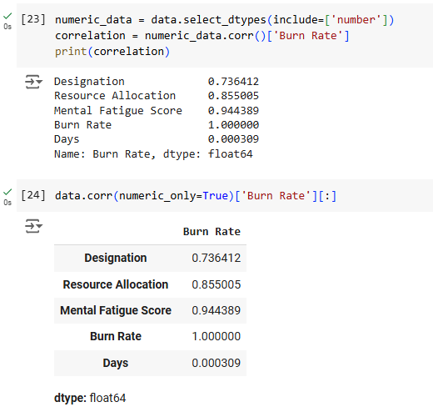
Result
Comprehensive Correlation Table (Burn Rate) This expanded table highlights the correlation of all numerical features with the "Burn Rate." Key insights:
Burn Rate correlates perfectly with itself (1.0000).
The influence of Mental Fatigue Score, Resource Allocation, and Designation is reaffirmed.
Days shows negligible correlation (0.000309), indicating minimal impact on burnout levels.

Slide 10
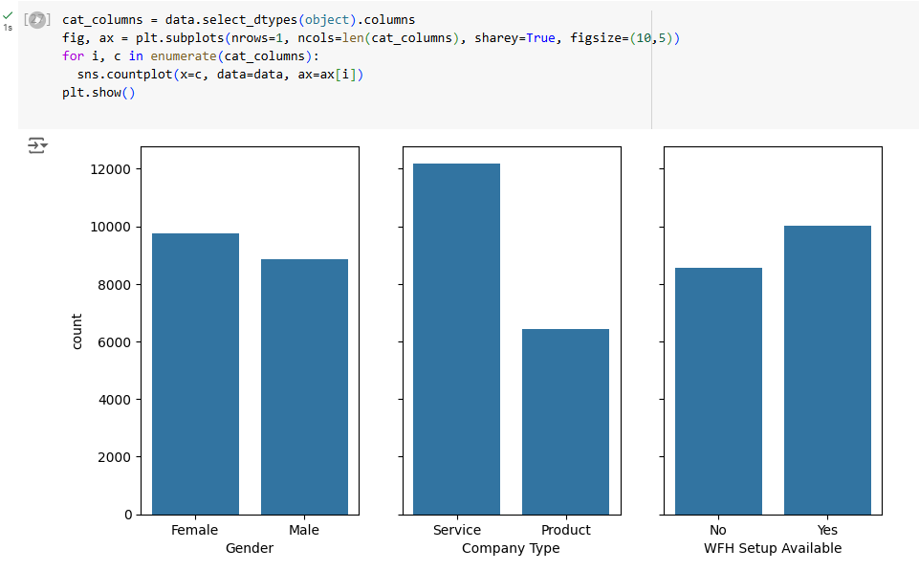
Result
Employee Burnout Analysis: Categorical Variable Distribution
The image shows the distribution of three categorical variables relevant to employee burnout:
Gender Distribution:
Displays counts for "Female" and "Male" employees.
Company Type:
Shows counts for "Service" and "Product" companies.
Work-from-Home Availability:
Counts for "No" and "Yes" regarding the availability of a work-from-home setup.
These visualizations provide insights into demographic and work environment factors that may influence employee burnout.

Slide 11
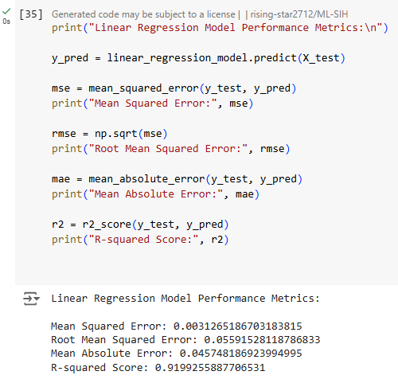
Result
Employee Burnout Analysis: Regression Model Performance
The image displays the performance metrics of a linear regression model used in the analysis. The metrics are as follows:
Mean Squared Error (MSE): 0.0031
Root Mean Squared Error (RMSE): 0.0559
Mean Absolute Error (MAE): 0.0457
R-squared Score (R²): 0.9199
These metrics provide a clear evaluation of the model's accuracy and its fit to the data.

Slide 12
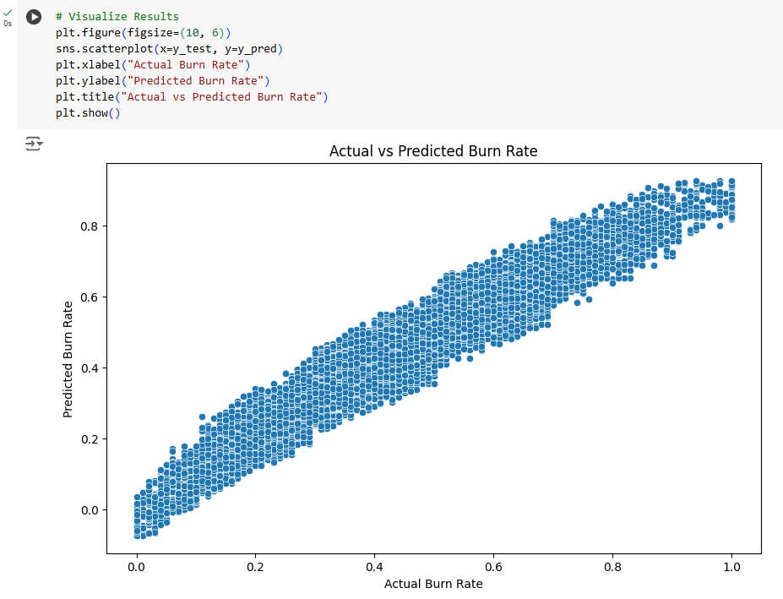
Result
Employee Burnout Analysis: Actual vs. Predicted Burn Rate
The scatter plot visualizes the results of the machine learning model's predictions, comparing the actual burn rate (x-axis) to the predicted burn rate (y-axis).
The points align closely along a diagonal line, indicating a strong correlation between the actual and predicted values.
This suggests that the model has performed well in predicting the burn rate.

Slide 13
Result
GitHub Link: https://github.com/KeerthanaJella7/Employee_Burnout_Analysis.git

Slide 14
Conclusion
In our analysis of employee burnout, we identified key factors such as resource allocation, mental fatigue scores, company type, and work-from-home setup availability as significant contributors to burnout. The proposed solution effectively highlighted these factors, providing actionable insights to address burnout issues within the organization.
Findings:
Key burnout factors: resource allocation, mental fatigue, company type, work-from-home availability.
Effectiveness:
The solution provided actionable insights for addressing burnout.
Challenges:
Data quality issues and model selection difficulties.
Improvements:
Better data collection, advanced models, continuous monitoring.
Importance of Accurate Predictions
Accurate bike count predictions are essential for ensuring a steady supply of rental bikes in urban areas, reducing wait times, and enhancing user satisfaction. Reliable predictions aid in efficient resource allocation, operational planning, and support sustainable urban transportation. Addressing challenges and implementing improvements will enhance solution effectiveness and better manage employee burnout, emphasizing the importance of data-driven approaches in workplace issues and organizational health.

Slide 15
Future scope(Optional)
Advanced Analytics: Using more sophisticated machine learning and deep learning techniques.
Real-Time Monitoring: Implementing systems for continuous data collection and analysis.
Integration with HR Systems: Seamlessly connecting burnout analysis with existing HR tools.
Personalized Interventions: Creating tailored burnout prevention plans.
Predictive Maintenance: Foreseeing burnout situations and taking proactive measures.

Slide 16
References
Scikit-learn documentation: https://scikit-learn.org
Pandas documentation: https://pandas.pydata.org
Research articles on burnout analysis.
Gaur, A., & Jindal, M. (2023). "Job Burnout Among Employees: A Systematic Literature Review." Journal of Emerging Technologies and Innovative Research (JETIR): https://www.jetir.org/papers/JETIR2302378.pdf?form=MG0AV3
Tiwari, P. K. (2023). "Job Burnout: A Theoretical Framework to Broaden Horizon." International Journal of Novel Research and Development (IJNRD). https://www.ijnrd.org/papers/IJNRD2307097.pdf?form=MG0AV3

Slide 17
THANK YOU

