Slide 1
File Systems (Open File Table Mechanism)- Keerthana J
Course: CPSC51500 Operating Systems
Instructor: Matthew Clavelli
Goal: To show how operating systems track open files using Open File Table and File Descriptor Tables.

Slide 2
Definition:
A file system organizes data on storage devices.
It manages files, directories, and metadata.
The OS uses file tables to know which files are open and who opened them.
Without this, processes could lose track of their files or cause corruption.

Slide 3
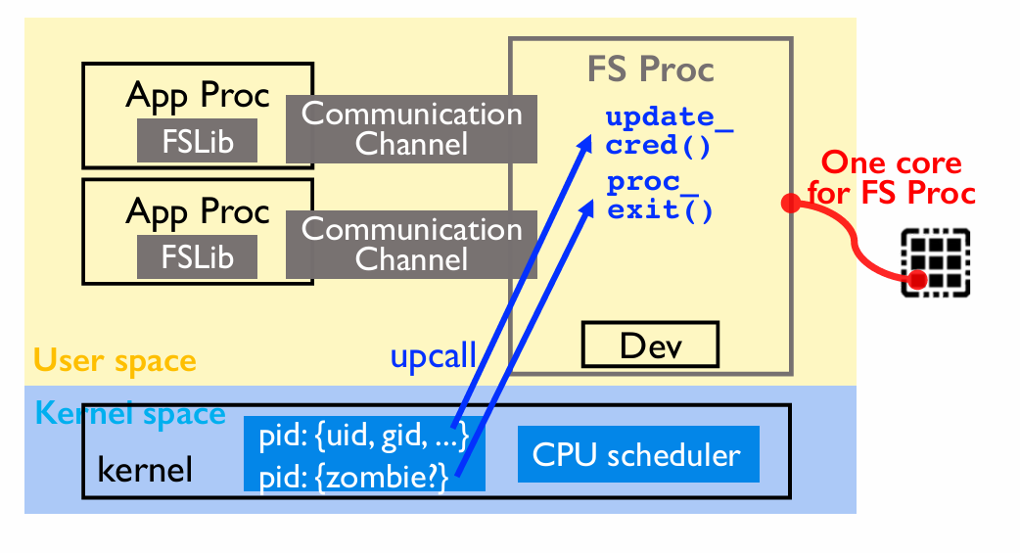
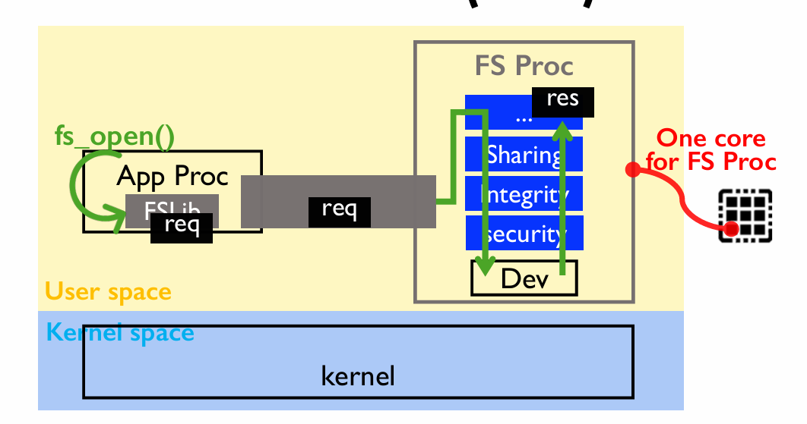
OS cordination

Slide 4
Concept:
Many processes may open the same file at the same time.
The OS must keep correct offsets, access modes, and locks for each process.
Open File Table prevents data loss and inconsistent reads/writes.
Example: multiple text editors reading the same log file.

Slide 5
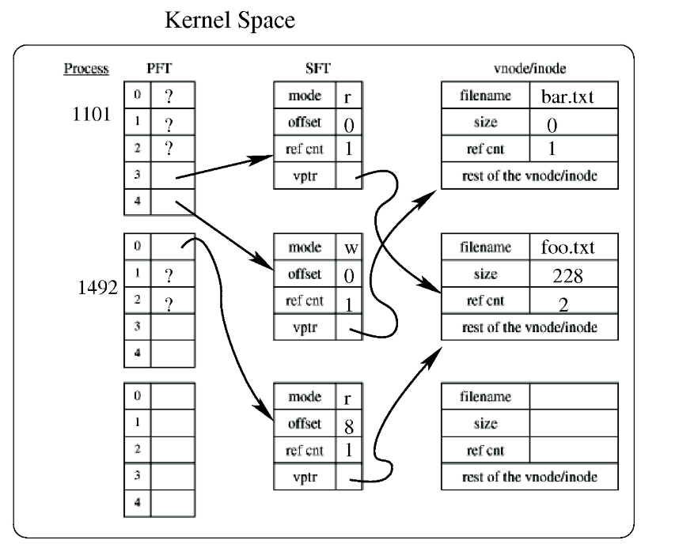
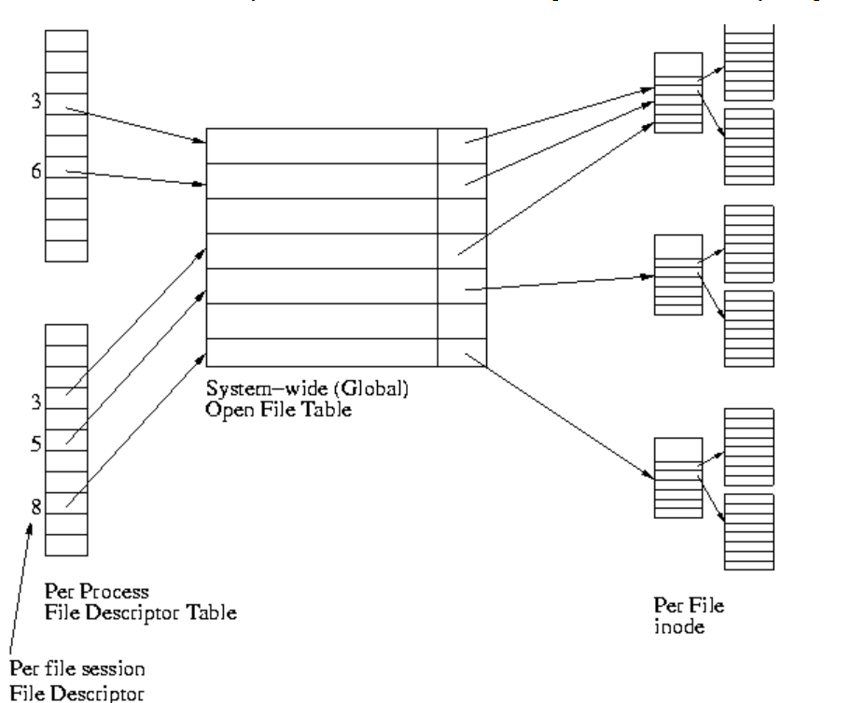

Slide 6
Open File Table (OFT)
Global table inside the OS kernel.
Each entry = one open-file description.
Stores:
Inode - file identity
Mode - read/write/append
Current offset- file position
Reference count -how many FDs point here
Lock info - if file is locked by a process
Shared among processes for efficiency.

Slide 7
File Descriptor Table
Each process has its own FD table.
Maps integer FDs (like 3, 4, 5) → OFT entries
Enables system calls like read(), write(), close()
Two FDs in the same process can point to the same OFT entry (after dup()).

Slide 8
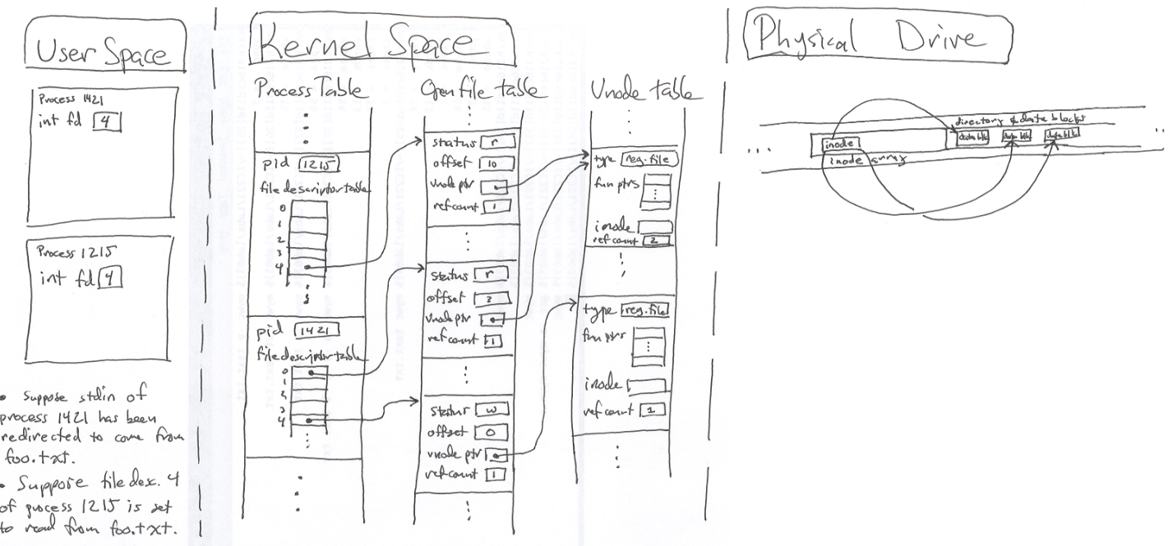

Slide 9
Required Program
Written in Python to simulate OS behavior
Components built:
FileSystem → tracks inodes & file contents
OpenFileTable → system-wide open entries
Process → per-process FD table
System → coordinates opens, reads, writes, locks
Allows testing of open, dup, append, fork behaviors.

Slide 10
Code Logic
Each open() → creates new OFT entry with offset and refcount.
dup() → adds new FD to same OFT entry → shared offset.
append → starts writing at end of file.
fork() → child inherits parent’s FD table → same OFT entries.
lock → blocks other processes from writing to same inode.

Slide 11
Output - I
Each section lists the system open file table and per-process FD tables.
Example output:
ofid=100 inode=1 mode=rw off=8 ref=2
Offset and refcount change as operations occur.
Shows how processes share or create independent file entries.

Slide 12
Output- II
Changing file path or append option changes offsets.
Output now displays file name in OFT for clarity.
Confirms that append mode starts at end of file, while normal open starts at 0.
Lock example shows “Write denied: file locked by other process”.

Slide 13
Depth Explanation
Explains actual OS behavior mirrored by this demo:
Real systems keep OFT in kernel memory.
FDs in Linux/Windows point to these entries.
Shared offsets mean dup() affects both FDs.
fork() copies FD table but not OFT entries.
Locks prevent race conditions and maintain file integrity.

Slide 14
Real-World Applications
Used in every modern OS for file handling.
Databases: Use file locks and shared offsets for transaction logs.
Servers: Use dup() to redirect I/O (e.g., web server logging).
Backup systems: Use OFT info to detect open files safely.
Cloud storage: Implements append and exclusive locks at the system level.

Slide 15
Conclusion
Open File Table is a critical OS data structure.
It ensures controlled access, data consistency, and safe multitasking.
The demo proved how offsets, refcounts, and locks change during operations.
Understanding this helps in system programming and debugging.

Slide 16
References:
https://www.andrew.cmu.edu/course/14-712-s20/applications/ln/14712-l16.html
https://www.cs.uic.edu/~jbell/CourseNotes/OperatingSystems/11_FileSystemImplementation.html
Kahanwal, B., Singh, T. P., Bhargava, R., & Singh, G. P. (2013). File System – A Component of Operating System. Shri Jagdishprasad Jhabarmal Tibrewala University.https://arxiv.org/abs/1312.1810
https://www.andrew.cmu.edu/course/14-712-s20/applications/ln/14712-l18.pdf
Liu, J., Arpaci-Dusseau, A. C., Arpaci-Dusseau, R. H., & Kannan, S. (2019). File Systems as Processes. In 11th USENIX Workshop on Hot Storage (HotStorage ’19). https://www.usenix.org/conference/hotstorage19/presentation/liu

