Slide 1
CAPSTONE PROJECT
TEAM NUMBER : 4
TOPIC : RENT A PLACE
DATE : 23/01/2022
TEAM MEMBERS
KEERTHANA K M
KAVITAPU LIKITHA
KATTA MOUNISHA
KELLETI BALAJI YASHWANTH

Slide 2
AGENDA
Introduction
Objectives
ReactJS and Spring Boot
Use Case Diagram
Usage of Bootstrap and Carousel
Screenshots of the Application
Conclusion
References

Slide 3
INTRODUCTION
Several people find it difficult to search for a place to stay, when they happen to move out from one city to another, sometimes even overseas. At such situation, it becomes very difficult to know your surroundings, or to not know whom to ask. Hence, an application called Rent A Place is developed to help people find their choice of place, for their expected time of stay. It uses MySQL to maintain the backend database, Spring Boot to trigger http requests and ReactJS for frontend.

Slide 4
OBJECTIVES
To create register, login and logout operations for users and owners.
To let admin perform crud operations on owners.
To let owner perform crud operations on properties.
To let user to view all properties and post review, rating for the same.
To create email service to let know register status.

Slide 5

ReactJS and Spring Boot
We make use of the @CrossOrigin annotation at Controller Class level in Spring Boot to give access to ReactJS to communicate with Spring Boot.
Usage of the server-side url(here, http://localhost:8080/) in either axios or fetch helps us to perform operations with the help of http requests.
Fig 3.1: Usage of Cross Origin

Slide 6
Use Case Diagram
Admin
CRUD on Owner
Owner
CRUD on User
User
CRUD on Property
View Property and Post Rating
Property

Slide 7
Usage of Bootstrap and Carousel
Bootstrap is used to provide better, improvised UI, for the ease of using, also for better user experience. It is used in the Home page to implement the sliding activity of images.
Carousel is another such functionality under Bootstrap that provides the slideshow of labels/images/html tags within a given component.

Slide 8
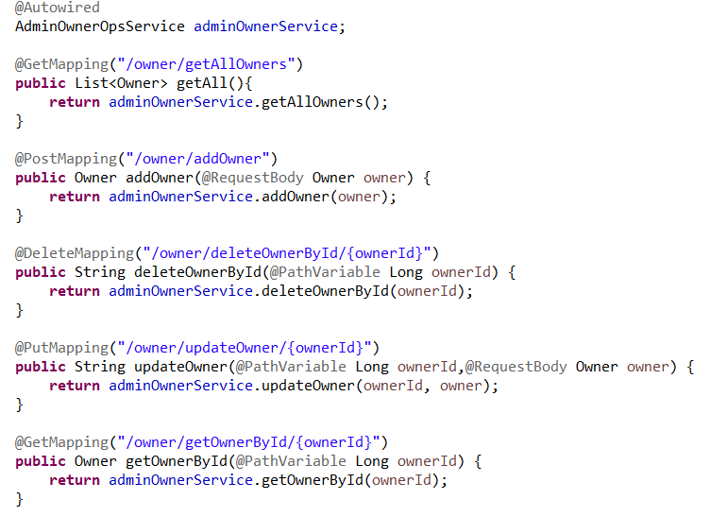
Screenshots of the Application
Fig 6.1: Owner CRUD Operations

Slide 9
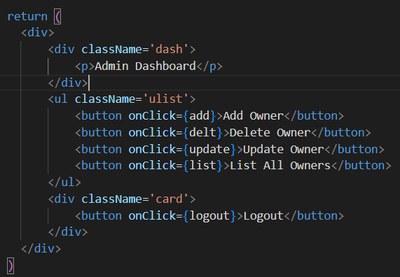
Screenshots of the Application(Contd.)
Fig 6.2: Admin Dashboard with Owner CRUD Operations

Slide 10
Conclusion
Rent A Place application helps an user to view, reserve a property and post review, whereas owner has the ability to perform crud on properties, also view all reservations and confirm it.

Slide 11
References
https://mdbootstrap.com/docs/b4/react/forms/search/
https://getbootstrap.com/docs/4.0/components/carousel/
https://www.w3schools.com/bootstrap/bootstrap_carousel.asp

Slide 12


