Slide 1
Travelix
Resort booking website

Slide 2
TEAM MEMBERS
Ishita Ray
Keerthana N P
Karan Yadav

Slide 3
LANGUAGES USED
HTML
CSS
JAVASCRIPT

Slide 4
SUMMARY
This website is used for booking resorts in different cities (Bangalore, Delhi, Mumbai and Kolkata).
The customer can select one of the many resorts in any of these cities.
The customer can select rooms of their choice for any number of days.

Slide 5

LOGO

Slide 6
CONTENTS
Header
Title
Booking options
Gallery
Customer Testimonials
Contact information
Footer

Slide 7
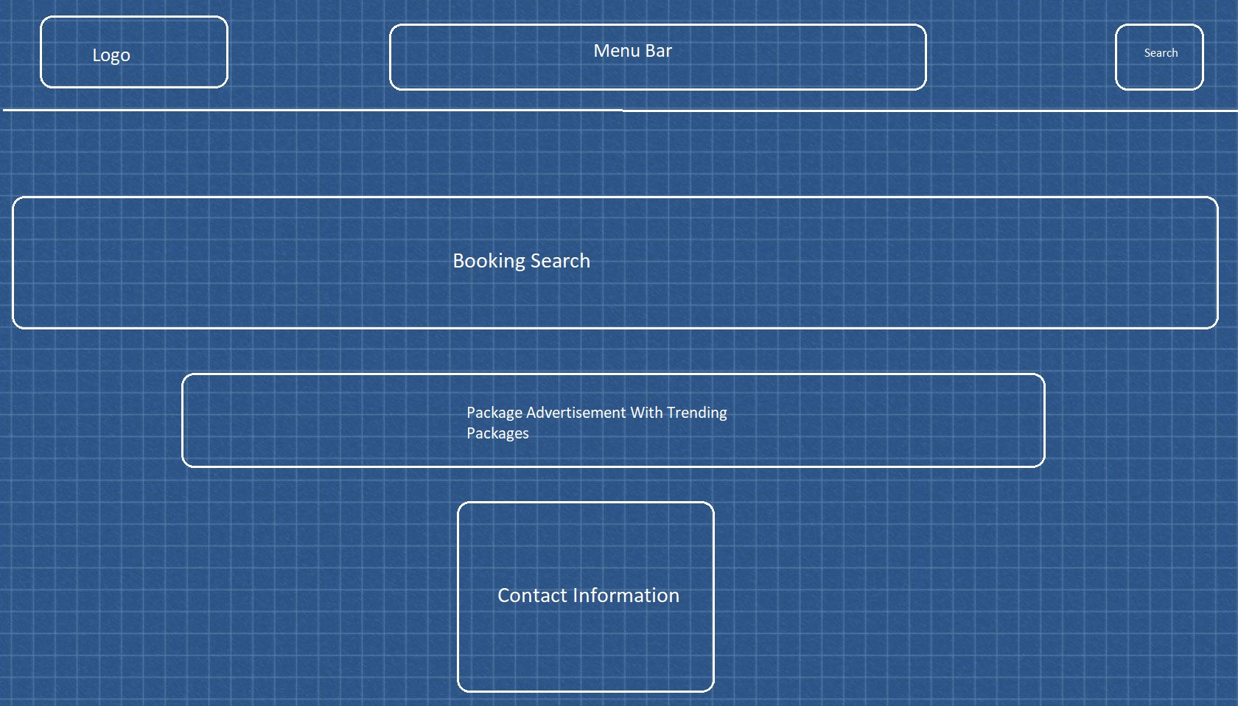
BLUEPRINT

Slide 8
SOCIAL CAUSE
We raise funds by asking the customers to donate how much ever money they wish to give. This money goes into a charitable trust.

Slide 9
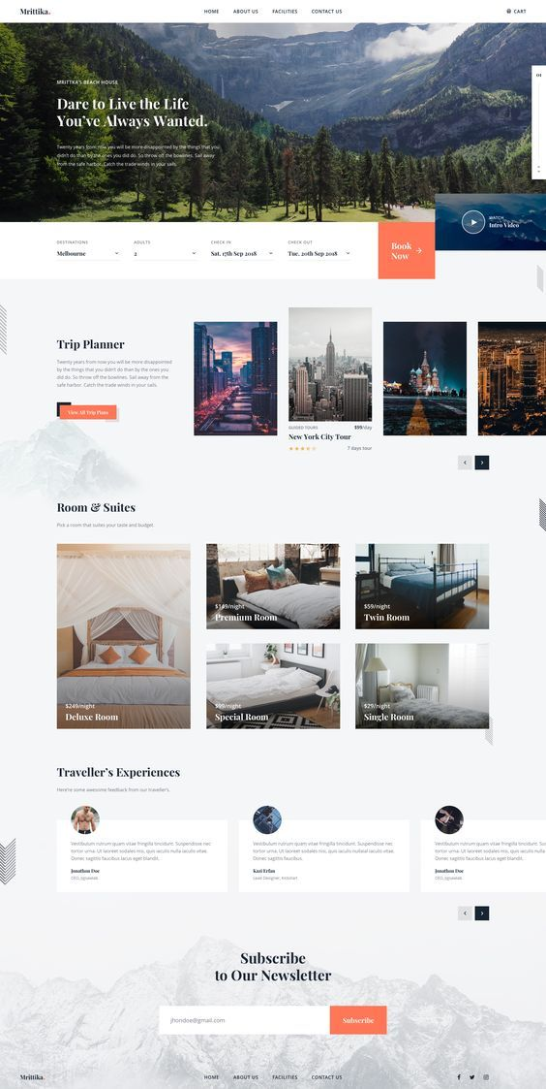
OUR WEBSITE MAY LOOK LIKE THIS:

Slide 10
THANK YOU

